Slide 1


Slide 2
Types of sentences:
*Simple sentence
*Compound sentence
*Complex sentence

Slide 3
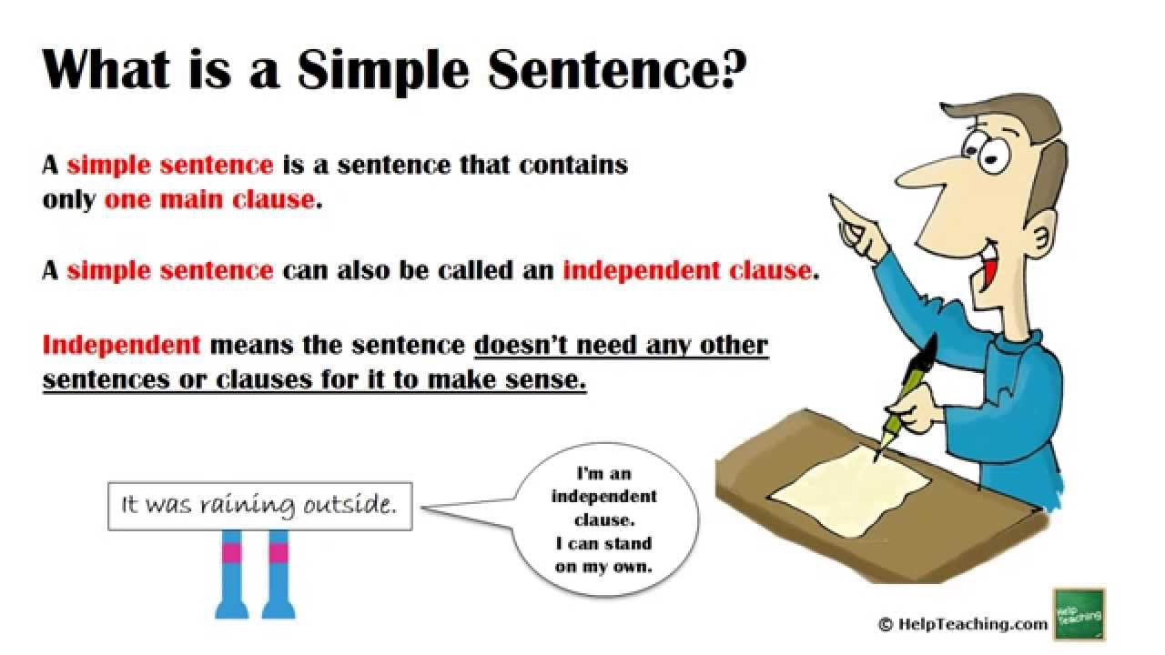

Slide 4
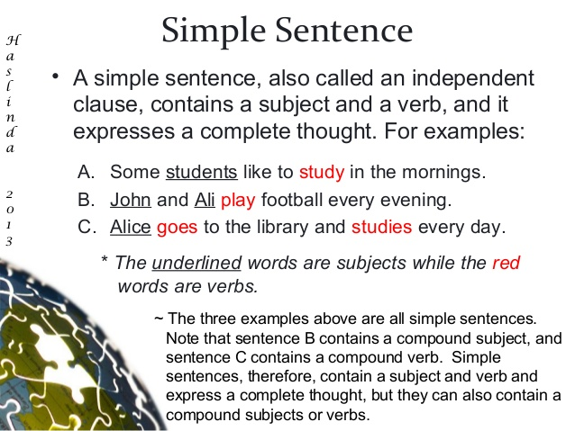

Slide 5
Read the following sentences and tick the Simple ones.
1. The baby cried for food.
2.They spoke to him in Spanish but he responded in English.
3. Megan and Ron ate too much and felt sick.
4. After eating lunch at The Cheesecake Factory, Tim went to the gym to exercise

Slide 6
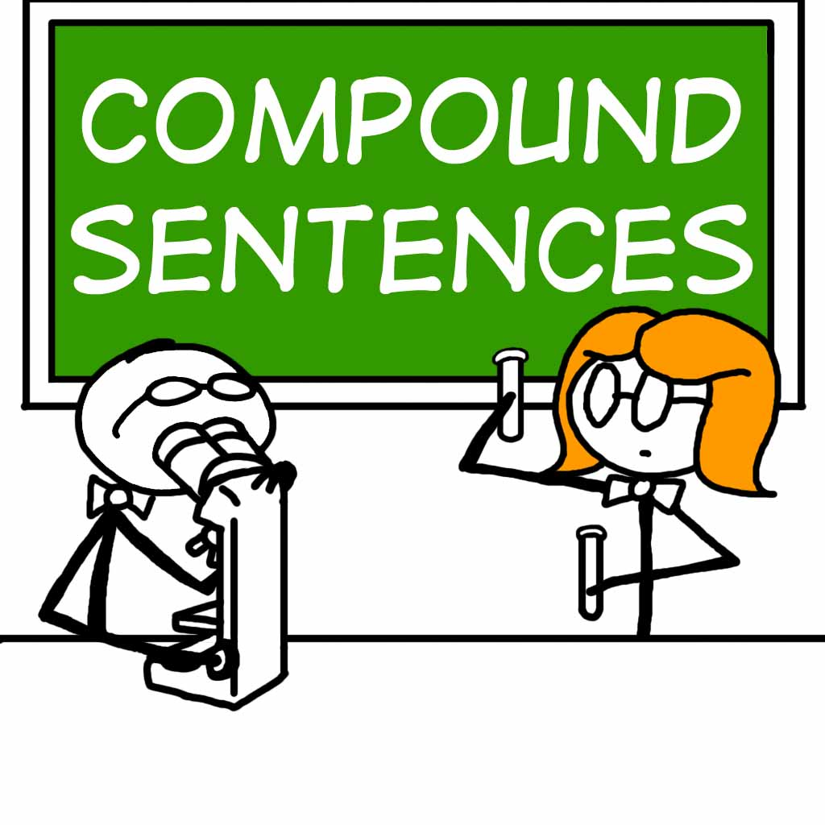

Slide 7
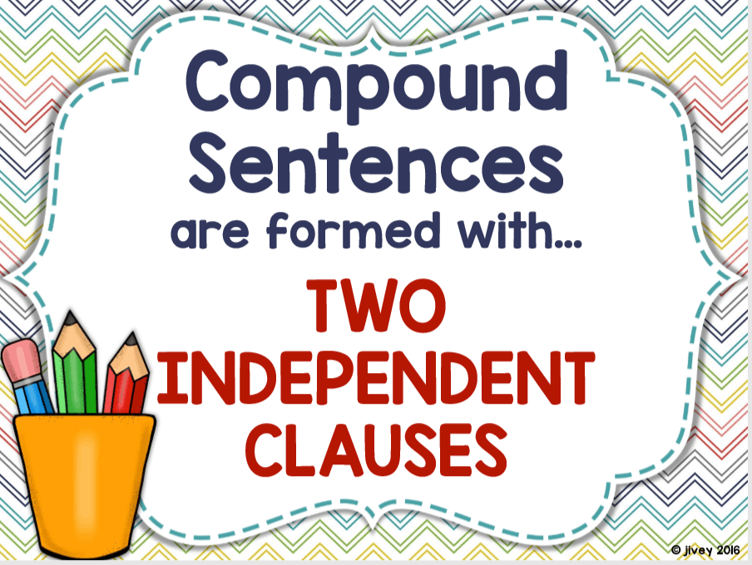

Slide 8
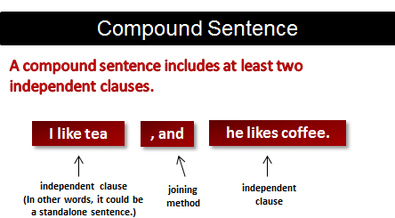
A compound sentence is:
two simple sentences joined using FANBOYS.
Examples:

Slide 9
FANBOYS
F: for
A: and
N: nor
B: but
O: or
Y: yet
S: so

Slide 10
Examples:
1. I really need to go to work _____ I am too sick to drive.
2. They got there early ____ they got really good seats.
3. Should we start class now ____ wait for everyone to get here?
4. Malls are great places to shop ____ I can find everything I need under one roof.

Slide 11
Examples:
1. I really need to go to work but I am too sick to drive.
2. They got there early and they got really good seats.
3. Should we start class now or wait for everyone to get here?
4. Malls are great places to shop and I can find everything I need under one roof.

Slide 12


Slide 13
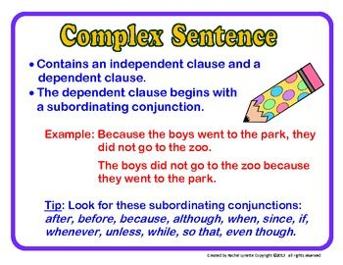

Slide 14
Examples:
1. Because my coffee was too cold, I heated it in the microwave.
2. Although he was wealthy, he was still unhappy.
3. When she was younger, she believed in fairy tales.
4. I really didn't like the movie even though the acting was good.

Slide 15
Examples:
1. Because my coffee was too cold, I heated it in the microwave.
2. Although he was wealthy, he was still unhappy.
3. When she was younger, she believed in fairy tales.
4. I really didn't like the movie even though the acting was good.

