Slide 1

MS Access
2010
Click Start
INTERNATIONAL EDITION

Slide 2
Learning Objectives
The student should be able to:
Open the Access application.
Create a database using two ways:.
  Using a blank Database
  Using sample template
Learn about the components of the MS Access 2010 window.
Describe and set some of the commonly used Data Type.
Know the importance of set one field as Primary Key (assigning .Removing)
Recognize the toe commonly used view in MS Access( Datasheet view, Design view)

Slide 3
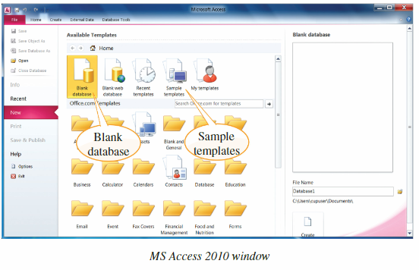
In MS Access2010 ,a database can be created in two ways

Slide 4
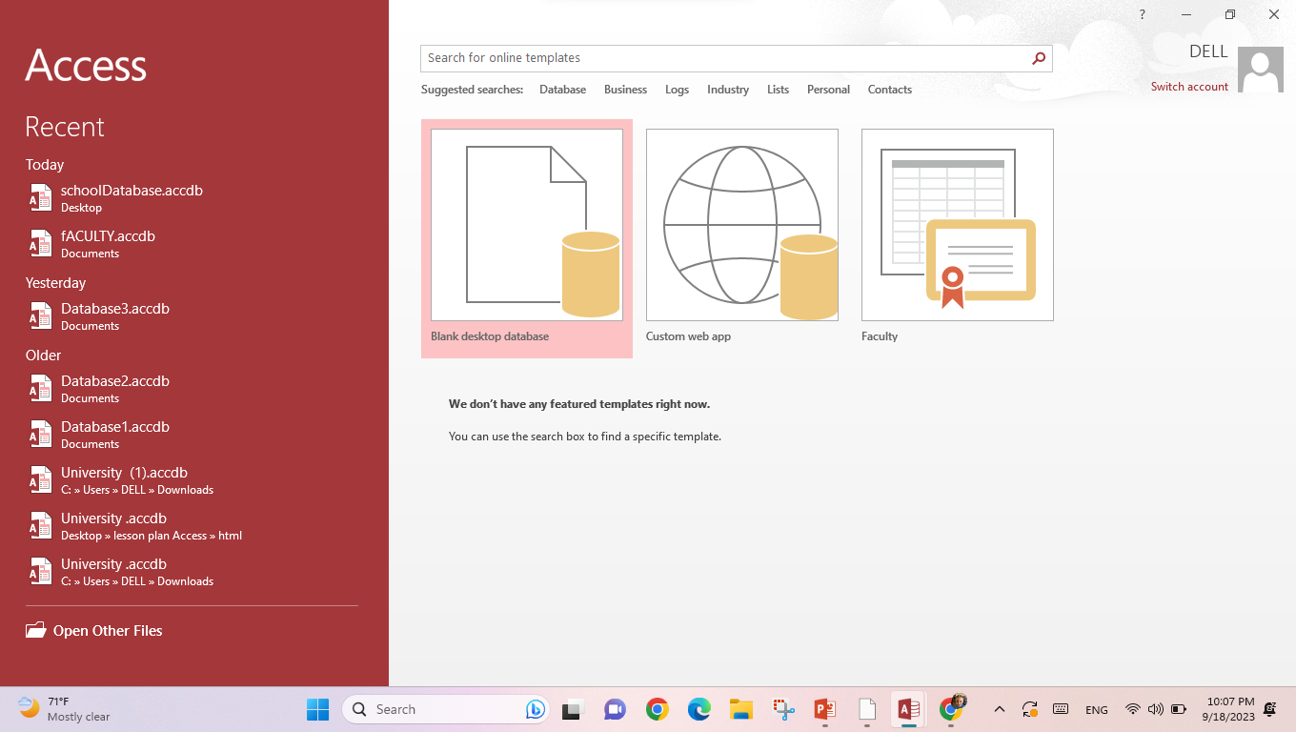
In MS Access2010 ,a database can be created in two ways
Available Templates
Blank Database

Slide 5
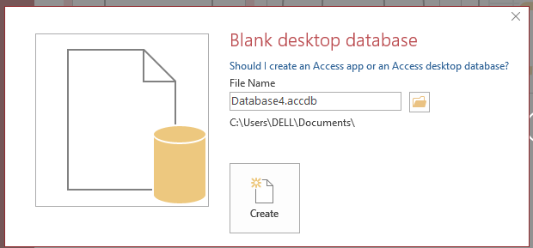
In MS Access2010 ,a database can be created in two ways
Change the name and the location of the database

Slide 6
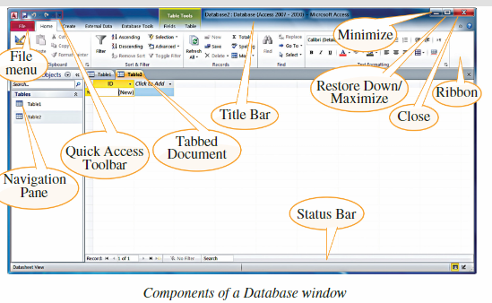
Components of a Database Window

Slide 7
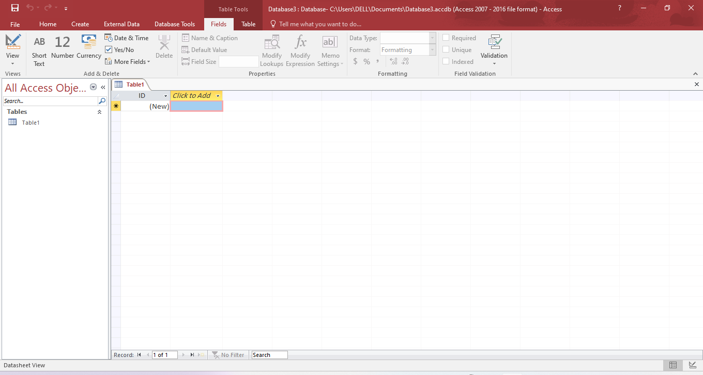
Components of a Database Window

Slide 8
https://wordwall.net/resource/60570070

Slide 9
Components of a Database Window
Title Bar: Shows the name of the database created.
The Minimize, Maximize/Restore Down and Close buttons are also found in this area.
File Menu: The button on the left of the Title Bar. It contains commands like New, Open, Save and Print.
Quick Access Toolbar: This has some of the most frequently used commands in MS Access like Save, Undo and Redo. The toolbar can be shifted below the Ribbon, and more commands can be added to it.
Ribbon: Contains the commands that can be performed on different database objects. These commands are classified under groups in different tabs.
Navigation Pane: The left pane of the window. Database objects in currently open or new databases are displayed.
Tabbed Document: The database objects appear in tabs, unlike the overlapping windows in the earlier versions.
Status Bar: This is found at the bottom of the window and displays the status and buttons to change the page views.

Slide 10
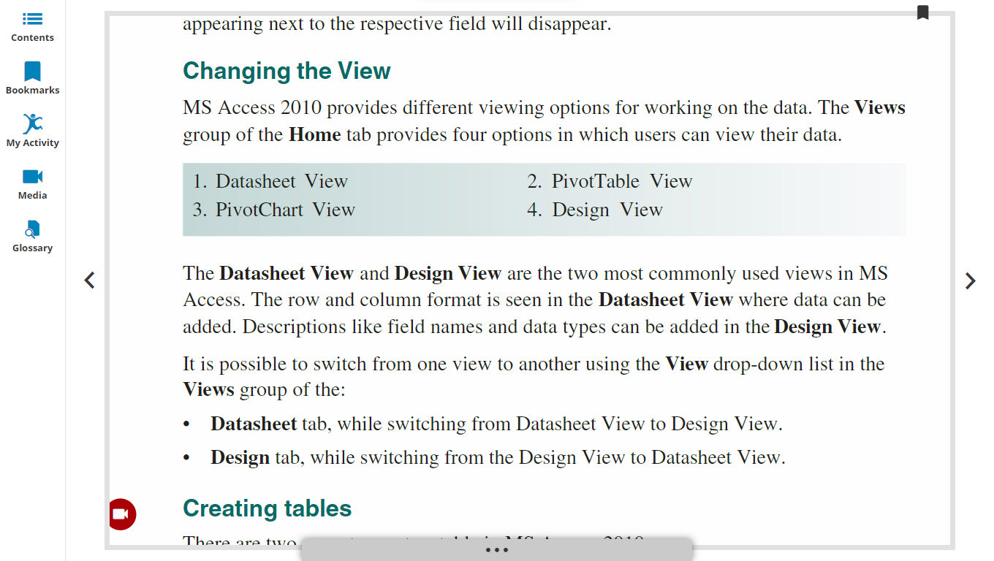

Slide 11
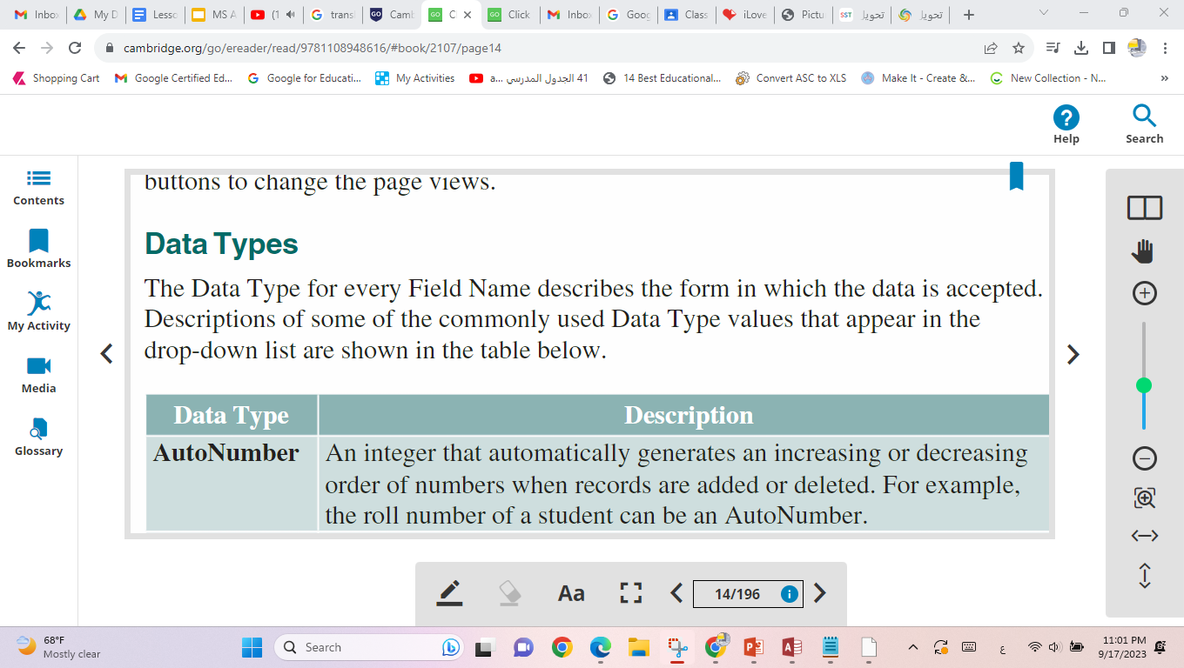
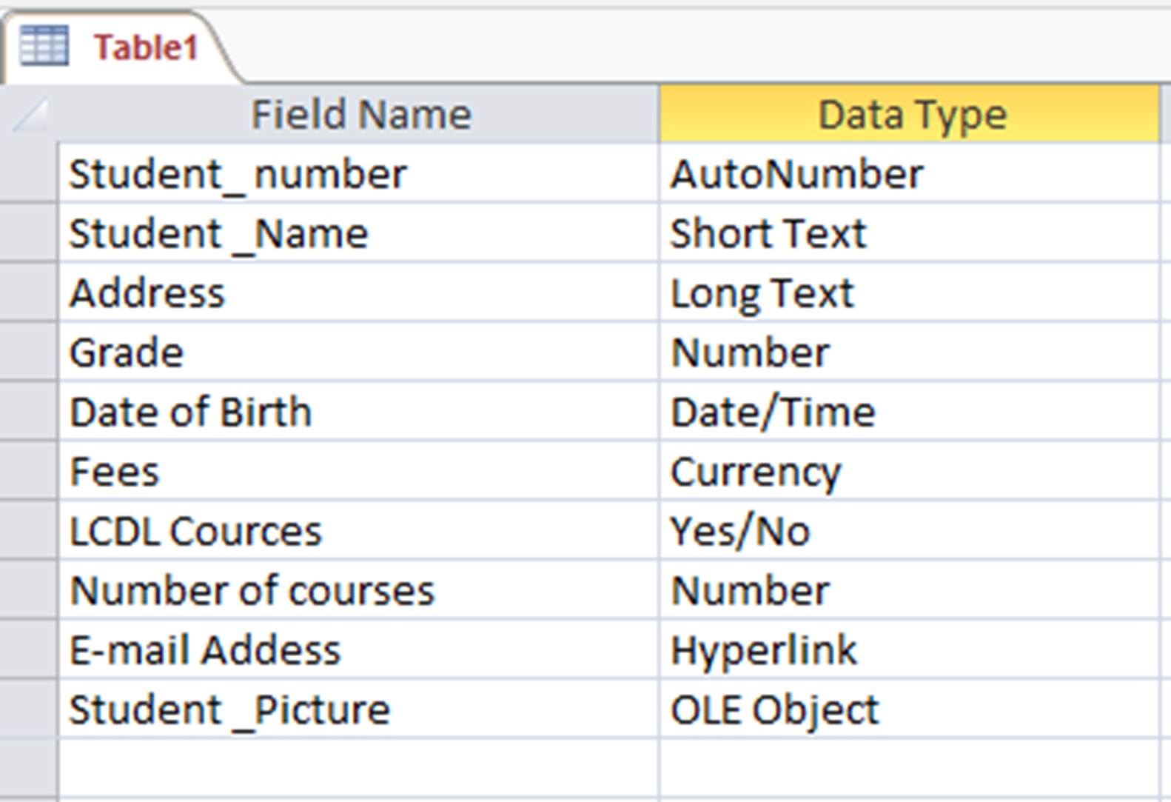
AutoNumber
Short Text
Long Text
Number
Date/Time
Currency
Yes/No
Hyperlink

Slide 12
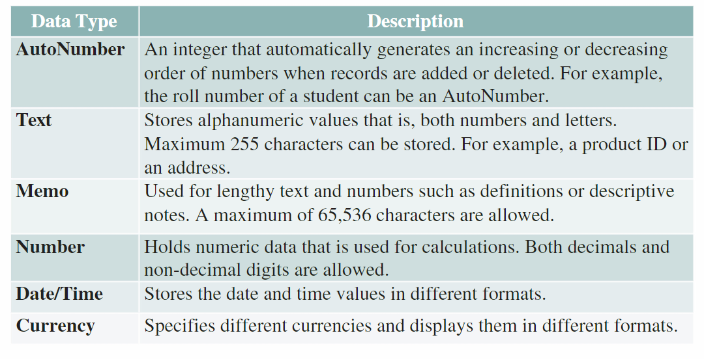
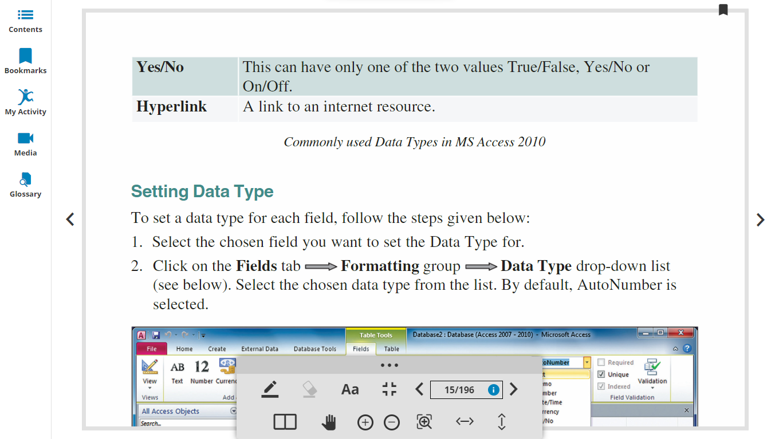

Slide 13
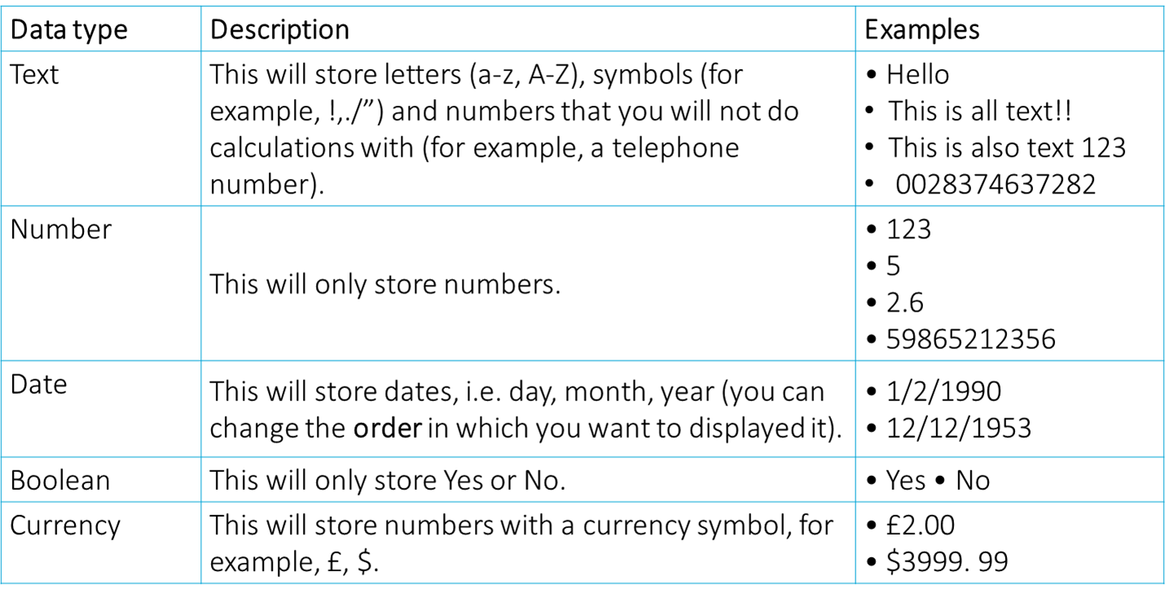

Slide 14
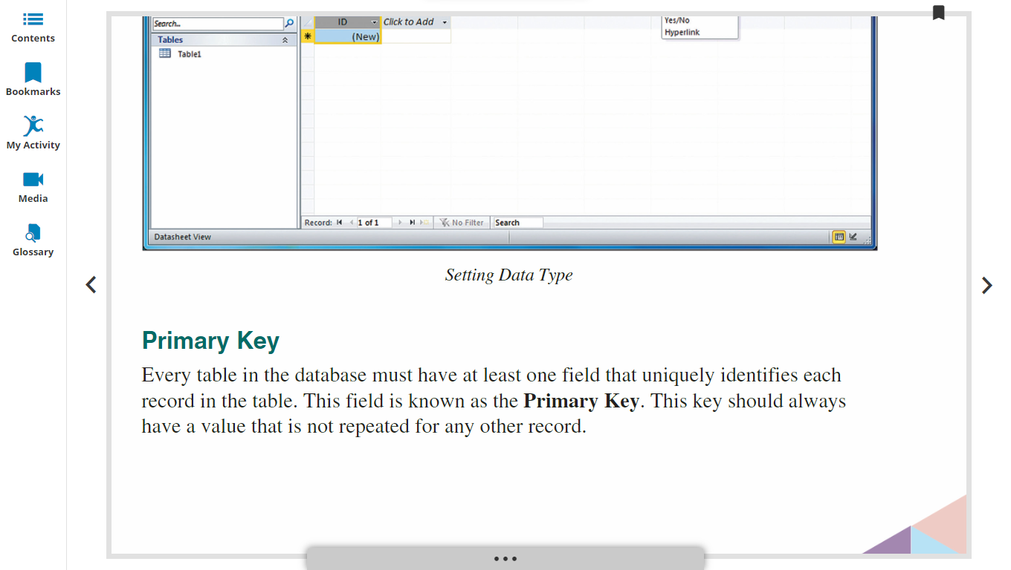
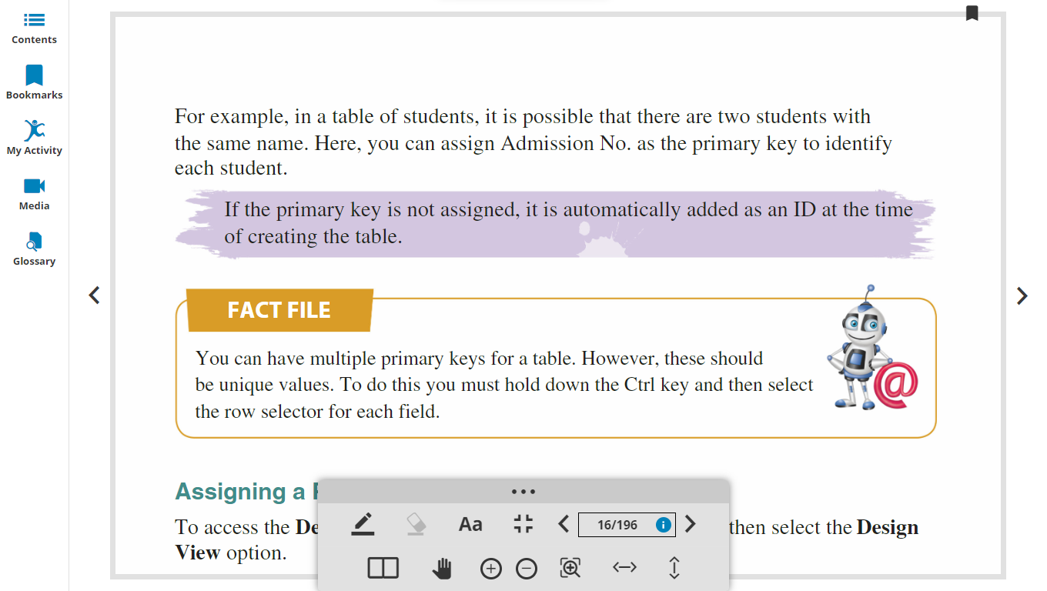

Slide 15

The properties of each primary key column or columns are:
Not accepting any duplicate values.
A table can take Multiple primary keys(should be unique value)
A primary key column cannot accept null values

Slide 16
Learning Objectives
The student should be able to:
Creating tables in MS Access.
  in Datasheet View
  in Design view
Field Grid Pane and Field Properties Pane
Modifying tables and their content.
  Changing Data Types
  Inserting a new field
  Deleting a field
  Moving a Field
  Renaming a Field

Slide 17
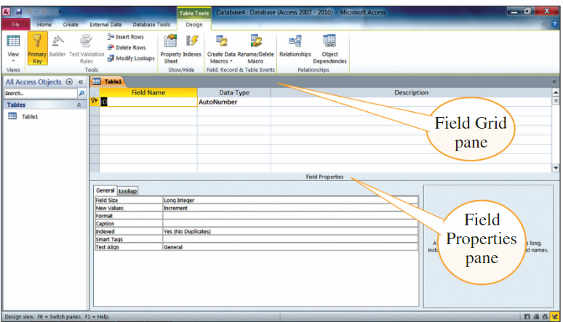

Slide 18

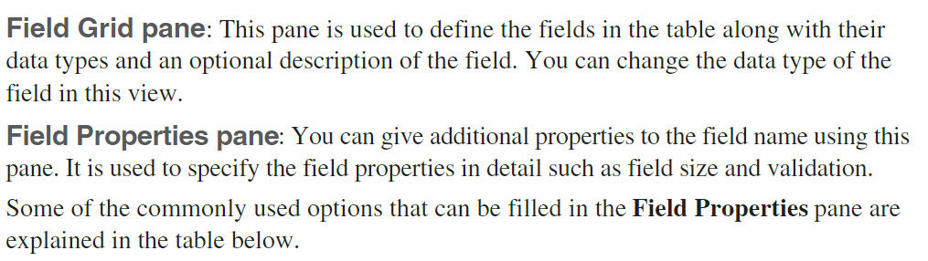

Slide 19
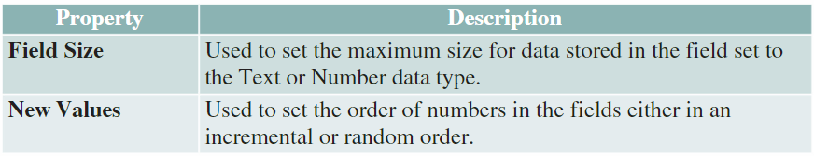
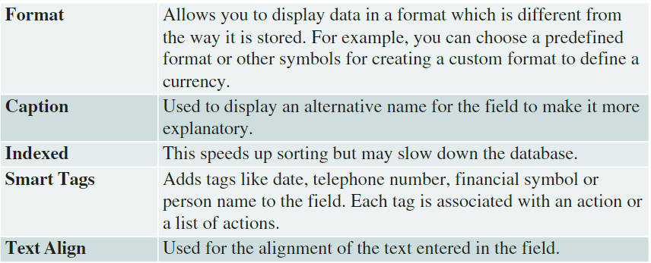
Validation text lets you provide a message to help users who input data that is not valid.
validation rule helps in restricting or controlling the user's input in the table field

Slide 20
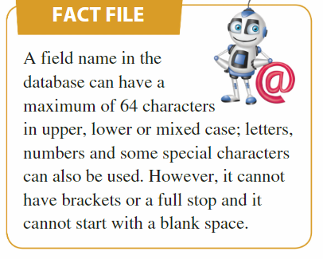
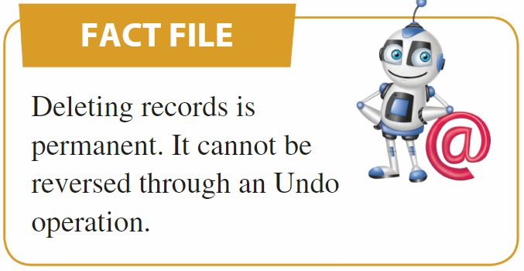
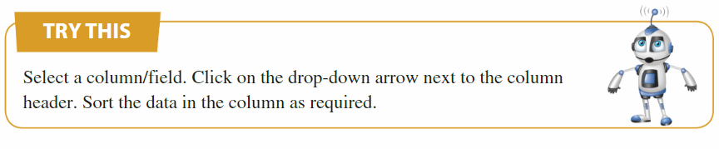

Slide 21
Learning Objectives
The student should be able to:
Creating tables in MS Access.
Change the field Properties
  Font size ,Default Value , Format , Caption,indexed, new value…
  Validation rules:enter the validation rule in Design view for Number,text and date Data type
  Add, delete records in a table. Add, modify, delete data in a record.

Slide 22
TO enter the validation rule in Design view Numbers:
Less than to 45:
<45
less than or equal to 45:
<=45
greater than or equal to 45:
>=45
equal to 45:
=45
must not be equal to 45:
<>45
number must be between 10 and 100 :
Between 10 and 100
validation rule | <45
validation rule | <=45
validation rule | >=45
validation rule | =45
validation rule | <>45
validation rule | Between 10 and 100

Slide 23
TO enter the validation rule in Design view: Text Data type Wild cards(*,?):
The Data must contain “er” : *er*
The Data must start with “me” : me*
The Data must end with “ly” : *ly
The Data must start with “be” and it only consists of four letters:
be??
The Data must end with “er” and it only consists of five letters:
???er
After Pressing the Enter Key it will Change to Like “ me* “
validation rule | "*er*"
validation rule | me*
validation rule | Be??
validation rule | “???er"
validation rule | Like "*er*"

Slide 24
To enter the validation rule in Design view: Date and time Data type:
Today’s date : =Date()
Today’s date or later : >=Date()
Today’s date or earlier: <=Date()
After 2/3/2020: > 2/3/2020
Before 2/3/2020: < 2/3/2020
After 2/3/2020: > 2/3/2020
After Pressing the Enter Key it will Change to >#2/3/2020#
validation rule | =Date()
validation rule | >=Date()
validation rule | <=Date()
validation rule | > 2/3/2020
validation rule | < 2/3/2020
validation rule | > #2/3/2020#

