Slide 1


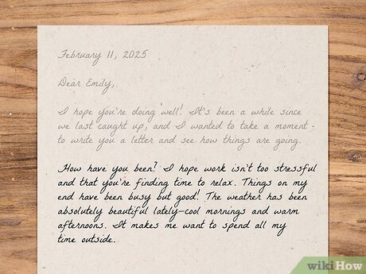

Formal and
Informal Letters

Slide 2
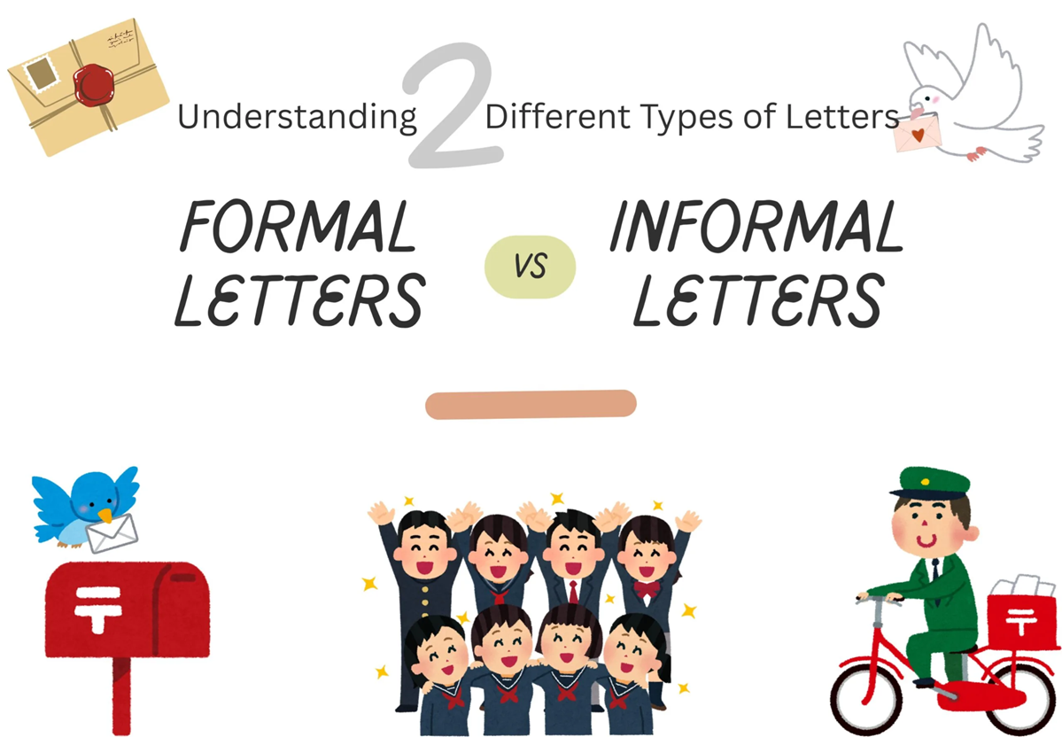

Slide 3

Lesson Objectives:
1
Learn about the difference between formal and informal letter structures.
2
Main points to consider and pay attention to when writing a formal or an informal Letter.

Slide 4
Starter activity:
1
Open the box:
https://wordwall.net/resource/33704823/english/formal-and-informal-letters
Find the match:
2
https://wordwall.net/resource/2721305/english/match-the-parts-of-an-informal-and-a-formal-letter

Slide 5

Formal Letters
1

Slide 6
Dear Sir/Madam,
I am writing to express my concern regarding the poor maintenance of the public park in our neighborhood. The park used to be a clean and enjoyable place for families, but recently it has become neglected.
Firstly, the playground equipment is broken and unsafe for children. Many parents are worried because swings and slides have not been repaired for months, which makes it dangerous for kids to play.
Secondly, the park is not cleaned regularly. Litter is scattered across the grass, and the walking paths are covered with fallen leaves and dirt. This discourages residents from spending time in the park, which used to be a central gathering place for the community.
In conclusion, I kindly request that the local council take immediate action to repair the equipment and maintain the park regularly. I believe these improvements will make the park safe and enjoyable for everyone again.
Yours faithfully,
John Smith
(signature)

Slide 7
Formal Letter Checklist:
Greeting: Use an appropriate formal greeting (e.g., Dear Sir/Madam, or Dear Mr. Smith, Ms. Aniston).
Introduction: Write a formal opening remark and clearly state the reason for writing the letter.
Main Body:
  -Organize into separate paragraphs.
  -Each paragraph should discuss one idea/point only.
  -Number of paragraphs depends on the task/question (minimum 2 paragraphs).
Conclusion:
  - Write a formal closing remark.
  - Briefly sum up or rephrase your main points.
  - Express a wish for action, response, or resolution.
Formal Ending: Use a formal sign-off (e.g., Yours sincerely, / Yours faithfully,).
Signature: Sign your name.
Full Name: Write your first and last name clearly.

Slide 8

Formal Letter Checklist: (Let’s break it down – with examples):
1. Greeting
Use a polite, formal greeting.
Examples:
  Dear Sir/Madam,
  Dear Mr. Brown,
  Dear Ms. Smith,
2. Introduction
Start with a formal opening remark.
State why you are writing.
Examples:
  I am writing to inquire about…
  I would like to express my concern regarding…
  The purpose of this letter is to apply for…
3. Main Body Paragraphs:
Organize into separate paragraphs.
Each paragraph = one idea only.
Examples:
  Paragraph 1: Explain your first point in detail (e.g., background, problem, or request).
  Paragraph 2: Explain your second point in detail (e.g., give reasons, examples, or suggestions).
  (Add a 3rd if required by the question.)

Slide 9
Formal Letter Checklist: (Let’s break it down – with examples):
4. Conclusion
Formal closing remark + summary + polite request.
Examples:
  I hope you will consider my request.
  I would appreciate it if you could respond at your earliest convenience.
  Thank you for your time and attention to this matter.
5. Formal Ending
Choose depending on the greeting:
  Yours faithfully, → if you wrote Dear Sir/Madam,
  Yours sincerely, → if you wrote to a named person (Dear Mr. Brown,).
6. Full Name
Write your first and last name clearly.
Example: John Smith
7. Signature
Sign your name.

Slide 10
Informal Letters
2

Slide 11

Dear Anna,
How are you? I hope you and your family are doing well. It feels like ages since we last talked! I’m writing because I really need your advice about something important.
As you know, I’ll be finishing school this year, and I’m trying to decide what to do next. Part of me wants to go to university, but another part of me is thinking about taking a gap year to travel and gain some experience.
The problem is, I’m worried that if I take a year off, I might lose motivation to continue my studies. On the other hand, going straight to university feels a bit overwhelming. Since you’ve already been through this, I thought you’d be the best person to ask. What do you think I should do?
Anyway, that’s all from me for now. I’d love to hear your thoughts and any advice you can give. I really value your opinion and can’t wait to read your reply.
Best wishes,
Sarah

Slide 12
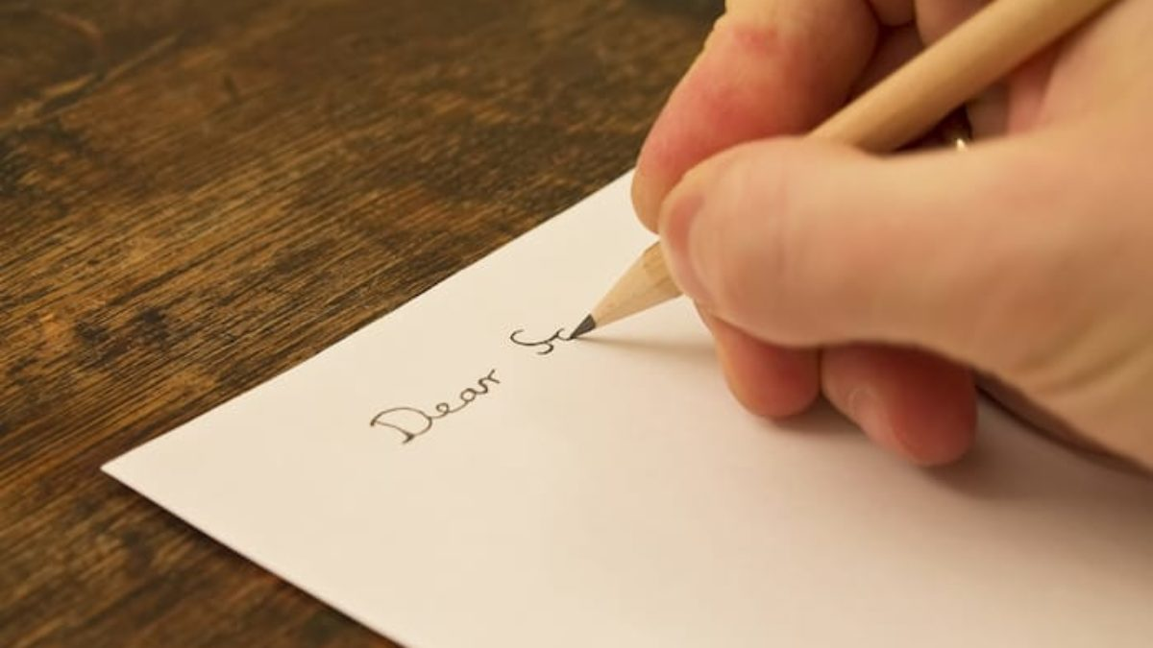
Informal Letter Checklist:
1- Appropriate informal greeting (Dear + first name of your friend) + ,
2- Introduction: Informal opening remark/greetings + the reason for writing the letter.
3- Main body paragraphs: write the main points/ideas required from you to include in your letter in detail.
- Each paragraph should discuss one point/idea only.
- The number of paragraphs varies depending on the writing question’s rubric/bullet points listed under the writing question. (Minimum 2 main body paragraphs). (Usually it is 3 prompts, so 3 separate paragraphs)
4-Conclusion: Informal closing remark + Sum up / rephrase briefly the points you mentioned throughout our letter + express wishes for something to be done.
5- Informal ending + ,
6- First name only.

Slide 13

Informal Letter Checklist: (Let’s break it down – with examples):
1. Greeting
  Use Dear + first name of your friend.
  Example: Dear Anna, Dear John,
2. Introduction
  Start with a friendly opening remark/greeting.
  State the reason for writing.
  Examples:
    How are you? I hope everything is going well.
    It’s been such a long time since we last spoke!
3. Main Body Paragraphs
Each paragraph should focus on one idea only.
Number of paragraphs: usually 3 (one per prompt in the question).

Slide 14
Informal Letter Checklist: (Let’s break it down – with examples):
4. Conclusion
End with a warm/friendly remark.
Sum up or rephrase your points briefly.
Express wishes or future plans.
Examples:
  Anyway, that’s all my news for now.
  Hope to hear from you soon.
  Take care and give my regards to your family.
5. Informal Ending
Use friendly sign-offs.
Examples: Best wishes, / Take care, / Lots of love,
6. First Name
Sign off with your first name only.
Example: Sarah

