Slide 1
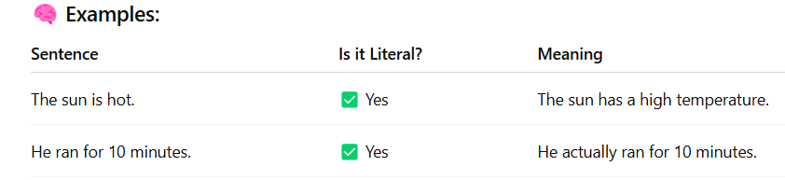
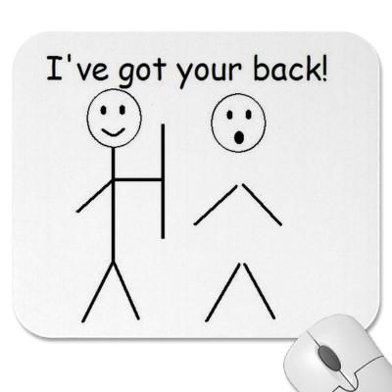
Figurative and Literal Language
Literally: means saying exactly what you mean — nothing more, nothing less. It is the opposite of figurative language.
Figuratively: figure out what it means
I’ve got your back. = to be ready to protect or defend someone
You’re a doll. = You are adorable!
^Figures of Speech

Slide 2
Figurative and Literal Language – Practice Activity
Read each sentence carefully. Write L if it uses Literal Language and F if it uses Figurative Language.
6. We walked three miles to get to the park. → _______
7. Time flew by during the fun lesson. → _______
8. The baby cried loudly during the movie. → _______
9. His heart was a rock — nothing seemed to hurt him. → _______
The sky was filled with dark clouds before the storm. → _______
Her smile was as bright as the sun. → _______
He has a ton of homework to finish tonight. → _______
The water in the lake was freezing cold. → _______
My backpack feels like it weighs a thousand pounds! → _______

Slide 3
Figurative and Literal Language
– Practice Answer key
Read each sentence carefully. Write L if it uses Literal Language and F if it uses Figurative Language.
6. We walked three miles to get to the park. → L (Literal)
7. Time flew by during the fun lesson. → F (Figurative)
8. The baby cried loudly during the movie. → L (Literal)
9. His heart was a rock — nothing seemed to hurt him. → F (Figurative)
The sky was filled with dark clouds before the storm. → L (Literal)
Her smile was as bright as the sun. → F (Figurative)
He has a ton of homework to finish tonight. → F (Figurative)
The water in the lake was freezing cold. → L (Literal)
My backpack feels like it weighs a thousand pounds! → F (Figurative)

Slide 4
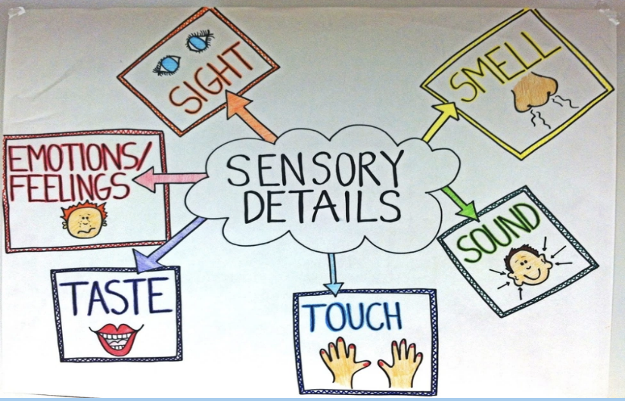
Imagery
Imagery is the descriptive language used in literature to re-create sensory experiences.
The images in a work supply details of sight, sound, taste, touch, smell, or movement and help the reader to sense the experience being described.
Usually it is thought that imagery makes use of particular words that create visual representation of ideas in our minds.

Slide 5
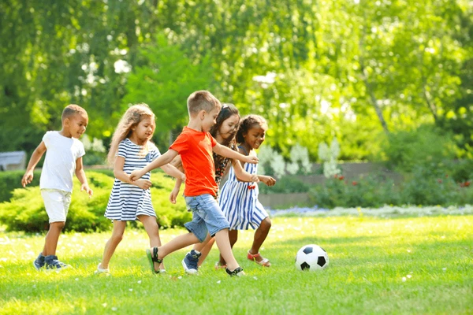
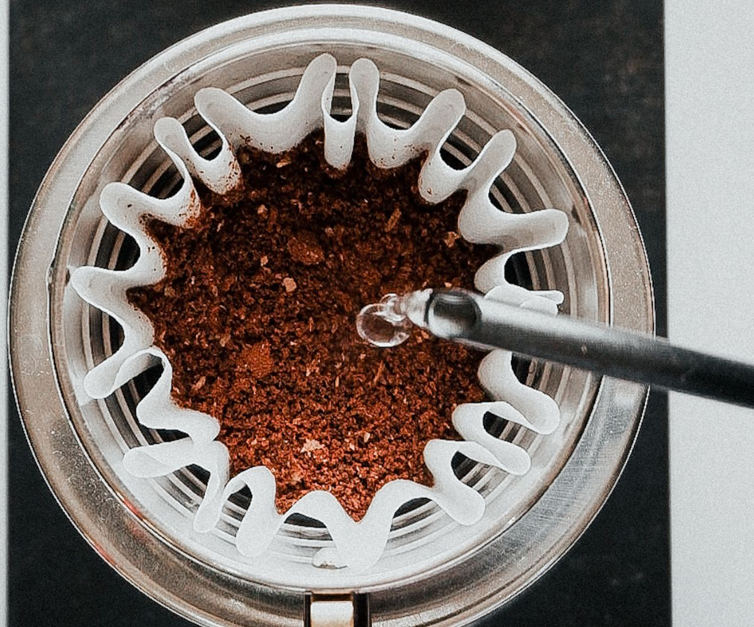
Examples of imagery:
It was dark and dim in the forest. The words “dark” and “dim” are visual images.
The children were screaming and shouting in the fields. “Screaming” and “shouting” appeal to our sense of hearing, or auditory sense.
He whiffed the aroma of brewed coffee. “Whiff” and “aroma” evoke our sense of smell.
The girl ran her hands on a soft satin fabric. The idea of “soft” in this example appeals to our sense of touch.
The rich smell of freshly baked bread filled the kitchen, and each bite was soft and buttery.
“Rich smell” and “freshly baked” appeal to the sense of smell.
“Soft” and “buttery” appeal to the sense of taste (and a little to touch, with texture).
.

Slide 6
Identify the Senses:Read each sentence below and underline the sensory words. Then, write which sense (sight, sound, smell, taste, touch, or movement) the sentence uses.
Example: The sizzling sound of bacon filled the kitchen. → Sense: Sound
The sharp smell of fresh paint made her wrinkle her nose. → Sense: ___________
His hands were sticky from the melted ice cream. → Sense: ___________
The thunder roared loudly across the night sky. → Sense: ___________
She tasted the sourness of the lemon and winced. → Sense: ___________
The puppy’s fur was soft like cotton under her fingers. → Sense: ___________
Leaves swirled around his feet as the wind blew hard. → Sense: ___________
.

Slide 7
Identify the Senses:Read each sentence below and underline the sensory words. Then, write which sense (sight, sound, smell, taste, touch, or movement) the sentence uses.
The sharp smell of fresh paint made her wrinkle her nose. → Sense: Smell
His hands were sticky from the melted ice cream. → Sense: Touch
The thunder roared loudly across the night sky. → Sense: Sound
She tasted the sourness of the lemon and winced. → Sense: Taste
The puppy’s fur was soft like cotton under her fingers. → Sense: Touch
Leaves swirled around his feet as the wind blew hard. → Sense: Movement
.

Slide 8
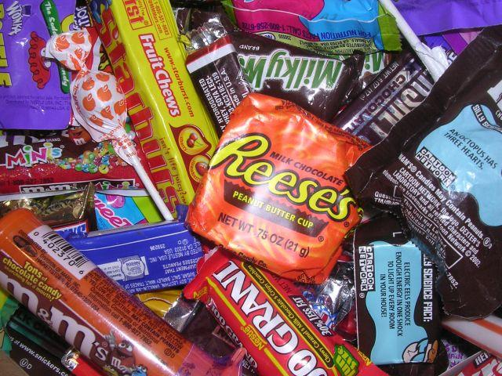
Simile
A figure of speech involving the comparison of one thing with another thing of a different kind, used to make a description more decisive, using the following tools: “like” or “as.”
Examples
The metal twisted like a ribbon.
They fought like cats and dogs.
She is as sweet as candy.
As cold as ice.
As light as a feather.
They're like two peas in a pod.
Sleeping like a log.

Slide 9
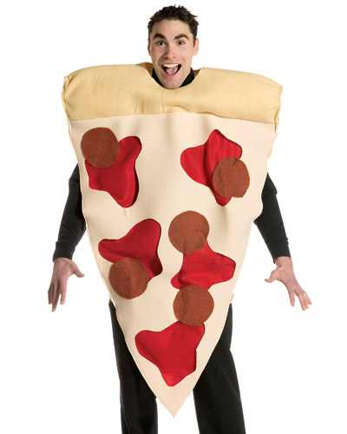
Important!
Using “like” or “as” doesn’t make a simile.
A comparison must be made.
Not a Simile: I like pizza.
Simile: The moon is like a pizza.

Slide 10
Metaphor
A figure of speech in which a word or phrase is applied to an object or action to which it is not literally applicable.
A way of describing someone or something by showing their similarity with something else.
A metaphor is a figure of speech that directly compares two unlike things by stating one is the other, thus highlighting their shared qualities. Unlike similes, which use "like" or "as" for comparison, metaphors make the comparison more direct and often more powerful.
Examples:
The mind is an ocean.
The snow is a white blanket.
She is an early bird.
She has a heart of gold.
He drowned in a sea of grief.
Meaning: He was overwhelmed by deep sadness or sorrow.
Her eyes were windows to her soul.
Meaning: Her emotions and true feelings were clearly visible through her eyes.
The city is a jungle.
Meaning: The city is wild, chaotic, and difficult to navigate, like a jungle.
His voice was music to my ears.
Meaning: His voice was very pleasant and enjoyable to hear.

Slide 11
More Examples:
Time is a thief.
Meaning: Time steals moments from our lives, often unnoticed, just as a thief takes possessions.
Life is a journey.
Meaning: Life has its ups and downs, different paths, and varied experiences, similar to traveling on a journey.
He has a heart of stone.
Meaning: The person is emotionally cold, unfeeling, or harsh.
She is a shining star.
Meaning: She is outstanding, remarkable, or exceptional in some way.
The classroom was a zoo.
Meaning: The classroom was chaotic and noisy, similar to the wild behavior of animals in a zoo.
Ideas are seeds.
Meaning: Ideas can grow and develop over time, just like seeds grow into plants.
His words cut deeper than a knife.
Meaning: His words were very hurtful or painful, much like a physical wound from a knife.
The test was a breeze.
Meaning: The test was very easy to complete.

Slide 12
Similes and metaphor
Similes and metaphors are often confused with one another. The main difference between a simile and metaphor is that a simile uses the words "like" or "as" to draw a comparison and a metaphor simply states the comparison without using "like" or "as".
Example of a simile: She is as innocent as an angel.
Example of a metaphor is: She is an angel.

Slide 13
Personification
Personification is a figure of speech in which non-human objects or animals concepts are given human attributes, emotions, or behaviors. This literary device helps create vivid imagery and can make descriptions more relatable and engaging.
Examples
The light danced on the surface of the water.
The sun smiled down on us.
The wind whispered through the trees.
The leaves waved in the wind.
The streets are calling me.
Rita heard the last piece of pie calling her name.
My alarm clock yells at me to get out of bed every morning
The city never sleeps.

Slide 14
Hyperbole
Exaggerated statements or claims not meant to be taken literally.
Exaggerating to show strong feeling or effect, make or emphasize a point, show contrast between two idea, grab the reader’s attention, set the scene for the story, add interest to an otherwise basic and simple description and add humor to the situation.
Examples:
I’m so hungry I could eat a horse.
My house is a million miles away.
I waited in line at the pharmacy forever.
She thought she would die of embarrassment.
My 16th birthday will never come.
I’m dying of laughter.

Slide 15
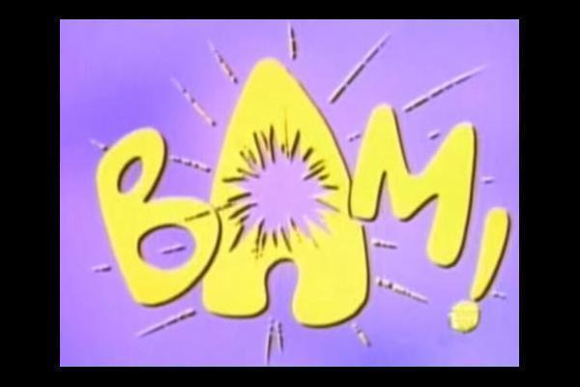


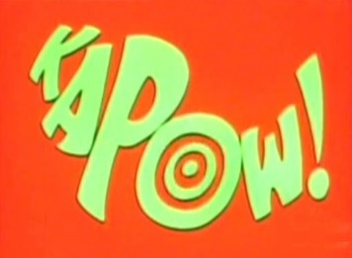
Onomatopoeia: a type of word that represents a certain sound and is often used for literary effect
The formation of a word from a sound associated with what is named.
SPLAT
PING
SLAM
POP
TINKLE.
BUZZ.

Slide 16
Idiom: a group of words used together to give a certain meaning that can’t be guessed from the meaning of its individual words. In other words, An idiom is a commonly used phrase or expression whose meaning does not relate to the literal meaning of its words. Idioms often carry cultural significance and are understood based on common usage rather than direct translation.
Examples:
Cut somebody some slack = to treat (someone) in a less harsh or critical way.
Under the weather = Not feeling well.
Break a leg = To wish someone good luck.
Once in a blue moon = Rarely.
The ball is in your court = A decision is up to you.
Break the ice = To initiate conversation in a social setting to ease tension or awkwardness.
Bite the bullet = To face a difficult or unpleasant situation with courage and determination.

Slide 17
Pun
A form of “word play” in which words that sound the same but have a double meaning.
The population of Ireland is always Dublin.
“Dublin” sounds like “doubling,” meaning increasing — it’s a play on words.
Denial is a river in Egypt.
“Denial” sounds like “The Nile,” a real river — pun mixes a feeling with geography.
It’s difficult for crabs to share because they are shellfish.
“Shellfish” sounds like “selfish” — combining sea life with behavior.
Her cat is near the computer to keep an eye on the mouse.
“Mouse” refers to both the animal and the computer tool — double meaning.
I’m reading a book on anti-gravity. It’s impossible to put down.
The pun plays on "put down," meaning both to stop reading and the concept of gravity.
I’m on a seafood diet. I see food and I eat it.
“Seafood” sounds like “see food” — turns a diet into a joke about eating everything you see.
Notes:
‹#›

Slide 18
Euphemism
A word or phrase used to substituted for or to avoid saying an unpleasant or offensive word.
“Economical” instead of “cheap”.
big-boned instead of large.
well-fed instead of overweight.
outspoken instead of bossy.
curvy instead of fat.
petite instead of short.
“Let go” instead of “fired”.
“Between jobs” instead of “unemployed”.
“Senior citizen” instead of “Old person”.

Slide 19
Oxymoron
When two words are put together that contradict each other. “Opposites”.
Old news
Pretty Ugly
Deafening silence
Organized chaos.
Friendly fight
False truth
Climb down
Close distance
Grow smaller
Unbiased opinion
Modern history
Small crowd

Slide 20
Sibilance Sibilance is a figure of speech in which a hissing sound is created within a group of words through the repetition of "s" sounds.
It is often used as an alliteration device in poetry and literature.
For example:
Sara ‘s silly sister swallowed her sweet.
Seth seems suspiciously surprised.
She sees how she has succeeded.
She should show some sympathy for the staff shortages.

Slide 21
Assonance
Assonance is the repetition of the vowel sound across words within the lines of the poem creating internal rhymes.
Examples of assonance across words include:
crying time;
great flakes;
between trees;
the kind knight rides by.
Chips and dips (Repetition of the /i/ vowel sound)
Surf and turf (Repetition of the /u/ vowel sound)
Go slow over the road (Repetition of the short /o/ vowel sound)
Do good have good (Repetition of the /oo/ vowel sound)
No pain, no gain (Repetition of the /ai/ vowel sound)
The light of the fire is a sight to admire (Repetition of the "i" sound)

Slide 22
Emotive language is the term used when certain word choices are made to evoke an emotional response.
Emotive language often aims to persuade the reader or listener to share the writer or speaker's point of view, using language to stir emotions in the reader or listener by using strong, emotionally charged words.
Non-Emotive Sentence | Emotive Version
The protestors were removed by police. | The protestors were dragged away by police.
The child was thin. | The child was severely malnourished.
Many animals die due to deforestation. | Countless innocent animals are losing their lives because their homes are being destroyed.
The man was injured in the accident. | The man was horribly wounded in the crash.
She was unhappy with the results. | She was devastated by the outcome.
The building was old. | The building was a crumbling, lifeless shell of the past.

Slide 23
More examples
Heart-wrenching: The heart-wrenching story of the orphan moved everyone to tears.
Explanation: "Heart-wrenching" evokes a strong emotional response of sadness and empathy.
Thrilling: The thrilling roller coaster ride left us exhilarated and breathless.
Explanation: "Thrilling" creates excitement and anticipation, generating a positive emotional response.
Horrifying: The horrifying images from the war zone shocked the world.
Explanation: "Horrifying" triggers fear and disgust, eliciting a strong emotional reaction.
Enchanting: The enchanting melody of the music transported us to a magical realm.
Explanation: "Enchanting" conveys a sense of beauty and wonder, evoking a positive emotional experience.
Devastating: The devastating news of the natural disaster brought the community together in solidarity.
Explanation: "Devastating" expresses deep sadness and sorrow, invoking empathy and compassion.
Exhilarating: The exhilarating feeling of freedom swept over her as she soared through the sky.
Explanation: "Exhilarating" communicates a sense of excitement and joy, evoking a positive emotional response.
Infuriating: The infuriating injustice of the situation sparked protests and outrage.
Explanation: "Infuriating" incites anger and indignation, motivating action or protest.
Emotive language can be a powerful tool for writers and speakers to connect with their audience on an emotional level, influencing their perceptions, beliefs, and actions.

Slide 24
Irony It is when the opposite of what is expected happens, or when someone says something but means the opposite (often using sarcasm). is the use of words to convey a meaning that is the opposite of its literal meaning: the irony of her reply, “How nice!” when I said I had to work all weekend.
A pilot has a fear of heights. ➤ Ironic because pilots are expected to be comfortable flying high in the sky.
"Well, this is just the best day ever," said the bus driver as his bus broke down for the third time. ➤ Verbal irony — the driver says the opposite of what he means.
"Thanks for the ticket, officer. You just made my day!" ➤ Verbal irony — the speaker is clearly upset, not thankful.
A fire station burns down. ➤ Situational irony — the one place that fights fires catches fire.
The Titanic, called "unsinkable," sank on its first trip. ➤ Situational irony — the ship that was supposed to be safest met a tragic end.
A math teacher’s child fails math. ➤ Ironic because you'd expect the child of a math expert to do well in math.
Posting on social media about how bad social media is. ➤ Ironic because the person is using what they’re criticizing.
A traffic cop gets his license suspended for unpaid parking tickets. ➤ Ironic because he’s supposed to enforce traffic laws.

Slide 25
Alliteration: Alliteration is the repetition of the same beginning sound or letter in two or more closely connected words.
Examples:
Clary closed her cluttered clothes closet.
Harry hurried home to watch football on TV.
Rachel ran right until she realized she was running round and round.
Polly's prancing pony performed perfectly.
The boy buzzed around, as busy as a bee.

Slide 26
Practice (1):
Write down the type of figurative language used in each of the following sentences:
1-My flowers were begging for water. ________________
2- The fragrance of spring flowers made her joyful. __________________
3- Time flies when you're having fun. _________________
4- Last night, I slept like a log. __________________
5- The burger, aromatic with spices, made his mouth water in anticipation of the first bite. _____________
Notes:
1-personification
2- imagery
3-metaphor
4-simile
5-imagery

Slide 27
Practice (1) Answer Key:
My flowers were begging for water. → Personification (Giving human qualities to non-human things — flowers can’t literally beg.)
The fragrance of spring flowers made her joyful. → Imagery (Appeals to the sense of smell and emotion.)
Time flies when you're having fun. → Idiom (Time can't literally fly — It's often used to express the feeling that a period of time, especially one that was enjoyable, has gone by faster than expected.)
Last night, I slept like a log. → Simile (Uses "like" to compare sleeping soundly to a log.)
The burger, aromatic with spices, made his mouth water in anticipation of the first bite. → Imagery (Appeals to the senses of smell and taste.)

Slide 28
Practice (2):
The angry storm clouds shouted their warnings. → ________________
Her smile was as bright as the morning sun. → ________________
The wind whispered secrets through the trees. → ________________
The candy was as sweet as honey. → ________________
The classroom was a zoo during recess. → ________________
His words cut deeper than a knife. → ________________
The old car coughed and sputtered before starting. → ________________
She danced like a leaf blown by the wind. → ________________
The snow blanketed the town in a soft, white cover. → ________________

Slide 29
Practice (2) Answer Key:
The angry storm clouds shouted their warnings. → Personification (giving human action “shouted” to clouds)
Her smile was as bright as the morning sun. → Simile (uses “as” to compare smile and sun)
The wind whispered secrets through the trees. → Personification (wind given human action “whispered”)
The candy was as sweet as honey. → Simile (uses “as” to compare candy and honey)
The classroom was a zoo during recess. → Metaphor ( It implies a state of chaos, noise, and potential unruliness, similar to the lively and sometimes chaotic atmosphere of a zoo. )
His words cut deeper than a knife. → Metaphor (words compared to a knife, implying hurtfulness)
The old car coughed and sputtered before starting. → Personification (car given human actions “coughed” and “sputtered”)
She danced like a leaf blown by the wind. → Simile (uses “like” to compare dance and leaf movement)
The snow blanketed the town in a soft, white cover. → Metaphor/Imagery (snow compared to a blanket; also creates a sensory image)

Slide 30
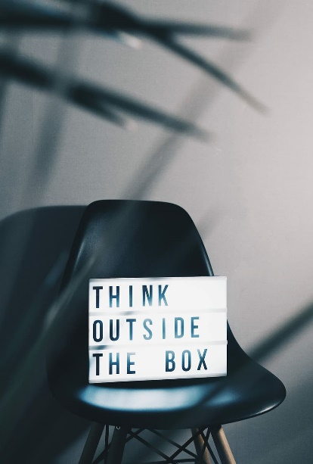
The following slides contain some examples of past paper questions.

Slide 31
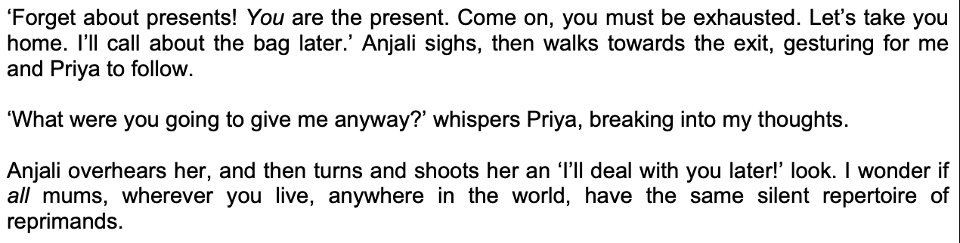
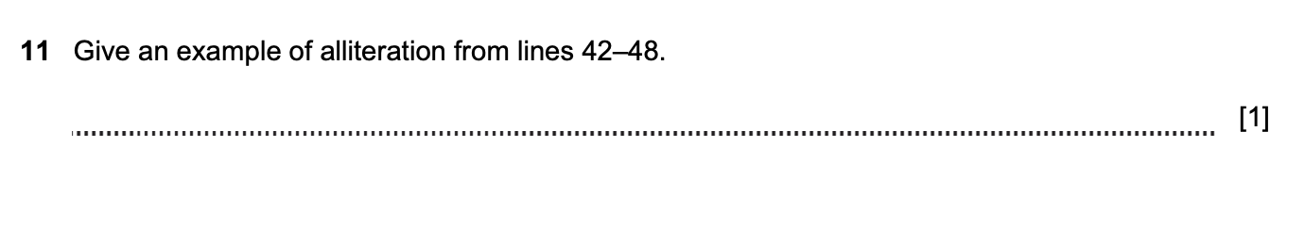
1
Notes:
(have the) same silent / repertoire of reprimands.

Slide 32
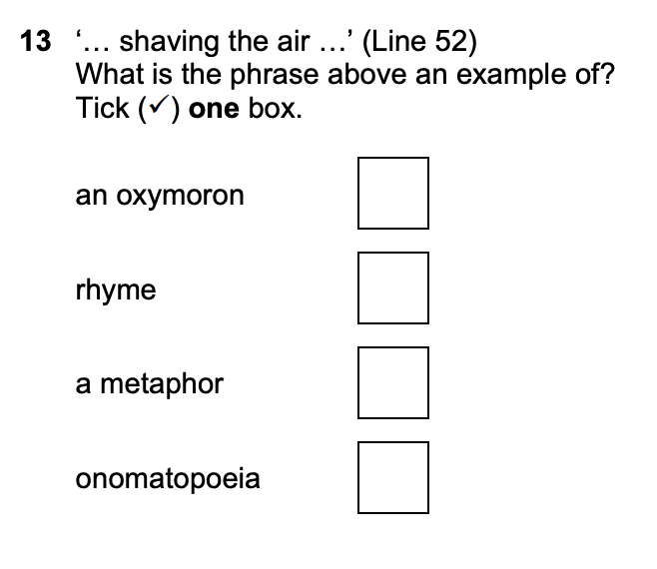
2
alliteration
Notes:
Metaphor

Slide 33
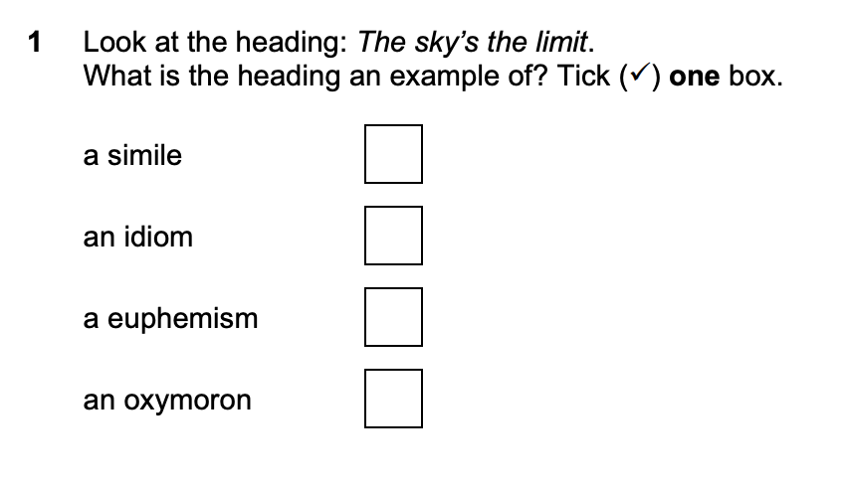
3
personification
a metaphor
Notes:
Idiom

Slide 34
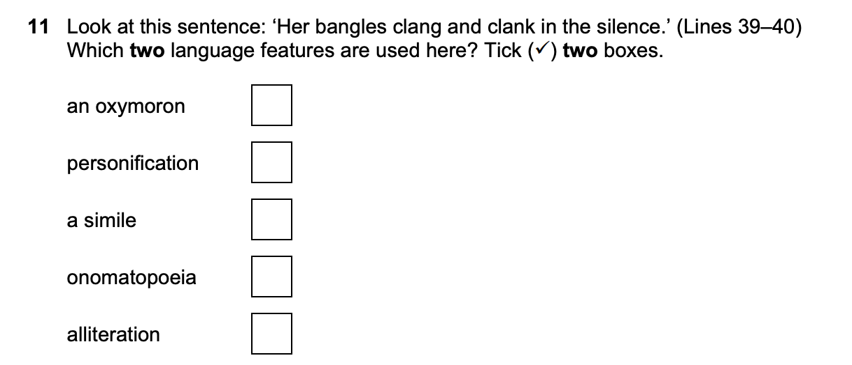
4
a metaphor
Notes:
onomatopoeia • alliteration.

Slide 35
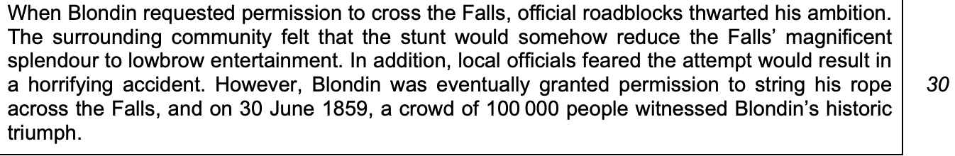
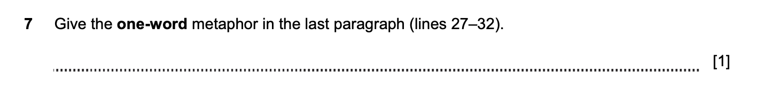
5
Notes:
“roadblocks” "roadblock" is often used as a metaphor to describe an obstacle or challenge that hinders progress or prevents someone from achieving a goal. It's a figurative way to say that something is getting in the way, similar to how a literal roadblock physically blocks a road.

Slide 36
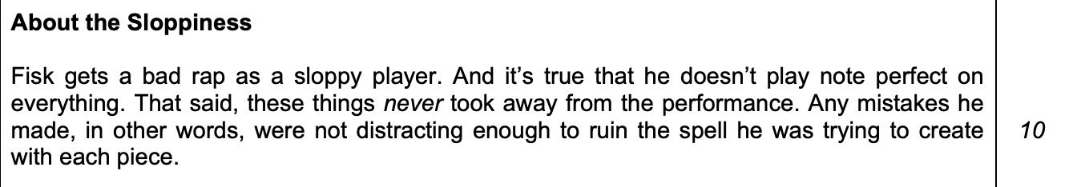
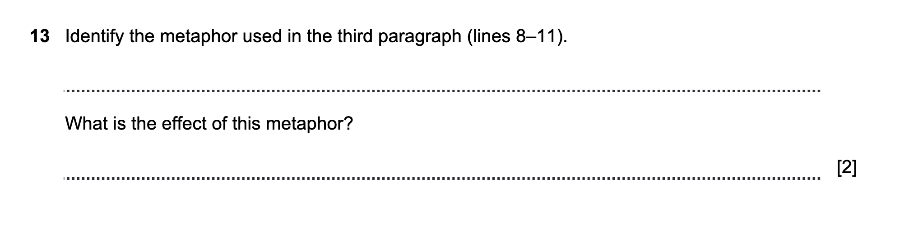
6
a
b
Notes:
‘…(ruin the) spell (he was trying to create)…’
-It compares his music / playing / concert to magic. / It says his music / concert is magical.
- It 'shows how mesmerised / captivated / spellbound the audience was'.

Slide 37
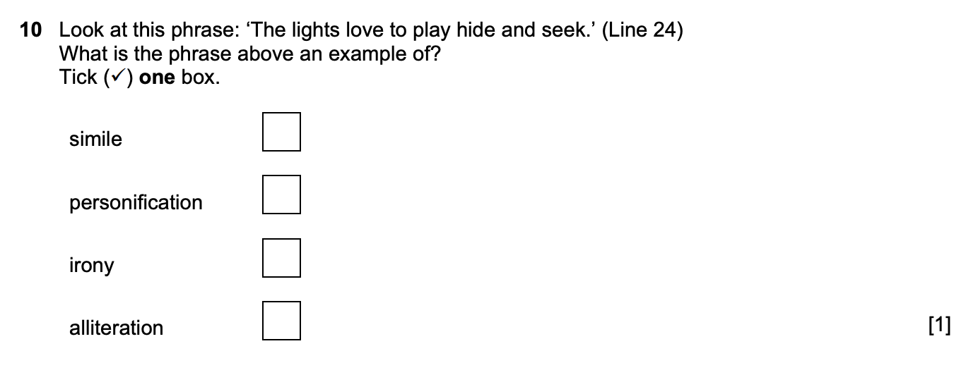
7
Notes:
Personification

Slide 38
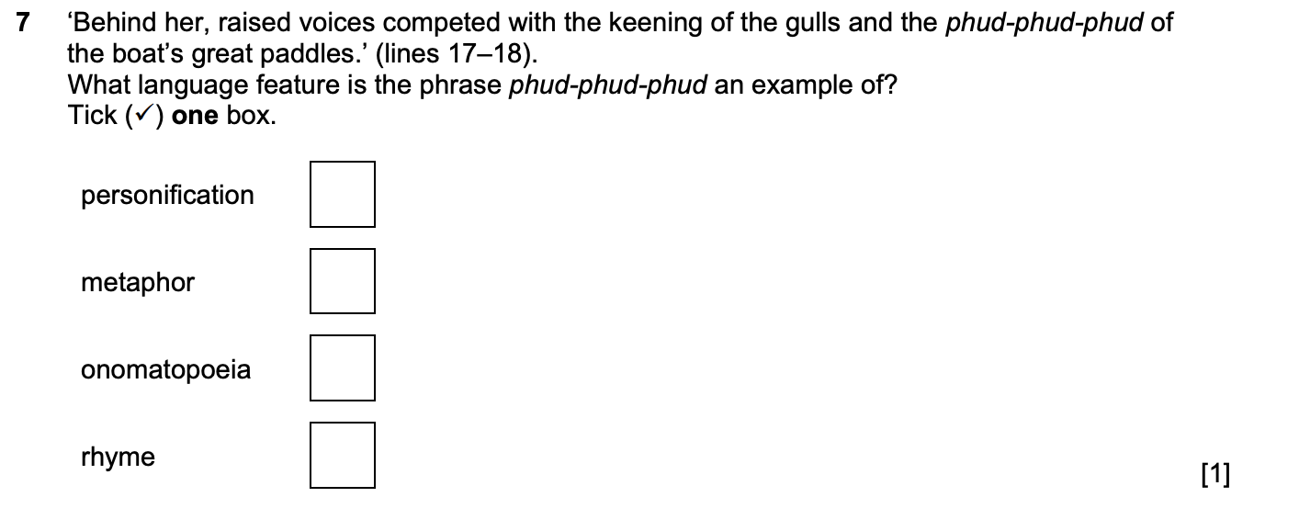
8
Notes:
Onomatopoeia

