Slide 1
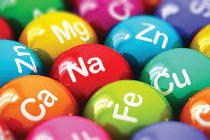
Mineral elements

Slide 2
Calcium Past Paper Question
Functions of Calcium:
With phosphorus, it combines to make calcium phosphate, which is the chief material that gives hardness and strength to bones and teeth.
Required for part of the complex mechanism which causes blood to clot after an injury.
Required to the correct functioning of muscles.
Required to the correct functioning nerves.
Required for the maintenance of bones and teeth once formed.

Slide 3
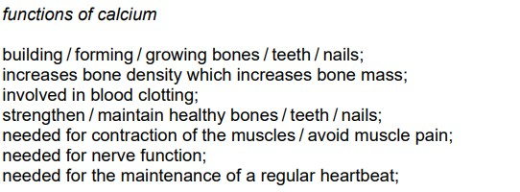

Slide 4
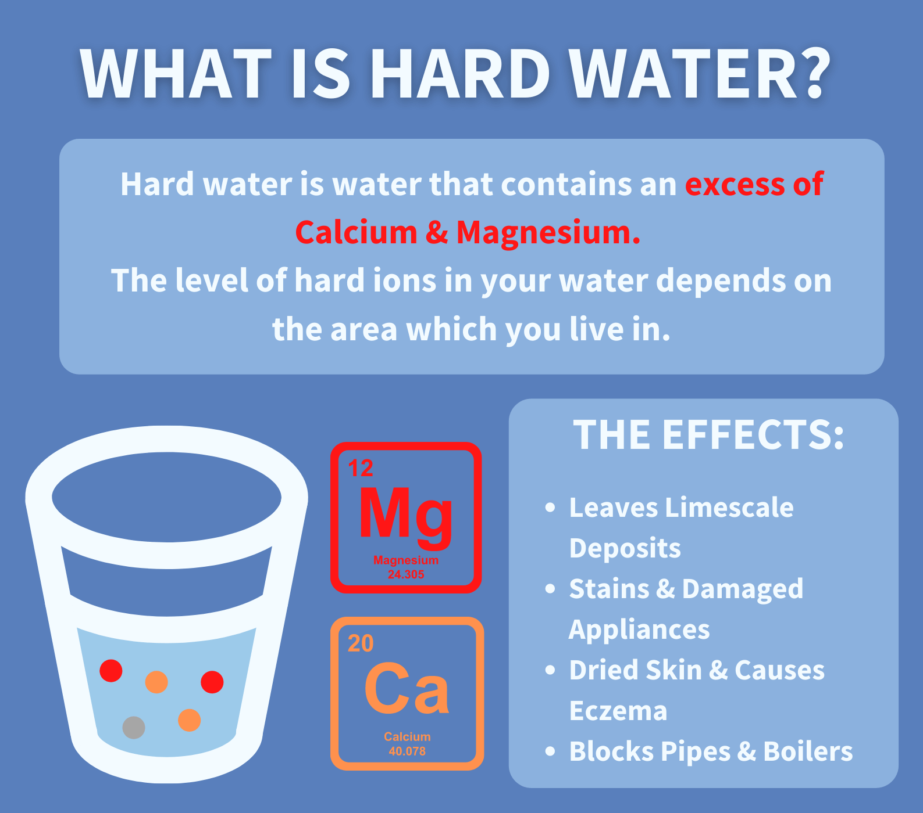
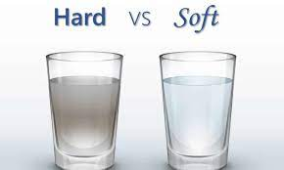
*Sources
Calcium is found in good supply in
Milk
Cheese
Wheat ( added to white flour by law)
Bones in canned fish
Hard water

Slide 5
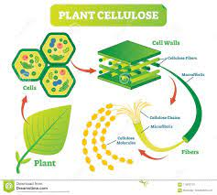
It is also found in green vegetables, but it may be unavailable to the body, because cellulose ( which the body cannot digest) affects calcium absorption.
It is found in whole grain cereals, but there it may combine with a substance called phytic acid which makes it unavailable to the body.

Slide 6
Requirements
The absorption of calcium (and phosphorus) and the mineralization of bones and teeth is controlled by Vitamin D. the body must have a sufficient supply of all three in order to function properly.
Vitamin D aids the absorption of calcium and phosphorus.

Slide 7
Around the age of 30, calcium starts to be lost and is not replaced. This process speeds up in women at the menopause, hormone replacement therapy (HRT) may help to slow it down.
The continual loss of bone mass can lead to osteoporosis, which means that the bones become weak, brittle and break easily.
Women are most at risk from osteoporosis, but it can also affect men.

Slide 8
Deficiency: Past Paper Question
Children- bones and teeth are not mineralized properly, and are improperly formed. The leg bones may bend under the weight of the body as in rickets, although this is not due to a deficiency of calcium alone.
Adults- strength of bones and teeth is not maintained, possibly resulting in osteomalacia (adult rickets).
Muscles and nerves do not function correctly, which may result in tetany, where the muscles contract and the patient has convulsions.
Osteomalacia osteoporosis
“adult rickets”

Slide 9
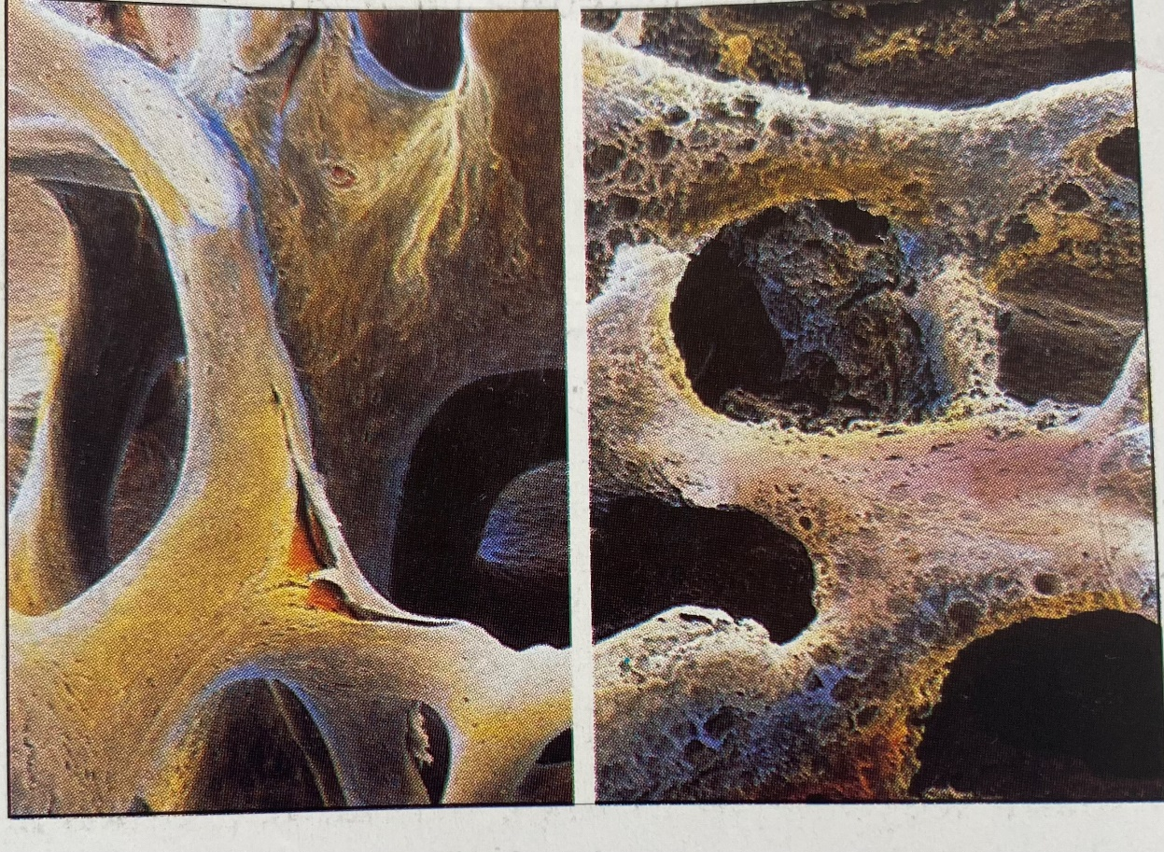
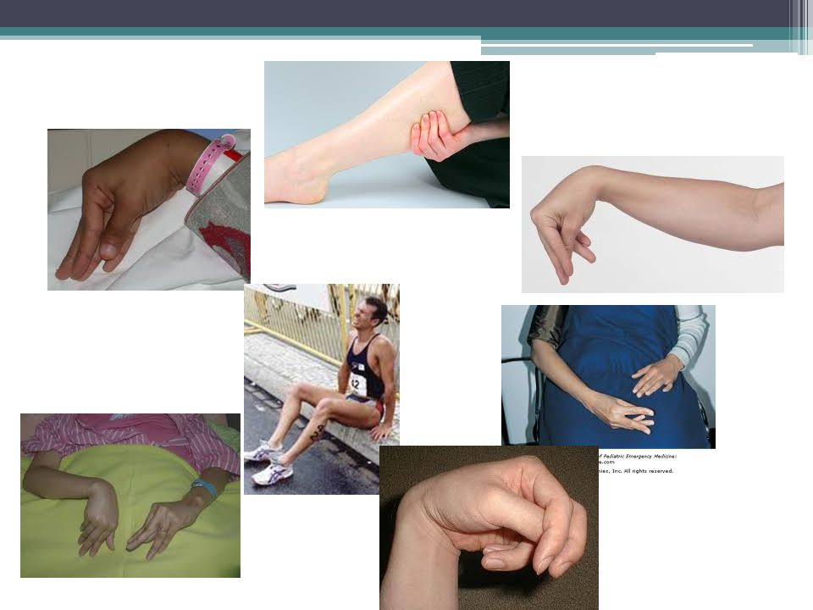

Slide 10
Too much calcium in the body is dangerous, as it will be deposited in organs such as the kidneys, and this may be fatal.
People who take too much Vitamin D absorb calcium in excessive amounts, which results in death.

Slide 11
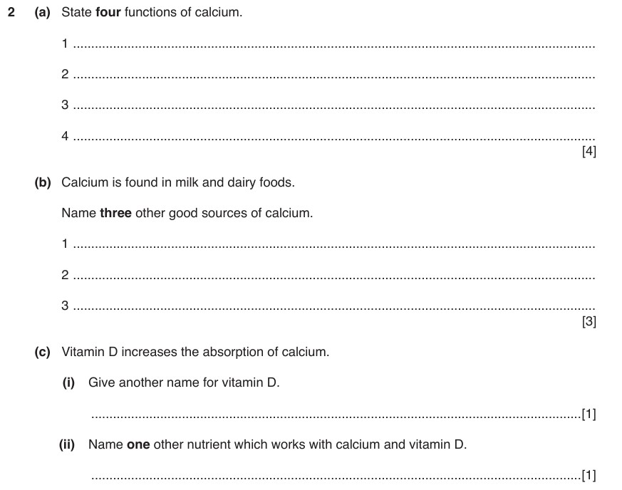

Slide 12
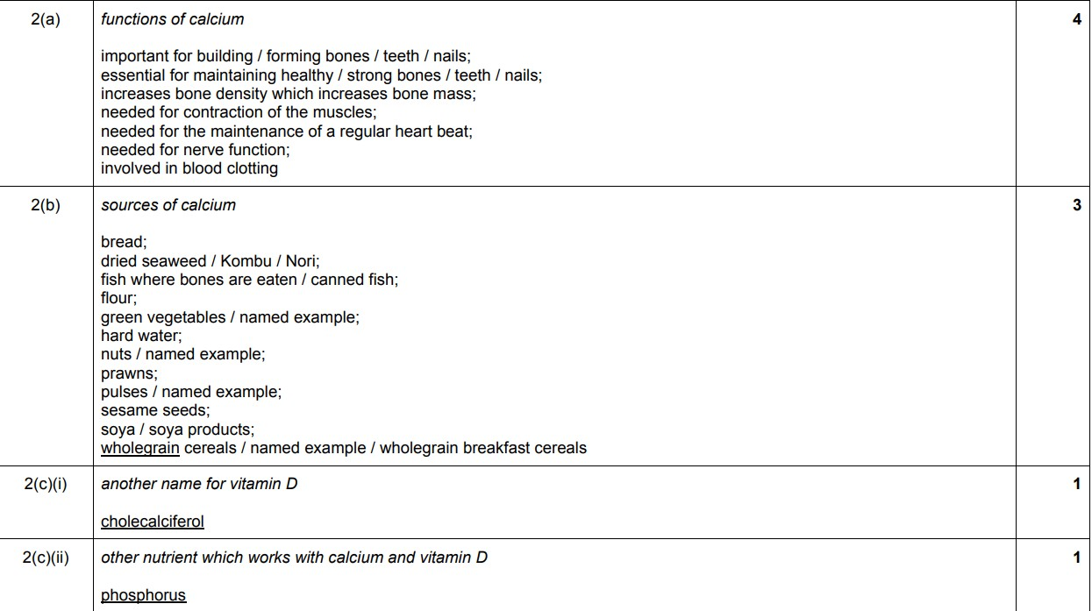

Slide 13
Phosphorus
Functions of phosphorus:
-Phosphorus works in conjunction with calcium, therefore has the same functions.
-It is essential for the production of energy in the body.

Slide 15
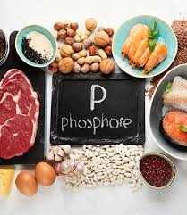
Sources:
Phosphorus is present as phosphate in all plant and animal cells, therefore it is present in all natural foods.
It forms part of many proteins.
It is used as an additive in manufactured foods.

Slide 16
Iron
Functions of iron:
Iron is a component of haemoglobin, the substance which gives red blood cells their colour.
Production of red blood cells
Haemoglobin is required to transport oxygen around the body to every cell, for the production of energy and the maintenance of all cell functions.

Slide 17
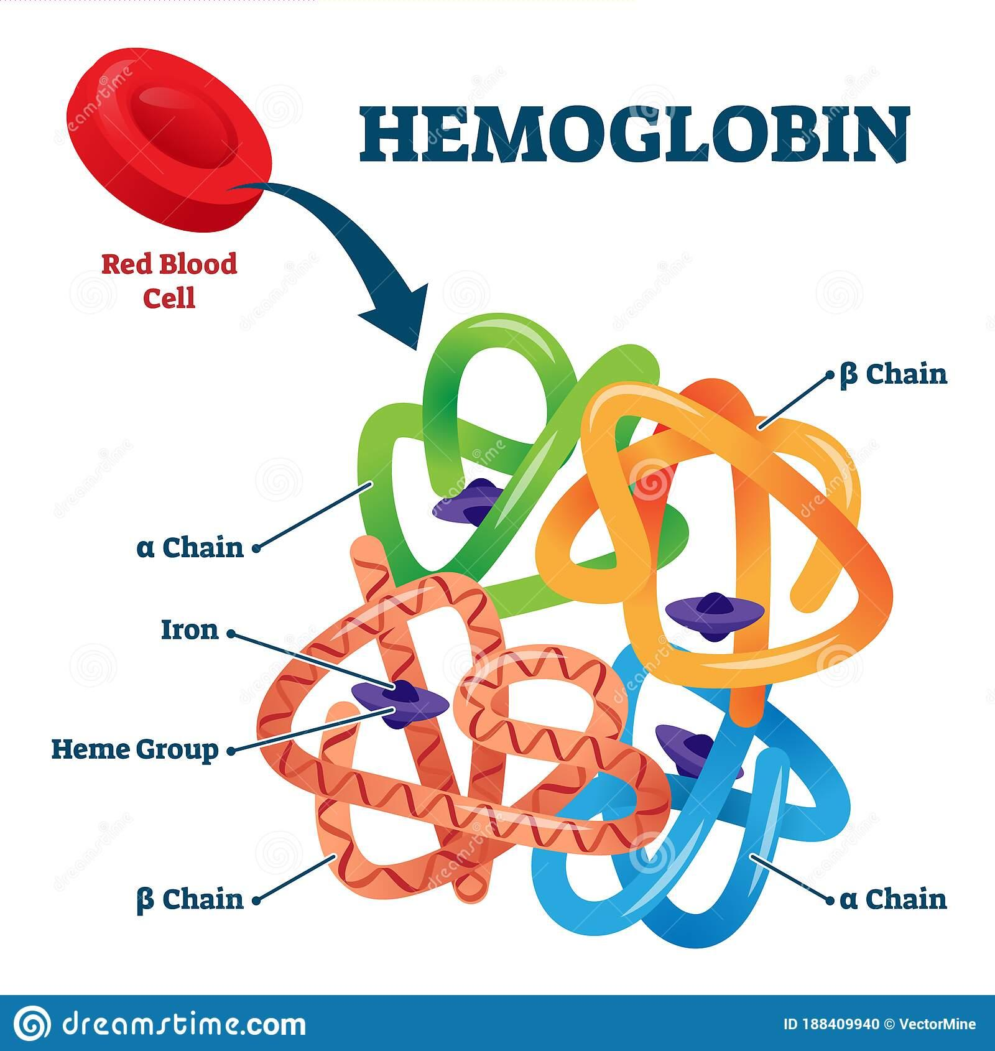
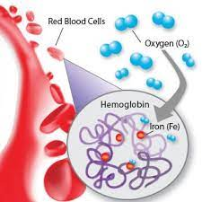

Slide 18
Sources:
Good sources
Reasonable sources
Liver, kidney, corned beef
Cocoa, plain chocolate
watercress
White bread ( added by law)
Curry powder, dried fruits
Pulses, wholegrain cereals
Green leafy vegetables

Slide 19
Absorption of iron
Iron in its ferrous form is easier to absorb than in its ferric form.
Iron from plant food, e.g. grains, leafy vegetables and soya proteins may be more difficult to absorb by the presence of phytic acid.
Ascorbic acid (Vitamin C) increases iron absorption, especially from plant foods, as it changes the iron from the ferric to the ferrous form.
Egg yolk is a good source of iron, but the iron is poorly absorbed by humans. Egg yolk should not be relied on as the main source of iron in the diet, and foods containing Vitamin C should be eaten with it.

Slide 20
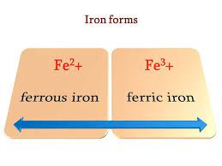
There are two forms of iron

Slide 21
Requirements:
Red blood cells die after about (six weeks), and must be replaced. This process is continually occurring in the body. As the blood cells are removed from the body, some of the iron is saved. However some iron is lost, and must be replaced by a daily food supply.
Absorption of iron is controlled in the small intestine. Normally, only a small percentage of the iron in the diet is absorbed, but if more is required (e.g. pregnancy), then more is absorbed to meet these demands.

Slide 22
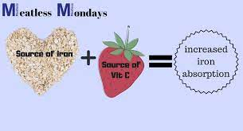
To ensure that iron is properly absorbed, foods containing iron should be eaten with foods containing Vitamin C.

Slide 23
Special requirements: Past Paper Question
Babies- are born with a supply of iron to last them up to four months, as milk contains very little iron. After this time babies need to be given iron in the form of solid food or mineral drops.
Pregnant women- Iron requirements increase in pregnancy to allow for the development of the growing baby’s blood supply. The body usually adapts to meet these demands, but some may require iron tablets.

Slide 24
3. Girls and women- The regular menstrual loss of blood means that iron is lost and must be replaced. After the birth of a baby, iron supplies must be replaced.
4. Injuries and operations- Result in loss of blood and the iron must be replaced.

Slide 25
Deficiency:
Haemoglobin is not made properly, so insufficient oxygen is carried around the body. This leads to fatigue, weakness, pale of complexion. In severe cases this leads to the condition known as iron deficiency anaemia.
General health is affected, as cells cannot function properly.

Slide 26
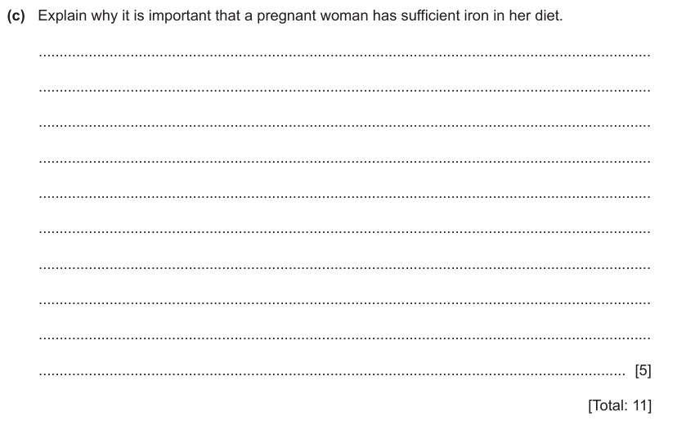

Slide 27
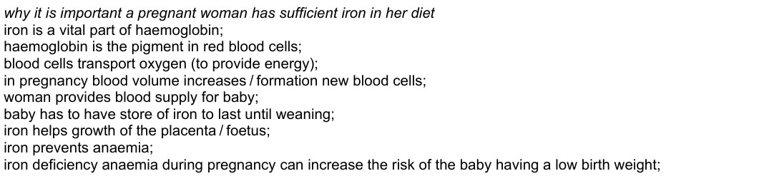

Slide 28
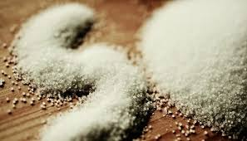
Sodium, chloride, potassium
Functions:
Required to maintain the correct concentration of the body fluids.
Chloride is required for the production of the hydrochloric acid in the gastric juice of the stomach.

Slide 29
Sources
All three are usually eaten as sodium chloride or as potassium chloride in food.
They are also added as salt to foods e.g.:
-yeast extract bacon
-cheese fish
They are found naturally in fish, meat and other foods.
Sodium in the form of sodium chloride (NaCl) “SALT” is added to many, manufactured foods, especially savory snacks.

Slide 30
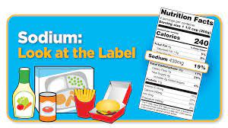
It forms part of monosodium glutamate (MSG) which is a flavor enhancer used in many foods.
Sodium bicarbonate and sodium nitrite are other commonly used additives.
*Food labels often give the sodium content.

Slide 31
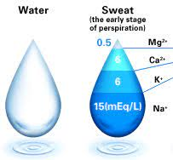
Requirements: Past Paper Question
Everyone needs these elements.
Sodium and chloride are especially necessary in hot climates where they are lost in sweat.
Workers in heavy industry need these elements.
Excess intakes are excreted in the urine and sweat.

Slide 32
It is sometimes necessary to place a person on a salt-restricted diet, for certain medical conditions: Past Paper Question
heart, kidney, or liver disease
High blood pressure. When temp. is higher, people
need higher minerals
This means that:
-Low-salt foods (e.g. natural cereals, fruit, unsalted butter) must be eaten with small amounts of fresh meat and fish, and root vegetables.
-No salt many be added to food but:
1. Alternative flavoring e.g. herbs, spices, can be used as a substitute.
2. Low sodium table salt is also available.

Slide 33

Deficiency:
Salt tablets are issued to some workers in hot climates (e.g. in civil engineering) if they are unused to long periods in such heat.

Slide 34
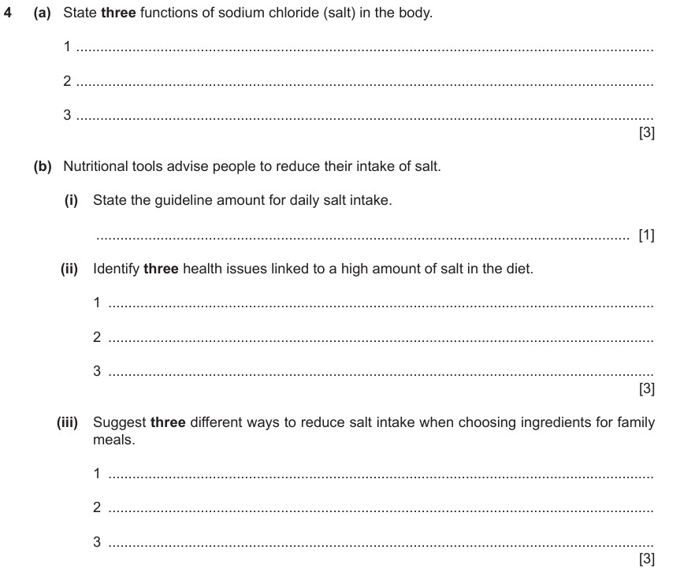

Slide 35
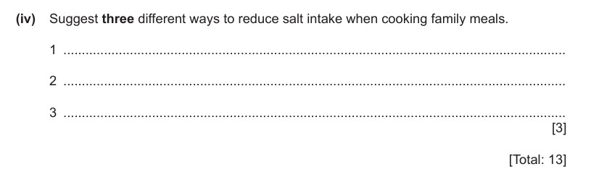

Slide 36
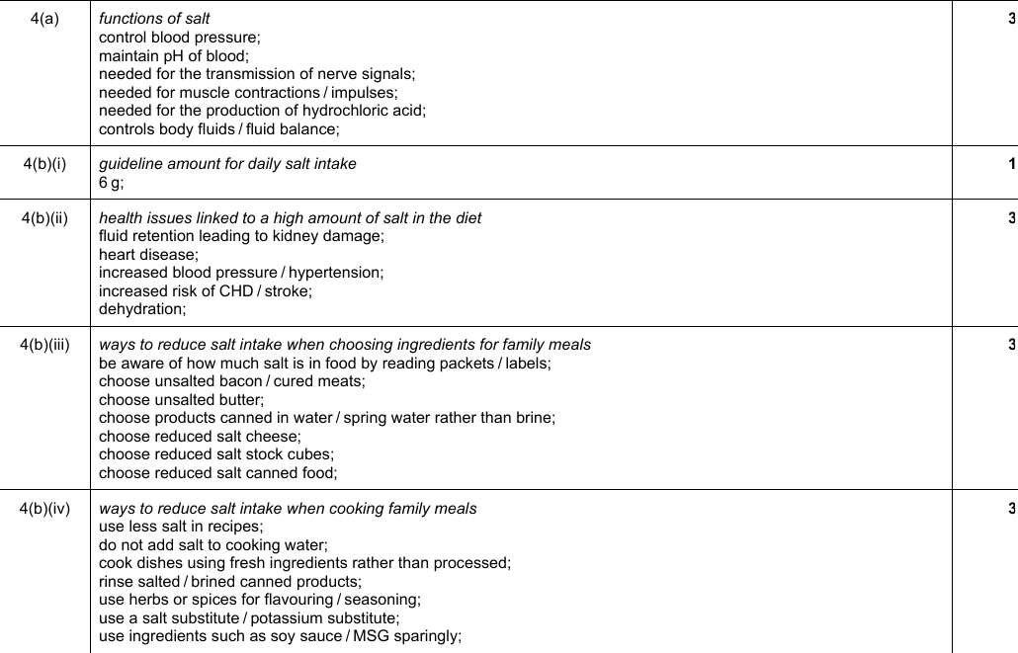

Slide 37
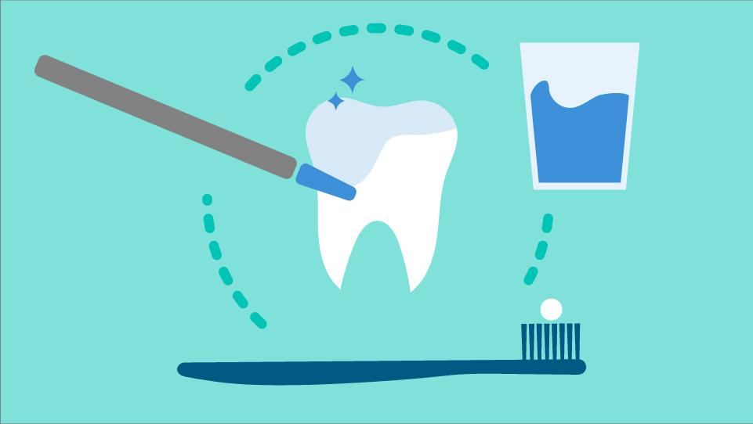
Fluoride
Functions of fluoride:
Fluoride is important in strengthening teeth against decay.
It combines with the protective enamel coating of the teeth, making them more resistant to attack by the acids produced by bacteria in the mouth.

Slide 38

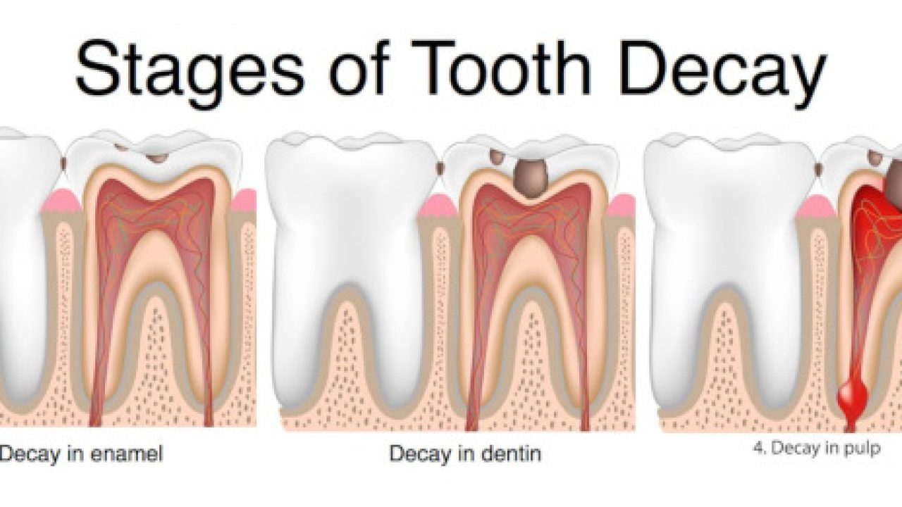
Tooth decay

Slide 39
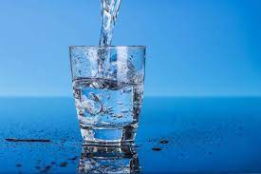
Sources:
Fluoride is found naturally in tea, sea-water fish, and in some water supplies.

Slide 40
Fluoridation of water supplies:
In areas where fluoride occurs naturally in the water supply, the number of children who need treatment for tooth decay is lower than in other areas.
It is recommended that all water supplies should have fluoride added at a strength of 1mg per 1 litre, to reduce the number of children requiring dental treatment.

Slide 41
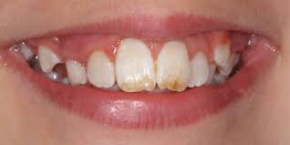
Requirements:
The strengthening effect of fluoride is only of value when the teeth are developing in children. Only small quantities are required.
Too much fluoride can be harmful, as it causes the teeth to become “mottled” with dark brown spots.

Slide 42
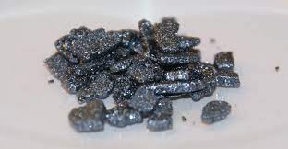
Iodine:
Functions of Iodine:
Iodine is required to make the hormone thyroxine, which is produced by the thyroid gland in the neck.
Thyroxine, along with other hormones, help to control the rate of metabolism in the body.

Slide 43
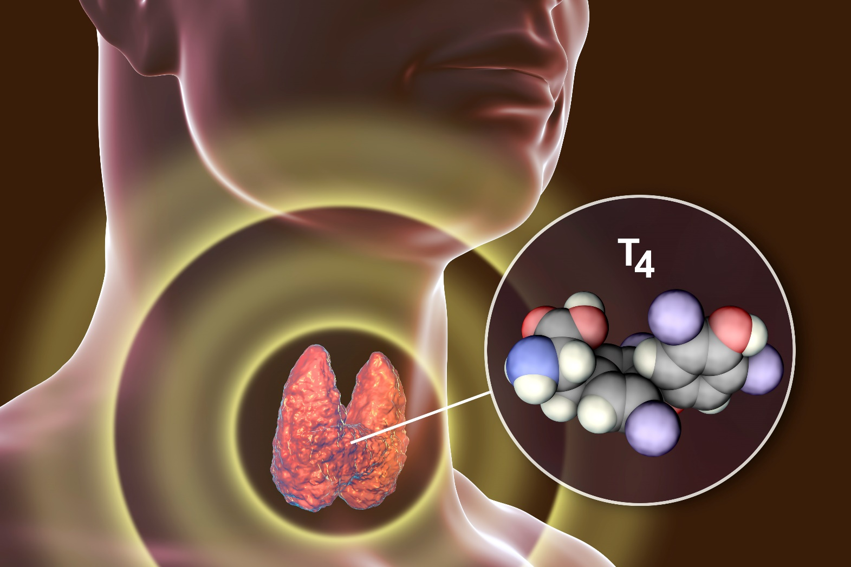
Thyroid gland

Slide 44
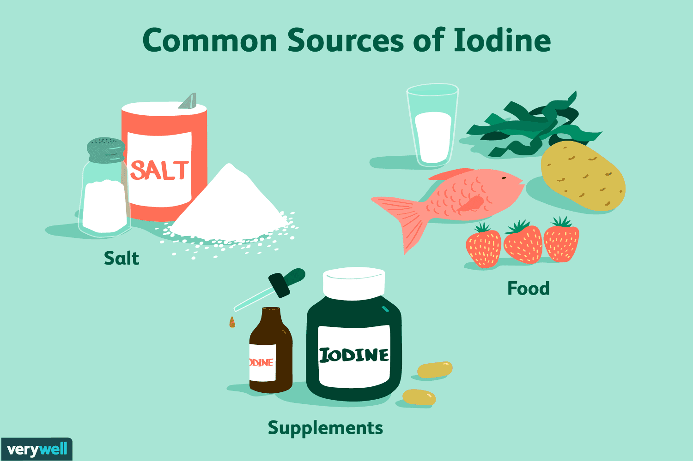
Sources
Iodine is widely distributed in foods, but is found in good supply in:
Sea foods.
Milk.
Green vegetables, especially spinach.
Fresh water ( depending on area)
Iodized salt ( added commercially)

Slide 45
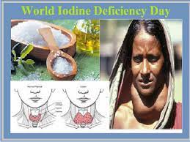
Deficiency: Past Paper Question
A deficiency of Iodine leads to a reduction in the amount of thyroxine produced by the thyroid gland.
As a result the metabolism slows down, and the gland swells up.
This swelling can be seen in the neck and is called a goitre.

Slide 46
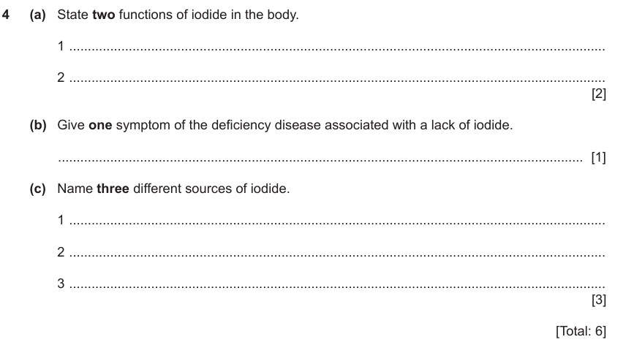

Slide 47
