Slide 1
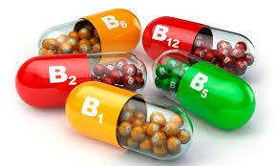
Water-soluble Vitamins
Vitamin-B complex
Vitamin- B is made up of at least 13 substances, which is why called Vitamin-B complex.

Slide 2
Sources:
The main food sources of the Vitamin-B complex are:
Cereals, especially wholegrain cereals
Cereal product, e.g.: bread and flour
Yeast and yeast extracts, beer
Wheatgerm
All meat, especially pork, bacon, ham
Liver, kidney, heart
Eggs, fish roe, milk

Slide 3
Thiamin ( Vitamin B1)
Functions of Vitamin B1 ( Thiamin):
Involved in the complex series of metabolic reactions that release energy from carbohydrate.
Required for the normal growth of children and for general health.
Required for the function and maintenance of the nerves.

Slide 4
*Requirements:
Thiamin cannot be stored by the body, so a daily supply is necessary for all age groups.
Requirements increase during:
Pregnancy and lactation.
During periods of increased metabolism e.g. muscular activity, some illnesses.
* People in very active jobs are therefore likely to need more Thiamin

Slide 5
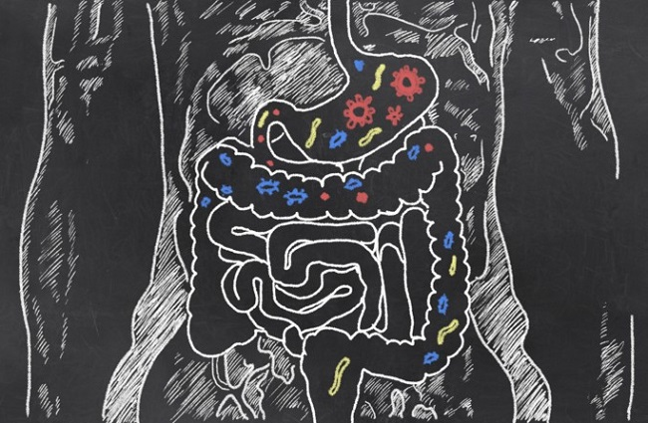
Bacteria that are normally present in the intestinal tract are able to make some Thiamin in humans and other mammals. However this is only a small contribution to the daily intake.

Slide 6
Deficiency:
A deficiency of Thiamin may occur for several reasons:
Alcoholism
Some digestive disorders
Pregnancy, due to loss of appetite and vomiting.
A deficiency may cause:
Depression, irritability, difficulty in concentration, defective memory, anxiety.
Growth retarded in children.

Slide 7
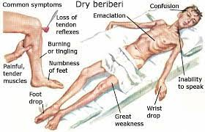
3. Nerves become inflamed and painful ( neuritis), muscles become weak, reflexes and reduced.
4. Severe deficiency leads to the disease beri-beri.
A patient with beri-beri becomes exhausted and loses weight, muscles become weak especially in the legs; ankles and wrists drop. Fluid may be retained in the tissues, causing swelling.

Slide 8
Stability in food preparation
Thiamin is very soluble in water, and some is destroyed by the high temperatures used in cooking.

Slide 9
Riboflavin ( Vitamin B2)
Functions of vitamin B2 ( Riboflavin)
Essential for normal growth.
Required for the release of energy from food, especially amino-acid and fat by oxidation.

Slide 10
*Requirement:
Riboflavin can be stored in small amounts in the liver, spleen, and kidneys, but a daily supply is required by all age groups.
Bacteria normally present in the intestine can produce some Riboflavin, but not enough to meet all the body’s needs.

Slide 11
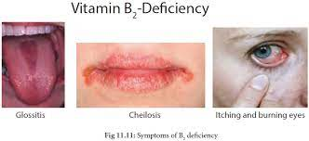
Deficiency:
A deficiency can result in:
Failure to grow.
Skin lesions, dermatitis (skin disorder), and conjunctivitis ( disorder of the outer membrane of the eye).
Tongue may swell, mouth and lips become sore.

Slide 12
Stability in food preparation:
Riboflavin is soluble in water, and is destroyed if heated in the presence of an alkali e.g. (bicarbonate of soda). Exposure to light also destroys the vitamin.
This is why foods such as milk should be stored in the dark.

Slide 13
Nicotinic Acid ( niacin) B3
Functions of Nicotinic acid
Like other B-Vitamins, nicotinic acid is an important factor in the release of energy from food, especially carbohydrate, by oxidation.

Slide 14
Sources:
Apart from it’s food sources, nicotinic acid can be made in the body from the amino-acid tryptophan ( in protein).
Foods such as eggs & milk, which are poor sources of nicotinic acid , contain tryptophan and are therefore useful to the body in this way.

Slide 15
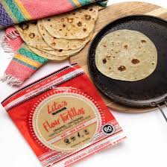
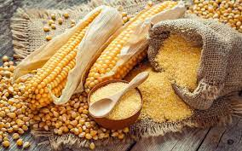
Some foods contain nicotinic in a form that is unavailable to the body. This is true of the cereal maize, and in areas of the world where maize is the staple food, nicotinic acid deficiency is a major problem.
In Mexico, where maize is the staple food, they treat it with limewater, before making the maize into tortillas. The lime water releases the nicotinic acid from the maize, so that a deficiency is unlikely.

Slide 16
Requirement:
Nicotinic acid is required everyday, and more is needed during pregnancy and lactation.

Slide 17
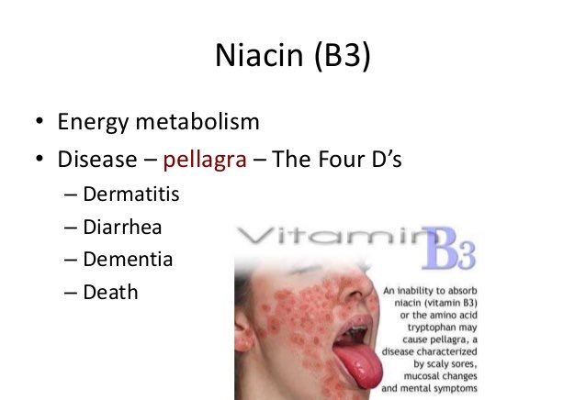
Deficiency:
Nicotinic acid results in the disease Pellagra which has these symptoms:
Dermatitis: especially on the skin that is exposed to the sun.
Dementia: loss of memory, confusion, depression.
Diarrhea: abdominal discomfort, loss of appetite, loose and frequent stools.

Slide 18
Folate (Folic acid) B9
Functions of Folate (Folic acid)
Essential for the normal growth.
Essential for the formation of red blood cells (erythrocytes).
Required for the release of energy from food, especially amino-acids.
Important for the production of the nucleic acids RNA and DNA.

Slide 19
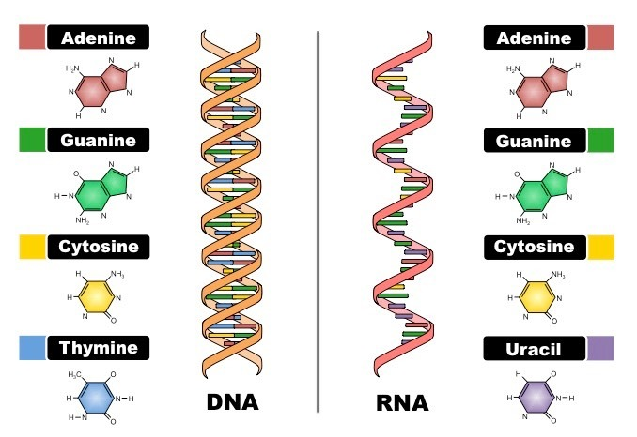

Slide 20
Requirement:
A daily supply of folate is required.
The requirement increases in pregnancy.
Deficiency:
A deficiency of folate result in:
1. Failure to grow properly.
2. Megaloblastic anemia, where the red blood cells become enlarged ( megalo-) and cannot give up their oxygen properly to the body cells.

Slide 21
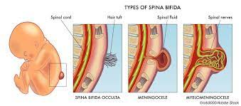
3. A lack of folate in early pregnancy may lead to a condition called spina bifida in the baby, which causes permanent disability.
Women are advised to eat foods with a good folate content, and take supplements before becoming pregnant and in the first 12 weeks of pregnancy.

Slide 22
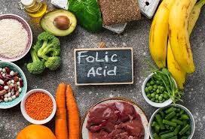
Sources:
Folate is found in potatoes, spinach, green leafy vegetables, Brussels sprouts, green beans, peas, okra, bananas, grapefruit, oranges, yeast extract, bread, cereals, pulses, and dairy products.

Slide 23
Stability in food preparation:
Folate is soluble in water, and will be destroyed by prolonged cooking. Most vitamins are sensitive to heat and water.

Slide 24
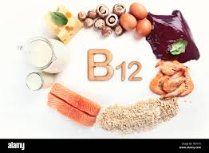
Cobalamin ( Vitamin B12)
Function of Vitamin B12 (Cobalamin)
Cobalamin is required for the metabolism of amino-acids as well as other enzyme system throughout the body.

Slide 25
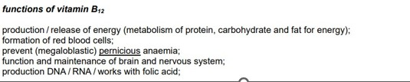

Slide 26
Requirements:
Cobalamin is produced in the intestines by bacteria, and is only found in useful amounts in animal foods.
Vegans, who eat no animal foods, may have an insufficient intake
Requirements are higher during lactation

Slide 27
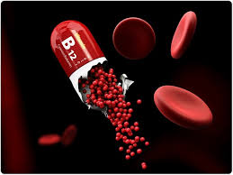
Deficiency:
A deficiency of Cobalamin results in megaloblastic anaemia
This may occur in patients with dietary disorders or in old age.

Slide 28
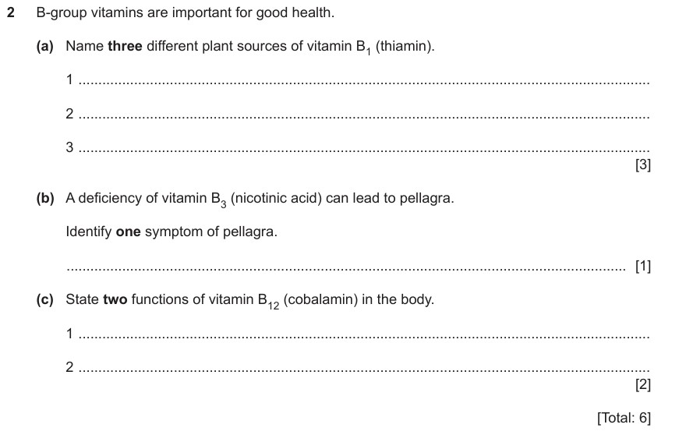

Slide 29
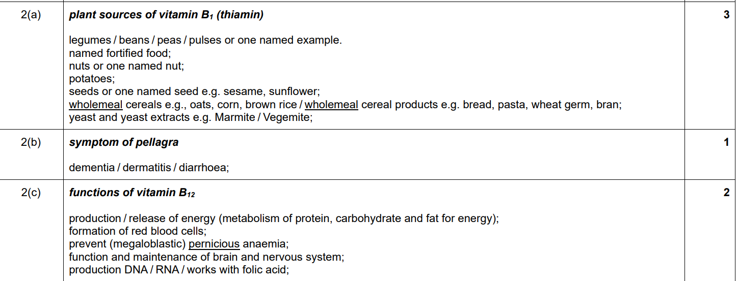

Slide 30
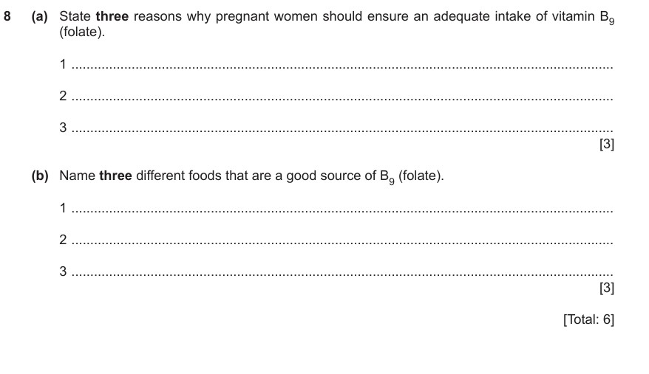

Slide 31
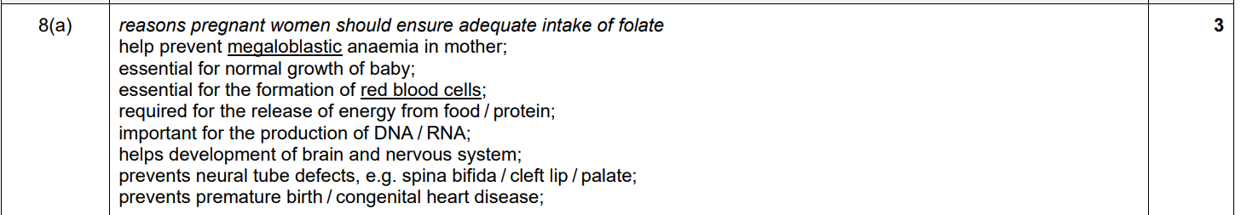
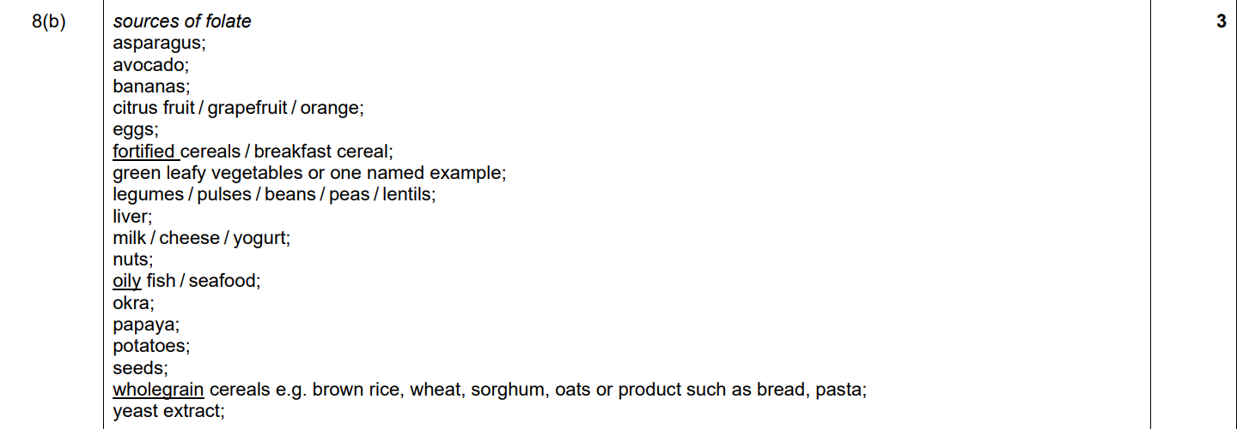

Slide 32
Ascorbic acid ( Vitamin C)
Functions of Vitamin c ( Ascorbic acid)
Required to make connective tissue which binds the body cells together.
Assists the absorption of the mineral iron from the small intestine during digestion.
Assists in the building of strong bones and teeth.
Required for the production of blood and the walls of blood vessels.

Slide 33
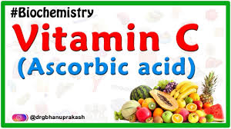
5. Required for the building and the maintenance of the skin and the lining of the digestive system.
6. Assists Vitamin E in its role as an antioxidant in the prevention of coronary heart disease.

Slide 34
Sources: Vitamin C is found in fresh fruits and vegetables
Rich Sources Good sources Reasonable sources
Rosehips, black citrus fruits Bean sprouts,
currants, green (oranges, lemons, peas, potatoes
peppers, kiwi grapefruit), spinach
fruit. strawberries, cabbage
broccoli, Brussels
sprouts.

Slide 35
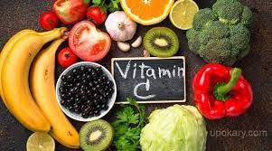

The amount present in food varies according to the:
Time of the year.
Stage.
Place of growth.
Variety of plant.
The degree of ripeness.

Slide 36
Requirements:
Although it is a water-soluble vitamin, ascorbic acid is stored in the body, mainly in the liver, adrenal glands, throughout the body fluids and tissues.
A healthy man has up to 1.5 g of ascorbic acid stored, of which about 45 mg are used per day.
Symptoms of scurvy appear when this store drops to below 300mg, which takes about three months on a diet completely devoid of Vitamin C.
A daily supply of Vitamin C keeps the store, because it is not stored in the body “ topped up “, but it is not a vital requirement.

Slide 37
Deficiency:
Prolonged deficiency may lead to:
Connective tissue not made or maintained correctly.
Walls of blood vessels weaken and break in places. Blood escapes and appears as small as red spots ( haemorrhages) under the skin.
General weakness, irritability, pain in muscles and joints , loss of weight, fatigue.
Gums bleed, teeth loosen.

Slide 38
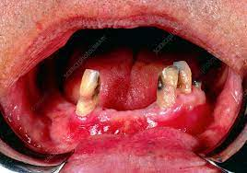
A severe deficiency leads to the disease ( scurvy) which was common years ago among sailors on long sea voyages, where fresh fruit and vegetables were not available. The symptoms, in addition to the previous include:
5. Cuts and wounds fail to heal properly.
6. Scar tissue may weaken and break open.
7. Anaemia, because iron is not absorbed properly without Vitamin C.

Slide 39
* Stability in food preparation:
Vitamin C is very quickly and easily destroyed by:
Heat- dry or moist.
Exposure to air- this leads to the oxidation of ascorbic acid into a form which is useless to the body.
The presence of an alkali, such as bicarbonate of soda, which causes Vitamin C to be oxidized.
Water – Vitamin C dissolves in water, so cooking methods which use minimum amount of water should be chosen.
To prevent the lose of Vitamin C, foods should be cooked and served as quickly as possible.

Slide 40
Leaching in vitamins:
Water-soluble vitamins, especially most of the B vitamins and vitamin C, leach into cooking water. Vitamins A, D and E are fat-soluble and leach into cooking oils. Vitamin C is the most likely to get lost in cooking.
Leaching is highly relevant to water-soluble vitamins losses when heat treatments occur in presence of water or a covering liquid. Leaching takes place particularly at the start of any heating step. This is modulated by vegetable's shape and size and temperature.

Slide 41
Ways to preserve vitamins in foods
Eat fresh foods.
Eat raw foods ( like salads).
Steam when possible.
Add some oils to your vegetables.
Reuse or conserve cooking water.

Slide 42


Slide 43
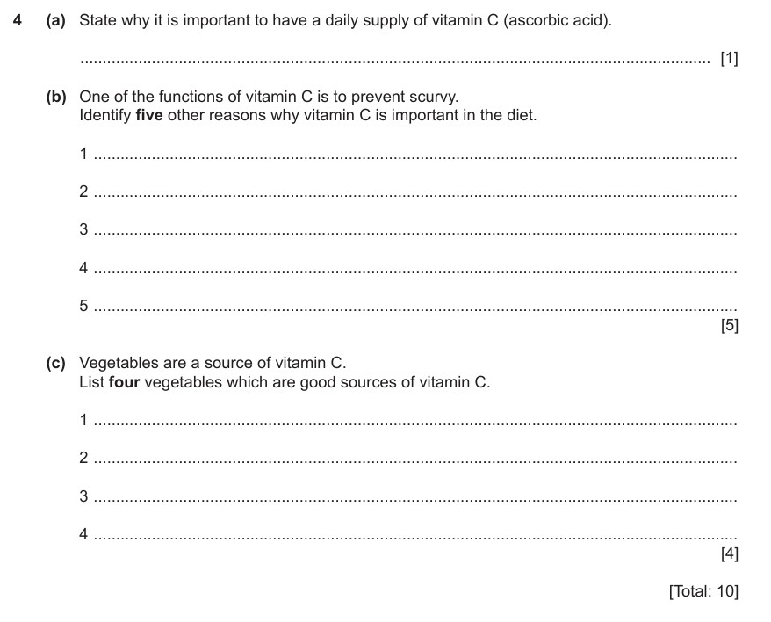

Slide 44
