Slide 1
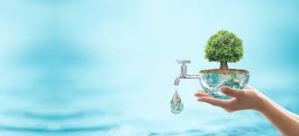
Water

Slide 2
Functions of water: Past Paper Question
Water is vital to life – 70% of the human body is water.
Required for all body fluids e.g. digestive juices, mucus, saliva, lymph, sweat and urine.
Required as apart of many metabolic reactions.
Keeps lining of mucous membranes, digestive tract, and bronchial tubes moist.
Water-soluble vitamins need to dissolve in water for proper absorption.
Lubricates joints and membranes.

Slide 3
Sources:
Many foods contain water, and some, such as fruits and vegetables are composed mainly of water.
In addition to the water that is taken in food as liquids (coffee, tea, milk),
some water is produced during the many metabolic reactions of the body.
Sauces, gravies and stews
Tap water is safe to drink in most developed countries, where it is treated to kill harmful bacteria.

Slide 4
In some areas where large amounts of fertilizers are used on growing crops, nitrate levels in tap water can be high.
Water softeners are installed in many homes in hard-water areas. Some of these work by replacing the calcium and magnesium in the water with sodium.
The water softeners should not be drunk by people with high blood pressure, and should not be used to mix baby feeds, as it contains high level of sodium

Slide 5
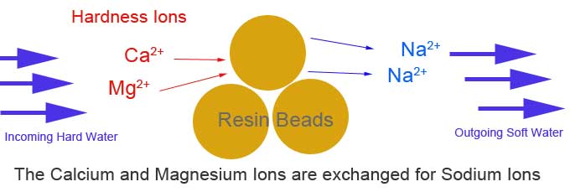
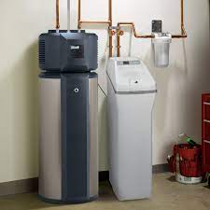

Slide 6
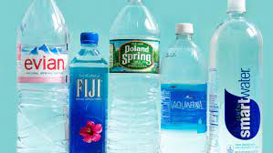
Bottled mineral waters, are often advertised as being healthy. There is no evidence that they are better for health than tap water and they are much more expensive.
It is recommended to drink bottled water, where tap water may be contaminated with disease- giving bacteria.

Slide 7
Requirements:
Water should be drunk every day, especially in hot weather when much is lost through sweating.
Water is constantly lost through the skin, and also from the lungs, kidneys, and bowels.
A minimum of two to three liters per day is recommended.

Slide 8
Extra water is required: Past Paper Question
During illness where a raised temperature results in increased sweating.
If vomiting or diarrhea has occurred, both of which can cause rapid dehydration especially in babies.
In lactation, when extra water is required for milk production.
After intense physical activity such as sport while sweating, especially at a high altitude.

Slide 9
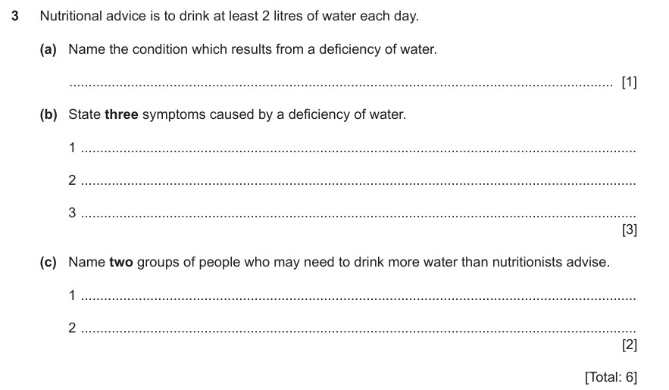

Slide 10
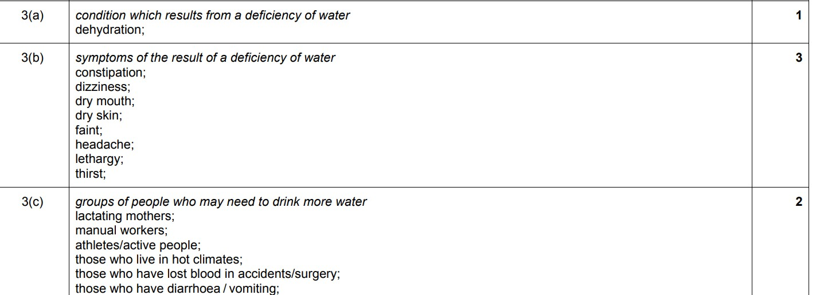

Slide 11
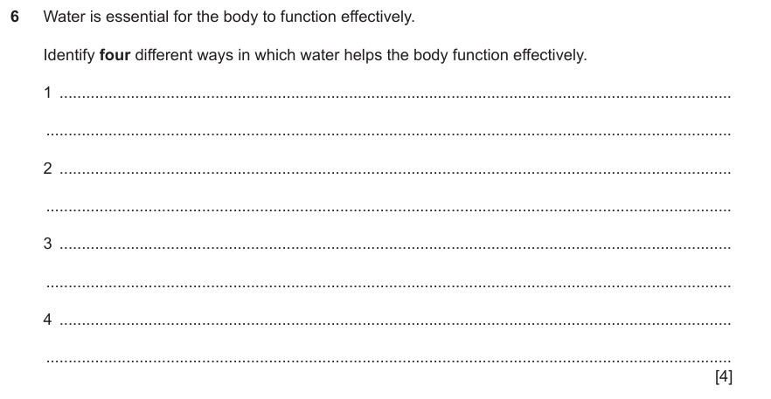

Slide 12
