Slide 1
What Is a for and against essay?
Page 64

Slide 2
Learning Objectives:
Students will explore both sides of an argument and teach students to exercise sound judgment.
Students will improve their ability to articulate ideas clearly and coherently in written form.
Students will learn to structure their essays logically, including introduction, body paragraphs, and conclusion.
Students will be able to analyze a given topic or issue from multiple perspectives.

Slide 3

Warm up Activity
Technology makes life easier

Slide 4
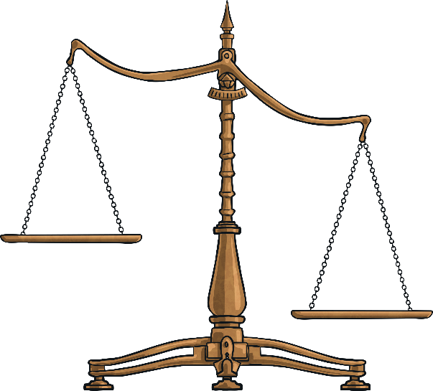
What Is a for and against essay?
One type of argumentative essay is that which gives advantages and disadvantages (For and Against).
It is a formal piece of writing in which a topic is considered from opposing points of view.
A good essay of this type should consist of:
a) an introductory paragraph in which you state the topic. This means that you talk generally about the topic without giving your opinion;
b) a main body in which the points for and the points against, along with your justification, appear in two separate paragraphs;
c) a closing paragraph in which you give either your opinion or a balanced consideration of the topic.
Page 64

Slide 5
What Is a Balanced Argument?
Note: In this type of essay writing, you must NOT include opinion words (I believe, I think, etc.) in the introduction or the main body.
Opinion words can ONLY be used in the final paragraph, where you may state your opinion on the topic.
Page 64

Slide 6
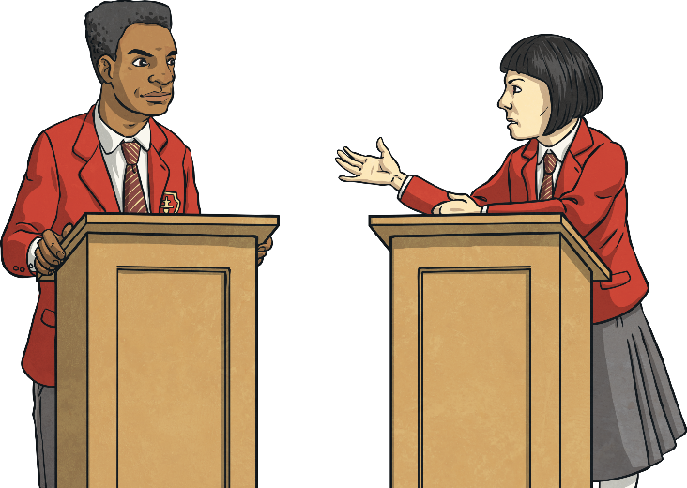
Points to consider
Firstly, you need a subject to write about.
Then you need to come up with the arguments for and against.
Make a list of the points for and against a topic before you start writing.
Write well-developed paragraphs in which the points you present are supported with justification, (i.e. reasons or examples).
Make sure each paragraph has more than one sentence. Make it detailed and informative.
Page 64

Slide 7
Points to consider
• Do not use informal style (e.g. short forms, colloquial language, etc.) or strong language (e.g. | firmly believe, etc.)
Try to include a quotation relevant to the topic you are writing about.
Begin each paragraph with a topic sentence which summarises what the paragraph is about.
Page 64

Slide 8
Linking words and Phrases
To Introduce points:
one major advantage/disadvantage of, a further advantage, one point of view in favour of/against opposing views of for and against;
To List points:
in the first place, first of all, to start with, secondly, thirdly, finally, last but not least.
To add more points to the same topic:
what is more, furthermore, also, in addition to this/that, besides, apart from this/that, not to mention the fact that
Page 65

Slide 9
Linking words and Phrases
To make contrasting points:
on the other hand, however, in spite of, while, nevertheless, despite, even though, although, it can be argued that
To introduce examples:
for example, for instance, like, especially, such as, in particular
To conclude:
to sum up, all in all, all things considered, in conclusion, on the whole, taking everything into account, as was previously stated
Page 65

Slide 10
Note
You can end a "for and against" essay by:
a) giving a balanced consideration of the points on the topic.
or
b) by giving your opinion, that is, for example, by expressing whether the advantages outweigh the disadvantages or vice versa.
Page 65

Slide 11
What is your opinion ?
https://wordwall.net/resource/98372464/copy-of-for-and-against-essay
Page 66

Slide 12

Should Homework Be Banned?
Anyone who has ever been to school knows what it is like to be sent home with piles of homework. For years, teachers have been setting extra maths, spellings and other assignments to be completed outside of regular lesson times. But with the increasing pressures of modern day life, there is a growing call for homework to be banned.
Many people see homework as an important part of school life; almost like an extension of the lesson. If the teacher cannot fit everything that is needed to be taught into the lesson, then being able to set homework is essential. This way, pupils can continue the learning at home, which in turn helps their understanding and knowledge of the subject. In fact, recent research shows a positive link between the amount children do for homework and their achievement levels.

Slide 13
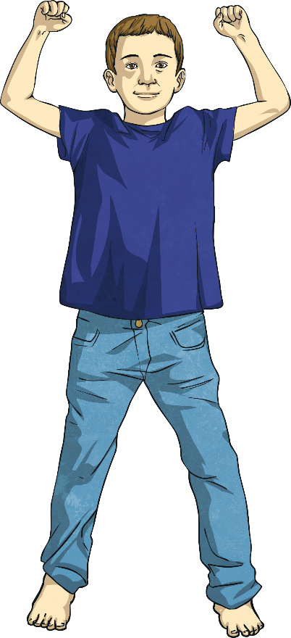
Should Homework Be Banned?
While there are a lot of people that understand that argument, the fact remains that children go to school to be educated and many parents welcome the chance to support their child’s education at home. Practising spelling or helping their child read gives parents the opportunity to play a part in their child’s learning. It also gives them a clearer understanding of how their child is progressing. Similarly, a lot of children enjoy doing homework with their parents.
On the other hand, are not children entitled to a break from learning? After spending all day at school, a few hours ‘downtime’ spent watching television, playing computer games or exercising outside is essential for a healthy, fun-loving child. In fact, the government’s own health guidelines recommend people aged between 5-18 should exercise for at least 60 minutes a day. Where are children going to fit that in if they are busy doing homework every evening?

Slide 14
Should Homework Be Banned?
The flip side of the argument is that many parents feel overwhelmed with the amount of homework their child brings home. With so many after school activities and clubs on offer, they feel there is not enough time to fit everything in. Furthermore, due to ever-increasing government expectations, parents sometimes feel unable to help their child as the work is too hard or on a subject matter they are not familiar with.
In conclusion, there are many strong arguments for and against banning homework from schools. If it helps a child’s education, then surely homework is a good thing. Then again, time away from studying to play is also incredibly important to a child’s wellbeing. On balance, I do not believe homework should be banned because it really is an important part of learning. However, I also believe there should still be time in the day for fun. Therefore, perhaps schools should come up with a compromise: keep homework, but do not set so much.

Slide 15
Techniques for beginnings and endings
The first paragraph may:
make reference to a strange scene or situation, e.g. Some scientists believe that in the future everyone will be genetically perfect.
• address the reader directly, e.g. Are you aware of any characteristics which you may have inherited from your parents? or ask a rhetorical question (question to which no answer is expected), e.g. Isn't it amazing how some children look so much like their parents?
• start with a quotation, e.g. "Genetics holds the key to the future".
Page 66

Slide 16
Techniques for beginnings and endings
The last paragraph may:
state a personal opinion, e.g. In my opinion, I believe, In my view, It seems to me, The way I see it, I think, etc.
give the reader something to consider, e.g. Perhaps the world would be a safer and more efficient place if everyone was genetically perfect.
end with a quotation, e.g. "Genetics holds the key to the future", or a rhetorical question, e.g. What will they think of next?
Page 66

Slide 17
Checklist
https://www.educaplay.com/learning-resources/18833987-for_and_against_essay_quiz.html
Now you have written your argument, read it through carefully.
Here is the checklist from earlier:
It needs:
an introduction;
opposing views of for and against;
supporting evidence;
a concluding paragraph that includes the writer’s own opinion;
to be interestingly written.
It should have:
a mixture of causal conjunctions and adverbials.
It has to be:
written in the third person (except final paragraph);
written using formal and technical language.

Slide 18
Activity time!
Social Media: Does it do more harm than good?
School Uniforms: Should they be mandatory?
Online Learning: Is it as effective as traditional learning?
Technology in Classrooms: Does it enhance or hinder learning?
Part-Time Jobs for Students: Beneficial or distracting?
Banning Junk Food in Schools – Should schools prohibit the sale of junk food to students?
The Influence of Celebrities on Teenagers – Do celebrities have a positive or negative impact on young people?
Page 65

Slide 19
3 Complete the following sentences, then replace the words in bold with other similar ones.
1 Public transport is often more convenient than taking one's car, and is also very economical. (also: in addition to being, not to mention the fact that it is, etc.)
2. Being able to speak a foreign language is very useful when abroad Furthermore, it can be an advantage when looking for a job. (Furthermore: Moreover, Also, What is more, etc.)
3 Although living abroad can be an interesting experience, it can also be difficult at times. (Although: Even though, Despite the fact that, etc.)
4 Being self-employed means that you are your own boss. However, it also means that you are responsible if things go wrong. (However: On the other hand, Nevertheless, etc.)
5 Exercise can help you to lose weight. What is more, it is very good for your health generally. (What is more: Also, Moreover, Apart from this, etc.)
Page 65

Slide 20
3. Complete the following sentences, then replace the words in bold with other similar ones.
6 Experimenting on animals is cruel, not to mention the fact that in most cases it is unnecessary. (not to mention the fact that: Apart from this, In addition to this, etc.)
7 Package holidays are cheap. On the other hand, the accommodation provided is not always very comfortable. (On the other hand: However, Despite this, etc.)
8 While living alone can be lonely, it can also be pleasant, as you can do what you want in your home. (While: In spite of the fact that, Although, etc.)
9 Keeping up with fashion takes a lot of effort. In addition, it can be very expensive. (In addition: Also, Furthermore, etc.)
10 Watching television can be educational. Nevertheless, it is not good for children to watch too much every day. (Nevertheless: However, On the other hand, etc.)
Page 65

Slide 21
Read the closing paragraphs below and say whether they express a balanced consideration or the writer's opinion.
1. conclusion, getting married has, to my mind, more advantages than disadvantages. After all, what can be more fulfilling than a steady relationship with the person you love that lasts for the rest of your life?
Points for:
emotional security, share everyday problems, share expenses
points against:
limited personal freedom (compromises have to be made), put up with annoying habits

Slide 22
Read the closing paragraphs below and say whether they express a balanced consideration or the writer's opinion.
2 To sum up, camping holidays do have advantages, the main one being thạt they are far cheaper than other holidays. In my opinion, however, there is too much hard work involved for them to ever feel like a real holiday.
Points for:
cheap, closer to nature, chance to socialise with people
points against:
lack of facilities, one has to do things on one's own (e.g. put up a tent), not comfortable/convenient, needs good planning
Page 65

Slide 23
Read the closing paragraphs below and say whether they express a balanced consideration or the writer's opinion.
3 To conclude, by looking after animals and helping them to breed, zoos play an important part in protecting many species from becoming extinct. Therefore, the negative aspects of keeping animals in captivity are balanced out by the positive ones.
Points for:
better medical care, protection from extinction, lots of food, protection from hunters
points against:
animals live in an unnatural environment - limited space for them - dependent on humans for survival - no freedom - loneliness/ boredom
Page 65

Slide 24
Read the closing paragraphs below and say whether they express a balanced consideration or the writer's opinion.
4. All in all, computers have both advantages and disadvantages. They may have replaced humans in many jobs, but they have also made our lives considerably easier, and it is now difficult to imagine life without them.
Points for:
save lots of storage space - work is done faster - individuals can concentrate on more productive/creative activities
points against:
many jobs have been lost - health problems
Page 65

Slide 25
Read the closing paragraphs below and say whether they express a balanced consideration or the writer's opinion.
5 On the whole, while most people go on holiday to rest, this is one thing you are unlikely to do on an adventure holiday. In my opinion, this disadvantage outweighs all the advantages associated with this kind of holiday.
Points for:
fun - lots of activities - no boredom - excitement - experience new things - lots of action
points against:
tiring, risky, no rest, expensive (e.g. equipment)
Page 65

Slide 26
Read the closing paragraphs below and say whether they express a balanced consideration or the writer's opinion.
6. Taking everything into account, there are both advantages and disadvantages in keeping pets. In the end it is up to the individual to decide whether the pleasure associated with owning a pet is worth the work that goes with it.
Points for:
good companions, protection from burglars (e.g. dogs), children learn to care for living things and be responsible.
points against:
expensive to keep, noisy, need space, tie the owner down (he/she can't go away without first making provisions for their pet)
Page 65

Slide 27
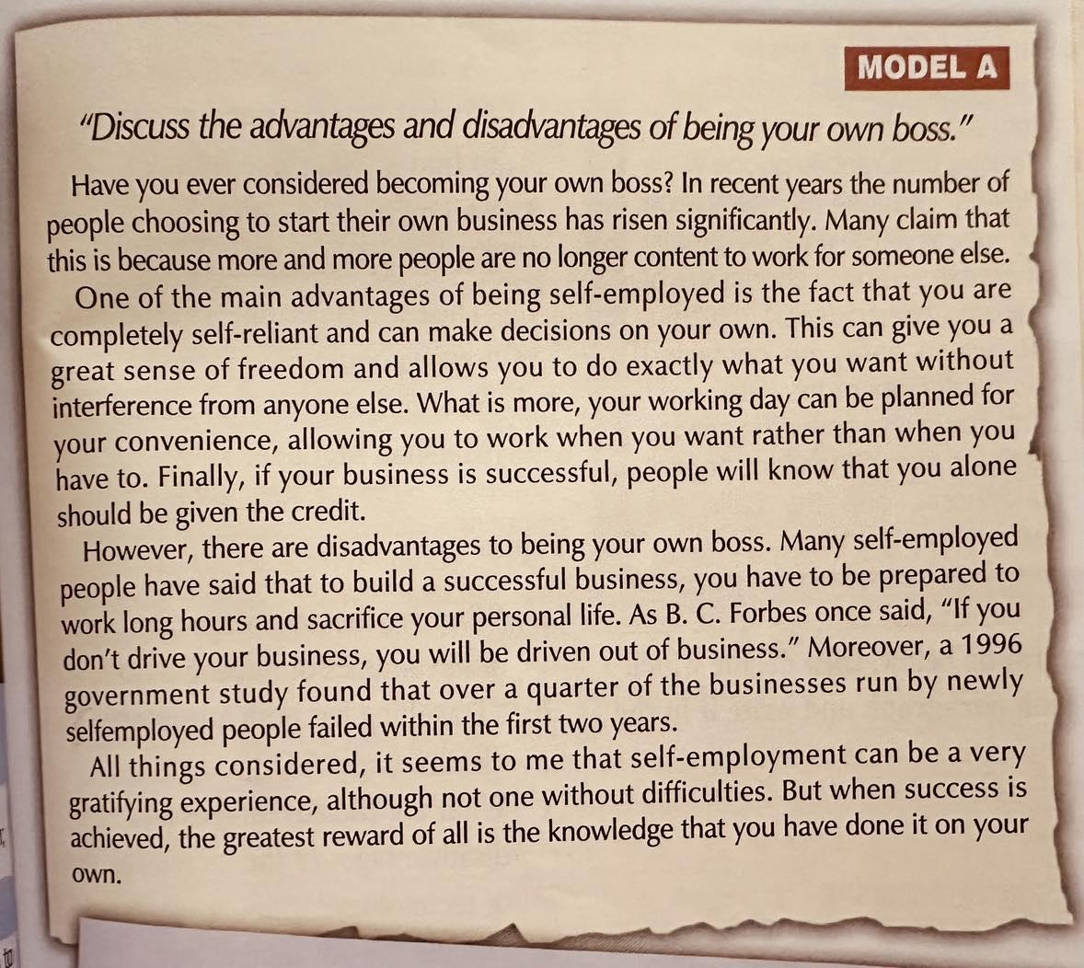
7 Read the compositions and the table of "Do's" and "Don'ts". Find an example of each point in the models and write "Model A" or "Model B" next to it as well as the phrase/word itself, as in the example. Finally, decide which of the two compositions is a good model, give the paragraph plan and say what a successful argumentative essay (for and against) should or should not contain.

Slide 28
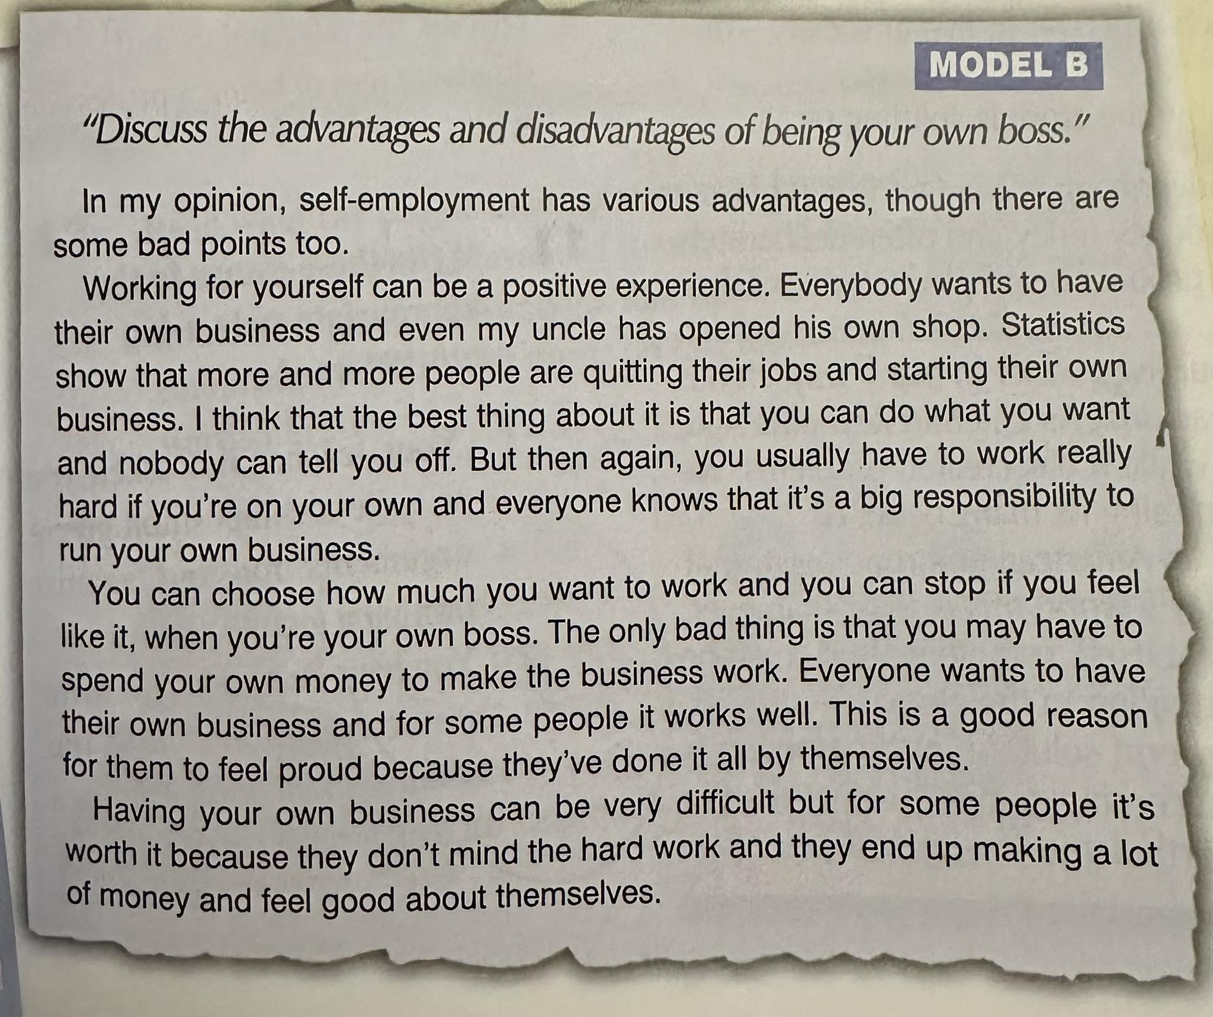
7 Read the compositions and the table of "Do's" and "Don'ts". Find an example of each point in the models and write "Model A" or "Model B" next to it as well as the phrase/word itself, as in the example. Finally, decide which of the two compositions is a good model, give the paragraph plan and say what a successful argumentative essay (for and against) should or should not contain.

Slide 29
DO'S
• well-developed paragraphs - Model A, e.g. second paragraph
• justification of arguments - Model A, e.g. This can give you a great sense ... without interference from anyone else.
• linking words/phrases - Model A, e.g. What is more, Finally, Moreover • quotations - Model A, e.g. 'If you don't drive your business ...
• generalisations - Model A, e.g. 3rd paragraph 2nd sentence
• reference to specific statistics - Model A, e.g. ... a 1996 government study found that over a quarter of businesses ... within the first two years.
• opinion only in the last paragraph - Model A, e.g. ... it seems to me ...
DON'TS
• informal style (short forms) - Model B, e.g. you're, it's, they've, don't
one sentence paragraphs - Model B, e.g. In my opinion, self-employment has various advantages
• overgeneralisations - Model B, e.g. Everyone wants to have their own business ...
• personal examples - Model B, e.g. ... my uncle has opened his own shop.
• opinion in the first paragraph - Model B, e.g. In my opinion ...
• blind use of statistics - Model B, e.g. Statistics

Slide 30


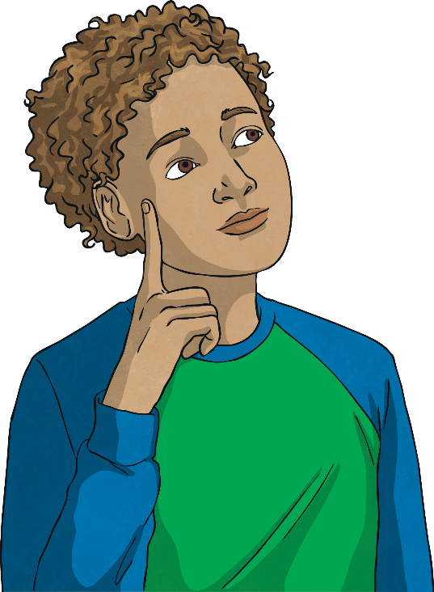
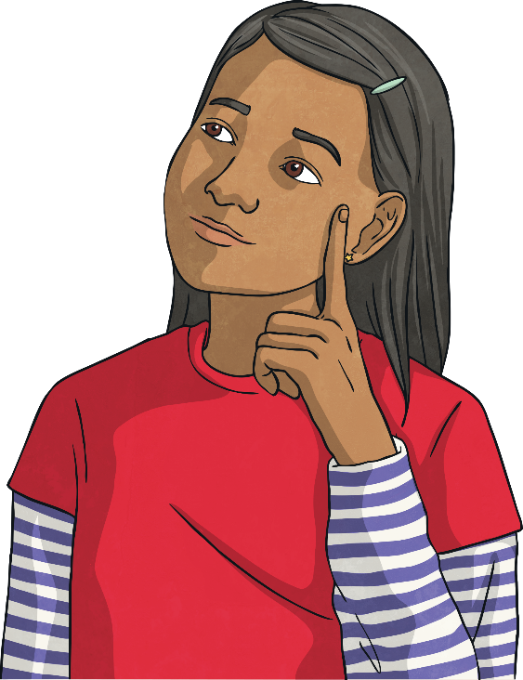
Should Homework Be Banned?
Let’s take a look at an example…
Here is a balanced argument about whether homework should be banned!
You may already have an opinion but wait until you’ve heard both sides of the argument before making your final choice!

Slide 31

Should Homework Be Banned?
Did you change your mind?
What do you think?
Which argument was stronger?

Slide 32
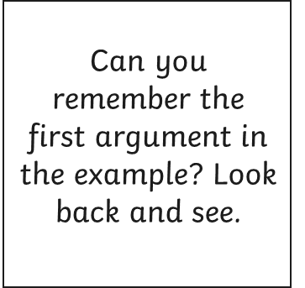
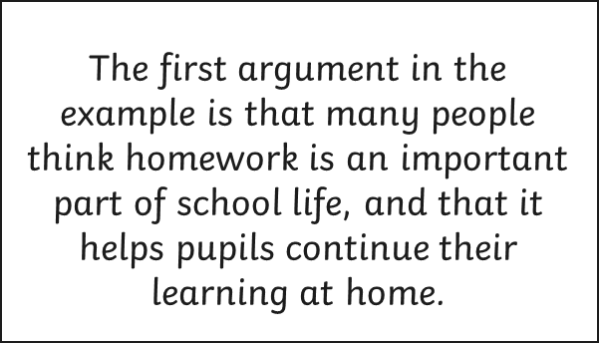
For and against… we need to note down the different sides of the argument.
Many people see homework as an important part of school life; almost like an extension of the lesson. If the teacher cannot fit everything that is needed to be taught into the lesson, then being able to set homework is essential. This way, pupils can continue the learning at home, which in turn helps their understanding and knowledge of the subject. In fact, recent research shows a positive link between the amount children do for homework and their achievement levels.
That needs to go on the planning sheet…
In the example, it’s all about whether banning homework is a good or bad idea. Your issue will have different arguments.

Slide 33
Write the title of your argument here
Should Homework Be Banned?
For | Against
Homework is an important part of school life and helps pupils continue their learning at home. (Research shows a positive link between homework and achievement levels.) Many parents like being a part of their child’s learning and welcome the chance to help them at home. | Children need time away from education, including time to play and do exercise. (Government guidelines: 60 minutes exercise a day.) Other parents feel overwhelmed with the amount of homework their child brings home. Some don’t understand it and struggle to find time to help their child.
Write your first argument here

Slide 34

Now we need to note down the other arguments.
You will also need supporting evidence to back up your argument.
Now note down all the for and against points for your argument.

Slide 35

Introducing Your Argument
To begin writing your argument, we need an opening paragraph. This needs to introduce the argument in a clear, concise and interesting way.
Here’s the opening paragraph in the example:
Anyone who has ever been to school knows what it is like to be sent home with piles of homework. For years, teachers have been setting extra maths, spellings and other assignments to be completed outside of regular lesson times. But with the increasing pressures of modern day life, there is a growing call for homework to be banned. Here are some of the arguments for and against.
You need to introduce the issue in your argument now. Remember, set out the argument clearly!
Explaining what you will be doing in the balanced argument
Introducing argument
Third person

Slide 36
Final Paragraph
The final paragraph is a bit different. It concludes the argument and includes your own opinion. It is written in the first person (I).
Here is the final paragraph in the example.
In conclusion, there are many strong arguments for and against banning homework from schools. If it helps a child’s education, then surely homework is a good thing. Then again, time away from studying to play is also incredibly important to a child’s wellbeing. On balance, I don’t believe homework should be banned because it really is an important part of learning. However, I also believe there should still be time in the day for fun! Therefore, perhaps schools should come up with a compromise: keep homework, but don’t set so much!
Now write the final paragraph for your argument.
Concluding
the argument
Your opinion
First
person

