Slide 1
Punctuation Marks
[ ]
-
[ ]
,
,
[ ]
-
,
(commas, dashes,brackets)
-
[ ]
,
[ ]

Slide 2
Commas ,
Commas indicate a brief pause; they're not as final as period. It provides readers with guidance on how a sentence is organized and it helps the reader to understand the writer’s intended meaning.

Slide 3
Commas’ rules:
Use commas to separate words and word groups in a simple series of three or more items.
We visited France, Italy, Germany and Spain.
Lara bought potatoes, onions and parsley.
Note that we don't add a comma before ‘and’.

Slide 4
2. When starting a sentence with a dependent clause, use a comma after it.
If you decide to come with us, bring your kit with you.
After we arrived, we went shopping.
Note that a comma is usually unnecessary when the sentence starts with an independent clause followed by a dependent clause. Example: We went shopping after we arrived.

Slide 5
3. Use commas to set off nonessential words, clauses, and phrases ( who, that, which). If something or someone is sufficiently identified, the description that follows is considered nonessential and should be surrounded by commas.
Mark Twain's book, Tom Sawyer, is a delight.
Jill, who is my sister, shut the door.

Slide 6
4. Use a comma after certain words that introduce a sentence, such as “well, yes, why, hello, hey,” etc.
Hello, just wanted to ask you if you`re free tomorrow morning?
No, you can't leave now.

Slide 7
5.Use a comma to separate the day of the month from the year.
We had an assessment on Saturday, March 20, 2021.

Slide 8
6. Use a comma to separate a city from its state.
She lives in Amman, Jordan.
We visited Ankara, Turkey last month.

Slide 9
7. Use commas to introduce or interrupt direct quotations.
He said, “I didn't like this recipe”
If the quotation comes before “he said, she wrote, they reported” or a similar attribution, end the quoted words with a comma, even if it is only one word.
-"Stop," he said.

Slide 10
8. Use a comma to separate a statement from a question.
I can go, can't I?
You didn't study, did you?

Slide 11

Dashes -
Dashes are used to add extra information to the sentence.
The number of stars in the milky way - including many which are undetectable - is estimated to be over 400 million.

Slide 12

Brackets [ ]
They are only used in special cases. Brackets (like single quotation marks) are used exclusively within quoted material.
Brackets are interruptions. When we see them, we know they've been added by someone else. They are used to explain or comment on the quotation.
"Bill shook hands with [his son] Al."

Slide 13

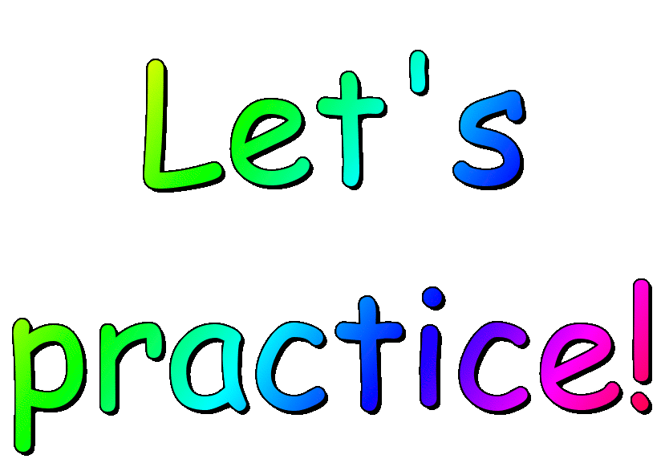

Slide 14
Punctuate the following sentences by adding commas where necessary:
We ordered pizza pasta and risotto for today’s dinner.
Crime which weakens our city must be reduced.
This company first started to work on May 15 1998.
You didn't visit the doctor as you told me did you?
Nancy said “I thought that I made it clear!”
Mrs. Johnson can you please help me?
I didn't say anything to her after all it's her own decision.
We decided to visit Beirut Lebanon this time.

Slide 15

Colons:
We use colons to :
1- Introduce that something follows like an example or a list.
The following students should submit the form now: Farah, Sarah and Yumna.
I learnt how to draw the map of all these countries: Egypt, Libya and Algeria.
2- Separate hours and minutes when writing out the time.
I use to wake up at 6:30 every morning.

Slide 16

Semicolons;
We use semicolons to:
1- Separate longer phrases in a list to make the sentence clearer.
We cook potatoes in different ways: mashed potatoes with gravy, mushroom and onion; fried potato with diced meat, cheese and tomato sauce; Grilled potatoes with spices and cheese.
2- link sentences which are closely related.
She is practicing more; her performance is becoming better and better.
3- instead of connectives (but , and).
I ordered a pizza; I didn't eat it.

