Slide 1

Diary writing

Slide 2
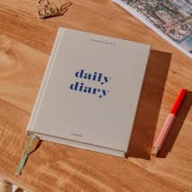
What is a diary?
A diary is a book in which you record :
A diary is a personal journal used to record events, feelings, and reflections.
It helps us express emotions, remember daily experiences, and organize thoughts.
Your diary is FOR you and BY you! (Meaning, it’s written in the first person)

Slide 3
Style of Writing:
First Person (I, me, my).
Informal and personal tone.
Chronological order (sequence of events - in the same order they happened in real life). Begin with events that occurred first and end with events that happened last.
Use of descriptive language (emotions, thoughts).
Can include questions to oneself or future intentions.
Use simple past tense (for events that already happened).
Sometimes use present tense (for current feelings).
Write in a natural, conversational style but avoid slang.
Use emotions, idioms, and exclamations.
Write about your feelings in detail and write why you feel that way.
Provide important details of the place, time, people or things that were part of the event.

Slide 4

Format of a diary
Features of a Diary Entry
Date/ Day/ Time: (top of the entry).
Salutation/Greeting: (e.g., Dear Diary,).
Heading (short title-main event) - optional. (e.g.Mia’s birthday party, Wedding day!, Casual Tuesday, etc.)
Introduction – Think about answering the following: who, what, where, when, why were you there....
Body – describe events, feelings, or reflections/thoughts in detail. Usually consists of 2 paragraphs (minimum) - based on the bullets in the writing question.
Closing – conclude with thoughts, feelings, hopes, or wishes.
Your first name.

Slide 5

Writing a diary entry:
What is written in a diary entry?
First paragraph:
Write an opening paragraph that has an introduction built into it. Think about answering the following: who, what, where, when, why were you there....
The main body paragraphs:
The body of a diary entry usually consists of 2 paragraphs (minimum) - based on the bullets in the writing question. They are written as a series of events in time order - in the same order they happened in real life.
Closing paragraph:
In the closing paragraph, write a comment about how you felt about your experience(s) and why. Possibly, a wish for something to happen.

Slide 6
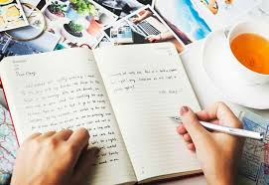
Example
You (Nada) recently had a chance to encounter an old school friend in the marketplace. Write a diary entry about it.
Step 1: Start by writing the date, day and time.
Step 2: Write the salutation/greeting (Dear Diary,).
Step 3: Write a heading (optional).
Step 4: Introduction.
Step 5: Start writing the main body paragraphs of the diary entry.
Step 6: Conclusion.
Step 7: Sign off with your first name.

Slide 7
Your diary entry should look something like this:
24th April 2021
Saturday
6PM
Dear diary,
Today was full of surprises! I met my old friend Sara. We bumped into each other at the local market place, where I had gone to pick up a few items.
As I was paying my bill, I saw a familiar- looking face staring at me with curiosity. Suddenly, it dawned simultaneously on both of us that each of us was staring at a long lost dear friend. Our joy knew no bound as we rushed towards each other.
A wave of nostalgia swept over us as we recalled our bygone days over a cup of coffee. How beautiful were those school days full of fun, laughter and mischief! We parted after promising to remain in touch with each other.
I will never forget this surprise meet up in my whole life . I was so happy meeting an old friend after a long time feeling that nothing has changed after all this time!
Nada

Slide 8
25th September 2024
Friday
8PM
Dear diary,
Today was one of the happiest and most exciting days of my life! Our school won the inter-school football championship, and I still can’t believe it actually happened.
The morning started with a mixture of nerves and excitement. I could hardly eat breakfast because my stomach was full of butterflies. On the way to school, I kept imagining all sorts of outcomes—what if I made a mistake, or what if we lost? But at the same time, I kept telling myself to stay positive.
When the match began, the other team seemed really strong. They scored the first goal, and for a moment, I felt like all our training might go to waste. Still, our coach kept encouraging us from the sidelines, reminding us to stay focused and play as a team. That really motivated me. Slowly, we began to gain confidence, and before half-time, we managed to score and equalize.
The second half of the game was intense. Everyone was giving their best, and the crowd was cheering so loudly that I could barely hear myself think. In the final ten minutes, I saw an opening near the goalpost, and without thinking too much, I kicked the ball as hard as I could. To my surprise and joy, it went straight into the net! The sound of the cheers around me is something I will never forget.
After the referee blew the final whistle, our team rushed onto the field, hugging and celebrating. I felt an overwhelming sense of pride, not just because I scored the winning goal, but because we worked together and never gave up. My teachers congratulated me, and even some juniors came running to shake my hand.
Now that I’m back home, I feel so grateful for this day. Winning was amazing, but what matters most is the teamwork, the encouragement we gave each other, and the lesson that hard work really does pay off. I hope I can keep this memory alive forever.
Alex

Slide 9
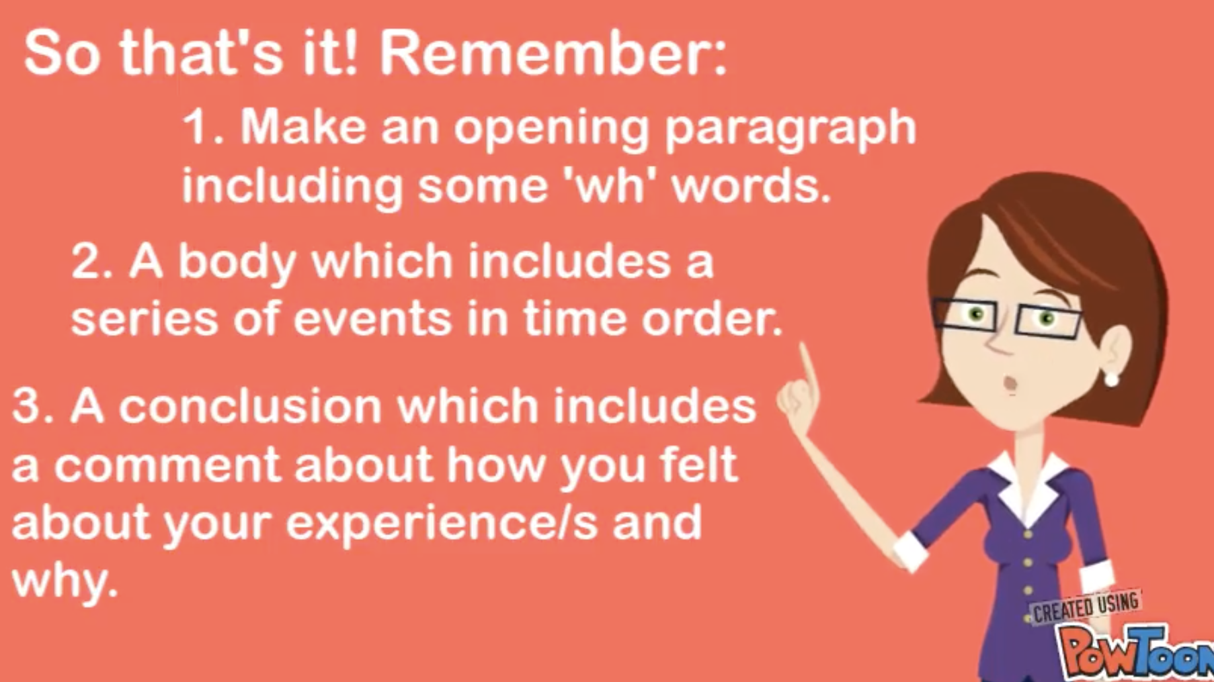
Wrap up!

Slide 10

Test yourself
Today was your first day at your new school. You met lots of new friends and teachers. Also, there was an incident at your school. Write a diary entry about it.

