Slide 1
Active and passive

Slide 2
Active voice
Passive voice
It tells us what a person or a thing does.
It tells us what is done to someone or something.
The subject does the action (verb) on the object.
The subject receives the action (verb).
Subject + action + object
Object + action + subject
Examples :
Example:
- The plants are watered by him.
- He waters the plants.
-Lory posted her picture on Instagram.
- The picture was posted on Instagram by Lory.
-She moved the couch.
- The couch was moved by her.

Slide 3
Passive voice
Passive voice is used to show that the subject does not act but receives the result of the action. The person or thing that carries out the action is called an agent.
We use passive voice:
1- When we want to emphasize the action rather than who did the action or what causes it.
They found her guilty = She was found guilty
2- When the agent is unknown.
Someone broke into the shop = The shop was broken into
3- in instructions or processes.
Your files should be put in the drawer.
Flour must be added to the mixture.

Slide 4
Passive voice
We use by + agent when we want to emphasize who does or what causes the action.
The telephone was invented by Alexander Graham Bell.
When we want to describe what caused the action or what the agent used to perform it, we use ‘with’ instead of ‘by’.
Fires are usually put out with water.
Don`t forget to pay attention for the tense of the verb in the active sentence!
- If the verb in the active sentence in the past tense, verb to be in the passive sentence should be in the past tense.
- If the verb in the active sentence is in the present the verb to be in the passive sentence should be in the present tense.

Slide 5

Present simple
Past Simple
She pays a lot of money.
John ate the pizza.
Past participle of verb ‘to eat’
Past participle of verb ‘pay’
object
A lot of money
is
paid
by her.
Verb ‘to be’ in the present tense
Verb ‘to be’ in the past tense

Slide 6
Passive voice (Present progressive)
When changing an active sentence into passive, there are a few steps to follow:
Switch the subject with the object.
Add verb to be. (The tense of the verb in the active sentence determines the tense of the verb to be) Since we are working with the present progressive tense, verb ‘to be’ in the passive sentence will change to “is being/are being”
Change the verb in the active sentence to the past participle tense.

Slide 7
Present progressive
Somebody is following us..
Past participle of verb “follow”’
We are being followed.
Verb ‘to be’ in the present tense

Slide 8
Passive voice (Present progressive exercises)
My father is washing the car………. The car is being washed by my father.
Farmer Joe is milking the cows…. The cows are being milked by farmer Joe.
We are cleaning the kitchen……… The kitchen is being cleaned by us.
He is packing the bags… The bags are being packed by him.
They are not writing essays… The essays are not being written by them.

Slide 9
Passive voice (Past progressive)
When changing an active sentence into passive, there are a few steps to follow:
Switch the subject with the object.
Add a verb ‘to be’. (The tense of the verb in the active sentence determines the tense of the verb to be) Since we are working with the past progressive tense, verb ‘to be’ in the passive sentence will change to “was being/were being”
Change the verb in the active sentence to the past participle tense.

Slide 10
The scouts were pitching the tents..
Past Progressive
Past participle of verb ‘pitch’’
The tents were being pitched by the scouts.
Verb ‘to be’ in the past tense

Slide 11
Passive voice (Past progressive exercises)
Ashley was preparing dinner………. Dinner was being prepared by Ashley.
They were chasing the dog… The dog was being chased by them.
He was ordering the food… The food was being ordered by him.
We were finding new reasons everyday… New reasons were being found by us everyday.
Oliver and Zack were cooking dinner… Dinner was being cooked by Oliver and Zack.

Slide 12
Passive voice (Future “will”)
When changing an active sentence into passive, there are a few steps to follow:
Switch the subject with the object.
Add a verb ‘to be’. (The tense of the verb in the active sentence determines the tense of the verb to be) Since we are working with the future tense “will”, in the passive sentence, verb ‘to be’ changes to “will be”.
Change the verb in the active sentence to the past participle tense.

Slide 13
They will announce the results in one hour.
Future “will”
Past participle of verb “announce”’
object
The results will be announced in an hour.
Verb ‘to be’ in the future tense

Slide 14
Passive voice (future “will” exercises)
She will answer your questions………… The questions will be answered by her.
The teacher will hand out your grades… Your grades will be handed out by the teacher.
Jack will accept your responses today… Your responses will be accepted by Jack today .
Emily will accompany you to the dance… You will be accompanied by Emily to the dance.
He will ask David some questions.. David will be asked some questions by him.

Slide 15
Exercises
She was watering the plants…………… The plants were being watered by her.
They were watching the game……………The game was being watched by them.
Alison is preparing the tickets……………The tickets are being prepared by Alison.
Sean will serve the coffee……………The coffee will be served by Sean.
Yasmeen is doing the dishes……………The dishes are being done by Yasmeen.
The girls are wearing the dresses to prom……………The dresses are being worn to prom by the girls.
My dad will fix the T.V today…………… The T.V will be fixed today by my dad.
My aunt was hanging up her picture on the wall……………Her picture was being hung up on the wall by my aunt.
My family will host the annual party……………The annual party will be hosted by my family.
Her parents were rebuilding their home…………...Their home was being rebuilt by her parents.

Slide 16
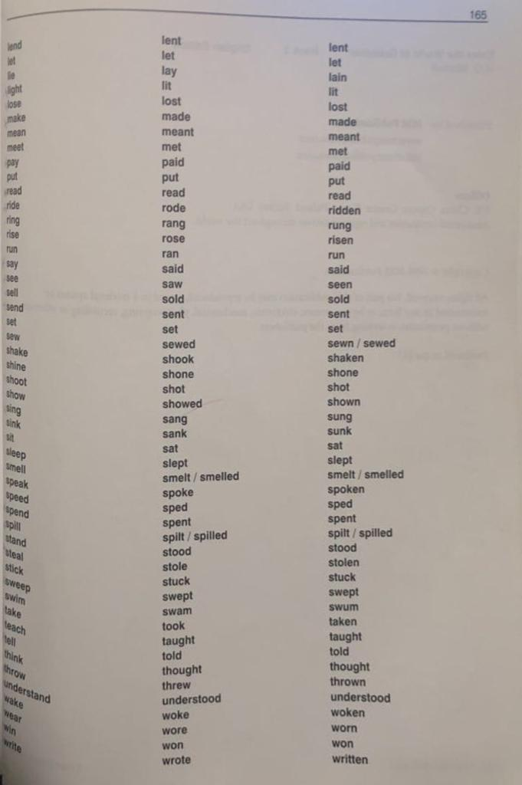
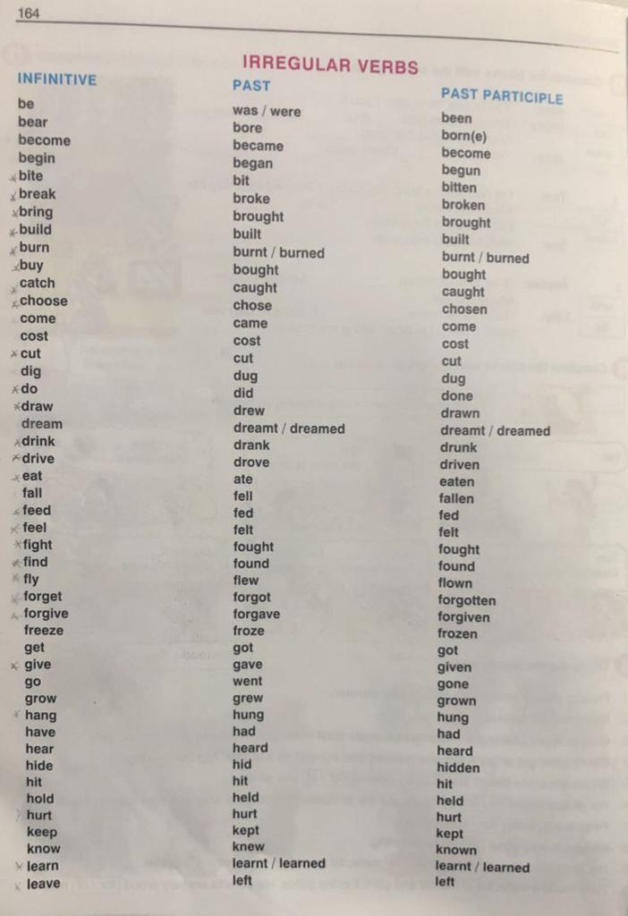
Check the following pages from the grammar book Pages ( 172-173)

Slide 17
Verbs with two objects
Some verbs like give, offer, tell, buy, send, show etc. can take two objects in the active voice.
Direct object (thing)
Indirect object (person)
Indirect object becomes subject
Example: Active voice Passive voice
They gave the boy an award. The boy was given an award.
OR
The award was given to the boy
subject
verb
Indirect object
direct object
direct object becomes subject

Slide 18
Note
When the direct object of the active sentence is the subject of the passive sentence, we use the prepositions to or for before the indirect object.
They offered him the job. = The job was offered to him.
She bought me a present. = A present was bought for me.

Slide 19
That-clauses in the passive voice
Some verbs like believe, consider, expect, find, know, report, say, think, understand etc. take that-clause as an object in the Active voice. The passive voice is formed as follows:
Active voice: People say that the film is excellent
Passive voice: It is said that the film is excellent OR The film is said to be excellent.
Active voice: Some people believe that Math is hard.
Passive: Math is believed to be hard OR It is believed that Math is hard.

Slide 20
Note
Bare infinitive verb Help
Say (regular infinitive verbs)
Announce
Full infinitive verb to help
To say
To announce

Slide 21
Note (continued)
In the active voice, the verbs make, help, hear, see etc. are followed by a bare infinitive. (Help can also be followed by a full infinitive) In the passive voice, these verbs are followed by a full infinitive.
Example:
Somebody saw him enter the library. = He was seen to enter the library.
She helped us (to) paint the room. = We were helped to paint the room.

