Slide 1
Vocabulary part 2

Slide 2
grazing/steppes

Slide 3
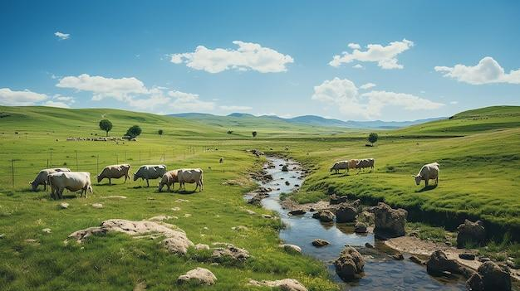
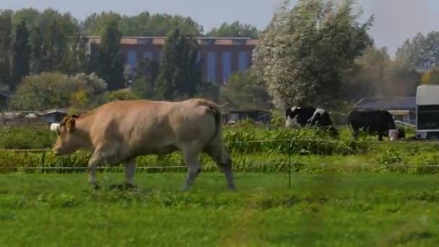
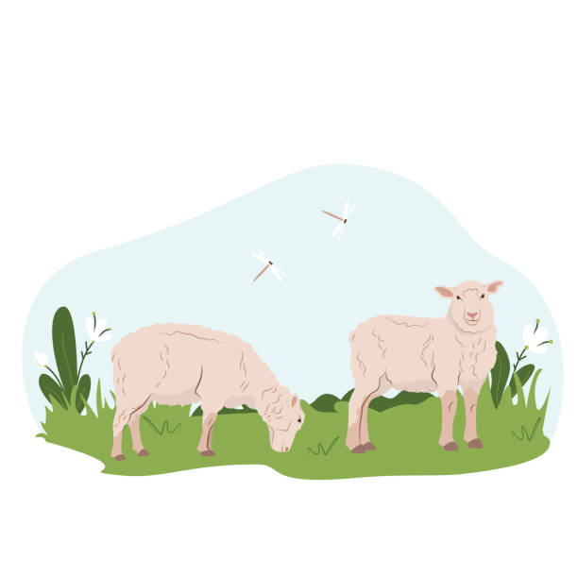

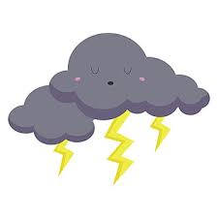
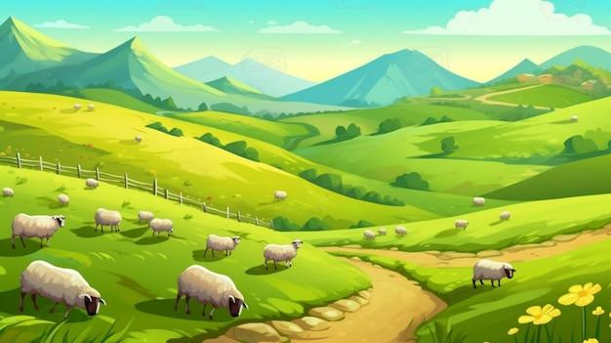
While
Even though
When
After

Slide 4
grazing (v.) / Steppes (n.):
While the cows were grazing in the steppes, they slowly moved toward the embankment to drink water.
When the breeze blew, the goats enjoyed grazing in the cool steppes.
Even though it was windy, the cows continued grazing.
Before it got dark, the sheep finished grazing and returned to the barn.
After the storm clouds moved away, the animals went back to grazing in the steppes.

Slide 5
clung

Slide 6
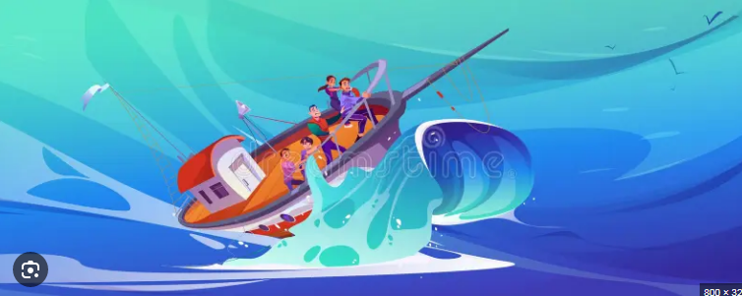
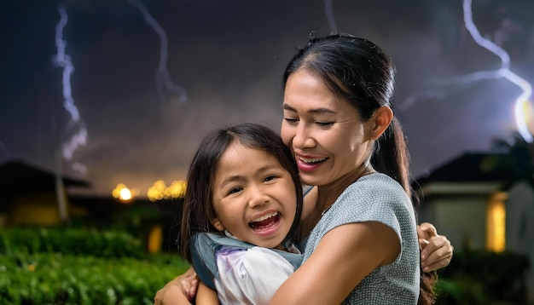
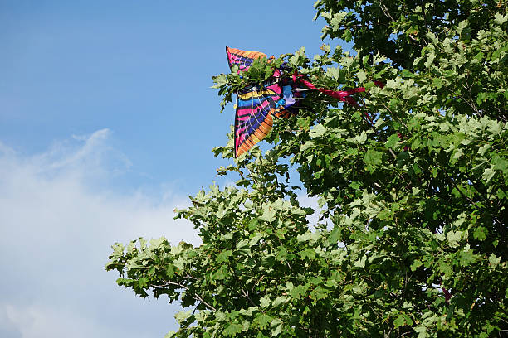

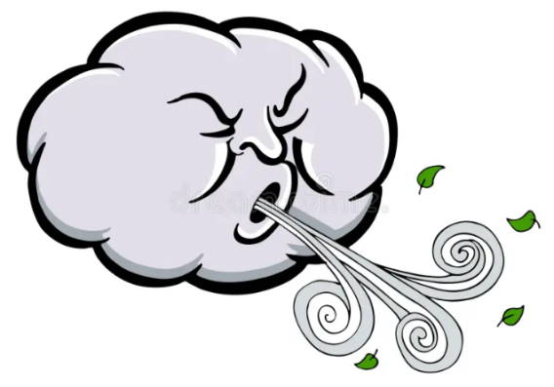
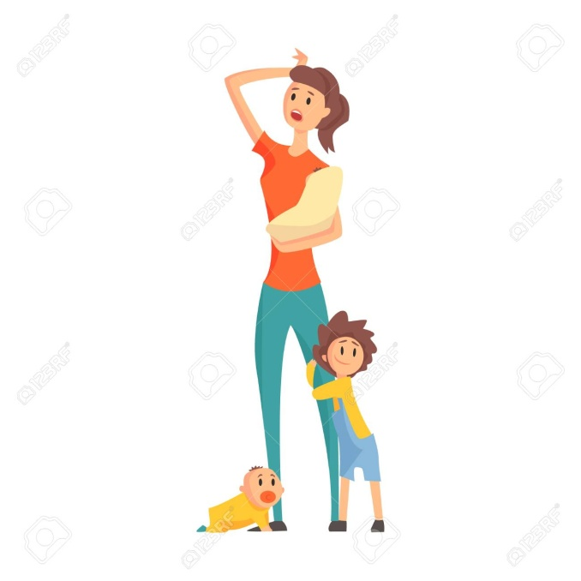
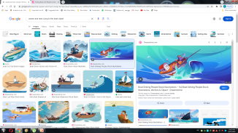
As
When
When
As soon as

Slide 7
2. Clung (v.):
As the storm raged, the children clung to their mother for safety.
When the wind blew fiercely, the leaves clung to the branches.
When the wave crashed, the children clung to the side of the boat.
As soon as the fireworks started, the child clung to his mother’s arm.
As the wind blew hard, the kite clung to the top of the tree.
Before the storm hit, the dog clung to its owner.

Slide 8
inched

Slide 9
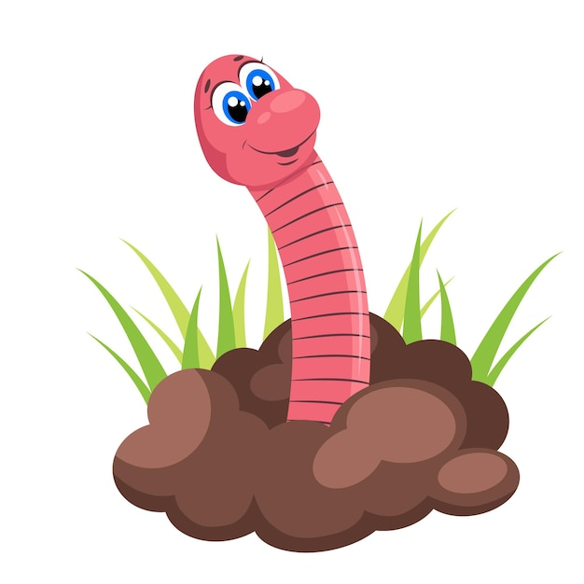

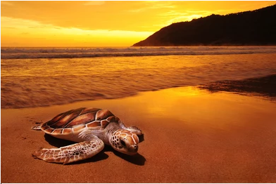
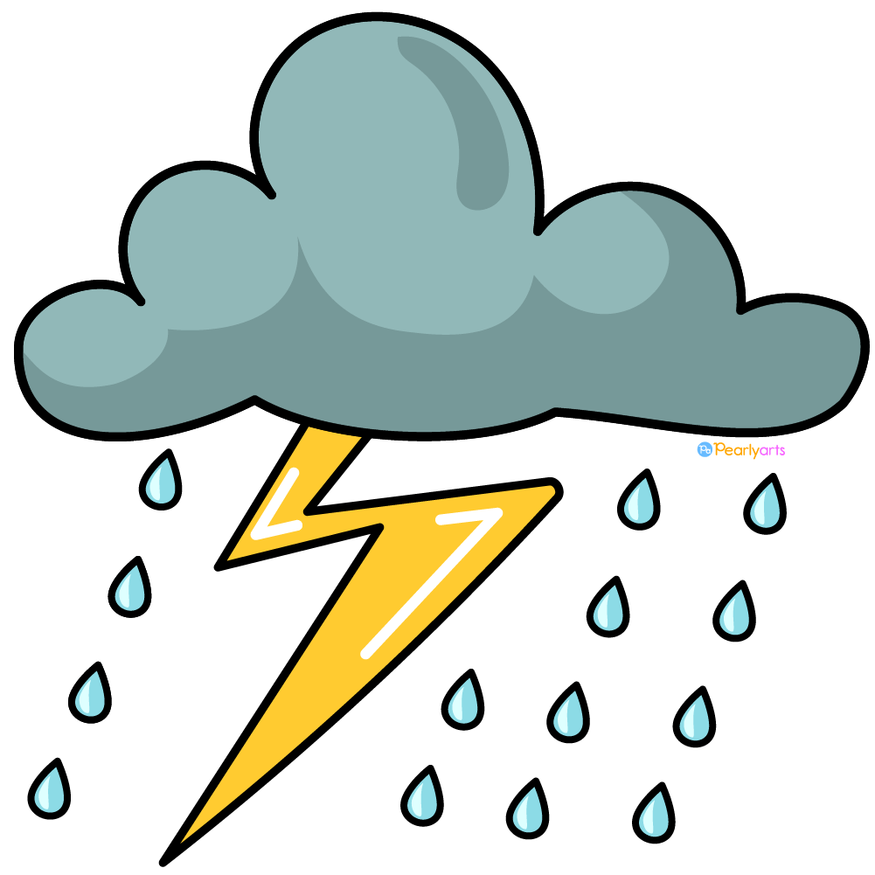
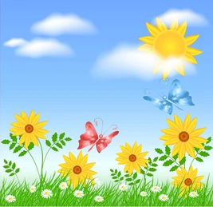
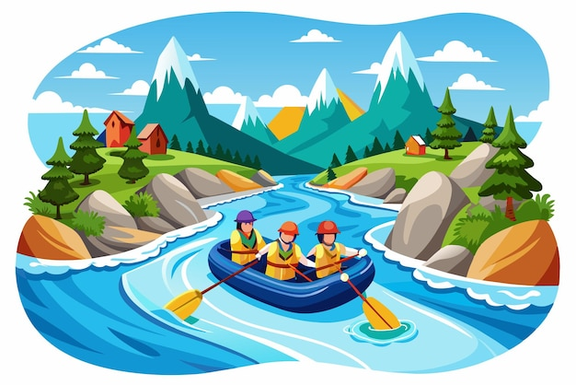
As
When
When
Before

Slide 10
3. inched (v.):
As the sun set, the turtle inched its way across the sandy shore.
When the rain stopped, the worm inched its way out of the soil.
While the wind blew softly, the balloon inched higher into the sky.
When the sun peeked through the clouds, the flowers inched towards the light.
Before the storm arrived, the raft inched closer to the embankment.

Slide 11
drenched

Slide 12
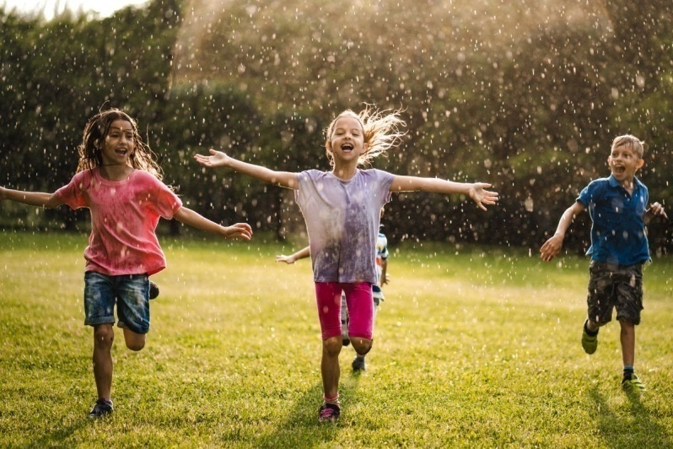
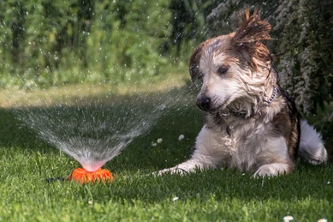
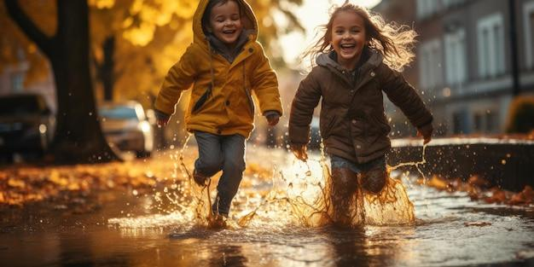
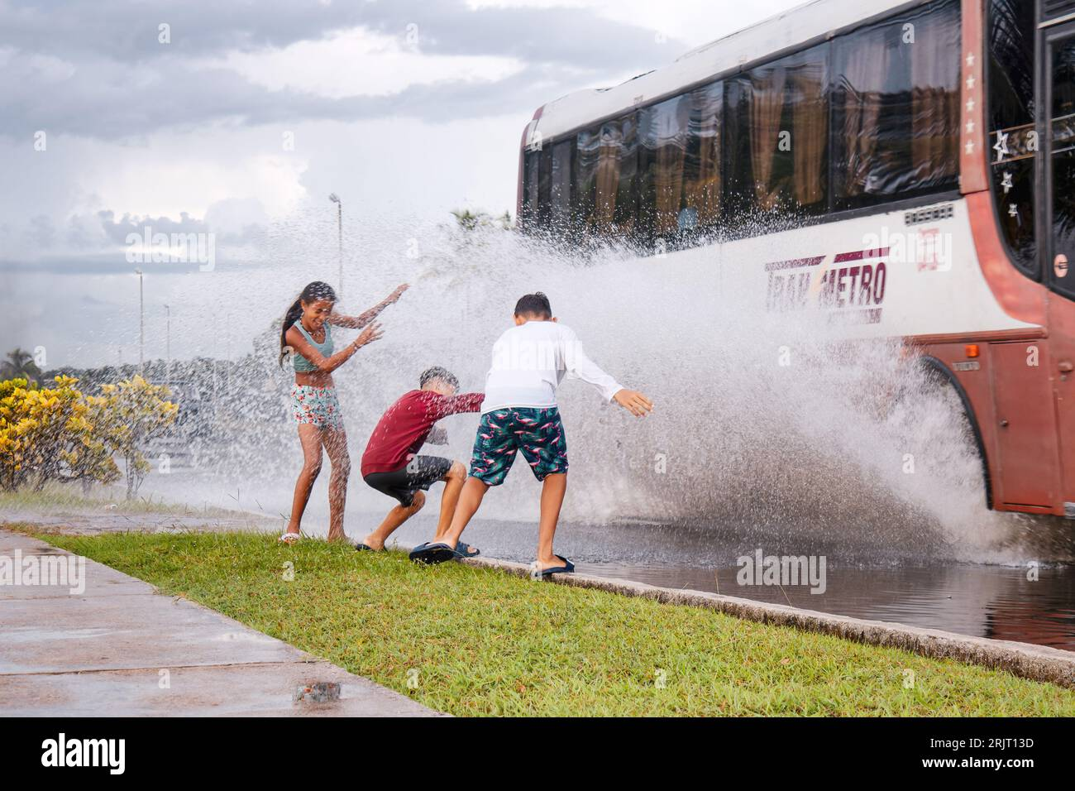
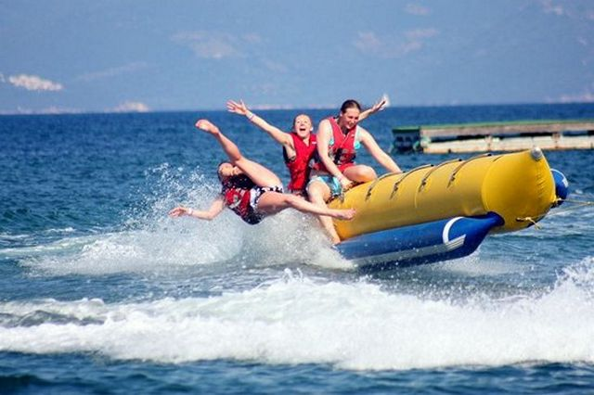
As / while
When
While
When
After

Slide 13
4. drenched (v.):
As the rain poured, the kids got drenched while they were playing outside.
When the sprinklers turned on, the dog got completely drenched.
While the kids were running through the puddles, their shoes became drenched.
After the boat tipped over, everyone was drenched by the cold lake water.
When the bus splashed through a puddle, the kids on the sidewalk were drenched.

