Slide 1
Vocabulary words
Writing Sentences

Slide 2
1) Wilderness (n.): overgrown and abandoned area.
-Synonym: desert / wild
*Sentence: The hunters released the wolf back into the wilderness when they finished their research.

Slide 3
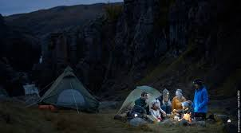
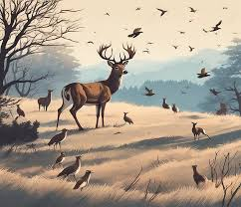
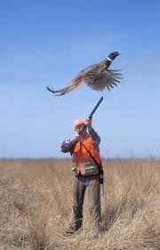
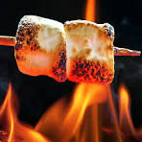
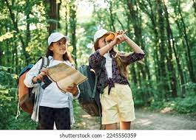
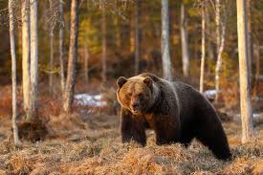
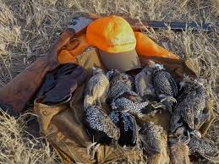

Slide 4
2) Reeds (n.): tall plants that grow beside water.
*Sentence: The hunter was hiding behind the reeds while waiting for his prey.

Slide 5
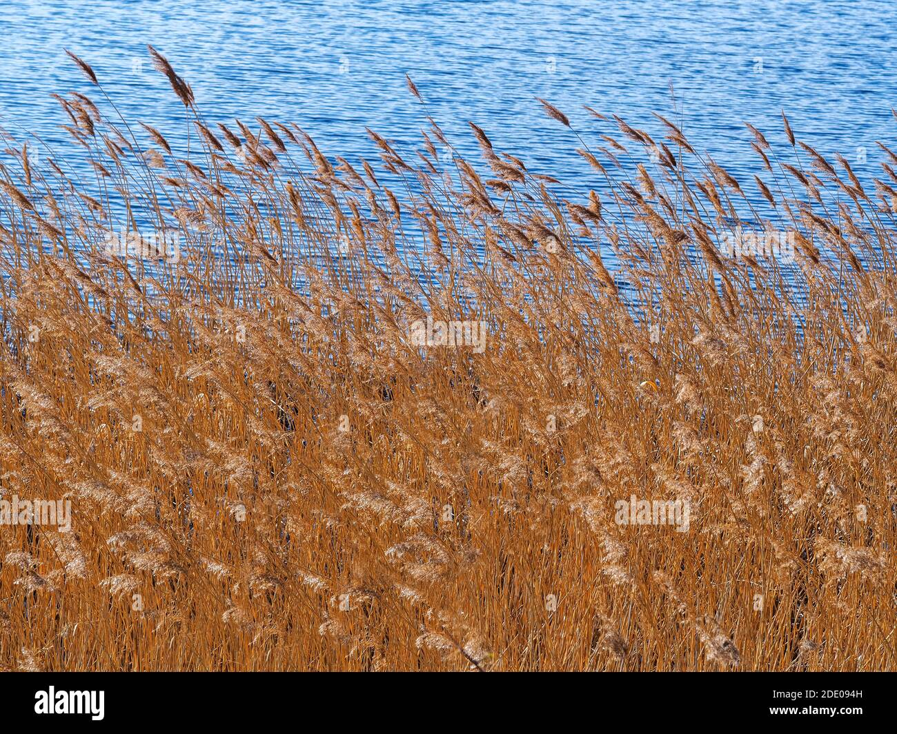
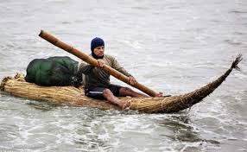
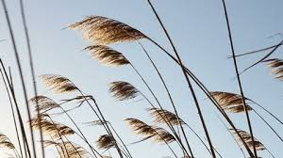
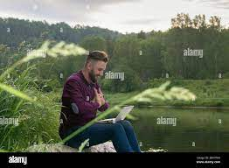
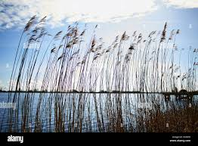

Slide 6
3) Flickered (v.): to make an irregular series of quick, sudden movements.
-Synonyms: fluttered
*Sentence: The candle’s light flickered when I ran next to it.

Slide 7


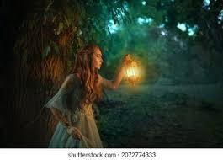
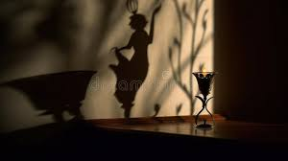
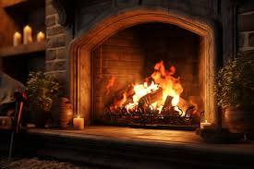
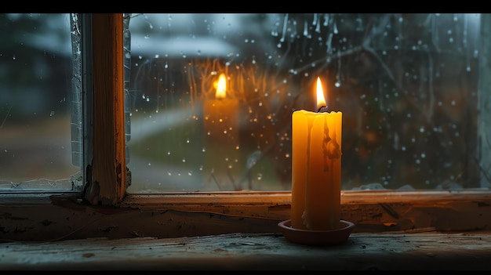
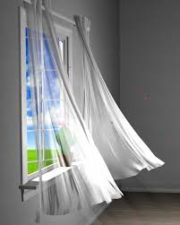

Slide 8
4) Darting (v.): move or run somewhere suddenly or rapidly
Synonym: dash
Antonym: creep, crawl
*Sentence: The fly darted about the room until it found an open window and flew out.

Slide 9
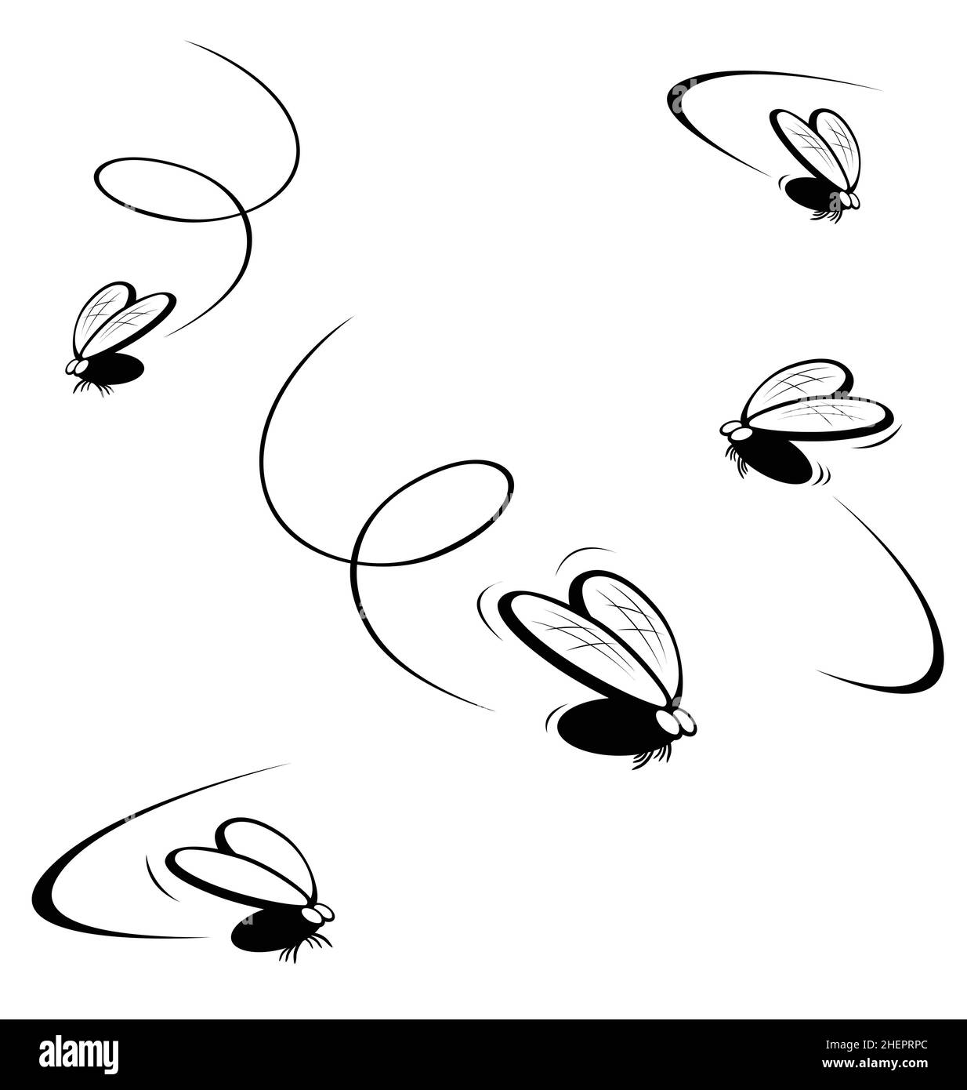
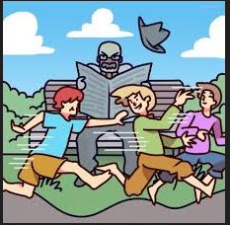

Slide 10
5) Haystack (n.): grass that has been cut and dried is collected into tall piles.
*Sentence: The mouse was hiding behind the pile of haystack because the cat was chasing it.

Slide 11
