Slide 1
Reading comprehension practice 4
A dangerous game

Slide 2


Read the text silently A dangerous game
Booklet 2 pp. (23+24)
7 min

Slide 3
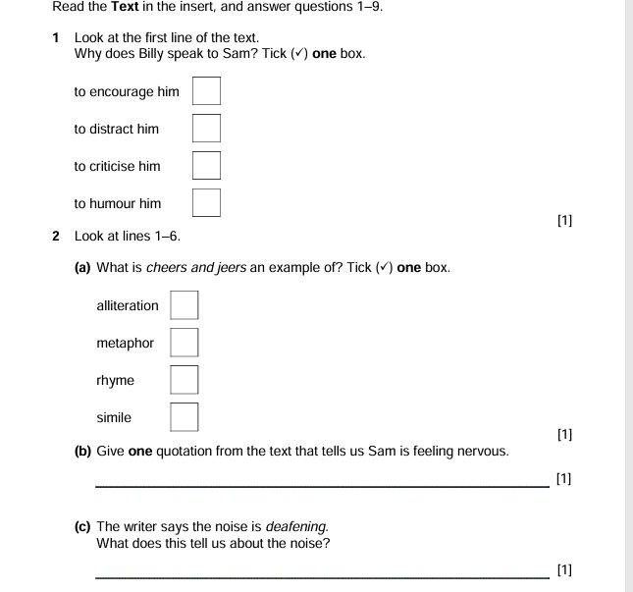
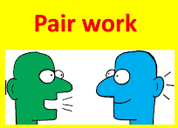

7 min
Answer questions 1 and 2 ( a-b-c-d)

Slide 4
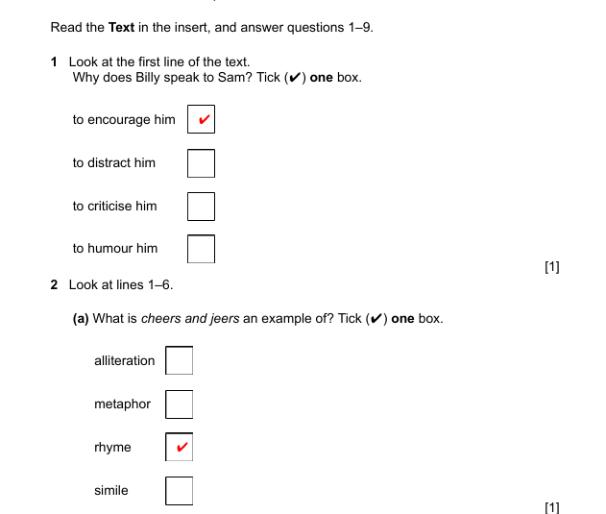

Slide 5
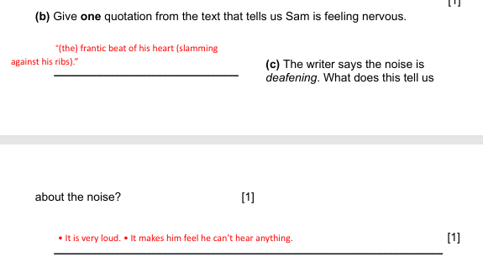
Check your answer 2 min

Slide 6
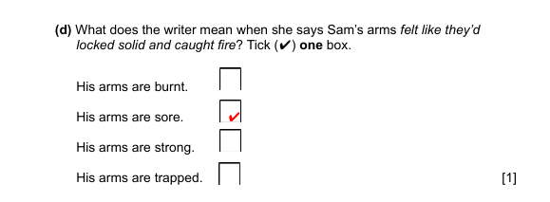

Slide 7
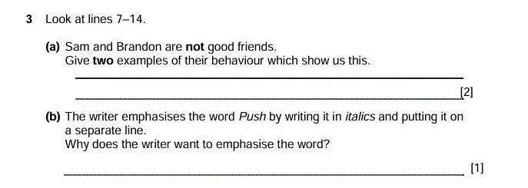
5 min

Slide 8
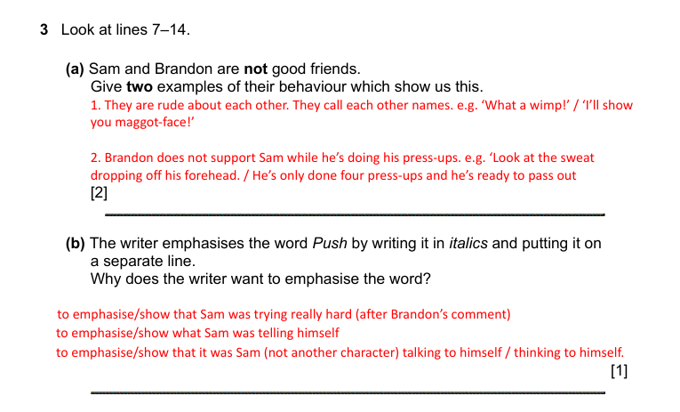
Check your answer 3 min

Slide 9
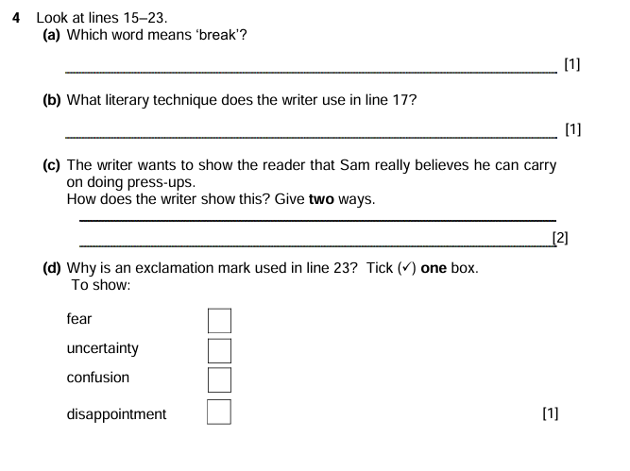
7 min

Slide 10
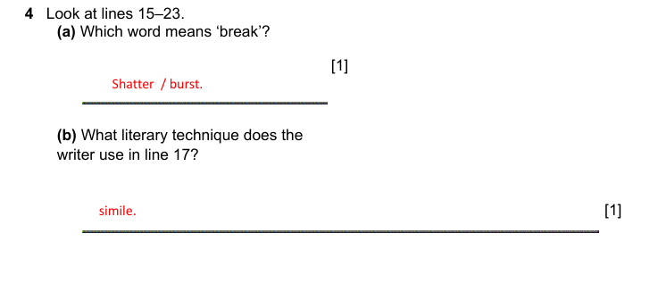
Check your answer 2 min

Slide 11
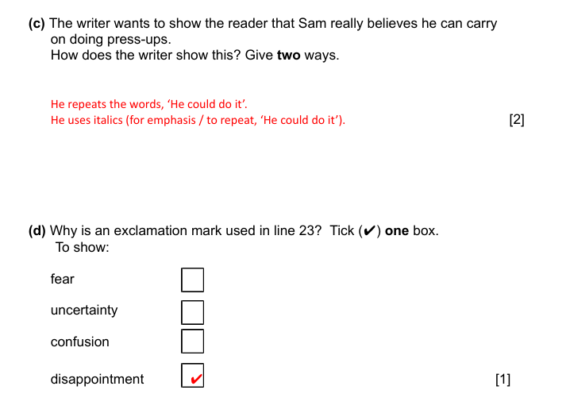

Slide 12
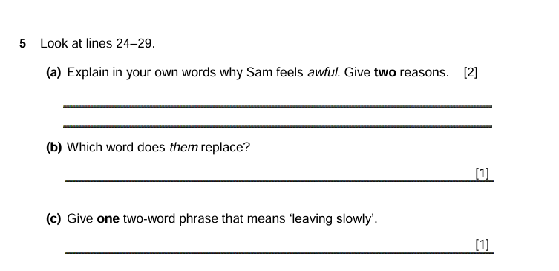
7 min

Slide 13
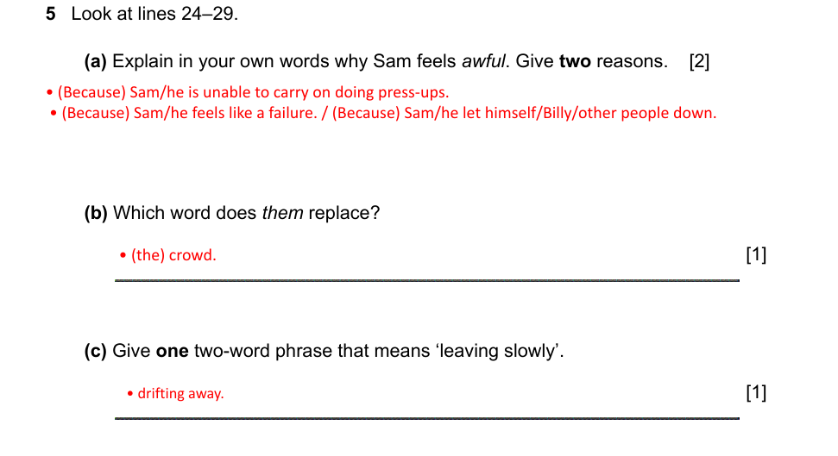
Check your answer 3 min

Slide 14
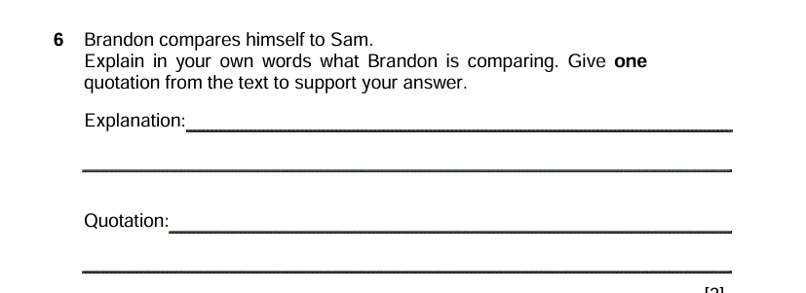
5 min

Slide 15
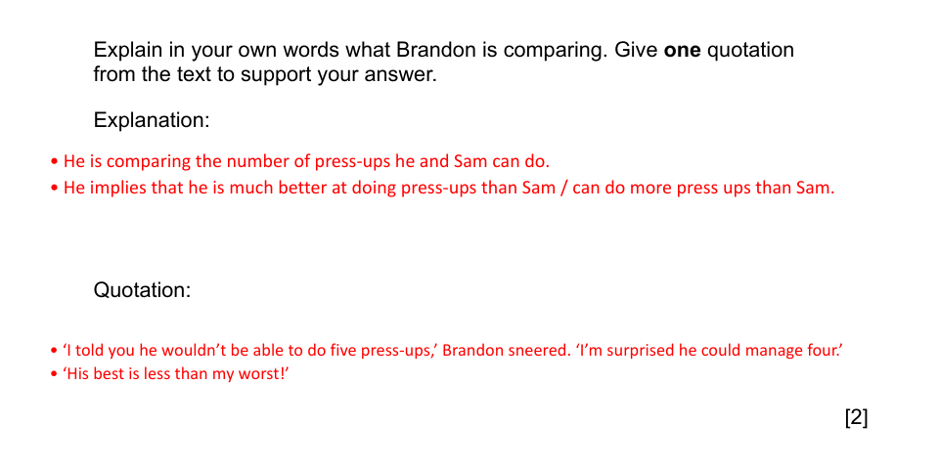
Check your answer 3 min

Slide 16

5 min

Slide 17
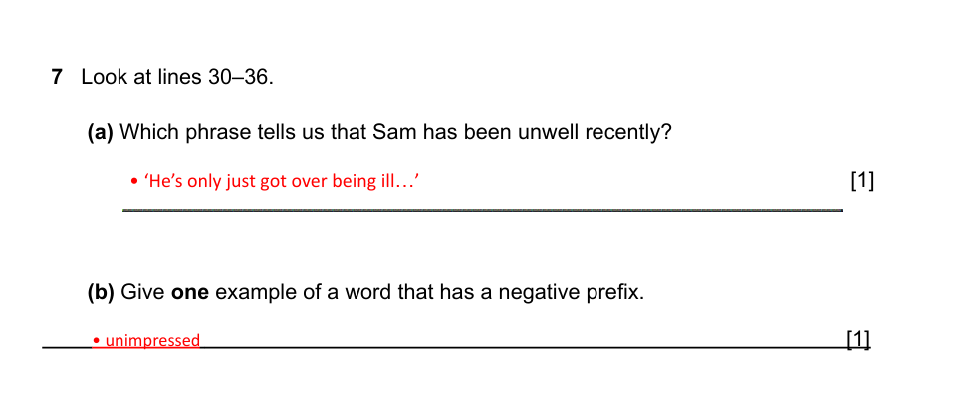
Check your answer 3 min

Slide 18


4 min

Slide 19
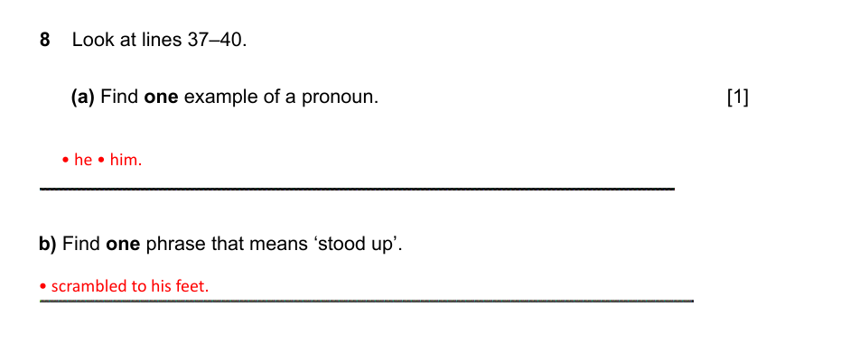
Check your answer 1 min

Slide 20
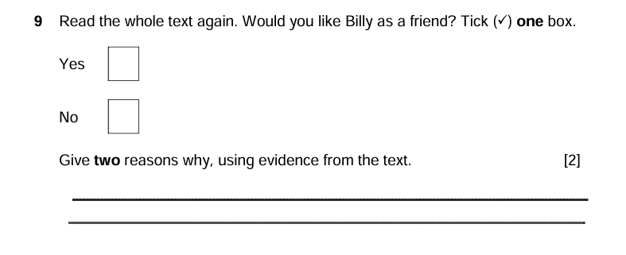
5 min

Slide 21
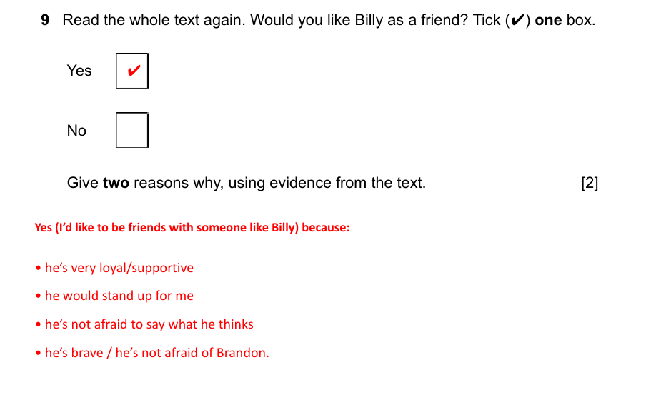
Check your answer 3 min

