Slide 1


Writing
Reports

Slide 2
Learning Objectives
Students will learn to organize reports using a logical structure, including an introduction, main body, and conclusion.
Students will identify the purpose of their report and tailor their writing style to suit the intended audience.
Students will use formal and precise language to convey information clearly and professionally.

Slide 3
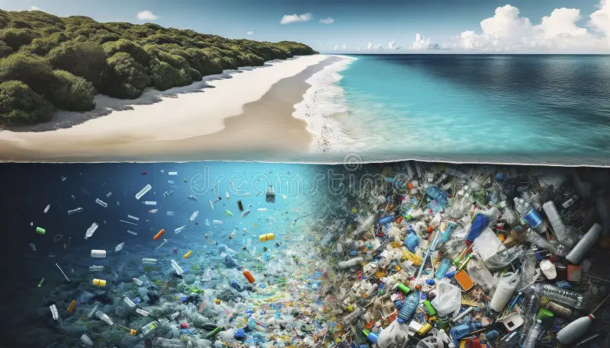
Warm up activity
What do you see on the surface?
What is surprising about what’s under the water?
What message is this image sending?

Slide 4

What is a report?
A report is a structured and formal piece of writing that is used to present information, facts, findings, and analysis on a specific topic or subject.
Reports are designed to inform the reader clearly and concisely, often to help them make decisions, understand an issue, or learn about a particular event, situation, or research study.
Reports are usually divided into sections with subheadings, which makes the content easy to follow and allows the reader to locate specific information quickly. Depending on the purpose, a report may include elements such as an introduction, main body, conclusion, recommendations, tables, charts, or diagrams.
(Minimum of 170 word count).

Slide 5

What is a report?
The writing style is typically formal, objective, and factual, avoiding personal opinions or informal language.
Reports can take various forms, including informational reports, which explain facts and findings about a topic, and event or news reports, which describe occurrences in a chronological and detailed manner. Overall, a report’s goal is to communicate information efficiently, accurately, and logically to its intended audience.

Slide 6
Points to consider:
Introduction:
General statement.
Generally introduce the topic.
Thesis statement/Purpose of the report.
What the report aims to address/Why is it important.
Main body paragraphs:
Answer prompts/points that are given in the writing question.
Conclusion:
The conclusion is where you summarize the event and state its impact or result. It gives closure to the report.
Recommendations or suggestions (optional).

Slide 7


A good report should consist of:
Title: A brief, clear, and informative title that reflects the content of the report.
(relevant to the event you are reporting/ Capture the essence of the report in a few words).
Byline (Reporter's Name and Role). (Optional)
Example: By Rohit Khanna, CNN News Reporter.
Introduction (Opening paragraph):
For an informational report, the introduction sets the scene by giving the reader a clear overview of the topic — what it’s about, why it matters, and what the report will cover.
By: Stating the purpose of the report and what the report aims to address.

Slide 8

Main Body Paragraphs (minimum 2):
This section presents all the information collected on the topic in detail. You may organize your content using subheadings to make it clearer and more structured.
Subheadings: Divide your main content into sections, each with a clear and relevant subheading.
Facts and Evidence: Each section should include specific points supported by evidence, such as facts, data, statistics, research findings, or real-life examples.
Logical Flow: Ensure that your ideas are presented in a logical and coherent order, with smooth transitions between sections so that the report reads naturally and clearly.
Conclusion:
This section should summarize all the main points discussed in the report.
Summary of Findings: Briefly restate the key ideas and evidence from the main body without introducing new information.
Recommendations (Optional): Offer thoughtful recommendations or actions that could be taken, supported by the evidence you have discussed/based on your findings.

Slide 9

Useful Language For Reports
To introduce: The purpose/aim of this report, this report highlights ….
To generalise: In general, Generally, On the whole.
To introduce other people's opinions: Many people consider, Some people argue/believe/ claim.
To conclude/summarise: In conclusion, All things considered, To sum up, All in all.

Slide 10
https://www.youtube.com/watch?v=HQTUWK7CM-Y
Writing Task: Report on Plastic Pollution
Title: The Effects of Plastic Pollution on Marine Life
Introduction (Paragraph 1)
Define plastic pollution.
Mention how it affects marine life and ecosystems.
State why this issue is important.
Main Body (Paragraphs 2 & 3)
Causes of Plastic Pollution:
  Human activities (littering, waste mismanagement).
  Single-use plastics and their role.
Effects on Marine Life:
  Ingestion of plastic by fish, turtles, and seabirds.
  Entanglement in plastic waste.
  Pollution disrupting marine food chains.
Conclusion (Paragraph 4)
Summarize the key effects.
Suggest solutions (reducing plastic use, recycling, awareness campaigns).
Call to action: Why should people care?

Slide 11
What Are the Effects of Plastic Pollution on Marine Life? - Earth Science Answers
Thank you

