Slide 1
News Articles

Slide 2
Learning Objectives
Students will be able to structure the main body with clear paragraphs, each addressing a specific aspect of the topic.
Students will learn to use linking ideas and time expressions for coherence and flow.
Students will avoid simplistic adjectives and utilize a more sophisticated vocabulary to enhance the quality of their writing.
Students will be able to apply techniques learned in previous units (descriptive, narrative, and argumentative) to enhance the effectiveness of their articles.

Slide 3
What are articles?
Articles are written to give information (e.g. news reports) or express opinions (e.g. argumentative articles). They can be either formal or informal depending on the audience they are addressed to and the topic they deal with.

Slide 4
A good news article consists of:

Slide 5
01
an eye-catching headline
which suggests the topic of the article that follows
- an interesting introduction

Slide 6
Main Body
02
consisting of two or more paragraphs in which the topic is presented in detail.

Slide 7
a conclusion which gives an appropriate ending to the article. Such pieces of writing can be found in newspapers, magazines or newsletters.
03
Conclusion

Slide 8
Points to consider
01
02
03
• Always think of a short, clear, appropriate headline which attracts the reader's interest
Each paragraph should deal with one aspect of the topic. You can use linking ideas or time expressions to join your ideas or introduce paragraphs
Decide on the style of the article before you start writing.
04
05
06
Avoid using simplistic adjectives (good, nice, bad, etc). Always try to use more sophisticated vocabulary instead. (splendid, gorgeous, awful, etc)
Address the reader in the second person (you) if the topic of the article and the style you have adopted permits this.
Descriptive, narrative and argumentative techniques - as presented in previous units (units 1, 2, 4, 6, 10, 11, 12, 13) - can be applied when writing articles.

Slide 9
How to write headlines for news Articles
A headline is a short, clear summary of the information presented in a newspaper article. To write headlines correctly, certain rules must be followed.

Slide 10
How to write headlines for News Articles
a) use the present simple tense to describe events which have occurred very recently. Earthquake hits L.A., for example, means the earthquake has just happened, probably in the last twenty-four hours;

Slide 11
How to write headlines for News Articles
b) omit the verb "be" when using the passive voice to describe a past event. Write
: President defeated or Lost boy found
not: President was defeated or Lost boy was found

Slide 12
How to write headlines for News Articles
Write “to be + past participle” when using the passive voice to describe a future event, as in:
Hospital to be opened by Queen ( = A hospital is going to be opened by the queen.)
When using the active voice to describe a future event, write the full infinitive (to be) only, as in Queen to open hospital (= The Queen is going to open a hospital)

Slide 13
How to write headlines for News Articles
d) omit articles (a, an, the) as in Child trapped in rubble ( = A child was trapped in rubble)

Slide 14
How to write headlines for News Articles
e) put nouns one after the other as in London factory explosion injures 27 (which means that an explosion in a factory located in London resulted in twenty-seven people being injured;

Slide 15
How to write headlines for News Articles
f) avoid using prepositions (words like under, over, across, through). Write: Unidentified virus spreads rather than An unidentified virus has spread across the country)

Slide 16
How to write headlines for News Articles
g) use abbreviations like US, UN, NATO. Write: UFO sighted not: An unidentified flying object was seen.

Slide 17

Writing Activity

Slide 18
Match these headlines with the topics below. There are two headlines for each topic. Which are the most successful? Why?
a. Exams not necessary more advanced vocab
b. Tahiti: Holidaymakers’ paradise
c. The ferry ran onto rocks makes you wonder what the article is about
d. Exams to be banned?
e. Go to Tahiti for your holidays
f. Storm forces ferry onto rocks gives clear into + eye catching
You are a reporter for a newspaper. Write an article about a ferry boat which ran aground in rough seas. (c.f)
Your school magazine has asked its readers to give their opinions on whether exams are useful as a means of testing students' knowledge. Write your article. (a,d)
You are a reporter for a weekly magazine. Write an article describing a popular holiday resort. (b,e)

Slide 19
Try to rewrite the following sentences into headlines, applying the theory above.
1 The prisoners' protest at the Tryall jail has ended.
Prison protest ends
2.Banks are planning to introduce security cameras at cashpoint machines.
Banks to introduce cash-point cameras
3 A tanker overturned, spilling its cargo of heating oil on the M11 motorway.
Tanker spills oil on M11
4 Nutritionists have condemned new slimming medications as very harmful.
Slimming drugs harmful, nutritionists say
5 The London School of Economics has won an award for being the best 11 War declared business school.
LSE wins “ Best Business School” award

Slide 20
Try to rewrite the following sentences into headlines, applying the theory above.
6 The Organization of Petroleum Exporting Countries has made a deal to 12 Storm destroys corn crop fix oil prices.
OPEC to fix price
7 The Zolosis factory was blamed for failing to protect workers against Terrorist drama ends peacefully unsafe chemical levels.
Zolosis factory blamed for poor safety
8 Contaminated baby food of various brands has caused a scare in the city of Redding.
Bad baby food scare in Redding
9 The director of the car company will be charged with fraud.
Director to be changed with fraud

Slide 21
Read the following sentences, underline the key words, then write possible headlines.
1 Breston is becoming a busy holiday resort due to the Mayor's successful promotional campaign.
2 A mother of four won 1 million in the national lottery last week.
3 A massive earthquake has destroyed most of Clifford Bay. Forty people were killed and fifty are still missing.
4 An attempt was made on the French Ambassador's life while he was visiting Austria. The assassin, who failed in his mission, was arrested.
5 Sting is going to give a concert in London. All proceeds from the concert will go to Amnesty International.
6 Medical researchers have discovered a new treatment which will help people suffering from asthma.
7 Many teachers object to the introduction of computers in school education, as they fear that computers will eventually replace them.
8 Police seized diamonds worth £1,000,000 at London's Heathrow airport last Monday.

Slide 22
Read the following sentences, underline the key words, then write possible headlines.
1 Breston is becoming a busy holiday resort due to the Mayor's successful promotional campaign.
2 A mother of four won 1 million in the national lottery last week.
3 A massive earthquake has destroyed most of Clifford Bay. Forty people were killed and fifty are still missing.
4 An attempt was made on the French Ambassador's life while he was visiting Austria. The assassin, who failed in his mission, was arrested.
5 Sting is going to give a concert in London. All proceeds from the concert will go to Amnesty International.
6 Medical researchers have discovered a new treatment which will help people suffering from asthma.
7 Many teachers object to the introduction of computers in school education, as they fear that computers will eventually replace them.
8 Police seized diamonds worth £1,000,000 at London's Heathrow airport last Monday.

Slide 23
Q5. Suggested Answers
1. Boost to Breston after Mayor’s Campaign.
Mum Worth a Million
Earthquake Tragedy
Attempt on French Ambassador’s life
Sting to Appear for Charity
Good News for Asthma Suffers
Teacher’s Computer Fear
Diamonds Seized at Heathrow

Slide 24
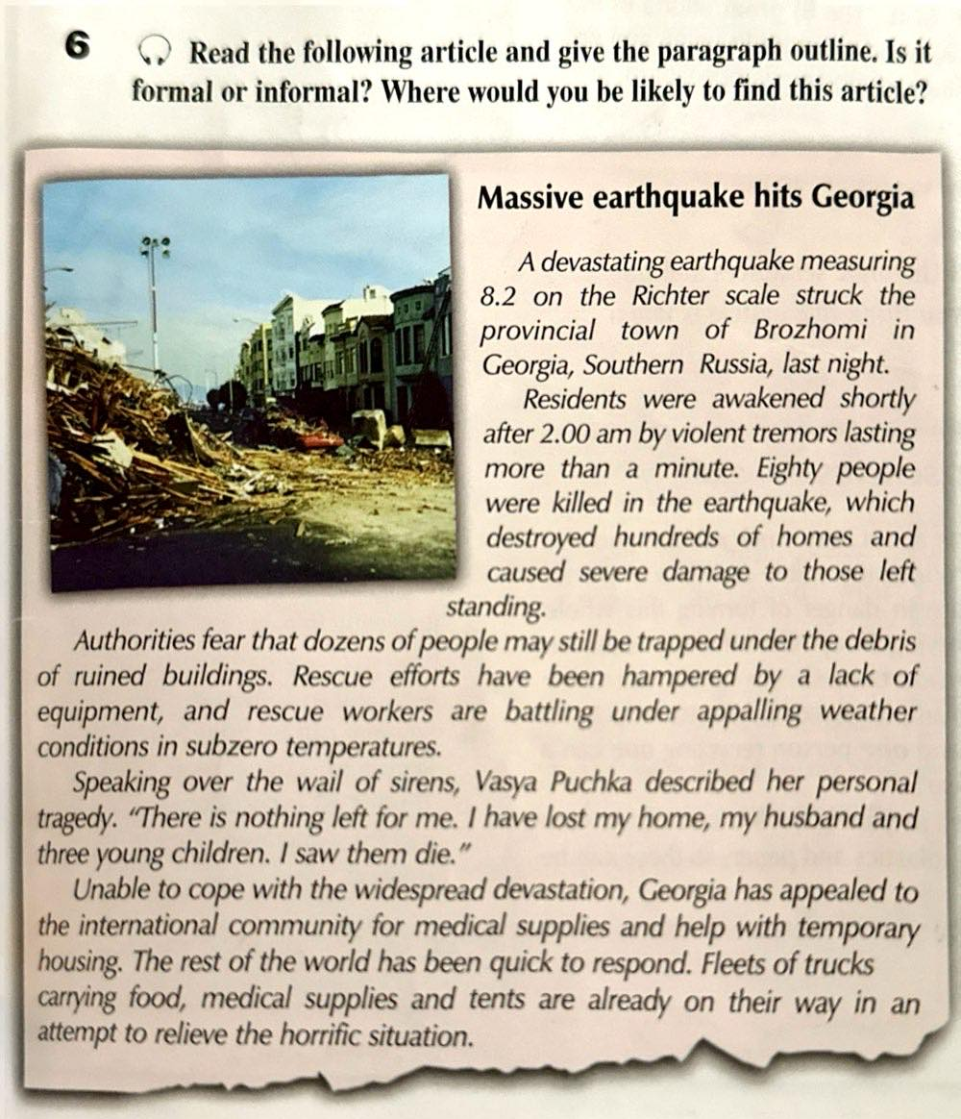
Answer Key
Introduction: (what - where - when: earthquake - Brozhomi - last night) Paragraphs 2, 3: Details (violent tremors - 80 killed - hundreds of homes destroyed - people still under debris - bad weather conditions)
Paragraph 4: Comments (Puchka said: nothing left - lost home, husband, 3 young children)
Conclusion: reaction, future development (appeal for medical supplies & temporary housing - rest of the world responded immediately)
• It is formal (advanced vocabulary, use of the passive).
• It could be found in a serious newspaper.
(As an extension T can ask Ss to close their books and say as many words as they remember relevant to the topic.)

Slide 25
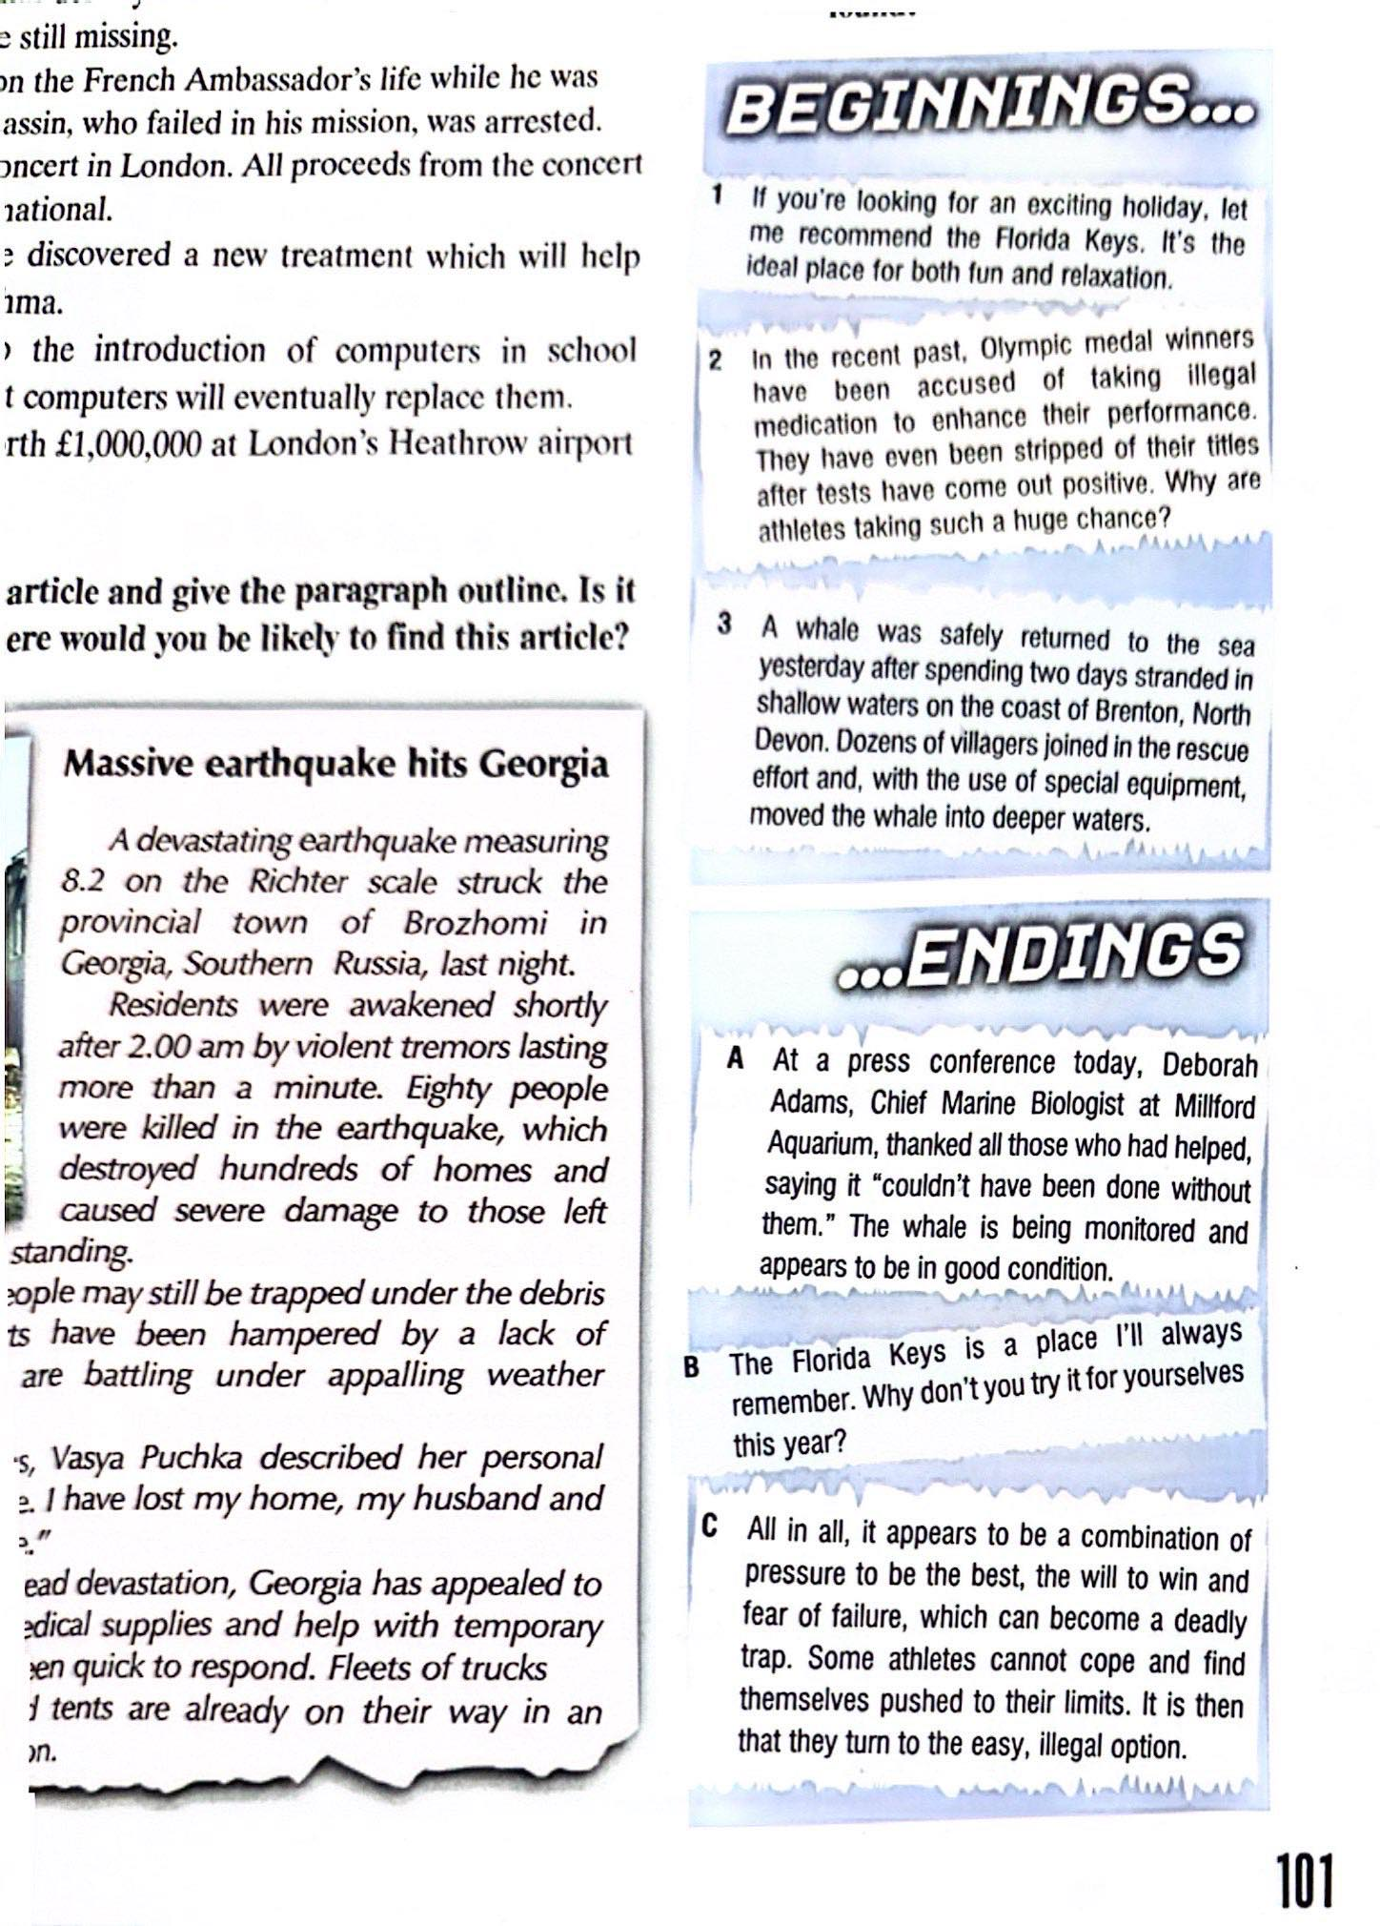

Slide 26
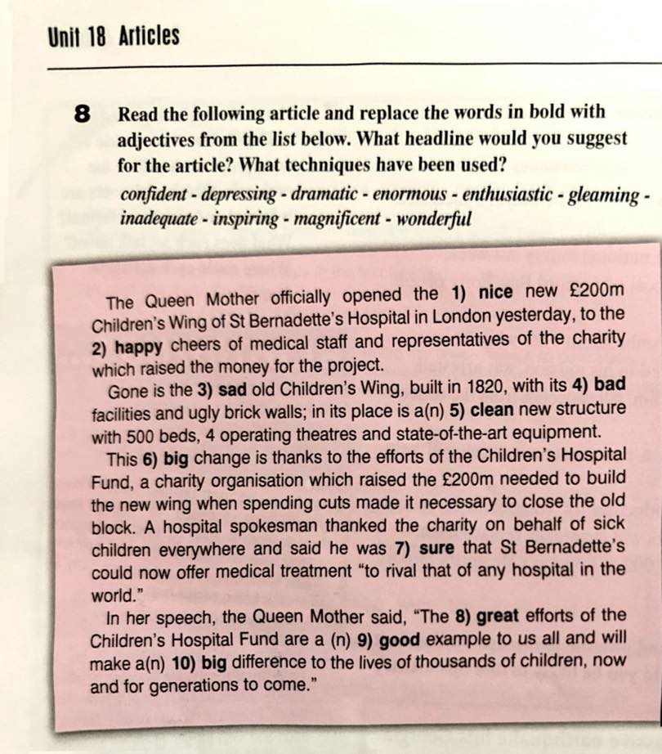
Model Answer
1 magnificent
2 enthusiastic
3 depressing
4 inadequate
5 gleaming
6 enormous/dramatic
7 confident
8 wonderful
9 inspiring
10 dramatic/enormous

Slide 27
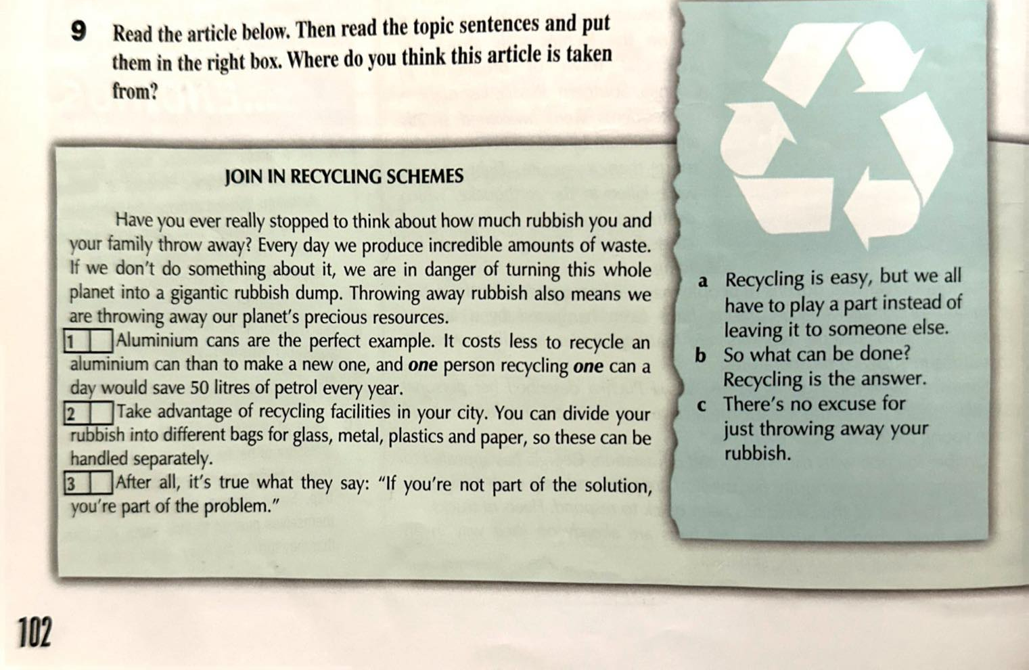
B
C
A

Slide 28
12 Read the following topics, identify the style they require and suggest an appropriate headline and a paragraph plan. Then write any two of them using 120-180 words.
1. Your school magazine has asked students to give their opinion on whether computers should be used in the classroom.
2. A young people's magazine has asked its readers to write an article promoting the most famous holiday resort in their country.
3. The newspaper you are working for has asked you to write an article on a recent disaster which hit the capital of your country.
4. A health and diet magazine has asked its readers to write an article giving their opinion on junk food.

Slide 29
Try to rewrite the following sentences into headlines, applying the theory above.
1. The president was interviewed by the famous journalist yesterday.
President Interviewed by Famous Journalist
2. A new shopping mall will be opened in the city center by the mayor next week.
New City Center Shopping Mall to Open Next Week by Mayor
3. Our team has achieved victory in the championship.
Team Achieves Victory in Championship
4. An important announcement was made by the CEO during the press conference.
CEO Makes Important Announcement During Press Conference
5. A cat was rescued by the firefighters from the top of a tall tree.
Firefighters Rescue Cat from Top of Tall Tree

Slide 30
Try to rewrite the following sentences into headlines, applying the theory above.
6. The famous actress is going to receive an award at the upcoming film festival.
Famous Actress to Receive Award at Upcoming Film Festival
7. An interesting article about space exploration was written by the renowned scientist.
Renowned Scientist Writes Interesting Article on Space Exploration
8. The construction of a new bridge will be started by the government soon.
Government to Start Construction of New Bridge Soon
9. A rare species of butterfly was discovered by a biologist in the rainforest.
Biologist Discovers Rare Butterfly Species in Rainforest
10. A high-profile summit will be attended by world leaders in the capital next month.
World Leaders to Attend High-Profile Summit in Capital Next Month

Slide 31
Checkpoint Exam Question Sample:
Section B: Writing
Spend 30 minutes on this section.
You have been asked to write an article for your school magazine about a new skill that you have been developing either in school or outside of school.
You should think about:
• what the skill is and how you have been developing it
• where and when you use the skill
• how you could develop the skill further in future.

