Slide 1
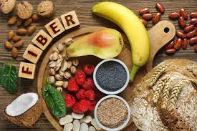
Dietary fibre (NSP)

Slide 2
After food has been digested, absorbed and metabolized, waste products are removed from the body by the process excretion.
Liquid waste is processed by the kidneys and excreted as urine, and solid waste as faeces from the large intestine.
The removal of waste products is vital as they are potentially harmful (toxic) to the body. Normally urine is excreted throughout the day, and faeces are excreted every day or so according to individual variation.
The faeces are formed in large intestine after the nutrients and some of the water have been absorbed following digestion.

Slide 3
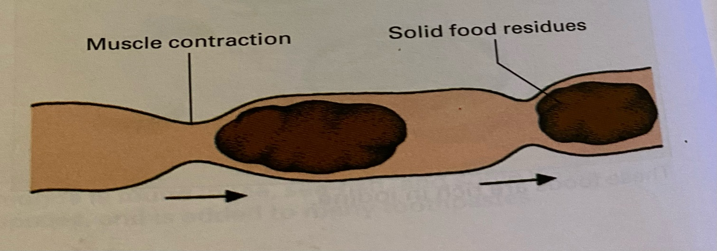
The solid residues pass along the intestine by the process of peristalsis which involves regular muscular contractions of the intestinal wall. These push the residue along.
The faeces finally collect in the rectum and are passed out through the anus.
Watch video

Slide 4
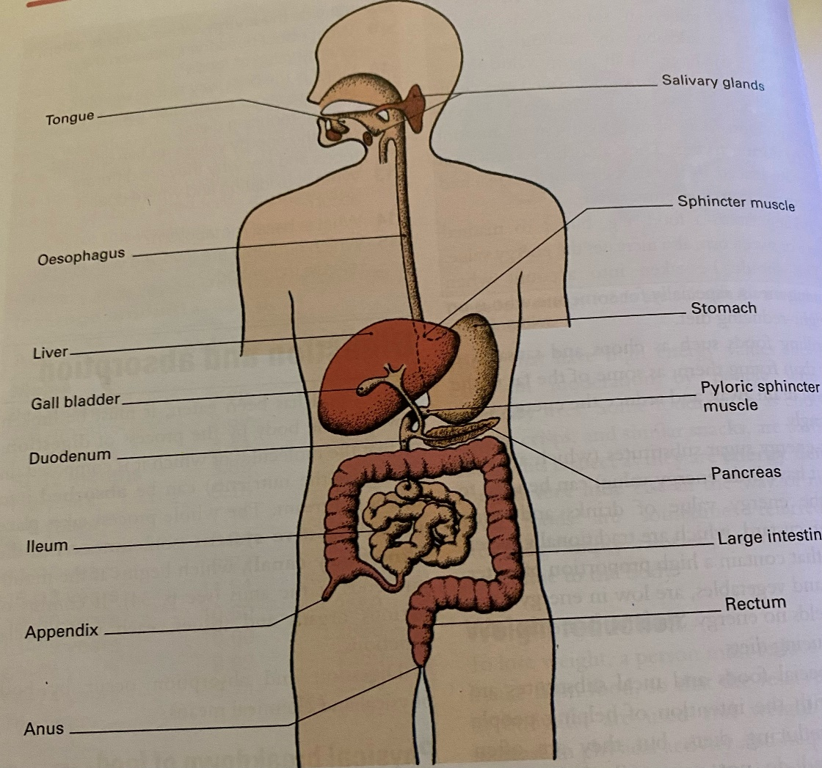
Usually the whole process takes place with minimum effort, providing the faeces are bulky and soft.

Slide 5
Non- starch polysaccharides or NSP ( dietary fibre) are found in the cell walls of plants.
They are not digested, but remain in the large intestine before passing in faeces.
The main sources of NSP are: Past Paper Question
Wholegrain cereals (as bran) e.g. wheat, rice, oats, Wholemeal bread, breakfast cereals, whole grain pasta, crispbreads ( bran can be purchased separately)
Fruits, especially skins of apples, plums
Vegetables, especially leafy vegetables, celery, potato skins

Slide 6
Functions:
Even though it is not digested, NSP is of great importance as it :
Absorbs a lot of water.
Binds other food residues itself, ensuring that the faeces are soft and bulky and pass easily out of the body in the minimum time.

Slide 7
If the faeces are not removed quickly and regularly, several problems can arise, including:
Constipation
Many people suffer from constipation. The faeces become very hard and move slowly through the intestine, and a lot of effort is required to remove them.
Abdominal discomfort and a general feeling of ill health accompany this condition.

Slide 8
2. Diverticular disease:
The extra strain put on the muscular walls of the intestine through constipation may lead to diverticular disease.
This may develop if the faeces are small and hard ( due to lack of NSP and insufficient water), and the muscular walls of the intestine have to work harder to move them along.
This causes increased pressure in the intestine and leads to pouches of the bowel lining being forced out through the intestine wall.

Slide 9
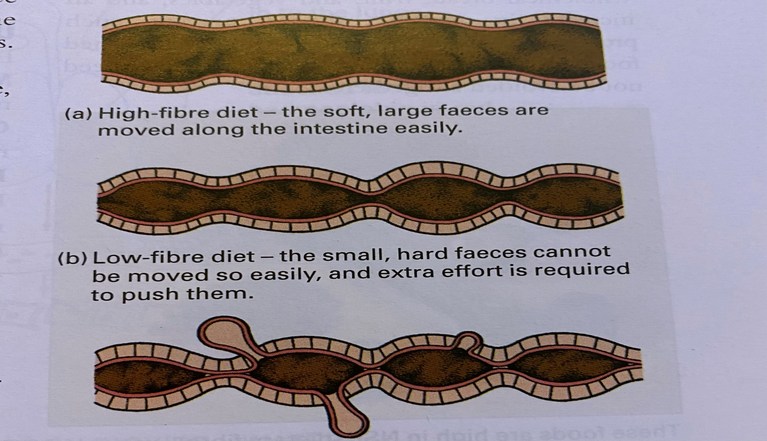
If the pouches ( called diverticula) become inflamed, this cause discomfort.
Part of the treatment for this is to put the patient on a high fibre diet.

Slide 10
3. Haemorrhoids (pile) and hernia
These may be caused by the increased effort required to remove hard faeces in constipation sufferers.

Slide 11
Refined foods
It is often suggested that people today do not eat enough NSP, and that that is a major cause of many disorders of the intestinal tract, including the previous problems and bowel cancer.
Many foods eaten today are refined. This means that they are processed in food factories into a variety of products, and much of their NSP content is removed.

Slide 12
Refined foods: processed foods that lack many nutrients, and they include:
White flour, white bread, white sugar.
Instant puddings and desserts
White (polished) rice
Instant potato

Slide 13
* Such foods are often blamed for the reduction in the amount of NSP eaten, as they are:
Convenient to prepare.
Highly palatable ( pleasant to taste).
Relatively inexpensive.
Lack of exercise is also a major factor in causing intestinal disorders, as exercise helps to keep the intestine active.

Slide 14
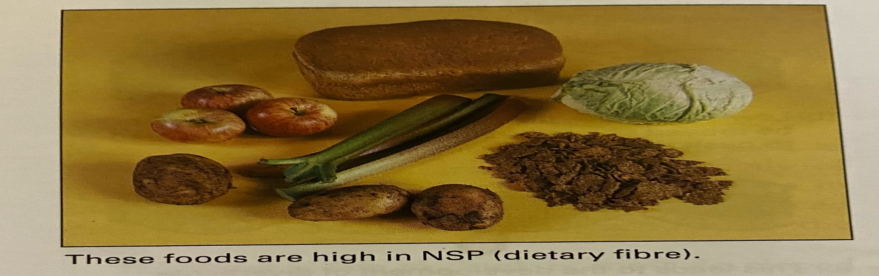
Everyone should eat plenty of NSP to avoid constipation and its accompanying disorders.
The regular consumption of wholegrain cereals, Wholemeal bread, fruit and vegetables, and an increase in exercise should prevent problems.
A reduction in the amount of refined foods eaten is advisable, although they need not be avoided altogether.

Slide 15
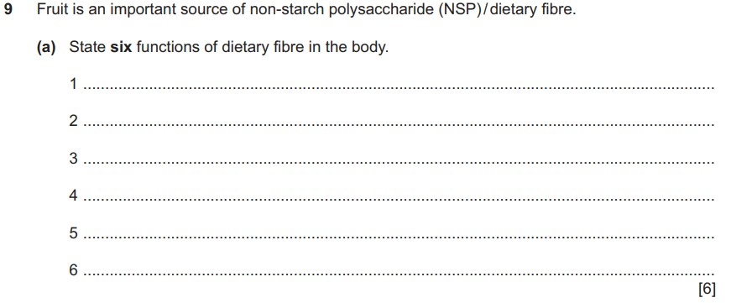

Slide 16
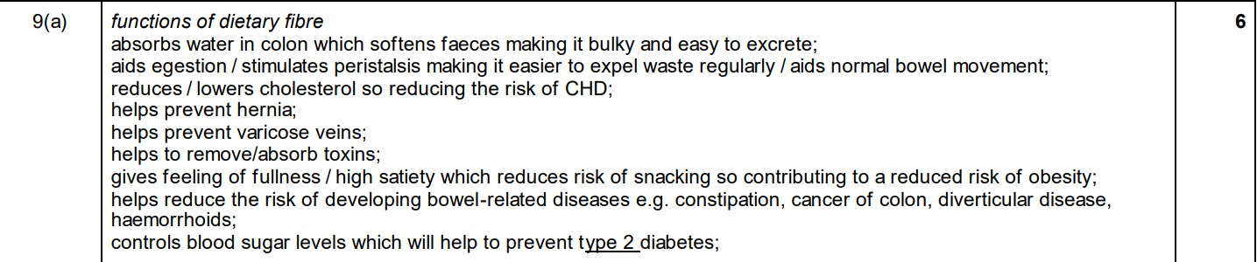

Slide 17
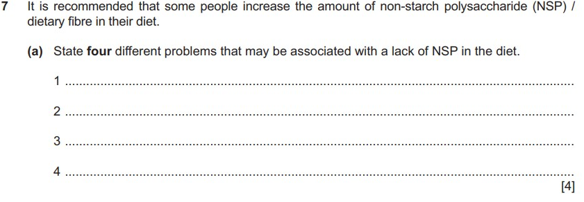

Slide 18
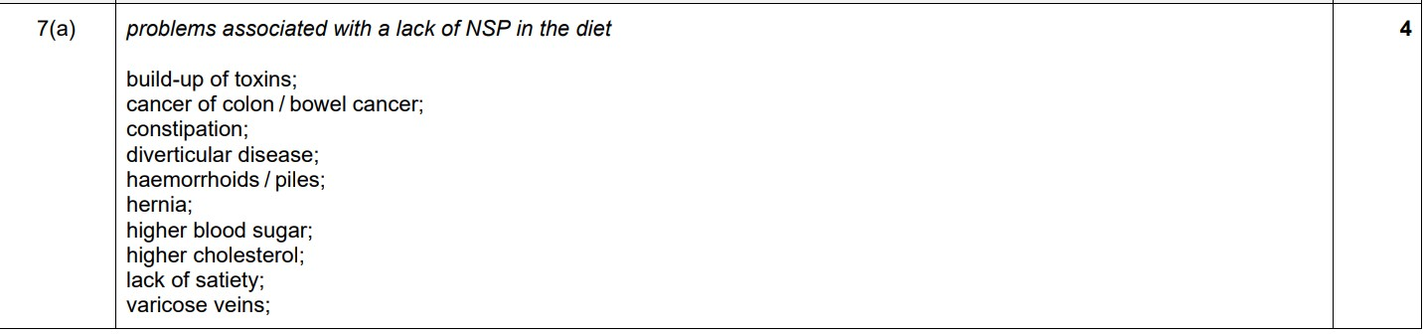

Slide 19
