Slide 1
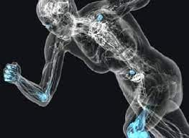
Energy
Every function and process in the body requires a source of energy.
All energy is supplied initially by food, and released for use in the body after digestion and absorption.

Slide 2
Use of energy in the body:
Energy is used in various forms in the body: Past Paper Question
Mechanical energy: for the movement of muscles (voluntarily or involuntarily).
Chemical energy: for all chemical and metabolic reactions.
Heat energy: to maintain the body temperature.
Electrical energy: for the transmission of nervous impulses.
One form of energy can be converted into another form in the body, but all energy is supplied initially by food.

Slide 3
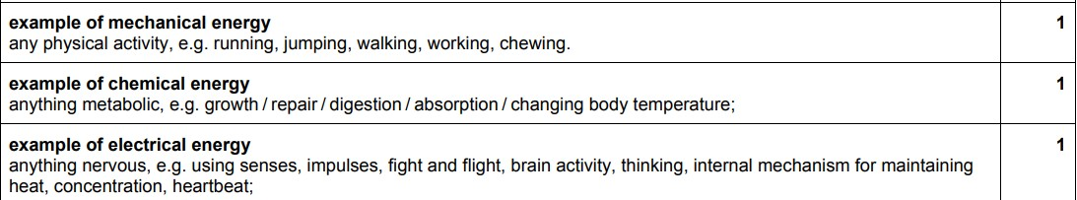

Slide 4
Foods that supply energy:
The three main nutrients, protein, fat and carbohydrate, all supply energy.
Fat, provides the most concentrated source of energy, weight for weight, so the most energy-dense foods are:
Fats ( lard, butter, margarine, suet)
Oils ( vegetable, nut, animal)
Fatty foods ( egg yolk, cheese, cream, meat)
Sugar, cereals, cereal products, starchy vegetables

Slide 5
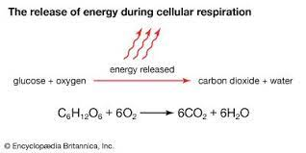
Energy release in the body:
Energy is released in a reaction between glucose and oxygen, which takes place in all body cells.

Slide 6
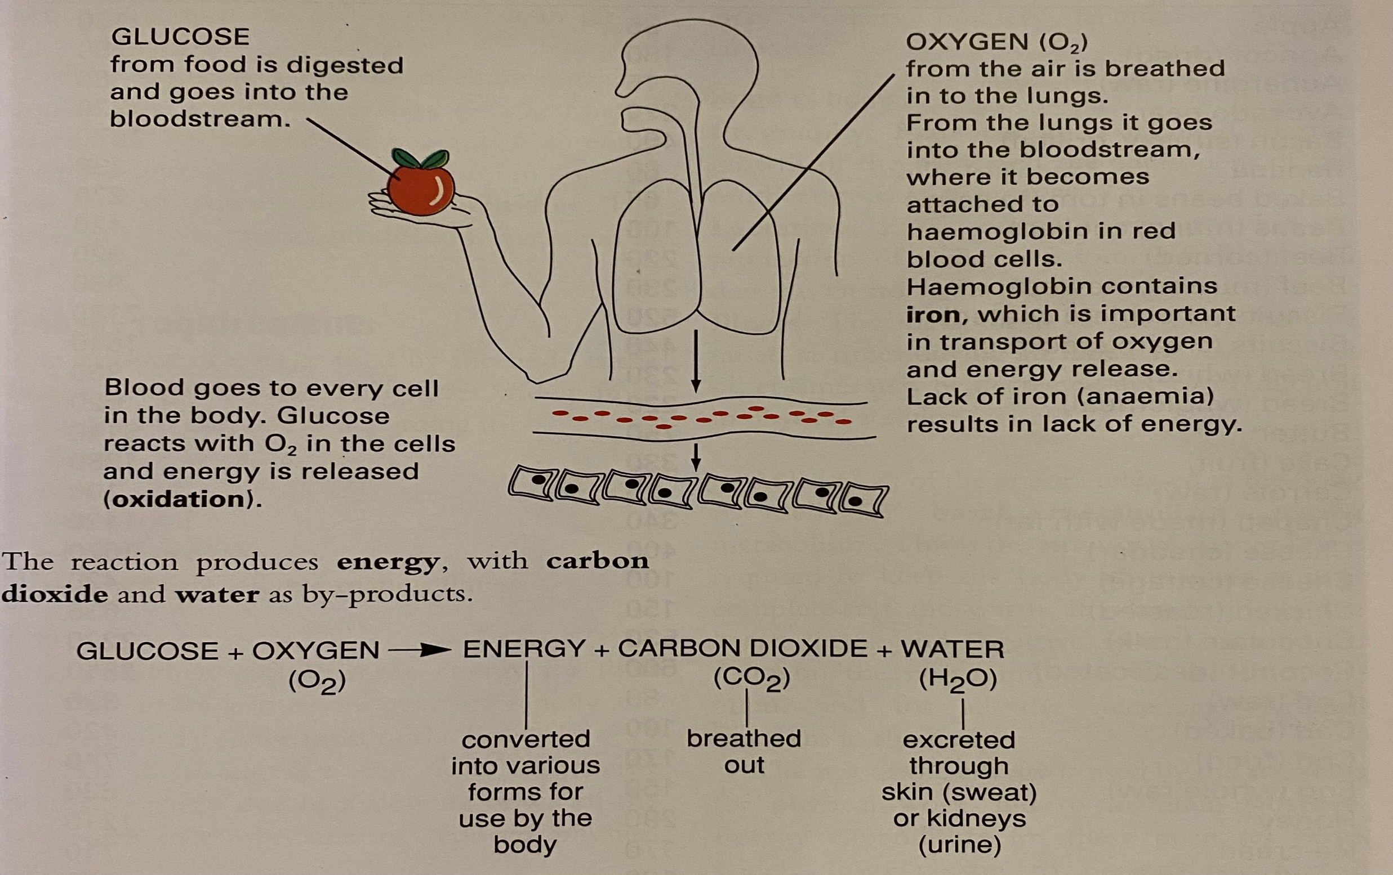

Slide 7
The reaction produces energy, with carbon dioxide and water as by-products.
Glucose + Oxygen Energy + Carbon dioxide +Water
CO2 H2O
The reactions that produce energy involve B vitamins and phosphorus.
Iodine is also important: it is a part of the hormone thyroxine which controls the speed of energy release ( metabolic rate).

Slide 8
Not all the glucose is converted to energy.
*Some is stored as glycogen ( in the liver and muscles)
Some as fat ( in adipose tissue under the skin)
Energy from glycogen can be released quickly (e.g. to run a race).
Energy stored as fat is released slowly (e.g. in time of fame)

Slide 9
Measurement of energy
Energy is measured in kilocalories( kcal) or kilojoules (kJ).
A kilocalorie (calorie) is defined as: the amount of heat energy that is required to raise the temperature of 1 kilogram of pure water by 1C.
1 kcal = 4.2 kJ

Slide 10
The three main nutrients, protein, fat, and carbohydrate, can all supply the body with energy, therefore said to have a calorific value or energy value:
1 gram of protein = 4 kcal
1 gram of fat = 9 kcal
1 gram of carbohydrate = 4 kcal
Fat supplies over twice as much energy as the same weight of protein or carbohydrate.
Protein is normally only used as an energy supply once it has performed its primary functions of growth and repair or if the diet is deficient in fat or carbohydrate.

Slide 11
Energy requirements: Past Paper Question
The amount of energy used by the body is the energy expenditure.
This varies widely from individual to individual, according to:
Age
Sex
Occupation
Physical activity
State of the body (e.g. pregnancy, illness)

Slide 12
Age
Young children require more energy for their size than adults as they are growing rapidly and tend to be very active most of the time.
With increasing age, the need of energy decreases, partly due to a slowing down of the body and partly because of reduced physical activity.

Slide 13
2. Gender ( sex)
Men tend to be larger in body size than women, so they have a higher metabolic rate and use more energy.
This does not really apply to children.

Slide 14
3. Occupation and physical activity
The amount of energy people use depends on their occupation and recreational activities.
Occupations are classified according to how active they are as follows:
1. sedentary: office workers, clerical tasks, drivers, pilots, teachers, journalists, clergy, doctors, lawyers, architects, and shop workers.

Slide 15
2. Moderately active: light industry and assembly plants, railway workers, postmen and women, joiners, plumbers, bus conductors, farm workers, builders’ labourers.
3. Very active: Coal miners, steel workers, dockers, forestry workers, army recruits, some farm workers, builders’ labourers, unskilled labourers.

Slide 16
4. State of the body
Pregnancy:
Extra energy is required for the growth of the baby, and the adjustment of the mother’s body to pregnancy.
Lactation:
Extra energy is required for the production of the milk, and some of this is laid down as fat stores during pregnancy.
Illness:
The metabolism of the body may be raised at times during an illness or fever, but at other times may be decreased due to a reduction in physical activity.

Slide 17
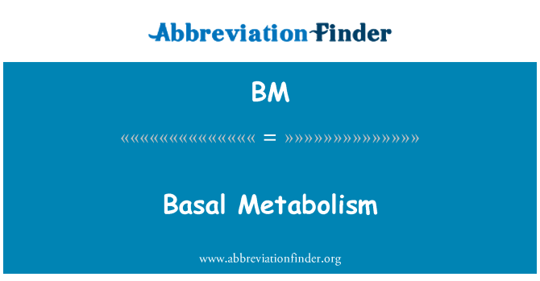
At least half of the energy released in the body is used for basal metabolism (resting metabolism).
This is the amount of energy that is required to keep the body alive when it is at complete rest and warm.
It is used to keep the heart, lungs, and digestive system moving, to maintain the nerve impulses to and from the brain, and for all the necessary chemical reactions in the body.

Slide 18
If the energy intake in food exceeds the amount of energy expended by an individual, then the excess is stored in the body as fat.
This is one of the major causes of obesity.
It is different for those who appear to be able to eat what they like without putting on weight.
It is likely that differences in metabolic rate ( the rate at which oxidation occurs), and the amount of heat produced by oxidation, account for this variation.

Slide 19
intake out = overweight
Energy Balance out intake = weight reduces
Foods that have high energy values should be eaten in moderation by people who lead sedentary lives.
Some foods such as chocolates, sweets, crisps are particularly bad as they are energy dense, but contain very little nutrients.
or empty calories, because they are of little value to the body.

Slide 20
Weight reduction:
To lose weight, a person must reduce the energy intake from food, so that the reserves of energy in body fat are used and weight is lost.
An increase in physical activity also helps.
A weight- reducing diet involves calculating the day’s energy intake and reducing it to a level at which energy reserves will be used up.

Slide 21
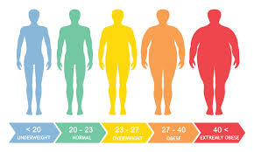
It is important to take the advice of a doctor before attempting to lose weight, as some diet sheets are misguided and nutritionally unsound.
Weight reduction is gradual and fairly long-term process.
The aim should be to change one’s eating habits to prevent future weight gain.

Slide 22
Effect of cooking on energy values
The energy values of some foods can be increased considerably by adding fat.
A fried egg has an energy value almost double that of a boiled egg.
( A boiled egg yields 80 kcal, a fried egg yields 150 kcal)
This is because most foods absorb a substantial amount of fat during frying.

Slide 23
They absorb even more if they are placed in fat before it has reached the correct cooking temperature.
Adding fat to a food e.g. butter to mashed potato or sweetcorn, also increases the energy value.
This should be taken into account when planning meals, especially for someone who is on a weight-reducing diet.
Grilling foods such as chops and sausages is better than frying them, as some of the fat in the food will drain away, and reduce the energy value.

Slide 24
Low- energy sugar substitutes ( which are very sweet but have little energy value) can be used to reduce the energy value of drinks and other dishes, e.g. custard, which are traditionally sweet.
Foods that contain a high proportion of water, e.g. fruits and vegetables, are low in energy value as water yields no energy. Such foods are useful in weight- reducing diets.
Many special foods and meal substitutes are produced with the intention of helping people on weight- reducing diets, but they are often expensive, and do not necessarily help to re-educate people’s eating habits.

Slide 25
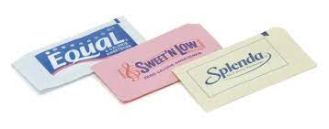
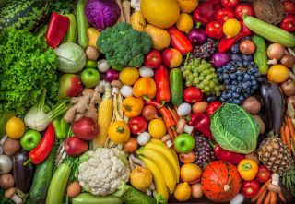
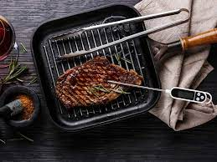
It is better to follow a diet that contains:
Plenty of fruit and vegetables.
Balanced amount of protein, fat and carbohydrate.

Slide 26
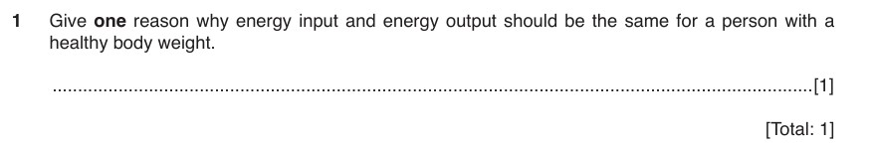
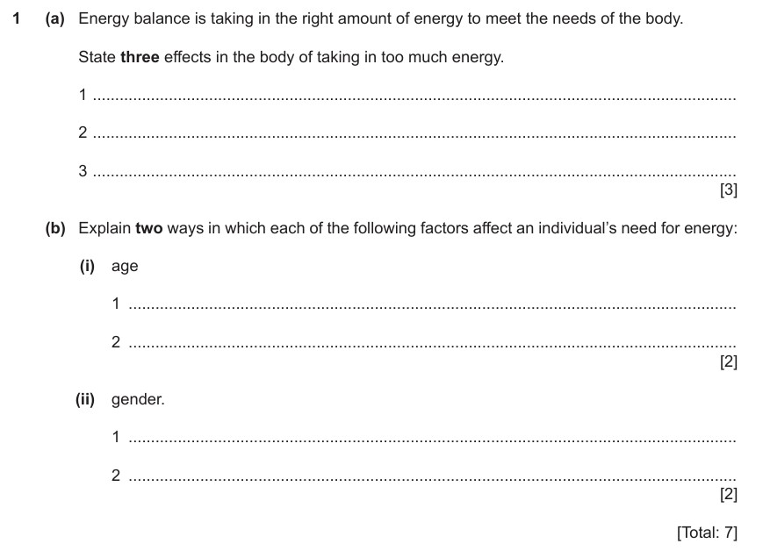

Slide 27
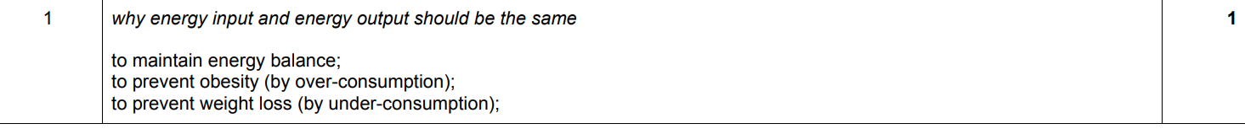
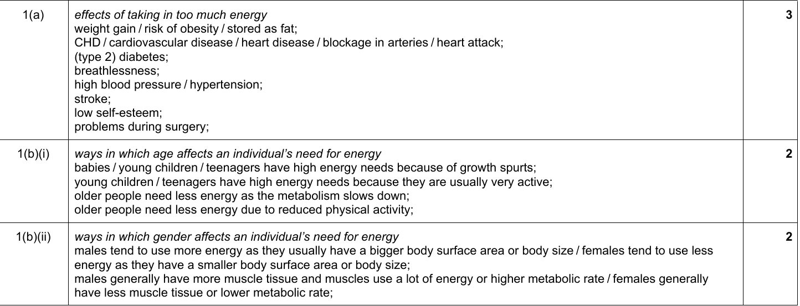

Slide 28
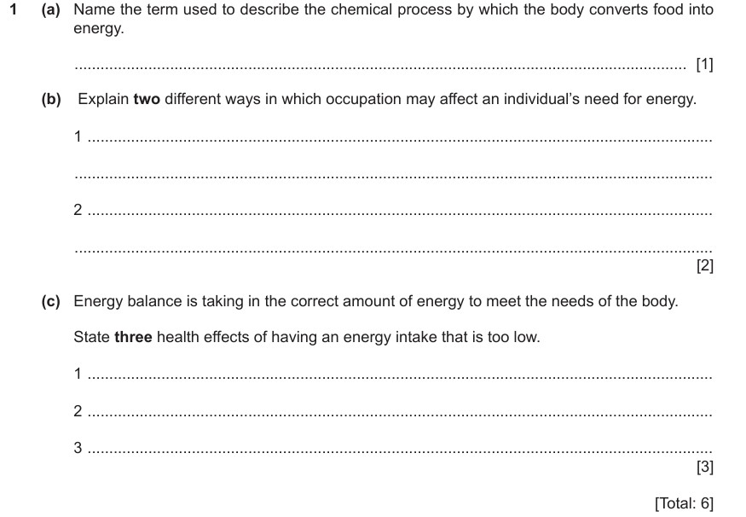

Slide 29
