Slide 1
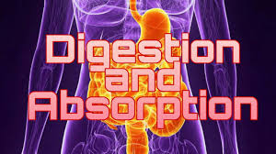
Digestion and absorption

Slide 2
When food has been eaten, it must be broken down in the body by the process of digestion.
Molecules of which food is composed ( nutrients) can be absorbed into the bloodstream.
The whole process takes place in the digestive system (alimentary canal), which begins at the mouth and ends at the anus.
It consists of various organs and tissues, each with special function.

Slide 3
Digestion and absorption occur by both physical and chemical mean:
Physical breakdown
Chemical breakdown
Food is broken up in the mouth by action of the teeth and jaw.
Muscular action of the stomach, reduces the size of food.
A variety of digestive juices’ are produced.
Enzymes, each chemical reaction has a specific enzyme.
This means that a particular enzyme can only work on one type of reaction.

Slide 4
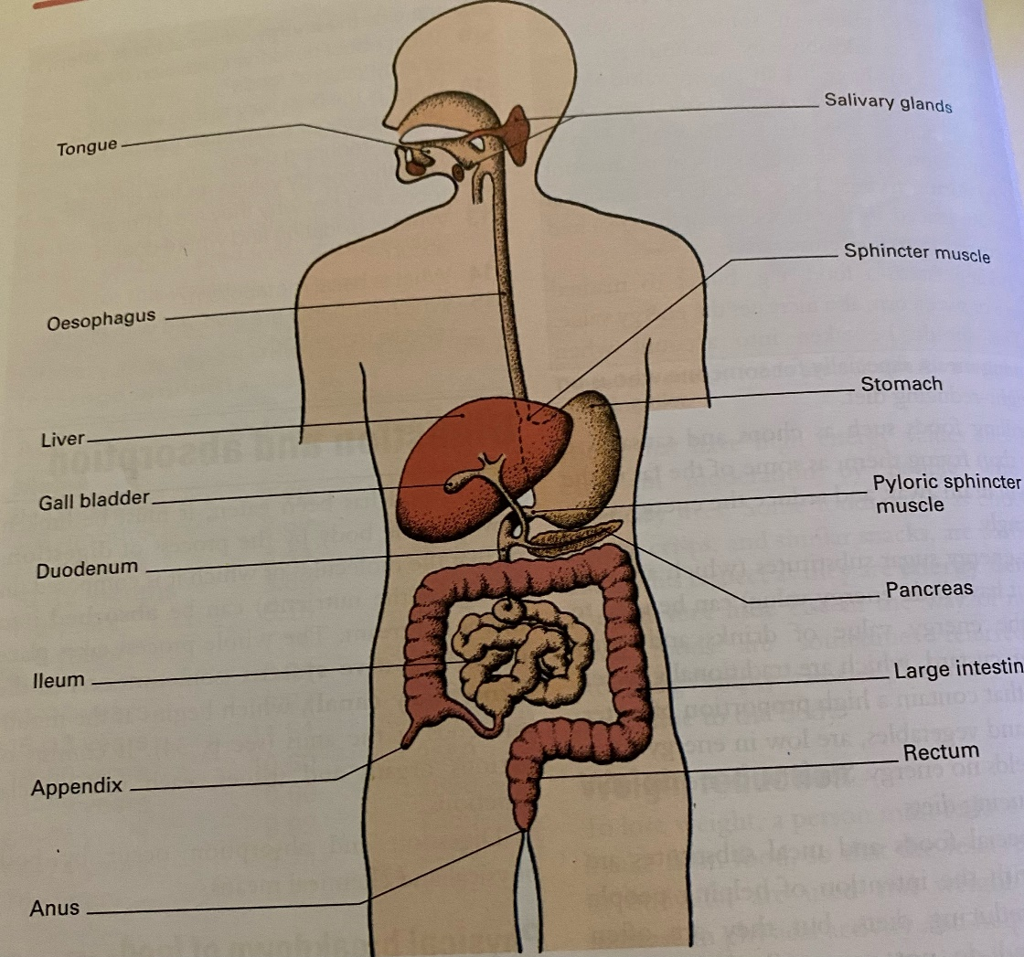

Slide 5
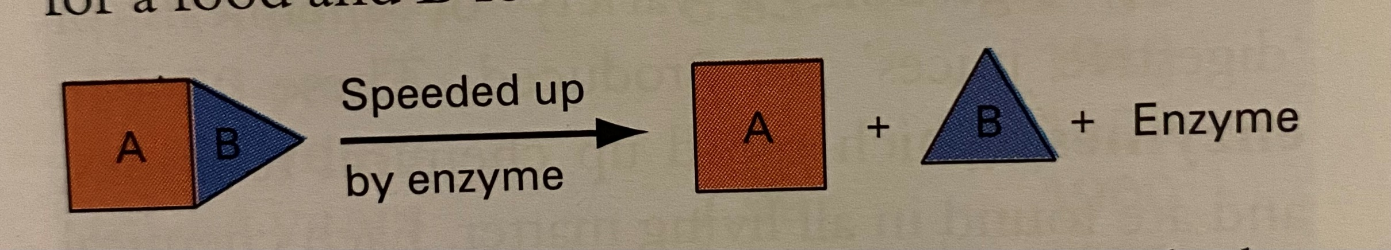
Functions of enzymes:
Speed up the breakdown of foods and the release of nutrients.
( speed up chemical reaction)
In order to enable food to move through the digestive system, mucus is produced.

Slide 6
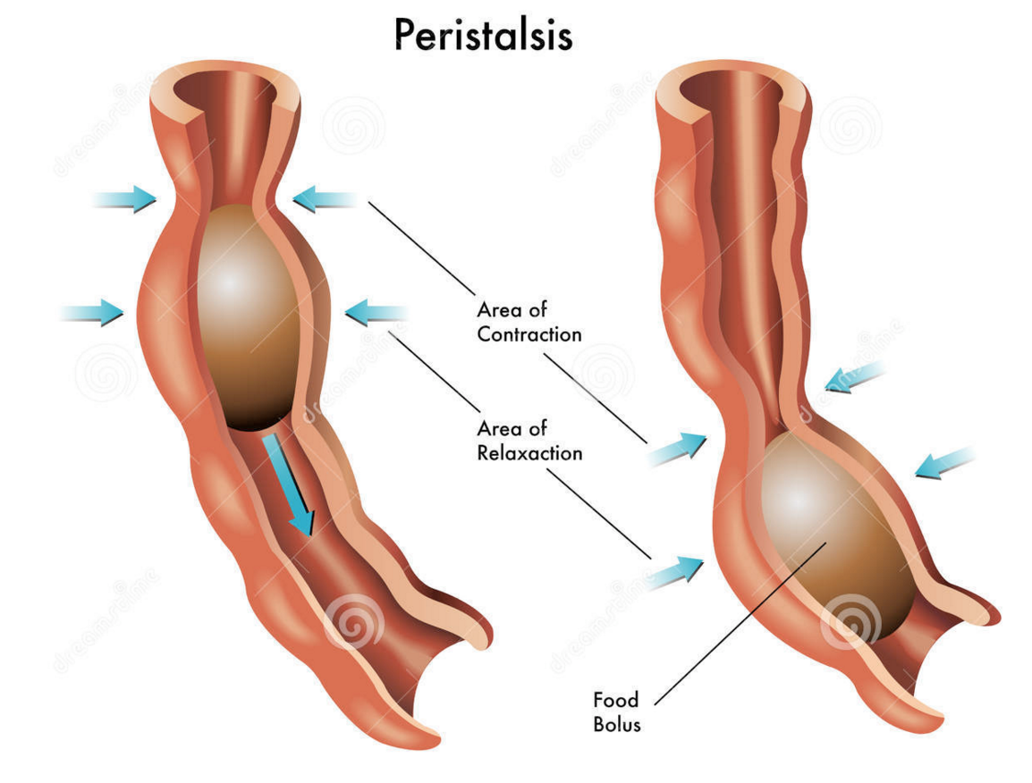
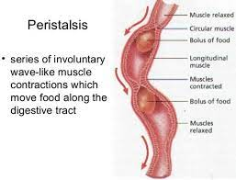
This lubricates the food and the membranes of the system which enables the food to move easily.
The muscular walls of the various parts of the system push the food along by means of regular contractions known as peristalsis.

Slide 7
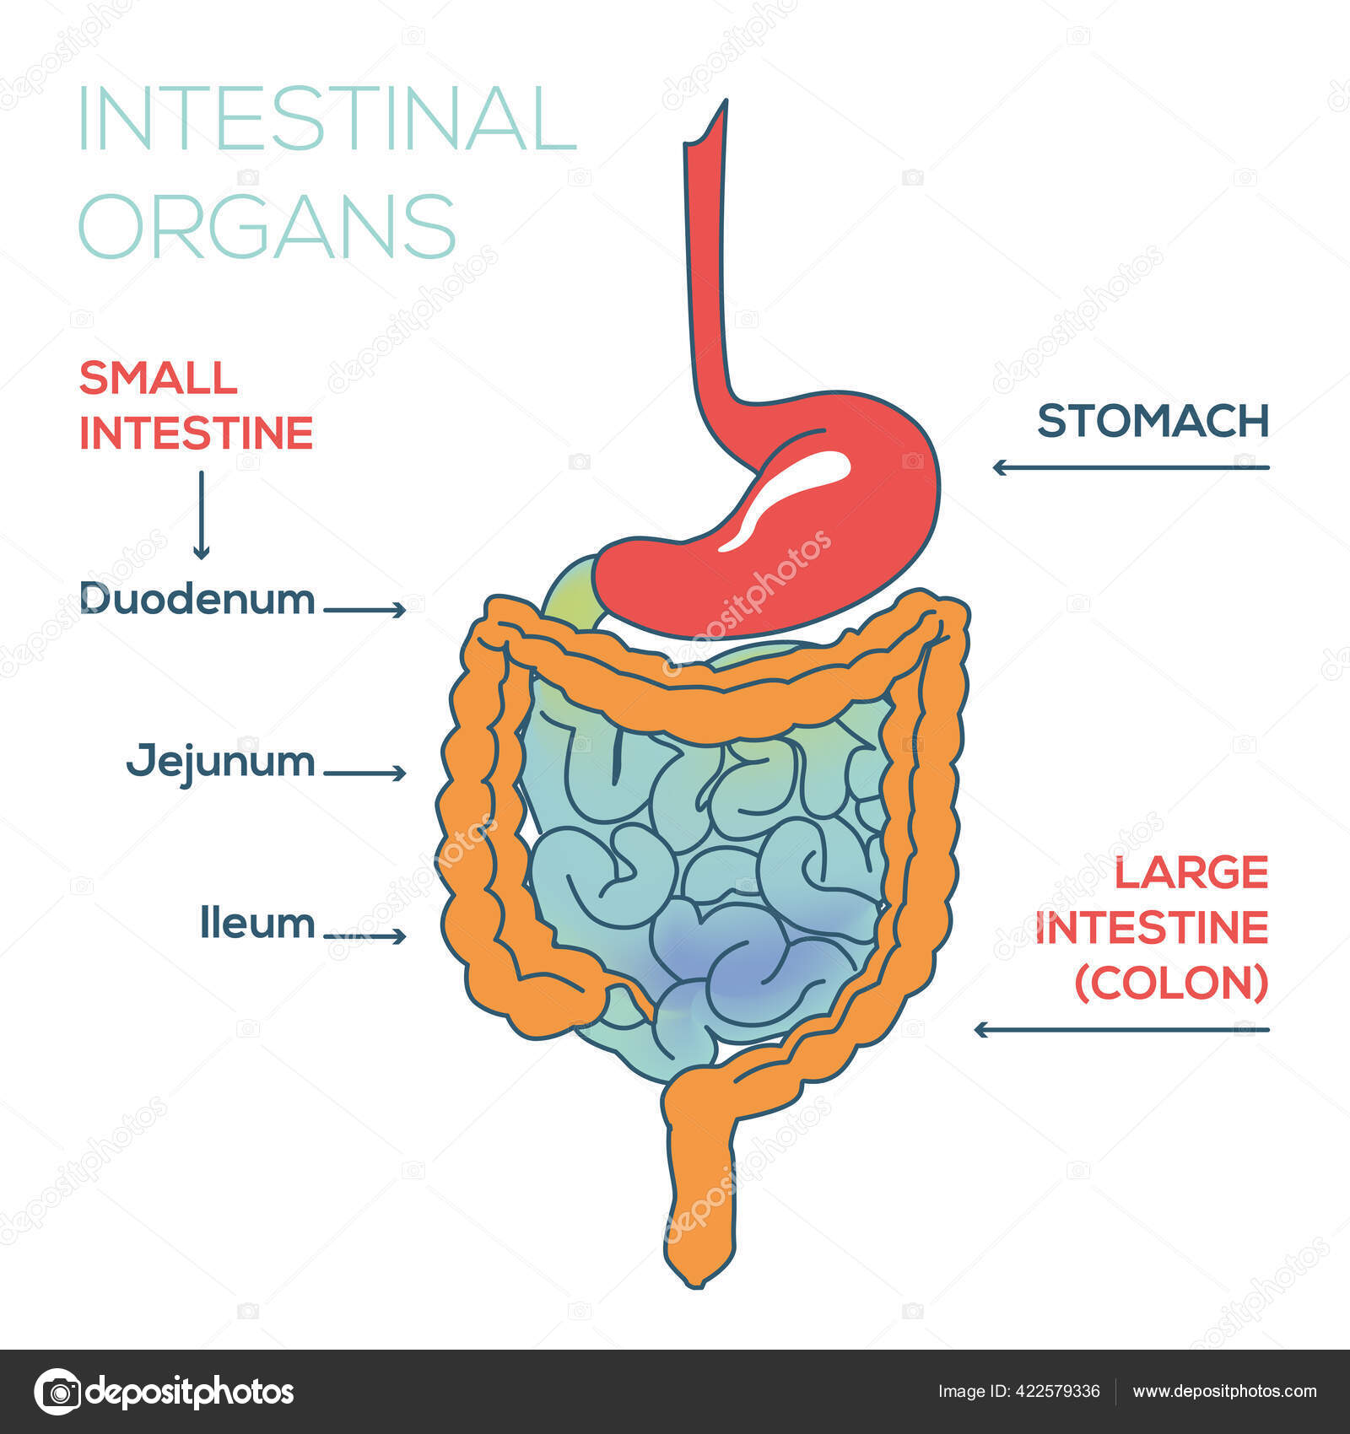
Digestion at each stage of the digestive system:
Mouth
Oesophagus
Stomach
Duodenum
Ileum

Slide 8
1. Mouth Past Paper Question
Physical breakdown
Chemical breakdown
Teeth: tear, rip and grind into pieces small enough to swallow.
Tongue: pushes the food round the mouth and down the throat.
Salivary glands: produce saliva to moisten food and make it easy to swallow.
Protein: None.
Fat: None.
Carbohydrate: salivary amylase produced by the salivary glands converts some starch to maltose. Cooked starch is acted on more quickly than raw starch.

Slide 9
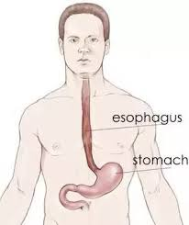
2. Oesophagus:
Food is transported down to the stomach by peristalsis.
( it is not a chemical or physical breakdown, it is a movement .
No physical or chemical breakdown.

Slide 10
3. Stomach Past Paper Question
Physical breakdown:
- food enters the stomach via sphincter muscle.
- strong muscular waves move the food around and help it to breakdown and mix with gastric juices and mucus produced in the stomach.
-broken-down food is chime. ( food+enzyme)

Slide 11
Chemical breakdown:
*Protein:-pepsin starts the breakdown of protein into smaller chains of amino-acids called peptides.
-Rennin clots milk so that pepsin can act more efficiently. More rennin is produced in young mammals.
*Fat: None.
*Carbohydrate: -Hydrochloric acid (HCl) produced by the stomach stops the action of salivary amylase, and helps pepsin to work.
-Food stays in the stomach about 4-5 hours, and leaves in small amounts via the pyloric sphincter muscle.

Slide 12
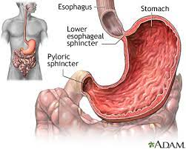

Slide 13
4. Duodenum Past Paper Question
Physical breakdown: None.
Chemical breakdown:
Trypsin continues the breakdown of proteins to peptones.

Slide 14
*Fat: -Bile emulsifies fats to disperse them in the liquid in small droplets, and pancreatic lipase breaks fat into soluble glycerol and insoluble fatty acids.
- Fatty acids react with the bile to become soluble.
*Carbohydrate: - Pancreatic amylase breaks down undigested starch to maltose.

Slide 15
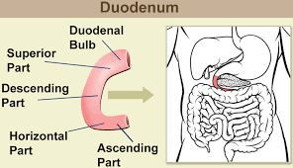

Slide 16
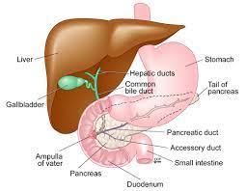
* Functions of bile: (From the gall bladder)
Past Paper Question
Bile neutralizes the acid and stops the action of pepsin.
Emulsifies fat to small droplets.
Reacts with insoluble fatty acids and makes them soluble.

Slide 17
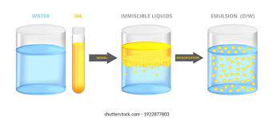

Slide 18
5. Ileum Past Paper Question
Physical breakdown: None.
Chemical breakdown: The glands produce intestinal juice which contains a variety of enzyme.
*Protein: - Erepsin converts peptones to amino-acids to complete protein digestion.
*Fat: Further broken down by lipase.

Slide 19
*Carbohydrate:
- Maltase breaks down maltose to glucose.
-Invertase breaks down sucrose to glucose and fructose.
-Lactase breaks down lactose to glucose and galactose.

Slide 20
Protein
peptides
peptones
amino - acids
Polysaccharides Disaccharides Monosaccharides

Slide 21
Some important notes:
Digestion: breakdown of food molecules, so that it can be absorbed.
What are the end products of the digestion process?
Amino acids are the building blocks of protein.
Glucose is the base unit of carbohydrate.
Glycerol and 3 fatty acids make fat molecule.

Slide 22
What are the functions of enzymes?
Speed up the chemical reaction and the release of energy.
What is the function of mucus (Saliva)?
Lubricates the food and the membranes of the system, which enables the food to move easily.
What are the functions of bile? (from gall bladder)
Bile neutralizes the acid and stops the action of pepsin.
Emulsifies fat to small droplets.
Reacts with insoluble fatty acids and makes them soluble.

Slide 23
Absorption of nutrients
Small intestine:
The absorption of nutrients occurs in the small intestine, along its whole length.
Alcohol is the only substance that can be absorbed elsewhere, usually in the stomach.
Food is passed along the small intestine slowly, taking about 2-3 hours to reach the large intestine. This allows plenty of time for absorption to take place.

Slide 24
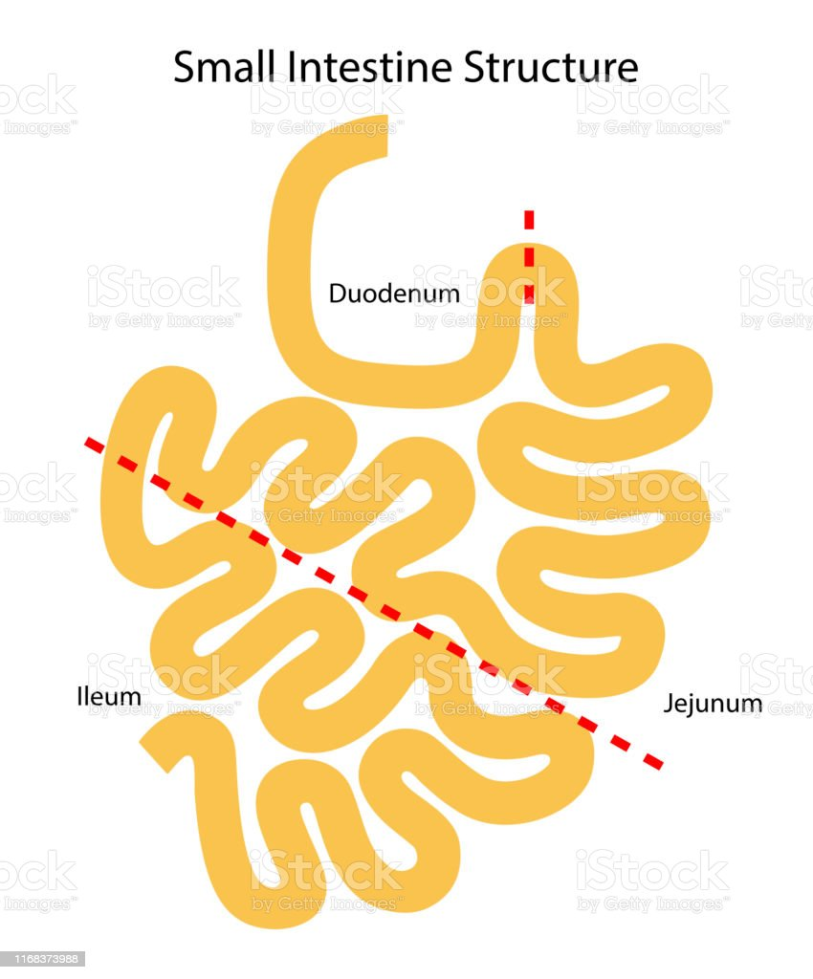

Slide 25
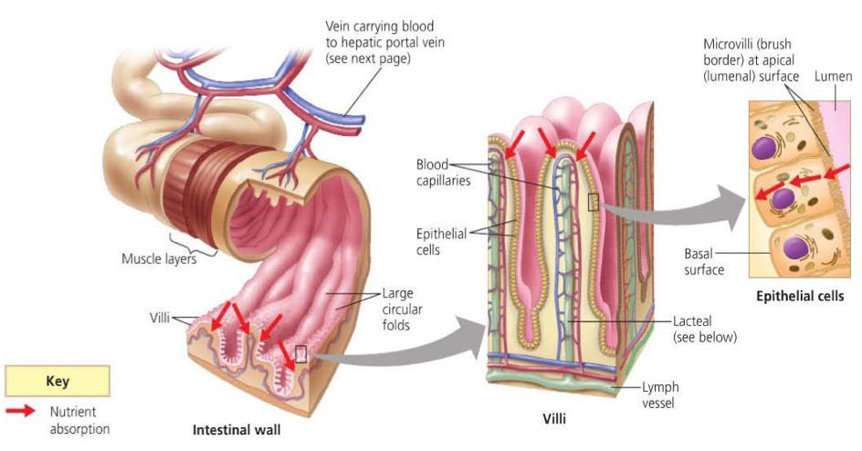
Past Paper Question
The walls of the intestine are lined with thousands of tiny finger-like projections called villi.
Each villus is surrounded by a wall of single cells, through which nutrients pass, to reach the center.

Slide 26
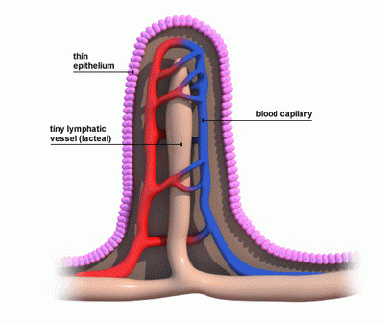
In the center is the lacteal which is connected to the lymphatic system. The lacteal is surrounded by tiny blood capillaries, which are connected to larger blood vessels.

Slide 27
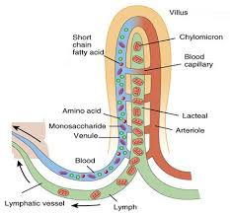
Absorption of the various nutrients occurs as follows:
- Monosaccharides, amino acids, water-soluble vitamins, and minerals are all absorbed into the blood capillaries, where they dissolve in the blood, and are carried away to other parts of the body.

Slide 28
Glucose is either used immediately for energy, or converted (along with other monosaccharides) to glycogen and stored in the liver and muscles.
Glycerol and fatty acids are absorbed into lacteal where they recombine to form fats, which mix with the lymphatic fluid.
They pass round the body in the lymphatic system, and join the blood circulation as insoluble fat. They are converted to soluble fat in the liver.
The fat-soluble vitamins are absorbed with the fats, and are taken to the liver as well.

Slide 29
2. Large intestine:
After the nutrients have been absorbed, the waste products and food residues pass into the large intestine, still in a liquid state.
Water is absorbed along the large intestine, making the food residues (faeces) more solid.
This may take up to 12 hours, and the faeces finally collect in the rectum, ready for excretion.
The whole process is assisted by dietary fibre (NSP) in food.

Slide 30
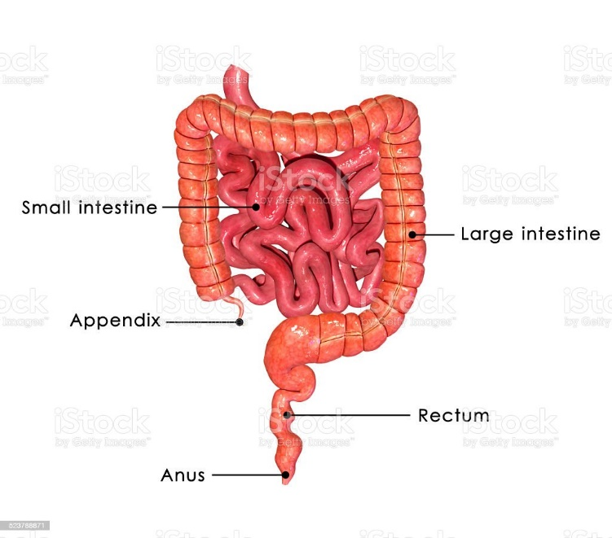

Slide 31
Digestion and cooking Past Paper Question
Digestion is assisted by the cooking of foods to soften and tenderize them, e.g.
Meat- cooking breaks down tough connective tissues and makes the meat more digestible.
Cheese- fat surrounding the protein melts, exposing the protein for digestion.

Slide 32
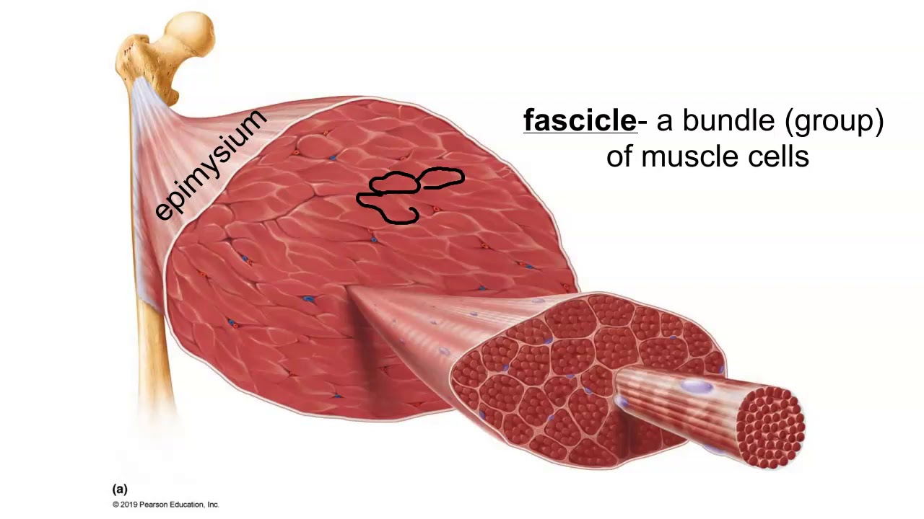
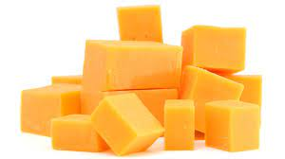

Slide 33
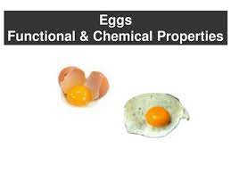
Cooking also renders some foods more solid so that the enzymes are able to act upon them more efficiently, e.g.
Eggs- cooking them lightly coagulates the protein, thus making them set so that they stay in the stomach for longer.

Slide 34
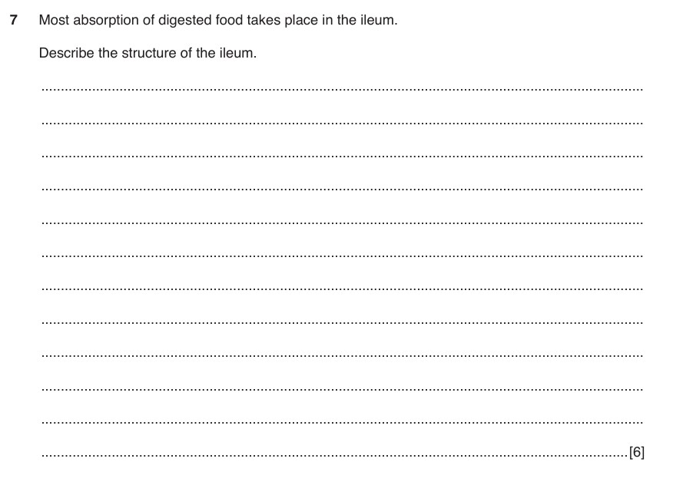

Slide 35
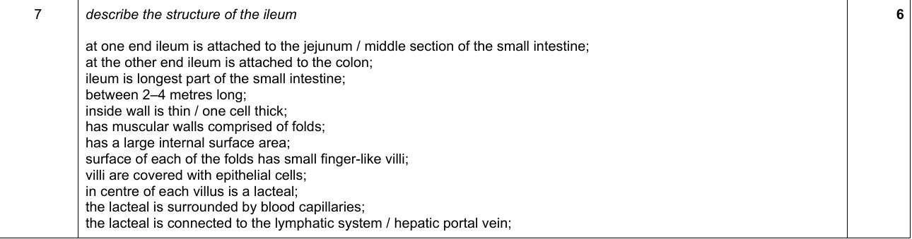

Slide 36
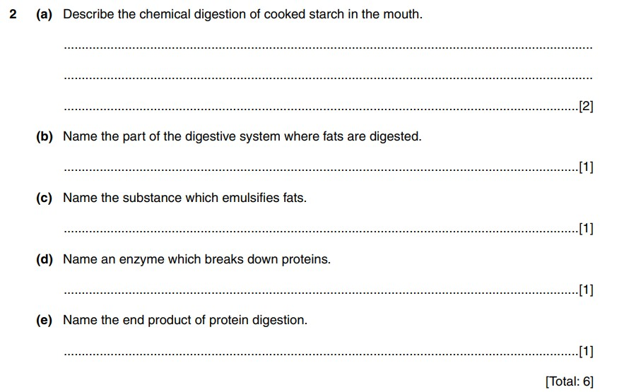

Slide 37
