Slide 1
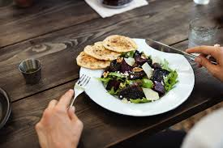
The nutrient content of food

Slide 2
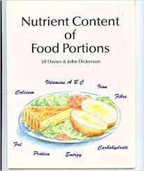
It is difficult to measure accurately:
-The amounts of different nutrients that people eat everyday.
-The amounts that are present in the food they consume.

Slide 3
The nutritional value of different foods is affected by:
The species or type of plant or animal.
Where and how they are grown or reared.
The effect of harvesting and slaughter.
The time taken to transport food.
The effect of processing the food in a factory.
The amount of wastage when preparing a food.
The effect of various processes and cooking practices in the kitchen.

Slide 4
The way food is prepared for consumption in the kitchen has an important effect on the nutritional content.
Some processes and practices lead to a loss of nutrients.
Others conserve or enhance the nutritional value of food.

Slide 5
*Practices that lead to a loss of nutrients
Past Paper Question
Heating
Destroys some Vitamin C, thiamin, and riboflavin.
Overheating protein leads to hardening and reduced digestibility.
Keeping food hot further destroys Vitamin C, thiamin, and riboflavin.

Slide 6
2. Soaking
- Leads to loss of Vitamin C, thiamin, riboflavin, and nicotinic acid into the liquid.
3. Exposure to air
a. Leads to the oxidation of Vitamin C in vegetables, fruit, and fruit juices.
b. Leads to gradual deterioration of fat, and rancidity.
4. Exposure to light
-Leads to the destruction of riboflavin and Vitamin A.

Slide 7
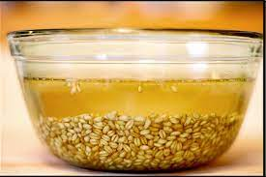
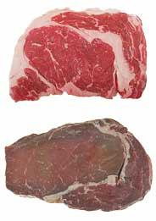
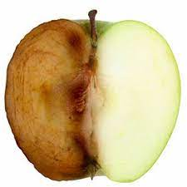

Slide 8
*Practices that conserve nutrients
Past Paper Question
Steaming
- Water-soluble vitamins are retained more effectively as food does not come into direct contact with water.
2. Stews and gravy
-Preparation of gravy from vegetables, cooking water retains some water- soluble vitamins.
- Water-soluble vitamins are retained in liquid used in a stew.

Slide 9
3. Pressure cooking
- Less destruction by heat as cooking time is reduced.
4. Preparing vegetables
a. Preparation just before cooking prevents the oxidation of Vitamin C.
b. If vegetables are prepared some time before they are to be cooked, they can be stored in an air- tight bag to prevent the oxidation of Vitamin C.
c. Placing green vegetables into boiling water, for cooking without pre- soaking, reduces the loss of water-soluble vitamins by leaching.
d. Minimum cooking time reduces heat destruction of Vitamin C, thiamin, and riboflavin.

Slide 10
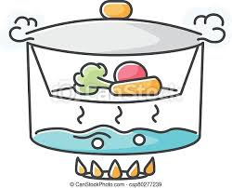
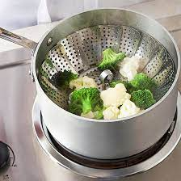

Slide 11
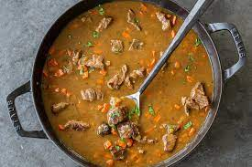
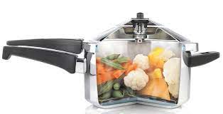
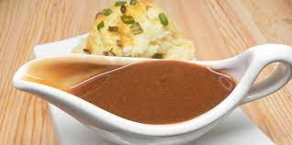

Slide 12
*Practices that enhance nutritional value
Combining food
a. The combination of low biological value protein foods (e.g. bread with lentil soup, baked beans on toast) means that indispensable amino- acids lacking in one food, can be provided by the other.
b. The combination of Vitamin C with foods containing iron enhances the absorption of iron from the small intestine.

Slide 13
2. Preparing food
a. The preparation of curry spices in iron pots leads to iron passing into the spices.
b. Grating cheese enables the fat to be more easily digested.
c. Homogenizing milk, reduces the size of fat droplets, which enables them to be digested easily.

Slide 14
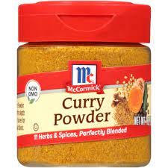
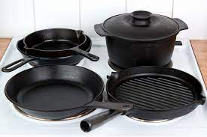
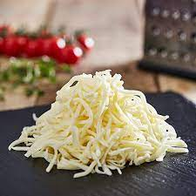

Slide 15
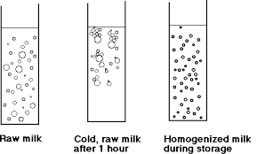
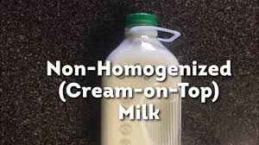

Slide 16
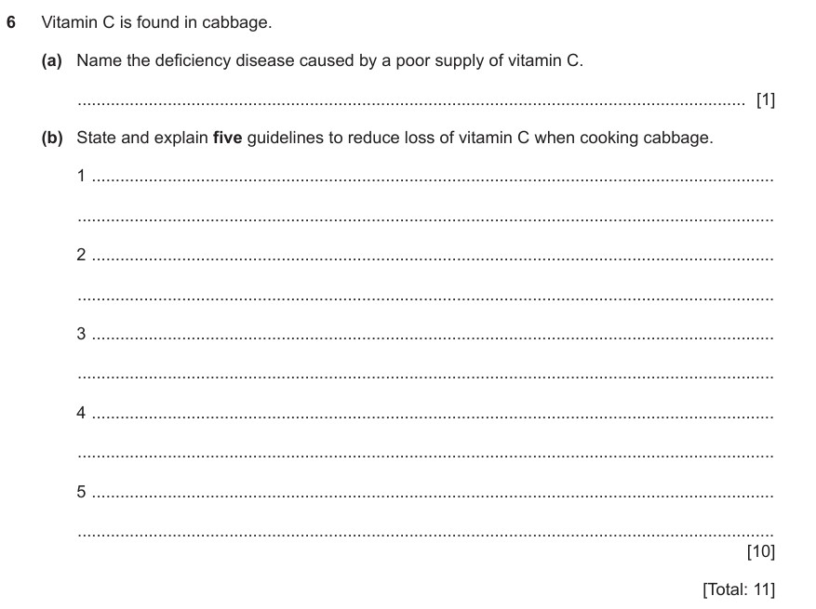

Slide 17
