Slide 1
Present Simple
&
Present Progressive

Slide 2
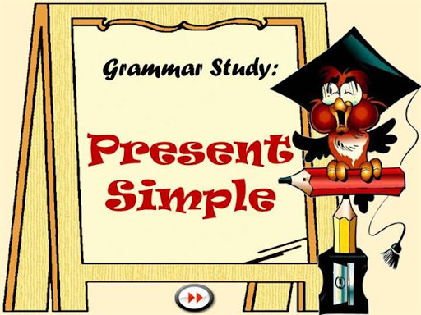

Slide 3
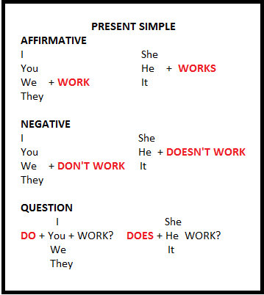

Slide 4
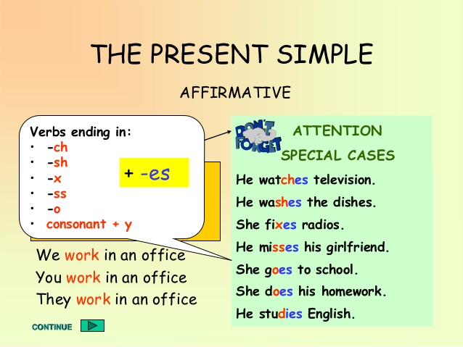

Slide 5
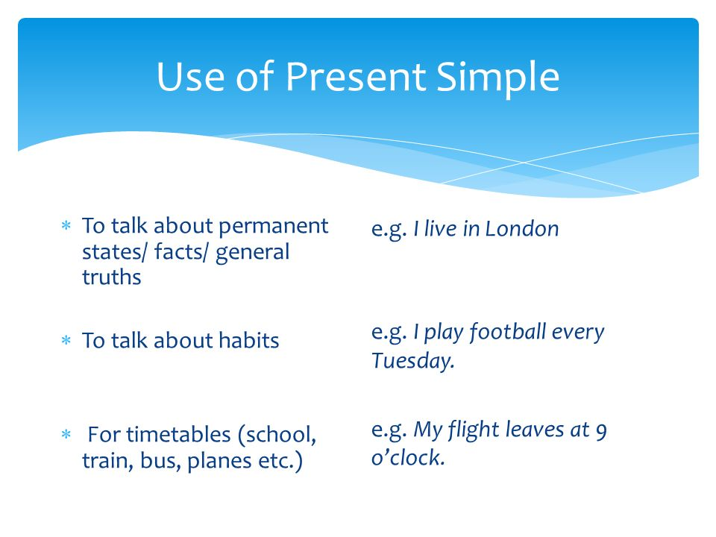

Slide 6
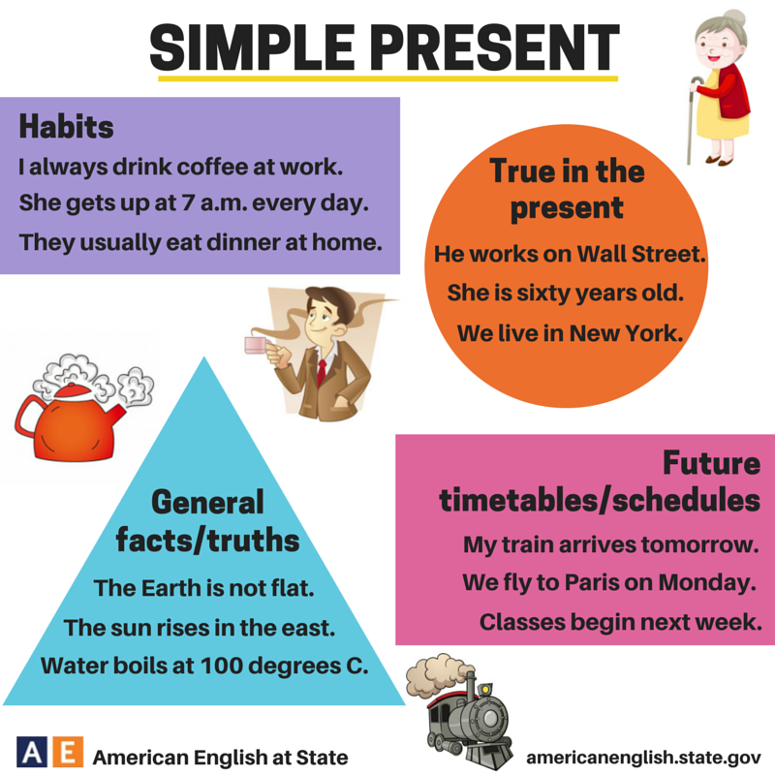
Permanent states

Slide 7
Present simple exercises
She always __prepares________ her lunch before school. (prepare)
You ____play______ basketball once a week. (play)
They ___visit_______ us often. (visit)
In this club, people usually _____dance_____ a lot. (dance)
He always ___tells_______ us funny stories. (tell)
John rarely ___leaves_______ the country. (leave)
Martha and Kevin ___swim_______ twice a week. (swim)
Linda ___takes care_______ of her sister. (take care)

Slide 8


Slide 9
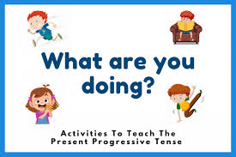

Slide 10
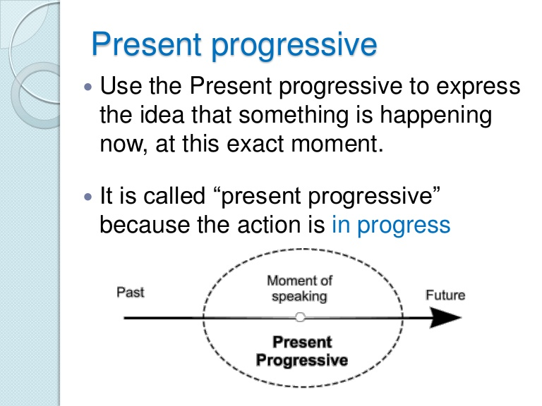

Slide 11
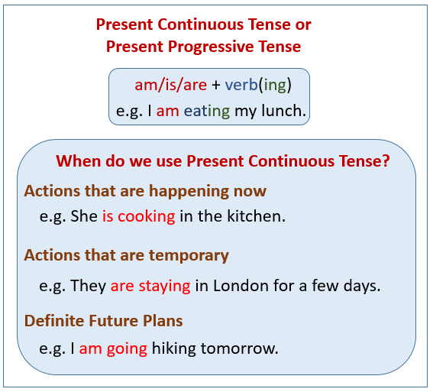

Slide 12
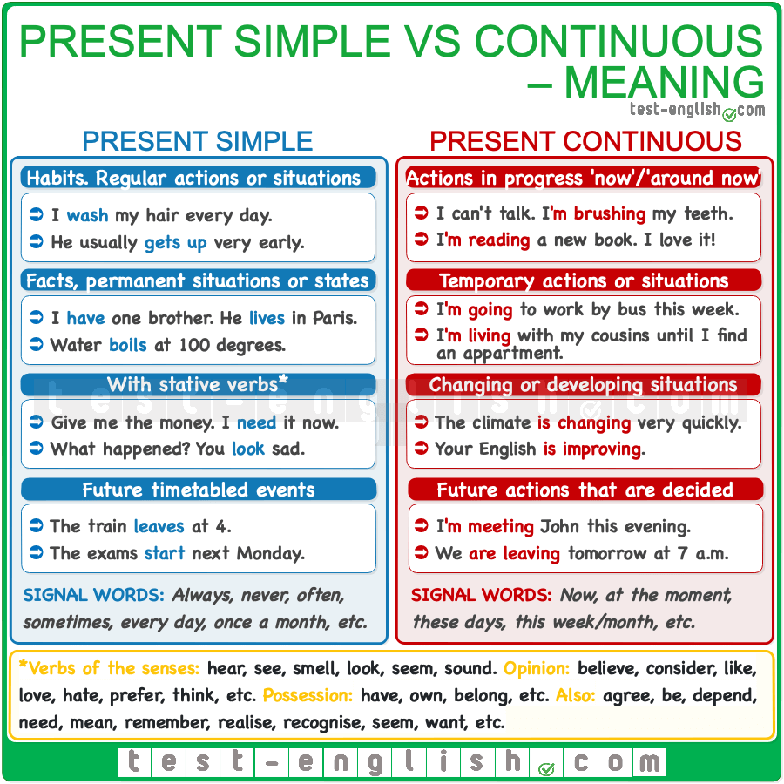

Slide 13
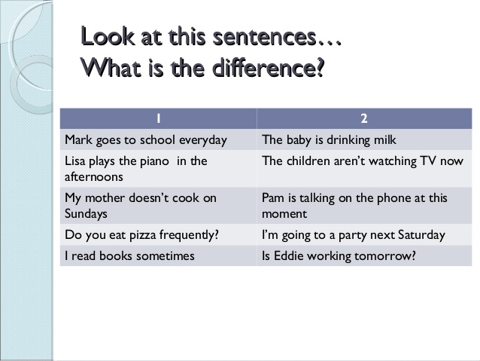

Slide 14


Slide 15
Cross out the wrong word(s).
1. I’ve changed jobs, I (work / working) for an insurance company. I (am talking / talk) to clients and I (organise / am organising) their insurance policies. At the moment, I (complete / am completing) a fire insurance form.
2. Peter: What (are you reading/ do you read), Jack?
Jack: I (read/ am reading) a mystery novel. I (am loving/ love) reading in my free time.

Slide 16
3. Simon: What (are you doing/ do you do) here at the club, Jane?
Jane: I (wait/ am waiting) for a friend. We (meet/ are meeting) here every Wednesday afternoon and then we (are playing/ play) squash.
4. Commentator: Stevenson (takes /is taking) the ball and (is passing/ passes) it to McFerry. McFerry (is kicking/ kicks) the ball to Hawk and …Yes! Yes! He (scores/ is scoring)! It (is being / is)a goal, with just one minute left in the game. Hawk (is playing/ plays) beautifully this season!

