Slide 1
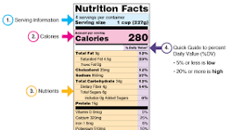
Food Labelling

Slide 2
Food manufacturers invest much money and time in designing packaging to attract customers to their food products.
their aim is:
1 To inform consumers about all the words, pictures, descriptions, trade marks, symbols, or brand names that appear on a food label.
2 To make sure that labels do not mislead consumers about: what the food is (its nature and identity) where it comes from (its country of origin) who made it (its manufacturer) what is in it (its composition) how it was made (its method of manufacture) how much there is (its quantity) how long it will safely keep (its shelf-life and durability) what it will look, taste, smell, and feel like (its properties)

Slide 3
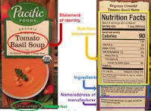
3 To make sure that the label does not make a false claim about the food, e.g. ‘aids weight loss’, without evidence to support the claim.

Slide 4
labels must show:
1 The name of the product, including any treatment the food has had, e.g. UHT milk, smoked haddock, freeze-dried coffee.
2 A list of ingredients, including additives, in descending order of weight.
3 The net quantity (for pre-packed foods) - the weight of the food without the packaging. A large letter ‘e’ after the weight means that, although the average quantity must be right, the weight in individual packs may vary slightly.

Slide 5
4 Instructions about storage, cooking, or use.
5 How long the food will be at its best. There are two ways of showing this: ‘best before’ or ‘best before end’ tells how long the product will be in its best condition if kept according to instructions on the label. It is shown as day/month/year unless the product has a shelf-life of less than 3 months, in which case the year is not shown.
If eaten after the best before date, the food may not cause food poisoning, but will not be in best condition ‘use by’ tells how long the food will be safe to eat if stored correctly. This is used for perishable foods, such as cream and fish, which would become a health hazard if kept too long. Freezing can prolong the safe storage of some perishable foods.

Slide 6
6 The name and address of the manufacturer, packager, or retailer.
7 The place of origin - where the food was originally grown or produced.

Slide 7

Difference between use-by date & best-before date

Slide 8
why there is a use-by date on the chicken or meat sandwich packaging
contains chicken / meat;
chicken / meat is a high risk / perishable food;
food should be eaten by this date to reduce the risk of food poisoning / so it is safe to eat;

Slide 9
benefits to the consumer of the manufacturer’s contact details on a food label
can see where product was manufactured
in case of moral / ethical reasons;
in case of complaint; in case of query;
in case they want to compliment / make a suggestion / provide feedback to the manufacturer;
* safety details that may be found on a food package label
allergy information;
cooking instructions;
date mark / use by date;
ingredients list;
storage information;

Slide 10
benefits of picture of product
can compare with other similar product pictures before purchasing / decide if they want to purchase the product;
can see from picture if it is the right product / easier to get correct product e.g. cake with pink icing;
consumer knows what to expect inside / can see what is in the package / shows what you will be buying;
useful if label is not in language of country where product is being sold;
visual image is useful for people with limited reading skill;

Slide 11
benefits of cooking instructions
can decide to purchase or not if they have the correct equipment available for suggested cooking method;
can decide to purchase or not if they have got the suggested time to cook the product / it will not be too expensive of fuel to cook the product;
consumer is inexperienced cook / can judge whether they are capable of following instructions;
if it is a new product to consumer who may need guidance on how to cook the product;
to achieve best results / cook food properly / prevent wastage by incorrect cooking;
to avoid illness / food poisoning;

Slide 12
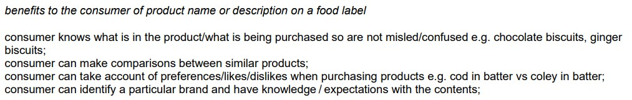
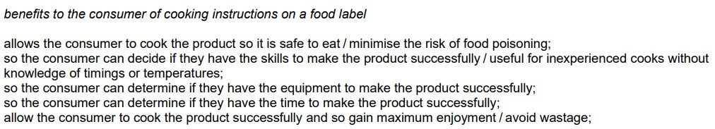

Slide 13
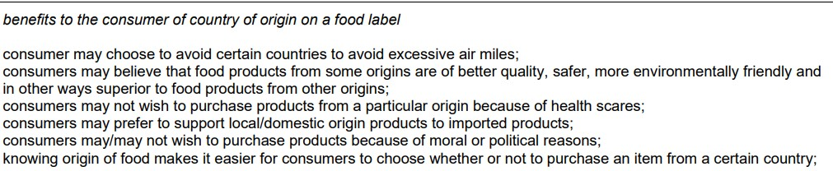

Slide 14
