Slide 1
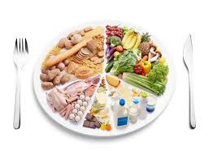
Dietary Guidelines

Slide 2
There has been researches into the effect that food has on people’s health, well being, and life expectancy.
People with certain health conditions e.g. :
High blood pressure.
High levels of blood cholesterol.
Heart disease.
diabetes.
Chronic constipation.
- May require more or less of the nutrient than that are required.

Slide 3
The dietary recommendations for a healthy lifestyle include:
Eat less sugar.
Eat less fat.
Eat more fibre and starchy foods.
Eat less salty food.
Drink less alcohol.
Eat a variety of foods.
Enjoy your food.
Eat more fruit and vegetables.
Eat the right amount to maintain a healthy weight.

Slide 4
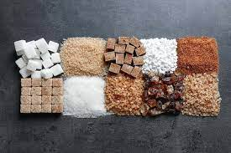
1. Eat less sugar:
It is recommended that refined (extrinsic) sugars provide no more than 10% of total energy intake.
This will help reduce cases of dental caries and obesity.

Slide 5
*Reducing sugar consumption:
Past paper Question
Avoid adding sugar to drinks, and choose soft drinks that have a reduced sugar content or contain sugar substitutes.
Include more naturally sweet foods, e.g. fruits, in meals, without adding more sucrose to them.
Use sugar-reduced products, such as fruit canned in fruit juice, jams, and other spreads, which are available in shops.

Slide 6
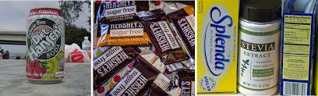
4. Gradually cut down the amount of sugar, normally added to items such as custard, breakfast cereals, cakes, and biscuits.
5. Restrict the consumption of sweets and other sugar- containing snacks, so that they become a treat rather than a habit.

Slide 7
2. Eat less fat
It is recommended that total fat intake is no more than 35% of total energy intake.
No more than 11% of energy intake should come from saturated fat.
This will help reduce the risk of developing heart disease.

Slide 8
*Reducing fat consumption:
Past paper Question
Use low-fat dairy products e.g. yogurt ( used as substitute for cream), cheeses (e.g. cottage), skimmed and semi-skimmed milk in cooking and for normal consumption.
Make more use of poultry and white fish, both of which contain less fat than red meat.
Avoid fried foods, and grill or bake instead.

Slide 9
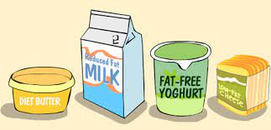
4. Make more use of low-fat spreads as a substitute for margarine or butter.
5. Become aware of foods such as sausages, cakes, crisps and pastries, that have a high (hidden) fat content (i.e. fat which is not visible) and restrict the consumption of these.
6. Make more use of fat-reduced products, e.g. canned fish in brine, low-fat salad dressings.

Slide 10
3. Eat more fibre (NSP) and starchy foods
It is recommended that the intake of fibre is at least 30 g per day.
This will help to prevent the development of intestinal disorders.
Starchy foods are filling and help to reduce the need to eat between meals.

Slide 11
*Increasing dietary fibre consumption:
Past paper Question
Make more use of whole grain cereal products in cooking, e.g. Wholemeal flour instead of white, wholegrain rice, and Wholemeal pasta.
Eat Wholemeal or wheatmeal bread instead of white bread.
Eat more fresh fruit and vegetables.

Slide 12
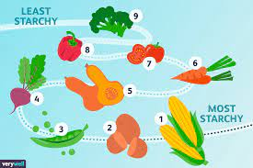
4. Choose breakfast cereals and snacks that are rich in fibre and, preferably, low in sugar.
5. Add a little bran to soups and casseroles.
6. Make more use of pulses, many of which are rich in dietary fibre.

Slide 13
4. Eat less salt:
It is recommended that the intake of salt is no more than 6 g per day.
*Reducing salt intake: Past paper Question
Try alternative flavours to salt (e.g. spices and herbs) when cooking, or if a salty flavour is required, make use of salt substitutes which contain less sodium.
Reduce the amount of salt added to cooked items, such as vegetables and soups, and the amount added to meals at the table.

Slide 14

3. Cut down on salty snack foods ( roasted peanuts and crisps).
4. Reduce the number and amount of foods eaten, that have salt added as part of their processing e.g. bacon, cheese, sausages, cooked meats, smoked fish, canned vegetables in brine.

Slide 15
5. Drink less alcohol
It is recommended that the amount of energy obtained from alcohol is no more than 4 % per day.
This would lower the risk of damage to the liver, and help prevent obesity.

Slide 16
6. Eat a variety of foods and enjoy your food
To follow dietary guidelines, checking lists of ingredients and working out the amount of fat, sugars, fibre, etc….. in food is time consuming and not always easy.
National Food Guide, shows the relative proportions of different groups of foods people should aim to eat, to encourage them to eat a variety.

Slide 17
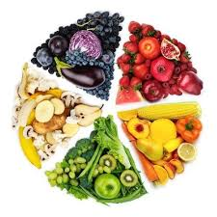
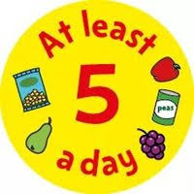
The ‘5 a day’, aims to increase the consumption of fruit and vegetables.
Shows the link between antioxidants in fruit and vegetables and the prevention of heart disease.
Eat at least 5 portions a day of fruit and vegetables, fresh, frozen or canned.

Slide 18
7. Eat the right amount to maintain a healthy weight
People are encouraged not to over eat, because of the risk of becoming obese.
Energy-dense foods, those with a high fat or sugar content should be eaten in small amounts.
Cooking methods that add fat to foods, such as frying, should be avoided and substituted with grilling or baking.
Eating too little food can also have serious effects on health.

Slide 19
Following the guidelines
Food labels, advice leaflets from supermarkets and health centers, and books about food can be helpful.
Healthy eating should begin when a baby starts eating solid food.
Encouraging baby to:
- eat variety of foods, including fruit and vegetables.
- Low-sugar foods, and wholegrain cereals.

Slide 20
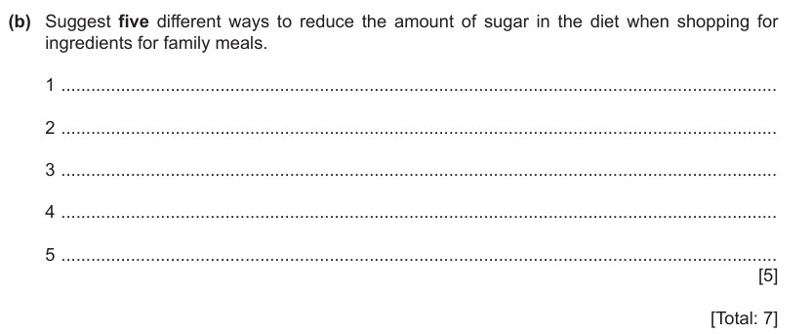

Slide 21
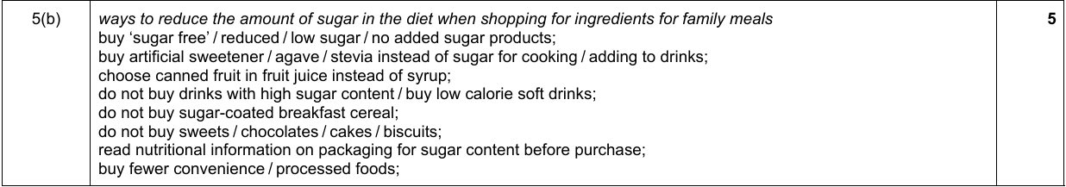

Slide 22
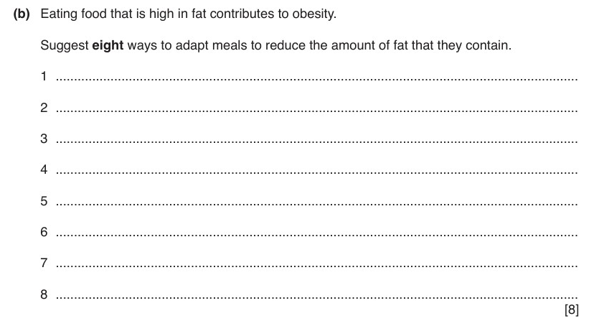

Slide 23
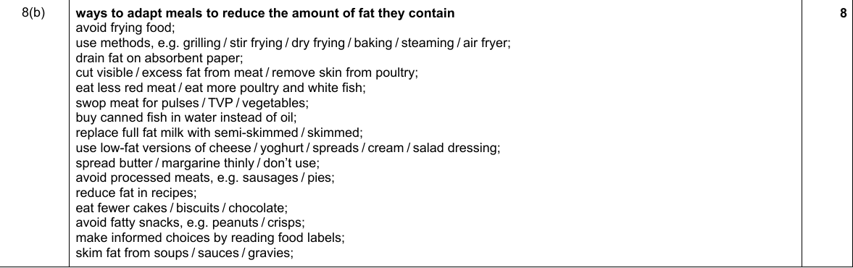

Slide 24
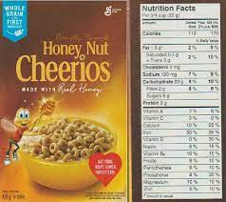
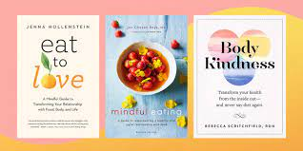
It is then easier to continue good eating habits into childhood and later life.

