Slide 1

Creating Reports
Using MS Access
Q&A Activity: https://wordwall.net/resource/101011846/untitled7

Slide 2


Slide 3
Learning objectives:
14/11/2023
2 sessions
The student should be able to:
Learn the importance of creating Reports within a database.
Create a report from the report wizard command.
Use options like sorting and grouping the data while
creating the report.
Open, save and close a report.
Understand the main purpose of creating report.
Preview and print the report.
Change the layout for a form in Form layout view.

Slide 4

The importance of creating Reports within a database
Importance of creating a report in Access: It helps you summarize, organize, and present data clearly from your database. Reports turn raw data into readable information for decision-making or printing.
Main goal: To display and analyze data in a professional, understandable format, showing totals, summaries, and key details—making it easier to share insights with others such as managers, teachers, or clients.

Slide 5
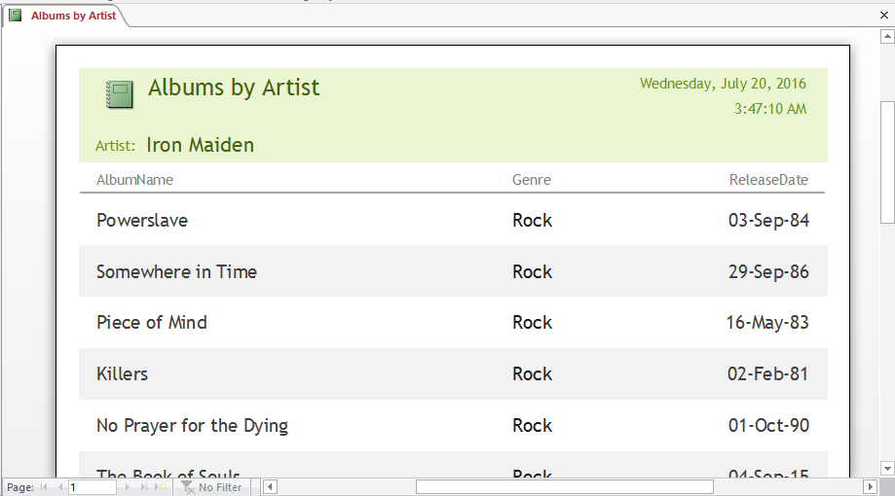
Report Definition:
A report is the Fourth of the Database Objects .
A report is the representation of data in a printed format.
Report is designed for formatting, calculating, printing, and summarizing selected data.
For example, you can create a simple report of students’ marks for all Grades.
Reports are useful because they allow you to present components of your database in an easy-to-read format.
We can build the report from a table or Query.
So a report consists of information that is pulled from tables or queries .

Slide 6
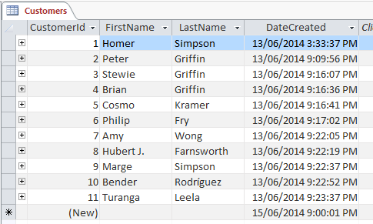
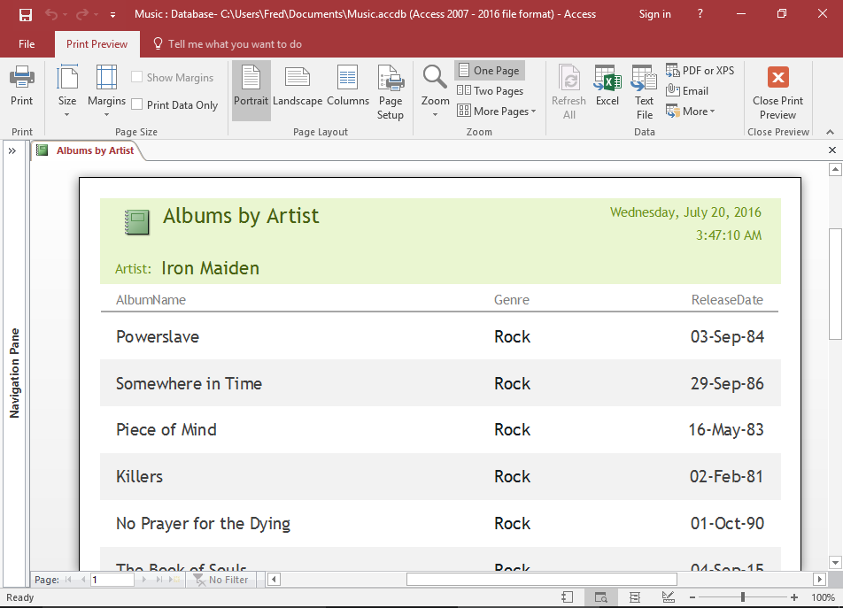
A table and form are used for Data Entry
A report is used to print , read and share data are not used for Data Entry
Printing Settings
Adding New Record

Slide 7
Notes: Keep the following in mind:
The report wizard is a user interface design pattern that enables users to achieve a goal through a series of steps.
The report is designed for printed format ,not used for Data entry.
Accept default settings .
We can build the report from a table or Query.
Change the layout for a report in Report layout view
Use the Print Preview to see how the report will look on paper when printed.
Preexisting value or setting
Don't change any selected option

Slide 8
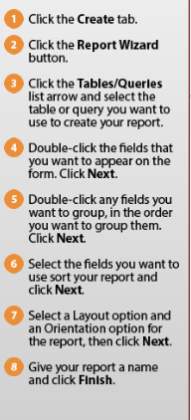
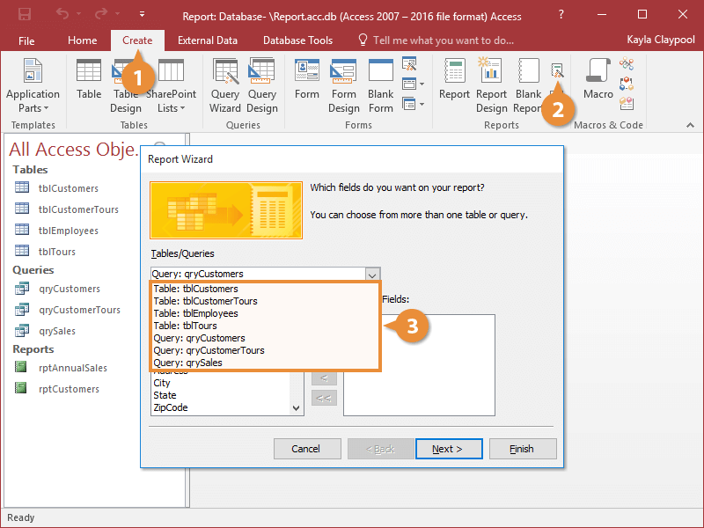
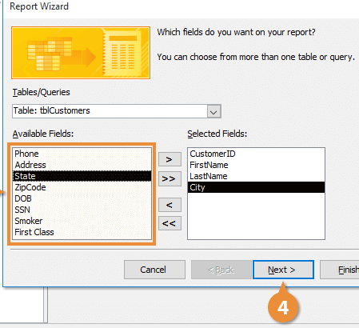
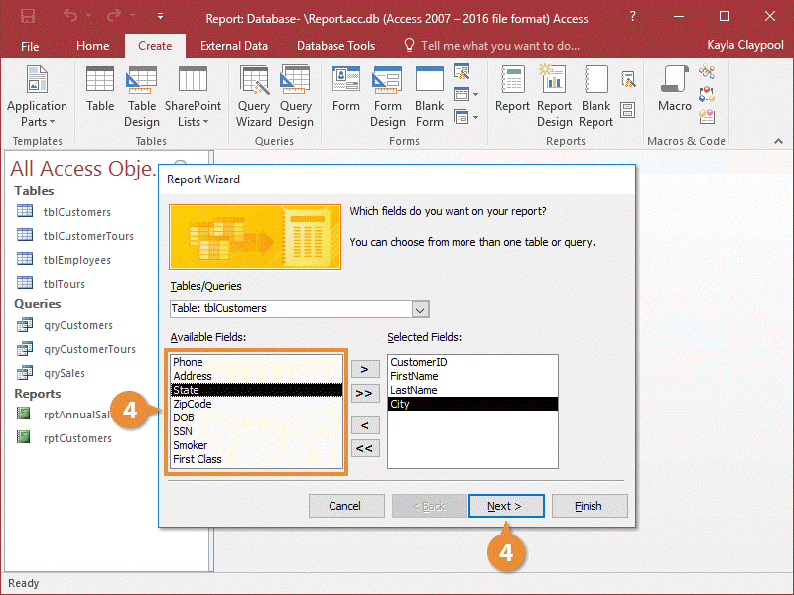
To create a report from a table , using the report wizard do the following:
Open the fruit market Database from your folder. Create a simple report with the name Deliveries_2023 from the Deliveries table using all fields ,grouped by the New Supplier field. Accept all the default settings.

Slide 9
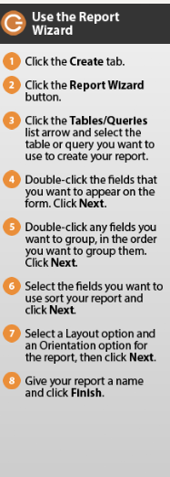
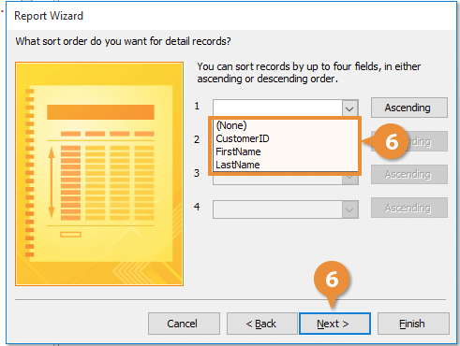
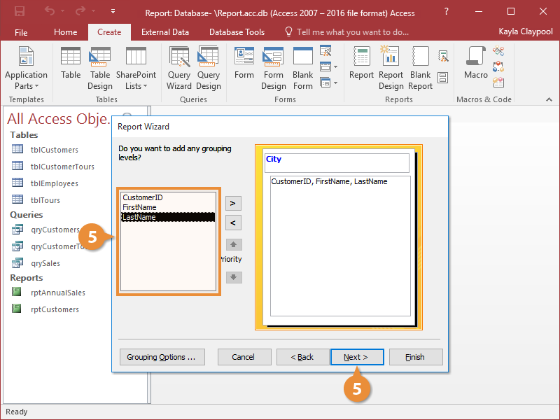
To create a report from a table , using the report wizard do the following:

Slide 10
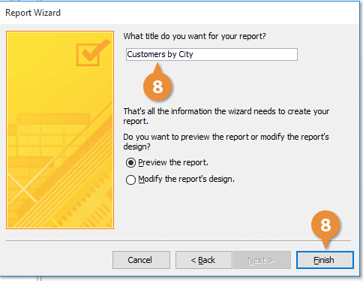
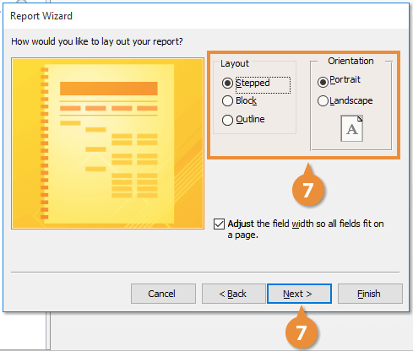
To create a report from a table , using the report wizard do the following:

Slide 11
Learning objectives:
15/11/2025
The student should be able to:
In layout view ,changing the layout for a report (formatting and rearrangement) .
In Design view ,Adding labels for static text, logo, background image, number of pages, date and time, title and image

Slide 12
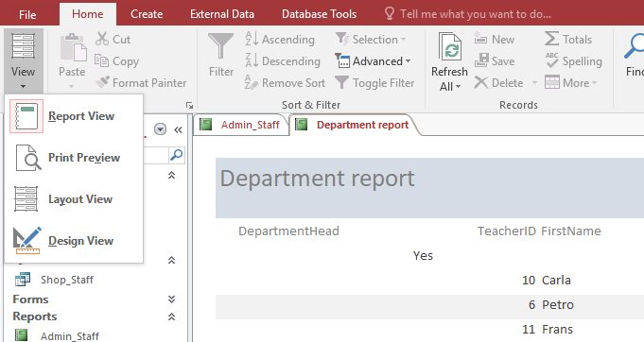
Change Report Views
Click the View list arrow on the ribbon and select a view option.
1

Slide 13
Change report Views
Before modifying a report , you need to know that reports can be viewed several different ways:
Report View: The normal view where you can view records only. You cannot add, edit, or delete data, and you cannot modify the design of the report in this view.
Layout View: Layout View allows you to apply formatting ,resize and rearrange fields while viewing live data.
Design View: Use for in-depth modification ,customization and calculation of your report. Live data is not visible—you're only working with the structure of the report.
Print Preview: Use the Print Preview to see how the report will look on paper when printed.

Slide 14
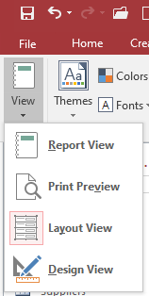
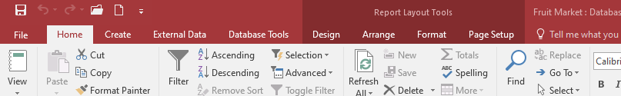
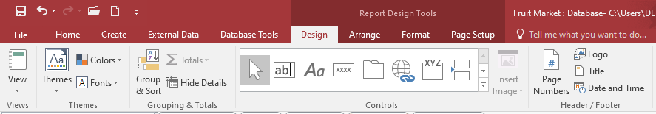
Change the layout for a report from the layout view :
Layout view is used for report modification, and can be used for nearly all the changes you would want to make to a report in Access. Using the Report Layout Tools menu
The report you see in Layout view does not look exactly the same as the printed report.

Slide 15
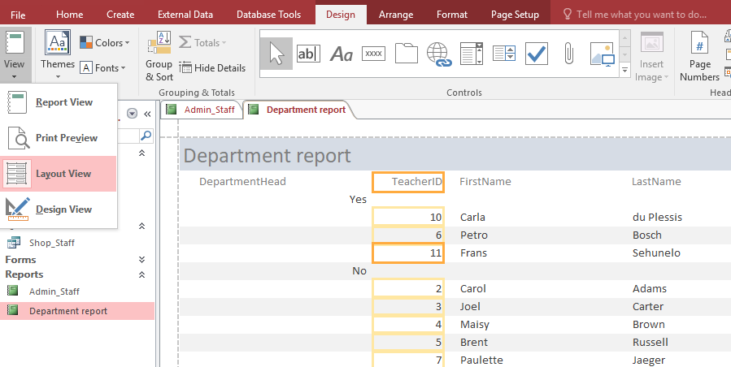
Moving and resizing a Control
In Layout view ,Click and drag or resize any control on the report to the desired location to be fully visible.
Keep this in mind: Before printing any report, make sure that all information are clearly visible in the report.
1
2

Slide 16
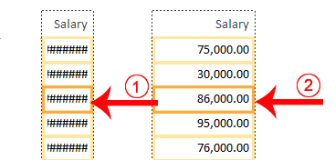
Change the Size of a Field:
If the data in a field seems crowded, if some of the data in the field does not appear, or if the data appears as pound signs (####), the field is too small.
TO Change the Size of a Field in the loayout view :
Click the field. A border appears around it.
Click a side of the border and drag outward to increase the width.
Click a side of the border and drag inward to decrease the width.

Slide 17
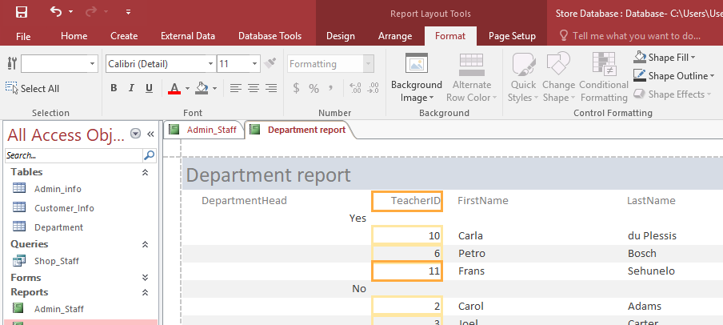
Formatting a report in Access
Open it in Design View or Layout View, then use the Format tab to change the appearance of controls. You can modify elements like fonts, colors,style and sizes, apply a fill color Shade, Shape Outline add Background images.......
3
1
2

Slide 18
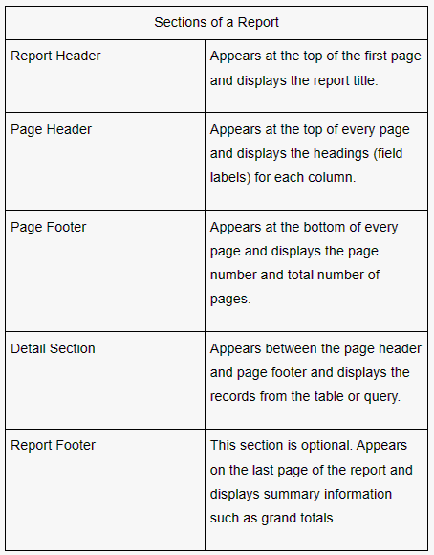
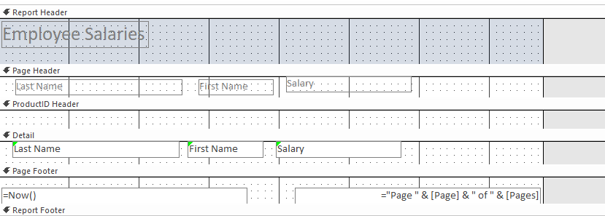
Report sections in Design view

Slide 19
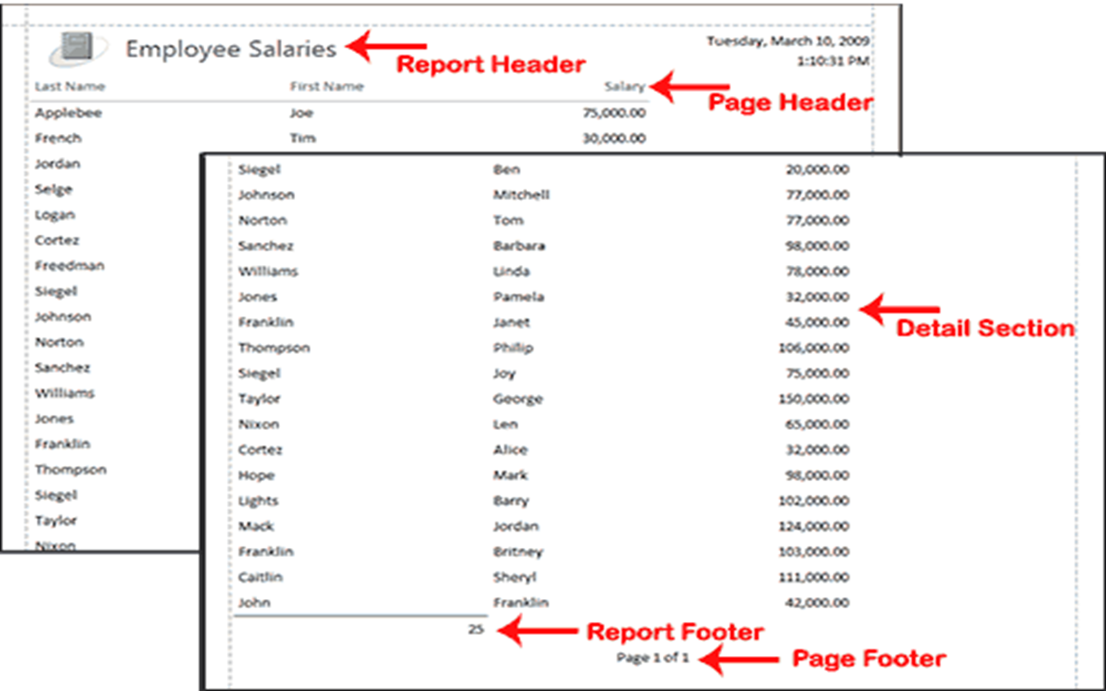
Report sections in Design view

Slide 20
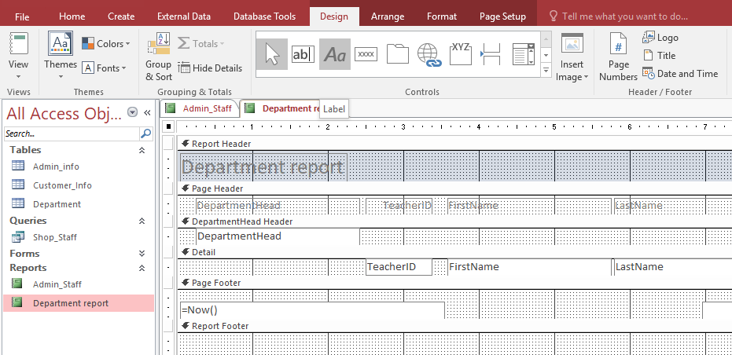

To add a label to an Access report
Open the report in Design View.
Click the Label button on the Design tab report the Controls Group.
Drag on the report to create the label box.
After drawing the box, you can type the text, and once you click outside the label, it will be set.
.
1
2
Text..
3
4

Slide 21

Commonly used Control Commands:
Controls
Select | Click this button and then click the control you want to select. To select multiple controls, click this button and hold down the Shift or Ctrl key as you click each control, or drag a rectangle around all controls you want to select.
Text Box | Creates a text box that displays information from a table and query. You can also use text boxes to find Calculated Values.
Label | Creates a static text label that is the same for every record, such as a heading. Most controls already have a text label attached.

Slide 22
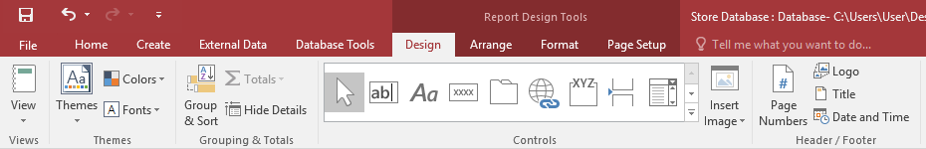
Adding a Logo and Insert Image:
1) Adding a Logo:
Open your report in Design View.
On the Design tab, in the Header/Footer group, click Logo.
The Insert Picture dialog box will appear. Browse to the location of your image file, select it, and click OK.
The logo will be inserted into the report's header. You can then resize and reposition it as needed.
2) Adding an Image:
Open your report in Design View.
On the Design tab, in the Control group, click Logo.
The Insert Picture dialog box will appear. Browse to the location of your image file, select it, and click OK.
The logo will be inserted into the report's header. You can then resize and reposition it as needed.
1
3
2

Slide 23
Adding a Title and Date&Time:
1) Adding a Title:
Open your report in Design View.
On the Design tab, in the Header/Footer group, click Title.
A new label will be added to the report's header, displaying the report's name as the default title. You can edit the text of this label to your desired title.
2) Adding Date and Time:
Open your report in Design View.
On the Design tab, in the Header/Footer group, click Date and Time.
The Date and Time dialog box will open.
You can choose to include the date, time, or both, and select the desired format for each.
Click OK. The date and time fields will be added to your report's header or footer. These fields will display the system date and time when the report is opened.
1
3
2

Slide 24
Adding a Page Number:
Adding a Page number:
Open your report in Design View
On the Design tab, in the Header/Footer group, click Page Numbers.
Configure the settings:
Format: Choose how the page number should appear (e.g., Page N or Page N of M).
Position: Select whether you want the page number to appear in the Header or Footer.
Alignment: Choose the alignment, such as Left, Center, or Right.
Apply the changes: Click OK to add the page numbers to your report.
1
2

Slide 25
Open the Department_2025 Report, then do the following:
Add a title containing the text “Managers Staff “to appear in the report header with left align.
2) Insert the label containing the text “Top Company” to appear in the left of the Footer section that will appear on every page, then save.
3) Insert a Back image from your folder to be used as a background to of the report, then save and close.
Open the AdminStaff report in the Design view. Then do the following:
Add the page number at the bottom of the page with right align.
3) Add the Date &time for the Admin_Staff report with Long Date format of the report header without including the time.
4mins
3mins

Slide 26
Learning objectives:
18/11/2025
The student should be able to:
Sorting the report by specific fields and in ascending or descending order.
Making calculations on reports involves creating calculated fields or formulas within reporting software like Excel.
Preview and print the report options.

Slide 27
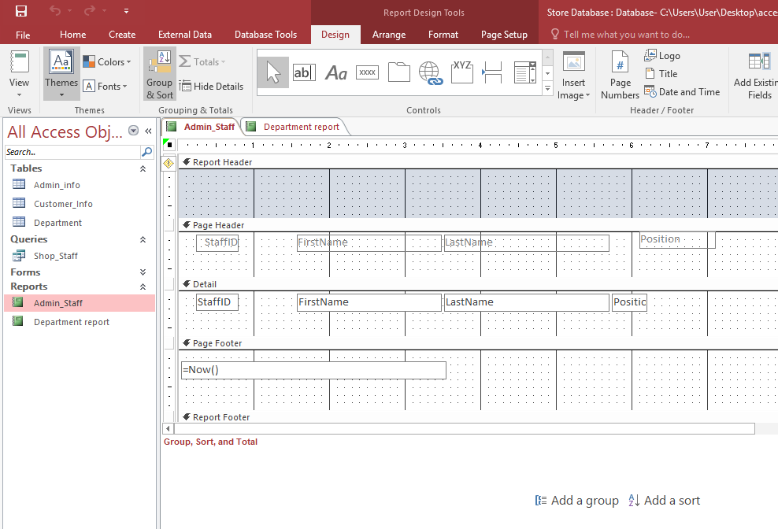
Sorting in a report in a specific order :
Sorting in Access arranges records in a specific order so information becomes easier to read, find and analyze. You can sort data alphabetically, numerically, or by date in either ascending or descending order. Sorting can be applied directly in a table, query, or report.
To sort in a report (Access):
Open the report in Layout View or Design View.
On the Design tab, select Group & Sort.
In the Group, Sort, and Total pane, click Add a sort.
Choose the field you want to sort by (e.g., Name, Date, Price).
Select Ascending or Descending order.
Save the report and switch to Report View or Print Preview to see the sorted results.
1
2

Slide 28

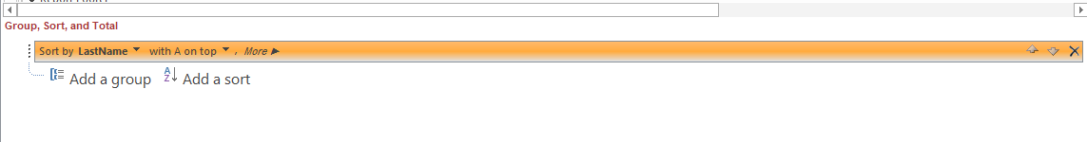
To remove sorting in an Access report:
.
To remove sorting option in an Access report:
Open the report in Layout View or Design View.
Go to the Group, Sort, and Total pane.
Locate the Sort row you want to remove.
Click the X (Delete) button next to the sort line.
Delete

Slide 29
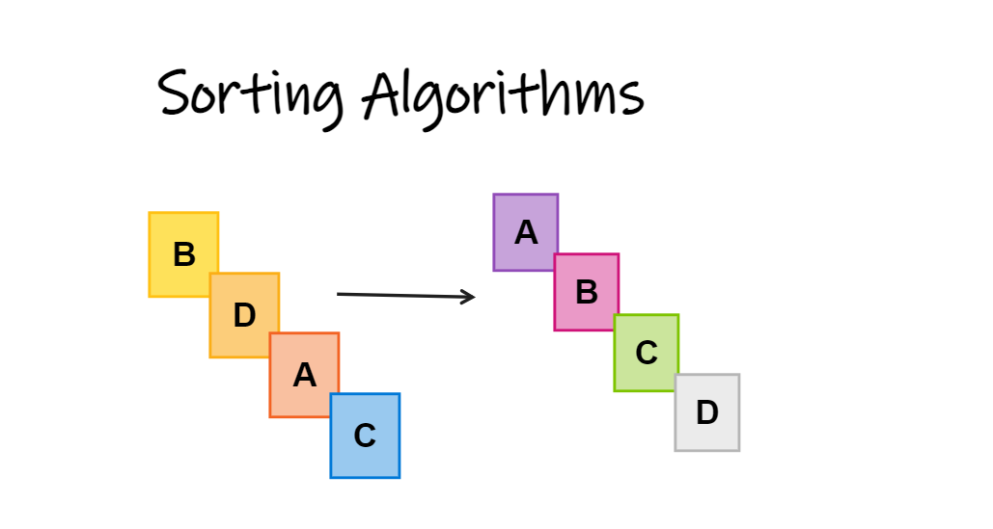
Apply Skills:
Open the Admin Staff Report in the Design view from the Store Database.accdb.
Sort the Data in the report into descending order of the First Name Field.
Remove the sorting option .
Sort the Data in the report into ascending
order of First Name the within ascending order of Position.
2
1

Slide 30
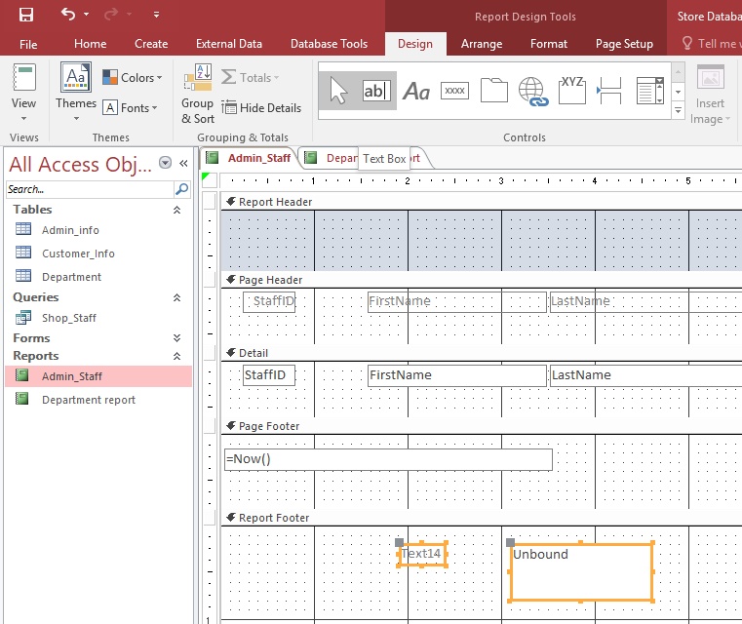
Calculating in a report :
Calculations in Access reports help you summarize and analyze data clearly. You can create totals, averages, counts, Min , Max ....
Calculations make reports more useful by showing summaries instead of just raw data. They help you compare results, analyze performance, and make decisions quickly.
Method1: Using Textbox control in a Report
Open your report in Design View.
Select the Text Box where you want the total to appear for example in the report footer
In the Text Box , use the =Sum([Field Name]) function.
Add text as a label to the left of the text box Example: =Sum([Sales Amount])
=count([Sales Amount])
=Min([Sales Amount]) ......
1
3
2

Slide 31

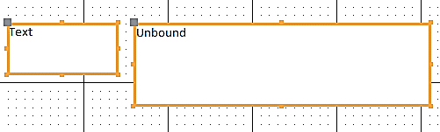
Apply Skills:
Open the AdminStaff report in the Design view.
Calculate the Number of admin Staffs' names and place this under the FirstName column for the report so that it appears on every page.. Then Add a label “The number of Managers are:” to the left of this value Save and close.
To add a label (text)
To add a Function
Left
Right

Slide 32
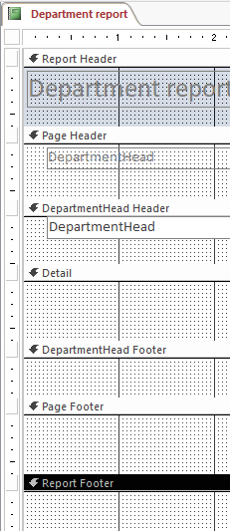
Always ensure that the calculation results appear in the correct place: * On every page {page Footer, page header } *At the bottom of each group.{Group Footer} *Only on the last page of the report {Report Footer} https://wordwall.net/resource/102092722
Important Notes when calculating:

Slide 33
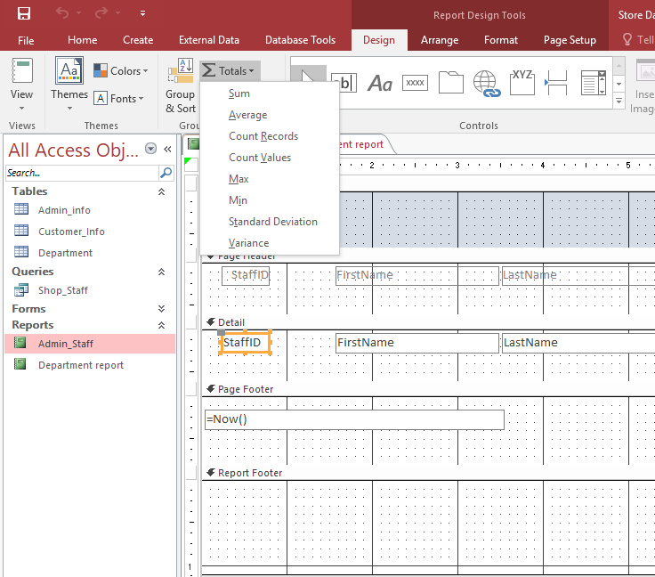
Calculating in a report :
. The Totals feature allows you to quickly summarize data from a table or query, making it easy to generate reports such as total sales, average grades, or number of orders.
Method2: Using Totals Command in a Report
Open your report in Design View.
Select the desired field that you want to make the calculation on it from Detail section.
Click on the Totals button (looks like ∑) in the Design tab.
Choose the type of calculation you want to perform.
For each field:
Choose Sum to calculate the total.
Choose Average for the mean value.
Choose Count to count the number of records.
Other options: Min, Max, etc.
2
1

Slide 34
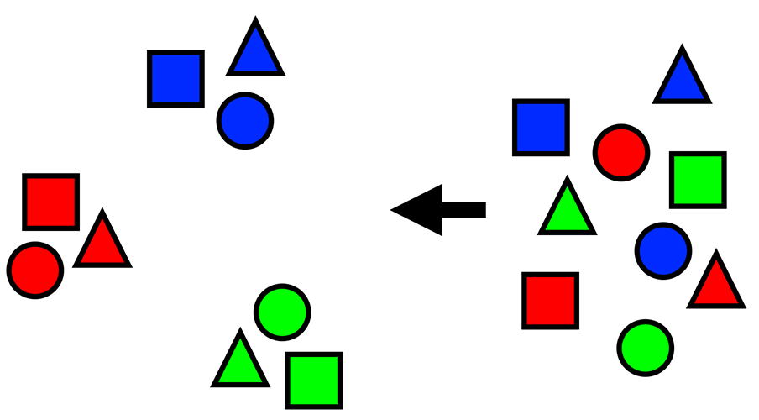

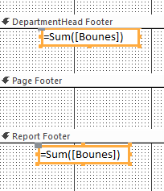
Apply Skills:
Open the Department_2025 Report.
Calculate the total bonuses for teachers and place this under the Bonuses column for the report So it appears only in the footer of the report.
When you use grouping in a report, the calculation function can appear in two places: the Group Footer and the Report Footer. You need to check carefully where the function is placed before printing
The Function will appear without label to add text we can add label from
Left
Right

Slide 35
Grouping

Slide 36
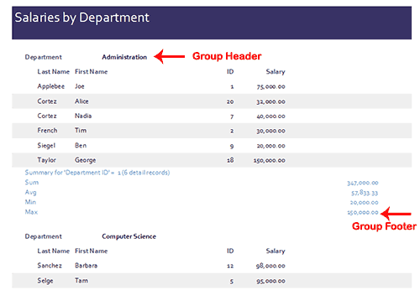
Grouping in Access:
Grouping data in Access allows you to organize records into categories based on common fields, that provides a clearer structure and makes printed output easier to read ,analyze and compare groups.
For example, if your data is grouped by the Department field and the records in the Department field have values such as Administration, Computer Science, and English.
Technique: Access will group all of the data for the Administration department together, all of the data for the Computer Science department together, and all of the data for the English department together.
Grouped by the Department field
Value

Slide 37
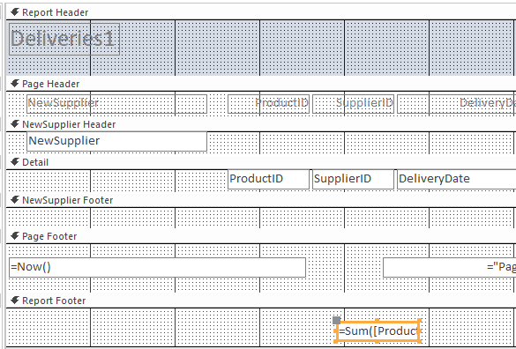
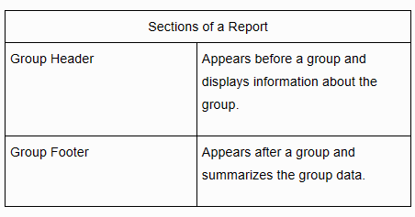
Grouping:
Tip: Reports created with the Report Wizard may have the following two sections in addition to the report sections found in reports created when you add any grouping level.

Slide 38
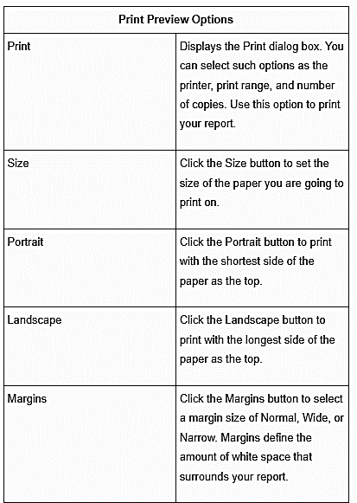
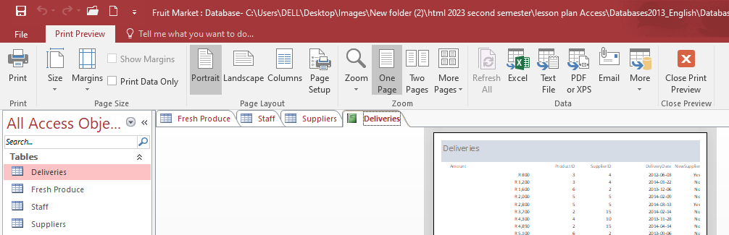
Report sections in Print Preview

