Slide 1

Nutritional disorders related to food shortages

Slide 2
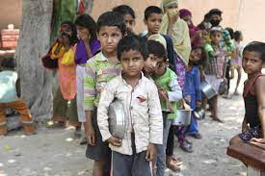
There are many people whose health and quality of life suffer through lack of food, as a result of poverty, war, disaster, pollution, or social and political factors.
When the choice of food is limited, as during famine, illness and death on a large scale are the usual results.

Slide 3
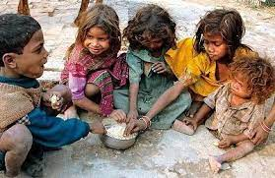
People who receive little or often no food for long periods of time for variety of reasons, suffer from malnutrition and the effects of long-term starvation.
Children, suffer badly as their requirements for nutrients are high. They may develop one of the following conditions “malnutrition diseases”.

Slide 4
Glucose
Glycogen (stored)
muscles liver

Slide 5
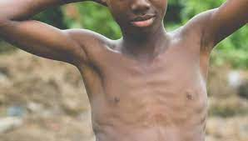
1. Marasmus “ severe calorie deficiency”
This name comes from the Greek name ‘wasting’, it mainly affects babies under one year old.
The body adapts to the shortage of food by the wasting of muscles and the depletion of fat stores.

Slide 6
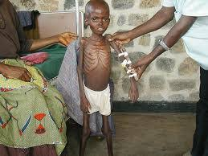
Energy is only supplied to vital organs ( brain and heart).
The child becomes very thin and weak and often results in death.
Marasmus = protein + energy

Slide 7
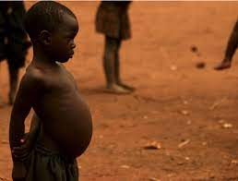
2. Kwashiorkor
It was thought that kwashiorkor resulted from a lack of protein in the diet.
It is now known to be a poor adaptation to famine (where total food intake is reduced).
Inadequate amount of calorie intake and
Inadequate protein intake are the main cause
of Kwashiorkor.
Kwashiorkor = protein ( swelling + flaky skin)

Slide 8
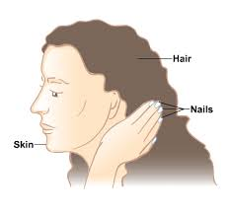
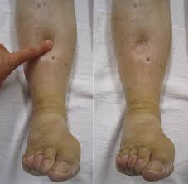
Kwashiorkor results in many symptoms:
Retarded growth.
chronic diarrhea, and infections.
deterioration of hair, skin and nails.
Retention of fluid under the skin, causing swelling ( called oedema).
Poor digestion of food.

Slide 9
In adults, starvation results in variety of symptoms, including:
Wasting of body tissue, especially adipose tissue.
Wasting of muscles and organs, such as the heart and intestines, to a size where they are too small and weak to function properly.
Dryness of hair and skin.
Oedema in the limbs and on the face.
Personality changes, causing restlessness, indifference, hysteria, and severe moodiness.

Slide 10
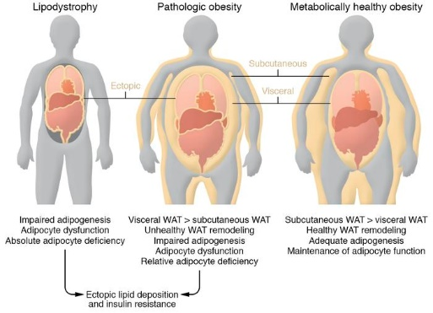

Slide 11
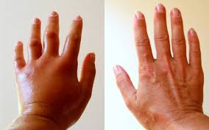
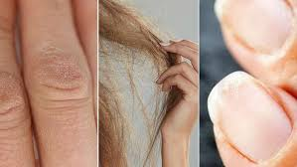

Slide 12
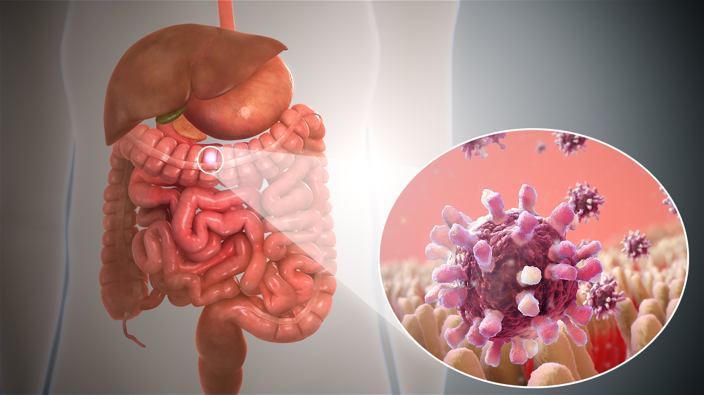
The treatment of starving people is difficult not only because:
Lack of money.
Political reasons.
Infections such as gastroenteritis, cholera, pneumonia.

Slide 13
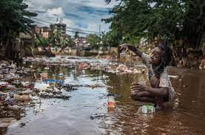
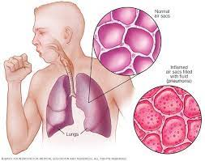

Slide 14
When digestion is poor, due to changes in the intestines
Small, frequent feeds of specially formulated food have to be given, and recovery may be very slow.
Large numbers of volunteer helpers are needed to distribute food, and assist medical teams.
Often this may be very difficult where roads are bad and transport is scarce.

Slide 15
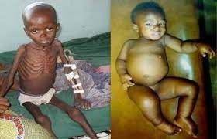
Marasmus vs Kwashiorkor

