Slide 1

Health disorders related to unwise food choice

Slide 2
People in different societies, who have enough to eat, suffer from health disorders that are the result of overindulgence in food, or unwise choices of diet.
Unbalanced diet, one containing too much fat or sugar, can result in a variety of nutritional disorders, including:
Heart disease
Obesity
Tooth decay and gum disease
Intestinal disease

Slide 3
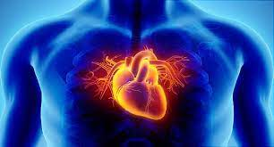
Heart disease
Heart disease is a major cause of death in most countries.
CHD ( Chronic heart disease), is the most common type of heart disease and can eventually lead to heart attacks.

Slide 4
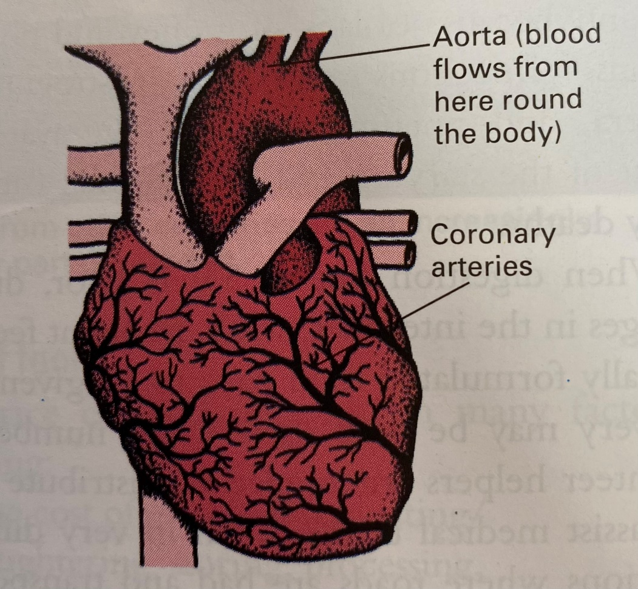
What happens in heart disease
Heart muscle needs a supply of oxygen from blood in the coronary arteries so that it can pump blood through vessels to all parts of the body.

Slide 5
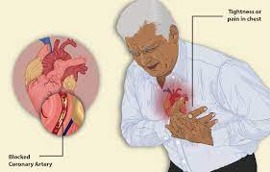
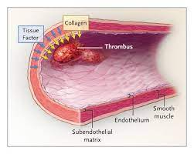

Slide 6
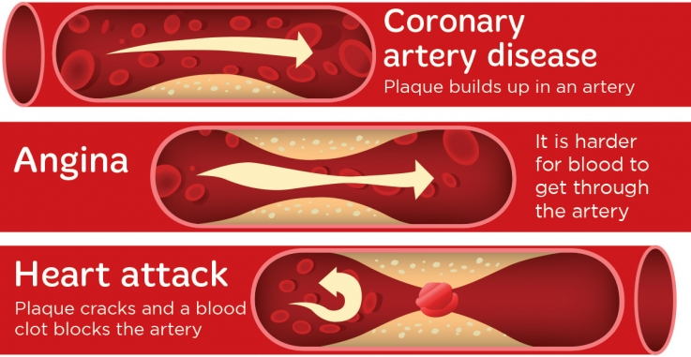

Slide 7
Causes of heart disease
No single cause of heart disease, but many risk factors.
CHD is brought on by more than one factor.
Some of the risk factors can be prevented or reduced by changing habits or lifestyle, but some cannot

Slide 8
Risk factors that cannot be prevented:
Being male – more men than women have CHD.
Increasing age.
Heredity – heart disease often runs in families.

Slide 9
Risk factors that can be prevented or reduced:
Smoking cigarettes – increases the risk of CHD for both females and males.
Choice of food – eating less fat and more fruit and vegetables help prevent CHD.
Being overweight
Lack of exercise – regular exercise strengthens the heart muscle and makes it work more efficiently.

Slide 10
5. Stress – people who are impatient, competitive, tense and anxious seem more likely to suffer from CHD than those who are calmer, less worried and more relaxed.
6. High blood pressure – makes the heart work harder and speeds up the blocking of arteries.
* The previous factors may cause high blood pressure.

Slide 11
Choice of food and heart disease
Our diet, the amount and type of fat we eat, can increase the risk of CHD.
Diets that are high in saturated fatty acids, may raise the level of cholesterol in the blood.
blood cholesterol = development of CHD
Cholesterol is found in some foods, and is made in the body by the liver, from saturated fatty acids in food.

Slide 12
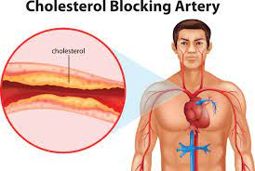
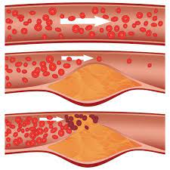

Slide 13
If cholesterol is oxidized “picks up oxygen from the blood”, it can be deposited in the linings of the coronary arteries, which start to become blocked.
Antioxidants, found naturally in foods, especially Vitamin E, Vitamin C, B-carotene, and selenium, help to stop cholesterol picking up oxygen, so it is deposited less in the coronary arteries.
Artificial antioxidants, which added to foods to preserve them, do not help the body.

Slide 14
Cholesterol will not be made in the liver, if the person eats foods that contain polyunsaturated fatty acids (PUFAs), and some monounsaturated fatty acids.
The (PUFAs) are found in oily fish, e.g. (herring and sardines), reduce the amount of cholesterol made by the liver.
When oils are processed to make them into margarine, the (PUFAs) in the oil may change to trans fatty acids, which will increase the amount of cholesterol made by the liver.

Slide 15
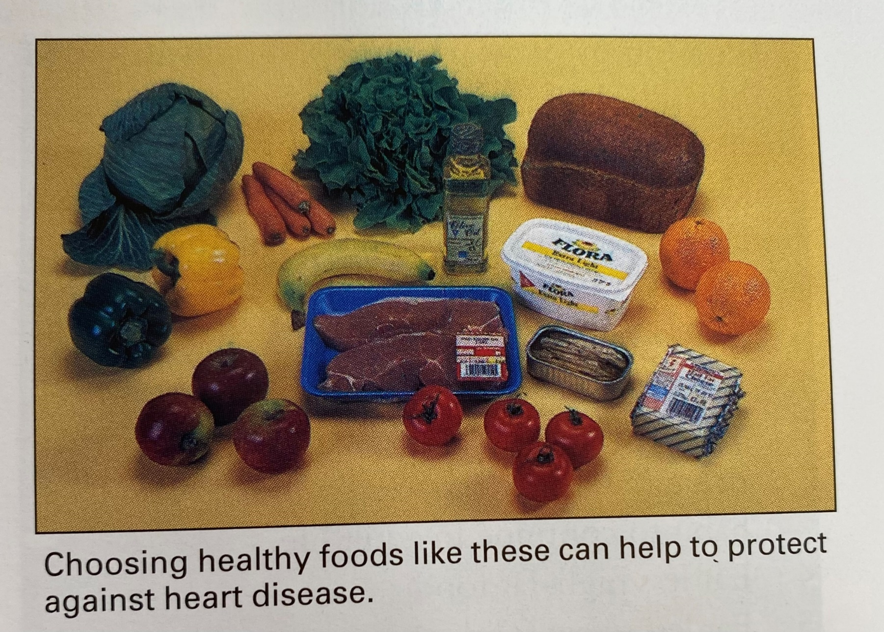
Some margarines manufacturers have tried to reduce the amount of trans fatty acids formed during processing.

Slide 16
* Prevention of heart disease should begin in early childhood by:
Eat a variety of food.
Eat fresh fruit, vegetables and salads.
Take exercise and be active, as this strengthens the heart and it is a good habit to continue in adult life.
Eat less high-fat food.
Eat less sweet food, as excess sugar is converted into fat in the body causing weight gain.
Eat less salty food, as too much salt can lead to high blood pressure.

Slide 17
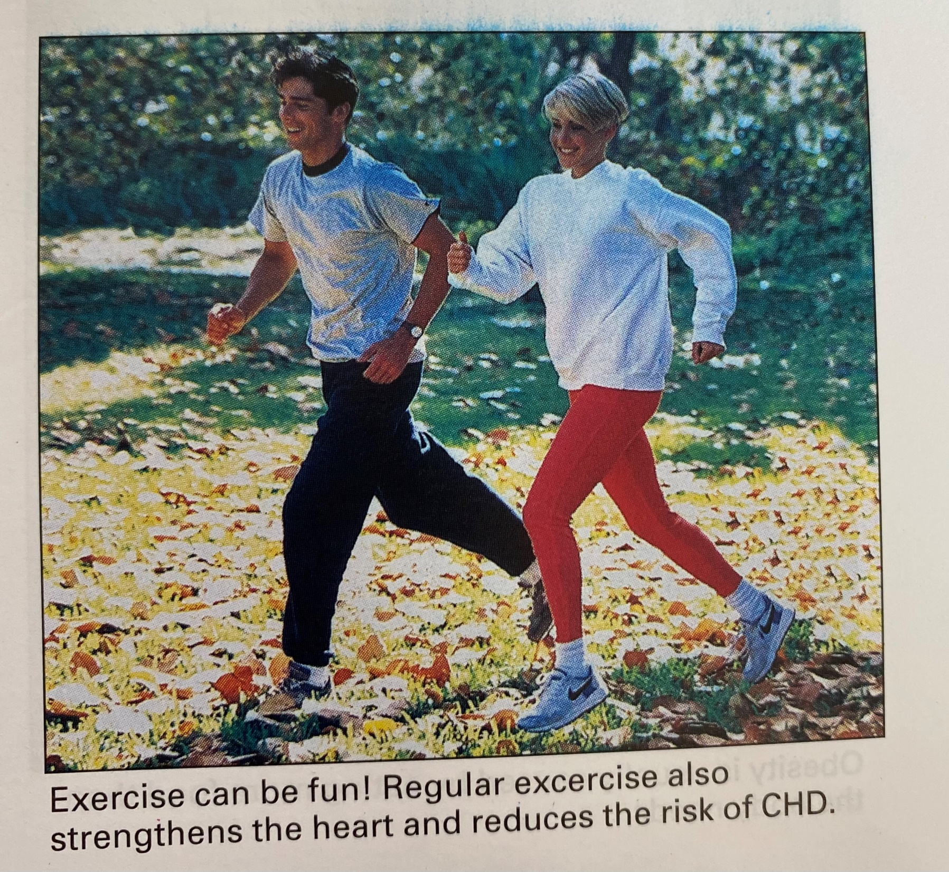
CHD patients are usually given dietary advice and are encouraged to stop smoking and limit the amount of alcohol they drink.

Slide 18
Obesity
Obesity (excessive weight gain) is a very common and increasing nutritional disorder in affluent countries.
It can be caused by hormonal disorders, but the major cause is eating more food than the body needs.
The excess is stored as fat in the body.

Slide 19
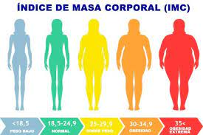

Slide 20
Obesity is known to be undesirable and unhealthy because:
Obese people are most prone to heart disease, chest infections, varicose veins, hernias, high blood pressure, diabetes, gallstones, osteoarthritis of the back, knees, and hips, and skin infections.
Extra body fat can cause complications during operations.
Unhappiness about being obese, and comments made by other people, may make an obese person turn to food for comfort, making their condition worse.

Slide 21
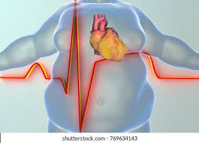


Slide 22
Losing weight
A person who is trying to lose weight should seek advice from a doctor or dietician, to agree a weight-reducing diet that suits them.
Weight loss takes time and requires changes to a person’s eating habits and way of life e.g. ( taking more exercise).
Will-power, determination, and an understanding of how food affects the body, are needed.

Slide 23
The most effective and healthy way to reduce weight is to take in slightly less energy from food than the body needs each day.
The body makes up the difference by releasing the energy it has stored in fat. Gradually the stores of fat are reduced.
The weight-reducing diet should include a good variety of foods to make it interesting, with plenty of fresh fruit, vegetables, and wholegrain cereals, and very little fatty or sugary food.
High-protein foods and alcohol should also be limited.

Slide 24
Exercising uses more energy, which promotes weight loss, tones of muscles, and generally helps to make a person feel better.
Very low calorie diets are heavily advertised as a quick and easy way to lose weight.
They usually consists of flavoured drink, containing a variety of nutrients, to replace breakfast and midday meal. A well-balanced “proper” meal is then eaten at the end of the day.

Slide 25
This type of diet can cause problems because:
It does not encourage the dieter to change their eating habits at every meal or in the long term. (change lifestyle)
It often leads to loss of muscle, instead of fat.
Once normal eating resumes, weight may be put back on quickly.
It can be expensive.

Slide 26
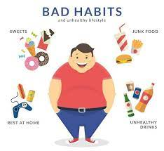

Slide 27
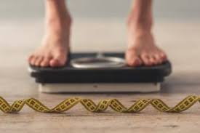
Eating disorders
Most publicity has been given to anorexia nervosa and bulimia nervosa.
These disorders have quite a lot in common, and a person may show symptoms of both.

Slide 28


Slide 29
Tooth decay and gum disease
Tooth decay and gum disease affect many people, especially people who often eat foods containing added sugar.
Dental caries is the name given to tooth decay.
Periodontal disease is the name given to gum disease.
The enamel covering the tooth is 96% minerals (mainly calcium & phosphorus).

Slide 30
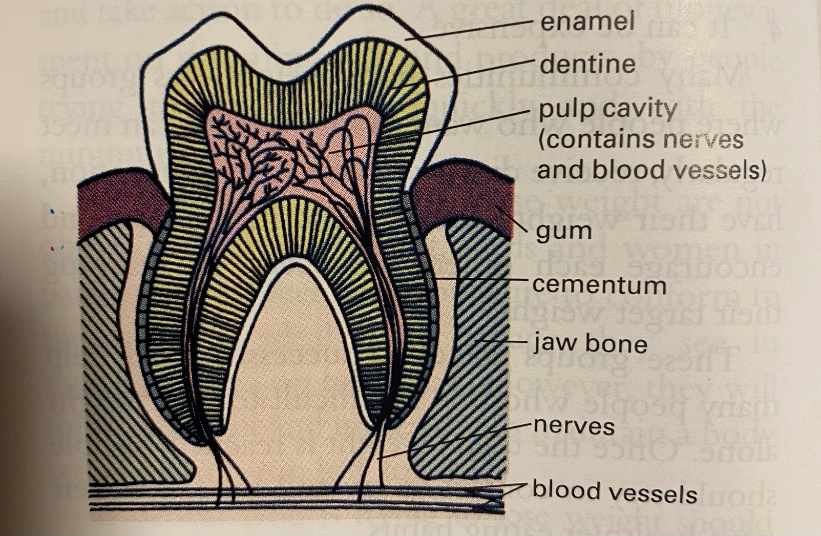

Slide 31
The teeth form in the jaws long before they erupt (come through the gum), and must be looked after if they are to last, and chew food efficiently.
When food is eaten, a white, sticky substance called plaque builds up on the surface of the teeth, especially next to the gum.
Plaque is micro-organisms, plus some water and polysaccharides.
When sugar is eaten, it is absorbed into the plaque, broken down by the micro-organisms, and turned into acid.

Slide 32
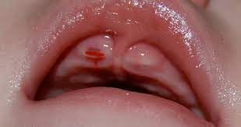
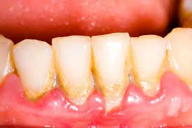

Slide 33
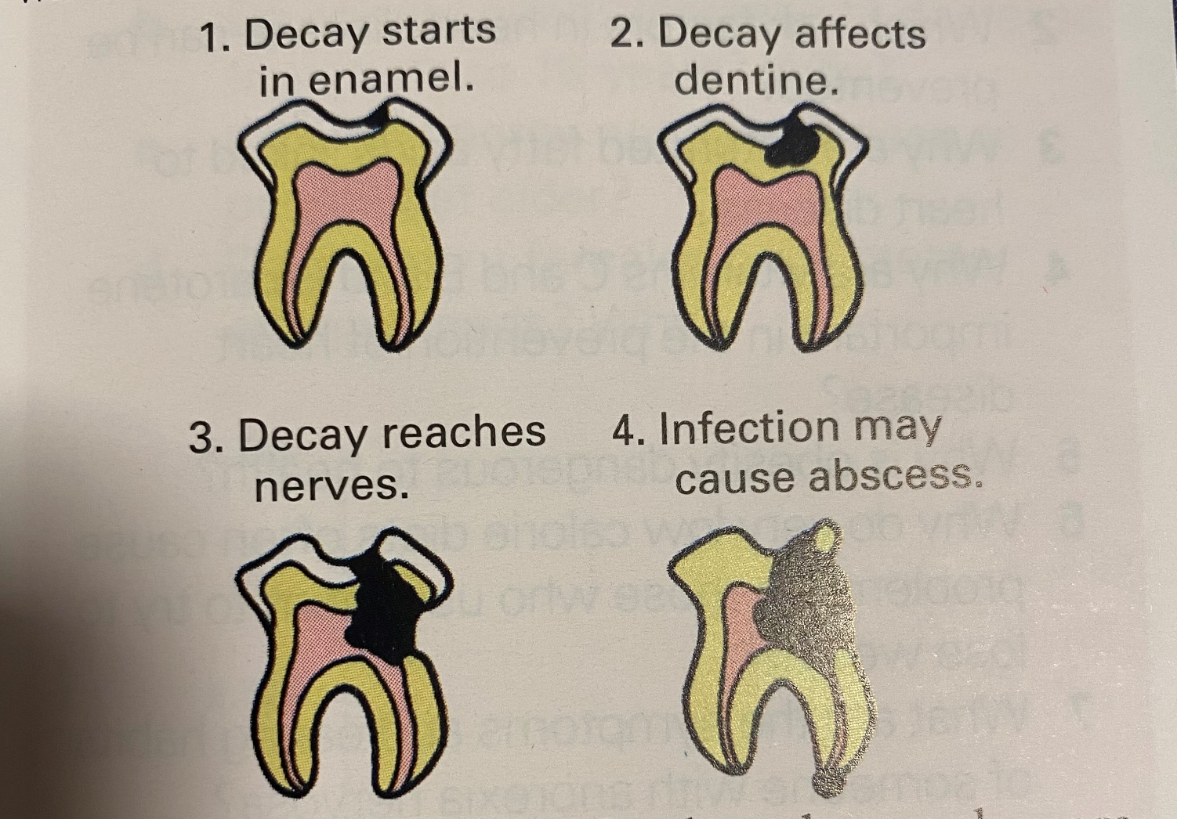

Slide 34
Eating a lot of sugary foods makes teeth more likely to decay. This is because the plaque pH stays low, as acid forms every time sugar is in the mouth.
this is why it is sensible to avoid eating sweet foods between meals.
Plaque can be stained using special disclosing tablets.
This helps when cleaning the teeth, because you can see whether they are really clean after brushing.

Slide 35
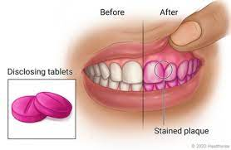

Slide 36
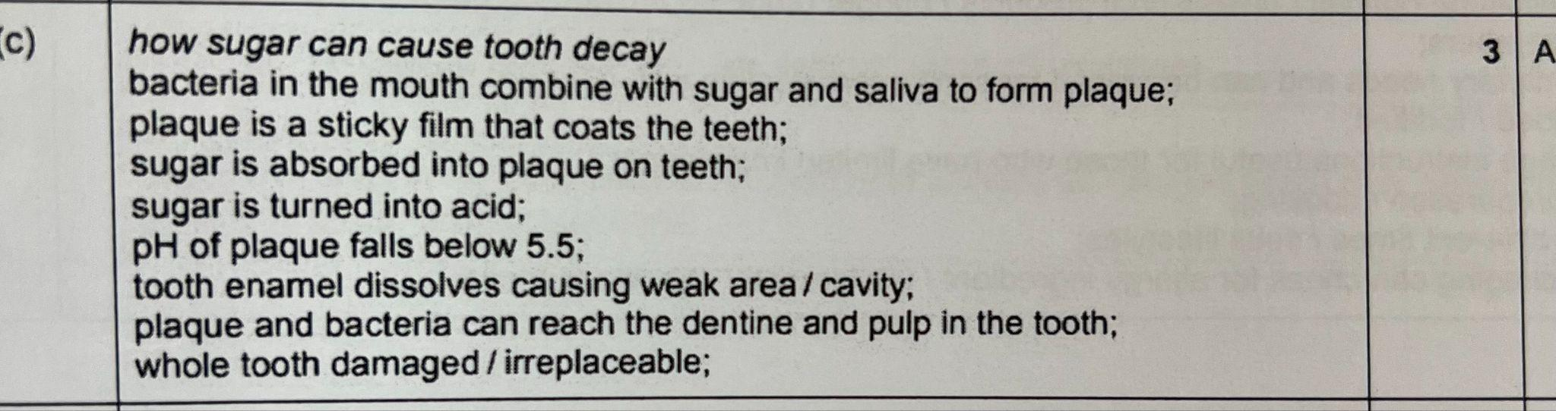

Slide 37
Teeth and gums can be kept healthy and look attractive by following these guidelines:
Babies –
1. do not add sugar to bottle feeds or solid food. Babies do not need it and will not notice that the food is not sweetened.
2. do not introduce babies to sweetened fruit juices and squashes too young.
3. encourage them to drink water between milk feeds.
4. do not give sweetened dummy to suck as this can cause tooth decay even when the teeth have not erupted (come through).

Slide 38
2. Children and teenagers –
1. limit their consumption of sweet drinks and sweet foods between meals.
2. have a special day of the week for eating sweets, preferably at the end of a meal, not between meals.
3. Study food labels. Many foods have sugar added, but give the chemical name (e.g. maltose, glucose, sucrose, fructose). These can cause tooth decay.
4. Look for low-sugar biscuits, soft drinks, and medicines. They often have artificial sweeteners added and will say so on the label.

Slide 39
5. Put less sugar into home- made foods. Many cakes, biscuits, and puddings can be made successfully with less sugar.
6. Avoid acidic drinks, especially concentrated fruit juices and carbonated ( fizzy) sweet drinks, which can damage tooth enamel.
7. Brush the teeth at least twice a day using a brush which is the right size, and in good condition. Pay particular attention to the biting surfaces of the teeth, and the point where the teeth meet gums. Do not brush too hard as this can damage the enamel.

Slide 40
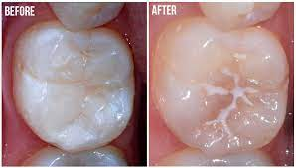
8. Learn how to use dental floss to clean between teeth and round the back teeth.
9. When the second (permanent) teeth erupt, the molars can be fissure sealed by the dentist. This is a painless process where the fissures (tiny nooks and crannies) on the top surface of the molar teeth are filled with a white plastic which sets and prevents particles of food becoming trapped there, and reduces the risk of decay.

Slide 41
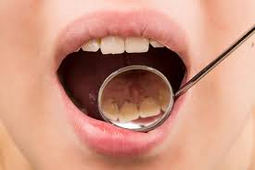
10. Use a fluoride toothpaste to strengthen the enamel of growing teeth. Toothpastes, mouthwashes, tablets, and drops containing fluoride can all be obtained from the chemist or dentist. Tablets and drops should only be given under the instructions of the dentist, as too much fluoride can damage tooth enamel.
11. Have a regular dental check-ups, at least twice a year.

