Slide 1
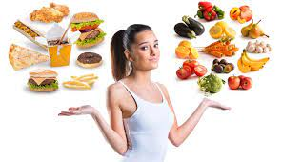
Choice of food

Slide 2
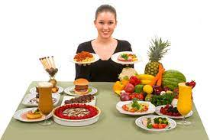
People who are fortunate to have a choice of food to eat, have the opportunity to choose a healthy and varied food intake, and to control their eating habits.
The choice that is made, depends on several different factors, some will be more influential than health considerations.
Past paper Question
Reasons that affects our Choices of food.

Slide 3
1. Personal likes and dislikes
Most people enjoy food, we all choose certain foods more than others.
Reasons for avoiding particular foods may include:
Dislike the flavour, appearance, or texture.
Disagreement with the way the food is produced (using crates for rearing calves to produce veal).
Dislike of the way that food is prepared or cooked.
Associating the food with feeling ill ( because of an allergy or past food poisoning).

Slide 4
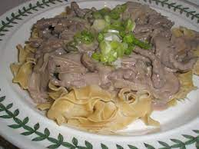
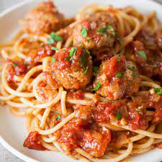
2. Food preparation
Food that is well prepared, well cooked and attractively presented is more likely to be chosen and enjoyed.

Slide 5

3. Religious and moral beliefs
Religious beliefs are very important to many people, and some religions have specific rules about what should and should not be eaten.

Slide 6
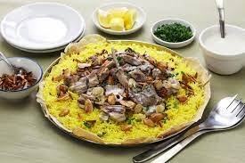
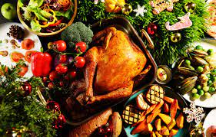
4. Customs, traditions, and festivals
Many occasions and ceremonies ( funerals, marriages, religions festivals, harvests) are celebrated with feasts or fasts ( not eating for a specific amount of time), or special meals and foods only prepared at that time.

Slide 7
5. Availability of food
Affluent countries such as (UK, USA, France and Germany) have plenty of food to feed their population.
These countries grow some of their own food and import (bring in ) the rest from around the world.
Some countries grow little food (and are too poor to import enough).

Slide 8
6. Variety of food
Many foods are imported from all around the world, making food choice even greater.
People can travel abroad more easily, and try foods, which then may become available back at home.
Recipe books, prepared dishes, and media coverage also encourage people to try new foods.

Slide 9

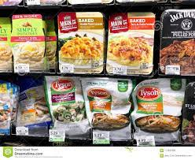

Slide 10
7. Cost of food
The price of food depends on many factors, including:
The cost of growing, harvesting/ slaughtering, storing, processing, distributing, packaging, advertising and selling the food.
Seasonal variations in fresh foods e.g. soft fruit is cheaper in the summer when it is most available.
Variations in the quality of a particular food e.g. tougher cuts of meat that require more cooking are generally cheaper.

Slide 11
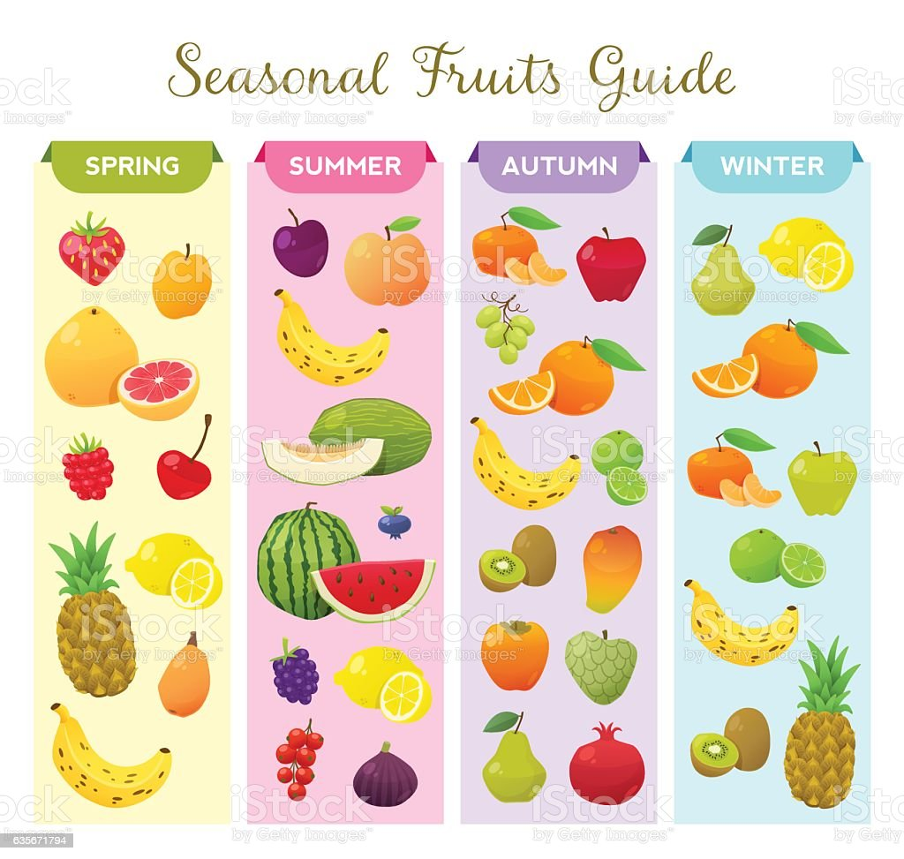
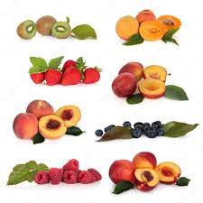

Slide 12
8. Food technology
Food technology has increased food choice in various ways, including:
Producing cheaper versions of basic food e.g. margarine instead of butter.
Producing new types of food from unusual sources e.g. quorn from mycoprotein.
Producing quick-to-prepare foods and ready-prepared meals.

Slide 13
4. Increasing food production by developing new agricultural practices e.g. hormone injections to cattle to improve milk yield, genetic engineering to produce high- yield cereal plants.
5. Increasing the shelf-life of foods to avoid wastage and preserving the food in good condition.
6. Improving packaging to enable more foods to be easily eaten away from the home, e.g. ring-pull cans, plastic food trays.

Slide 14
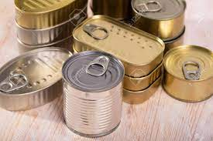

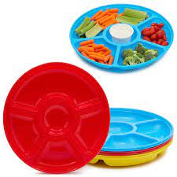

Slide 16
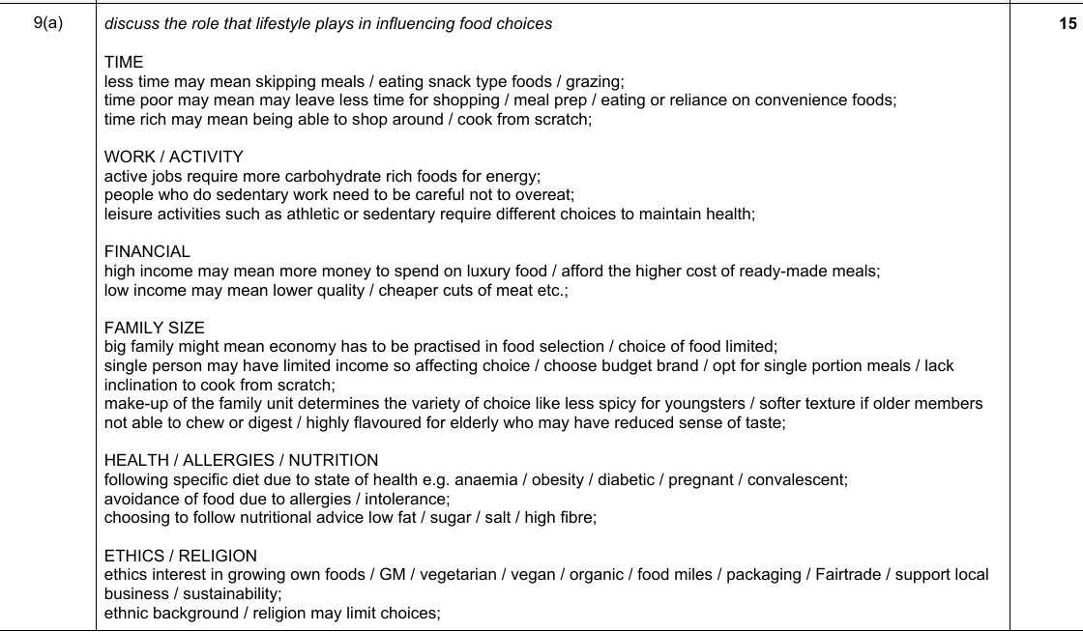

Slide 17
