Slide 1
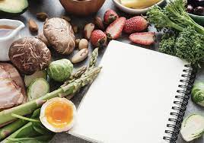
Meal planning

Slide 2
Food is a vital part of our lives and much of our time is spent in its preparation.
Everyone has different needs and requirements for food, according to:
Their age and sex.
Their health condition.
Their daily activity.
The climate in which they live.
Their likes, dislikes, food customs and taboos.

Slide 3
The preparation and consumption of food is influenced by:
The interest and motivation of the person who is preparing the food.
The culinary abilities and skills of the food preparer.
The time and the facilities that are available for preparing food.
The foods that are available.
The income available to be spent on food.

Slide 4
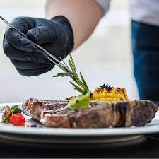

Slide 5
Appetite and the desire to eat food are also affected by:
The colour, appearance, and presentation of the food.
The taste, smell, and texture of the food.
The surroundings and atmosphere in which the food is eaten.
Until recently, meals were a very time consuming part of family life.
Long and elaborate preparation was often involved, and the whole family would sit down together to eat in a leisurely manner.

Slide 6
Foods habits have changed to fit in with rapidly changing lifestyles:
The increase in shift-working, more women going out to work.
Television viewing at mealtimes.
have contributed to a general reduction in the time spent preparing food and eating meals.
* One or more members of the family will often be absent at mealtimes.

Slide 7
There has been an increase in what nutritionists call “grazing”.
Grazing is when food is eaten in small quantities throughout the day, with or without main meals.
Many food manufacturers produce “snack” sized versions of their existing products (e.g. biscuits), which encourages people to graze.
Grazing can lead to obesity and dental caries.

Slide 8
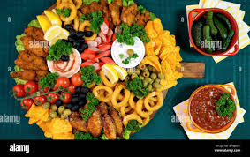
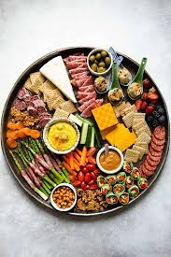

Slide 9
Advances in kitchen technology, such as the introduction of freezers and microwave ovens, have helped to reduce the time spent on food preparation.
The ability of convenience foods has also been important, and many ready- prepared dishes and main meals require only heating in an oven or microwave.
There is a great variety of foods to choose from in the shops, due to advances in food production, technology, transport, and storage.

Slide 10
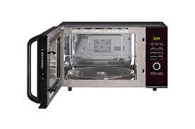
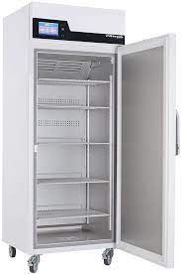
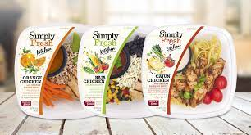

Slide 11
Multicultural society, and many foods are imported from overseas, foreign restaurants and take-away shops have changed eating habits.
Meals have to be planned, however individual needs have to be considered.
Few people work out a detailed weekly plan for their needs, and buy food according to that plan.
Long-term meal planning is necessary; in catering establishments such as canteens, hospital kitchens, restaurants, and hotels.

Slide 12
* Terminology associated with meal planning
Balanced diet
- a balanced meal is one that provides all the nutrients an individual needs in suitable amounts throughout the day.
- it also provide a balance of texture, flavour, colour, and variety of foods in order to be appetizing.

Slide 13
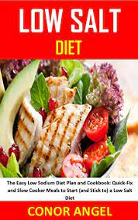

Diet
- The word “diet” refers to the food eaten by an individual every day. There are also special diets, e.g. low-fat diets, low-salt diets, diabetic diets.

Slide 14
Meals
Breakfast
the word means to break a fast, i.e. a period of time when food is not eaten ( during sleep).
Lunch/ dinner
there are regional differences in the meanings of these two words. Some people refer to the meal eaten at midday as dinner; others call it lunch and refer to the meal eaten in the evening as dinner.
“ In this book: breakfast, midday meal, evening meal.

Slide 15
Tea
- tea used to be served in many homes at about 4 o’clock in the afternoon, and usually consisted of a drink of tea with some form of cake or biscuit,
High tea
The meal eaten at about 6 o’clock in the evening is called high tea.
It is usually consists of a cooked dish, with a drink and some form of cake or biscuit.

Slide 16
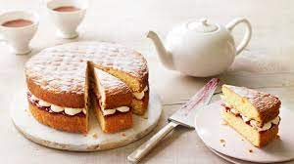
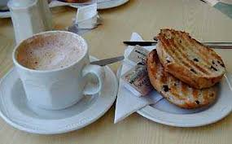

Slide 17
Supper
- the last meal eaten before bedtime is usually called supper.
- this might be a full evening meal, or it might be a hot drink and biscuits.
Courses
The word “ courses” refers to how a meal is divided up. A three-course meal consists of:
1st course – starter / appetizer
2nd course – main part of meal
3rd course – sweet, or cheese and biscuits

Slide 18
