Slide 1

Following dietary guidelines

Slide 2
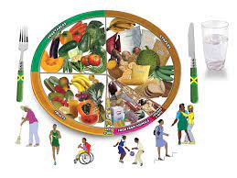
To achieve a healthy diet, the dietary guidelines should be followed as closely as possible.

Slide 3
Information about how different foods can be used in a healthy diet is available from various places, including:
Food labels.
Supermarket information leaflets.
Food advice centers (often supermarkets and large food companies).
Health visitors.
Health centers.
Child care clinics.
Magazine articles and TV programs.
Computer databases.

Slide 4
A mixture of foods every day makes meals more varied and interesting, and provides different nutrients.

