Slide 1

Writing an Article

Slide 2

LEARNING OBJECTIVES
Explain the primary purpose of article writing, such as informing, persuading, or presenting balanced arguments, with examples of when each purpose is most suitable.
Analyze how the audience influences the language, style, and tone of an article and will choose appropriate words and tone based on the intended readership.
Create a structured outline that includes a clear introduction well-developed middle section with key points, and a concise conclusion.

Slide 3

Warm up Activity
Topic: The Importance of Recycling
Instructions:
Below are three audiences and examples of language and tone. Match the correct language and tone with the right audience.
Audience | Language | Tone
1. Young children | a) Uses detailed facts and environmental terms | i) Friendly and fun, easy to understand
2. Environmental activists | b) Uses simple words and playful examples | ii) Passionate and urgent, encouraging action
3. Business executives | c) Uses formal, professional words like “sustainability” | iii) Persuasive and professional, emphasizing benefits

Slide 4
In the Cambridge Stage 8 curriculum, article writing focuses on teaching students how to structure and present ideas clearly, engage their audience, and express their opinions or provide information in a formal or semi-formal style.
The structure of an article should be logical and coherent, with a clear introduction, body, and conclusion. Articles may inform, persuade, or entertain, depending on the topic.
Here is an overview of the structure and content for writing an article at Cambridge Stage 8 level:

Slide 5
1. Title/Headline
  The title is an essential part of an article.
  It should grab the reader’s attention and provide a clear idea of the topic being discussed.
  Example: The Importance of Recycling in Our Communities

Slide 6
2. Introduction
  The introduction should briefly introduce the topic and engage the reader's interest. It can start with a question, a surprising fact, or a general statement related to the topic. The introduction should clearly state what the article will discuss or explore.

Slide 7
2. Introduction
  Example:
Did you know that every year, the average person generates nearly five pounds of waste per day? That adds up to thousands of pounds per household annually, most of which ends up in landfills, contributing to pollution and climate change. Recycling offers a powerful solution to this growing problem, helping communities reduce waste, protect natural resources, and build a more sustainable future.

Slide 8
Thesis Statement
  What is a thesis statement? A thesis statement clearly identifies the topic being discussed, includes the points discussed in the paper, and is written for a specific audience. Your thesis statement belongs at the end of your first paragraph, also known as your introduction.
  Example: Recycling is essential for protecting our environment, conserving limited natural resources, and supporting sustainable community development.

Slide 9
2. Introduction
  Content:
  Engage the reader with an interesting opening.
  Introduce the main topic by writing general statement
  Outline the purpose of the article (whether it’s to inform, persuade, or discuss).
  Example:
  "Have you ever wondered where all your waste ends up? Every year, millions of tons of trash are produced around the world, but only a small portion gets recycled. Recycling is essential for protecting our environment, conserving limited natural resources, and supporting sustainable community development.

Slide 10
2. Introduction
  Content:
  Engage the reader with an interesting opening.
  Introduce the main topic with general statement .
  Outline the purpose of the article (whether it’s to inform, persuade, or discuss).
  Example:
  "Have you ever wondered where all your waste ends up? Every year, millions of tons of trash are produced around the world, but only a small portion gets recycled. Recycling offers a powerful solution to this growing problem, helping communities reduce waste, protect natural resources, and build a more sustainable future."

Slide 11
  3. Body Paragraphs
  The body of the article is where the main points are discussed. These paragraphs should be logically structured, with each paragraph addressing a specific aspect of the topic. Each point should be supported with examples, explanations, or evidence.
  Content:
Present key points or arguments clearly.
Use separate paragraphs for each point.
Provide explanations, examples, facts, or statistics to support the points.

Slide 12
  3. Body Paragraphs
Example Structure for Body Paragraphs:
First Paragraph: Explain the environmental benefits of recycling, such as reducing waste in landfills and conserving natural resources.
Second Paragraph: Discuss how recycling saves energy and reduces pollution by decreasing the need for raw material extraction.
Third Paragraph: Highlight the role of communities and individuals in recycling efforts, such as sorting waste and participating in local recycling programs.

Slide 13
  3. Body Paragraphs
Example body paragraph 1:
"Recycling has a significant positive impact on the environment. By diverting waste from landfills, we reduce the amount of trash that takes hundreds of years to decompose. Additionally, recycling materials like plastic, glass, and paper conserves natural resources, ensuring that fewer raw materials are extracted from the earth."

Slide 14
  3. Body Paragraphs
Example body paragraph 2 :
In addition to conserving resources, recycling plays a crucial role in saving energy and decreasing pollution. Manufacturing new products from recycled materials often uses significantly less energy than producing them from raw materials. For example, recycling aluminum can save up to 95% of the energy required to produce it from bauxite ore. This reduction in energy consumption translates to fewer greenhouse gas emissions, which mitigates climate change and reduces air pollution.

Slide 15
  3. Body Paragraphs
Example body paragraph 3 :
The success of recycling efforts heavily relies on the active participation of individuals and communities. Simple practices, such as separating recyclables from general waste and participating in local recycling programs, can make a substantial difference. Communities can further support these efforts by implementing accessible recycling programs and educating residents on proper recycling practices. Through these combined efforts, we can create a cleaner, more sustainable environment.

Slide 16
  5. Conclusion
  The conclusion summarizes the main points made in the article and leaves the reader with a final thought. This section can include a call to action, a recommendation/suggestion for something to be done, or a final reflection on the topic.
  Content:
  Summarize the main points discussed in the article.
  Offer a final thought or reflection on the topic.
  Optionally, provide a call to action or suggestion for future steps.

Slide 17
Example/ conclusion
  "In conclusion, recycling is a simple yet effective way to make a positive impact on the environment. By taking small steps to recycle more and waste less, we can contribute to a cleaner, greener planet. Start today by separating your recyclables and encouraging others to do the same."

Slide 18
  4. Linking Words and Phrases
  To ensure the article flows smoothly, use appropriate linking words and phrases. These help to connect ideas between paragraphs and maintain the reader’s interest.
Examples:
  To add information: "Moreover," "In addition," "Furthermore,"
  To contrast: "However," "On the other hand,"
  To give examples: "For example," "For instance,"
  To conclude: "In conclusion," "To sum up,"

Slide 19
General Tips for Article Writing:
  Engage the Reader: Keep the reader interested with an engaging title, introduction, and informative content.
  Formal or Semi-Formal Tone: Depending on the purpose and audience, the tone should be either formal or semi-formal.
  Clear and Coherent Structure: Each section (introduction, body, conclusion) should be logically organized.
  Use of Examples and Evidence: Support your arguments with facts, examples, or personal experiences where appropriate.
  Word Count and Conciseness: Stick to the required word count, ensuring that your article is concise and to the point.

Slide 20
Characteristics of formal language
  When writing a formal piece of writing, it usually consists of the following:
  1- Full sentences
  2- Normally written in the third person narrative (avoids using second person pronouns)
  3-correct grammar and vocabulary
  4- No contractions ( example: I would)
  5- No idioms
  6- Passive voice (example: the application form is completed)
  7- No phrasal verbs (example: “to investigate” instead of “to look into”)
  8- No abbreviations (example: As soon as possible) and colloquialism.
  9- No exclamation marks
  10- No imperatives (example: you may complete the form)

Slide 21

Example
Introduction
Title: Why We Should Walk to School
  Every day, thousands of students travel to school by car, contributing to traffic congestion and air pollution. But what if there was a healthier, more environmentally friendly alternative? Walking to school offers numerous benefits for both students and the community.

Slide 22
Body
  "Firstly, walking to school helps students stay active and healthy. With many children spending hours in front of screens, walking provides a simple way to incorporate daily exercise into their routine. Regular physical activity has been shown to improve concentration and academic performance."
  "Secondly, walking reduces traffic congestion and pollution around schools. Fewer cars on the road mean cleaner air and a safer environment for everyone. By choosing to walk, students and parents can contribute to a greener and more sustainable future."

Slide 23
Conclusion
  "In conclusion, walking to school offers multiple benefits, from improved health to a cleaner environment. Let’s encourage more students to take this step toward a healthier lifestyle and a better planet. Consider walking to school next week – your body and the environment will thank you."

Slide 24
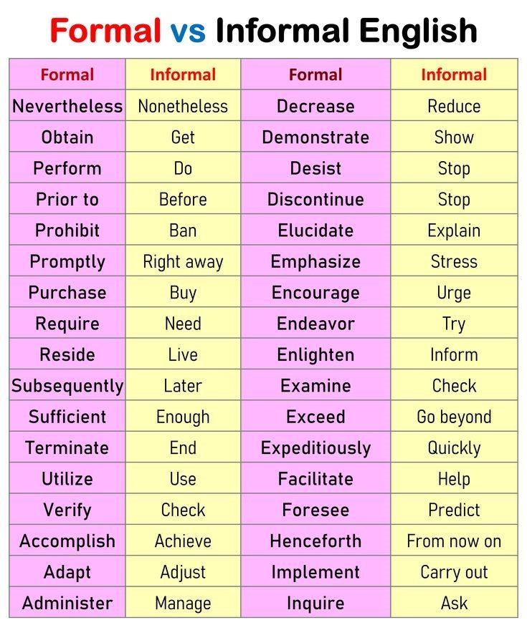
Make sure you are using formal verbs in your writing

Slide 25
Writing Task 1
Write an article for a school magazine about the benefits of outdoor activities for teenagers.
You could include some of the following in your article:
the physical and mental health benefits of outdoor activities
how outdoor activities can improve social skills and teamwork
ideas for popular outdoor activities teenagers can try

Slide 26
Writing Task 2
Write an article for a school magazine about the impact of social media on teenagers.
You could include some of the following in your article:
the positive and negative effects of social media on mental health
how social media influences friendships and self-image
tips on how to use social media responsibly

Slide 27


Thank You

