Slide 1
Past simple & Past progressive

Slide 2
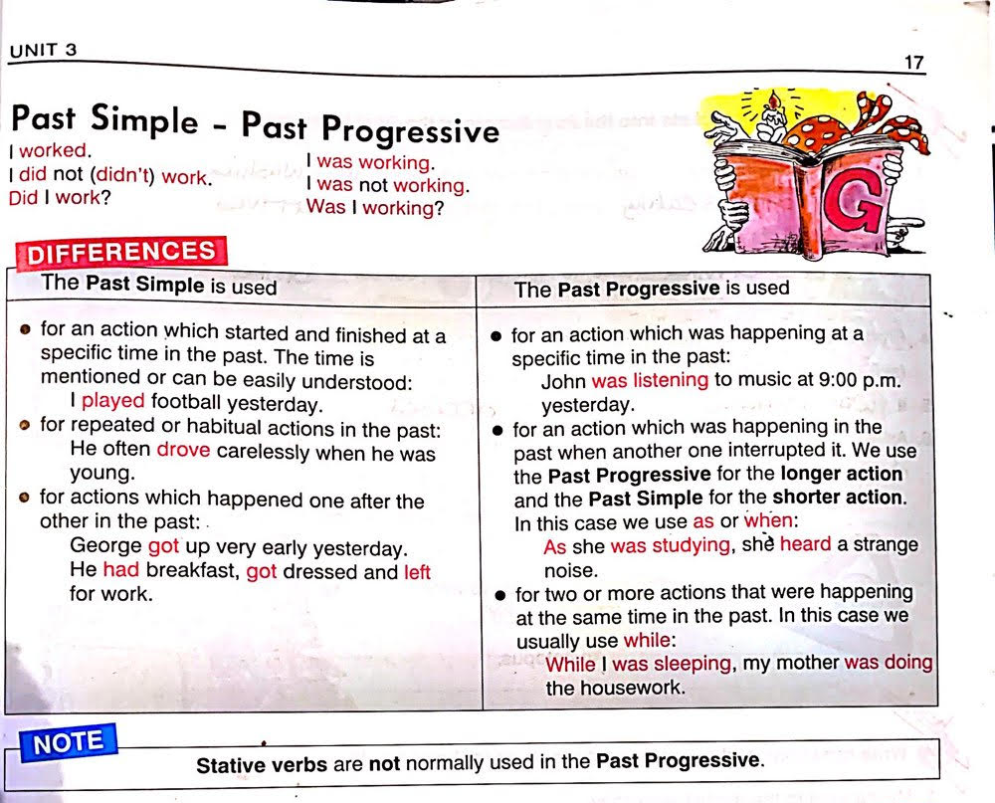

Slide 3
Past simple
Past progressive
A complete action that took place in the past.
A habit or a repeated action in the past.
Completed actions that took place one after the other in the past.
An action that was in progress in the past.
An action that was happening in the past when another one interrupted it.
2 or more actions happening at the same time in the past

Slide 4
Past simple (Affirmative)
A complete action that took place in the past.
Examples:
I bought this suit last week.
I left early yesterday.
I informed my mom about my situation.

Slide 5
Past simple (Negative)
A complete action that took place in the past.
Examples:
I did not buy this suit last week.
I did not leave early yesterday.
I did not inform my mom about my situation.
After adding “did not”, change the verb to its infinitive form. (bought=buy/left=leave/informed=inform)

Slide 6
Past simple (questions)
A complete action that took place in the past.
Examples:
Did you buy this suit last week?
Did you leave early yesterday?
Did you inform your mom about your situation?
Did+ subject+ verb (infinitive)

Slide 7
Past simple
2) A habit or a repeated action in the past.
Examples:
She always came late to the office.
She never apologized to me.
They usually prepared lunch at 2 p.m.
Tip: The highlighted keywords are used to indicate the use of past simple (A HABIT OR A REPEATED ACTION IN THE PAST).

Slide 8
Past simple
3) Completed actions that took place one after the other in the past.
Examples:
I arrived home, had a glass of milk and went straight to bed.
She added the ingredients in a bowl, whisked them together and placed them in the oven.
They left the soccer game, took showers and had dinner.

Slide 9
Past simple key words
Yesterday
Then
Last night/week/month/year
Usually
Never
Sometimes
On Mondays/Tuesdays etc.
A month/day/week/year ago
etc.

Slide 10
Past progressive (affirmative)
An action that was in progress in the past.
Examples:
They were watching the game at 8:45 p.m.
She was listening to the radio at 9:00 a.m.
I was playing volleyball at 7:30 p.m.
subject + verb to be (was/were) + verb-ing.

Slide 11
Past progressive (negative)
An action that was in progress in the past.
Examples:
They were not watching the game at 8:45 p.m.
She was not listening to the radio at 9:00 a.m.
I was not playing volleyball at 7:30 p.m.
subject + verb to be (was/were) + not + verb-ing.

Slide 12
Past progressive (questions)
An action that was in progress in the past.
Examples:
Were they watching the game at 8:45 p.m?
Was she listening to the radio at 9:00 a.m?
Was he playing volleyball at 7:30 p.m?
was/were + subject + verb-ing.

Slide 13
Past progressive
2) An action that was happening in the past when another one interrupted it. The longer action should be in the past progressive form while the shorter action should be in the past simple form.(if they are both long actions, both should be progressive)
Examples:
She was sweeping (longer action) the floor when she found (shorter action) a coin.
As they were listening (longer action) to music, he arrived (shorter action).
Tip: “As” and “when” are key words for past progressive interrupted actions.

Slide 14
Past progressive
3) 2 or more actions happening at the same time in the past.The longer action should be in the past progressive form while the shorter action should be in the past simple form.(if they are both long actions, both should be progressive)
Examples:
While I was washing the car, my mother was cooking.
My sister was eating while I was washing the dishes.
Tip: the word “while” is a key word for actions happening at the same time.

Slide 15
Let’s practice!

Slide 16
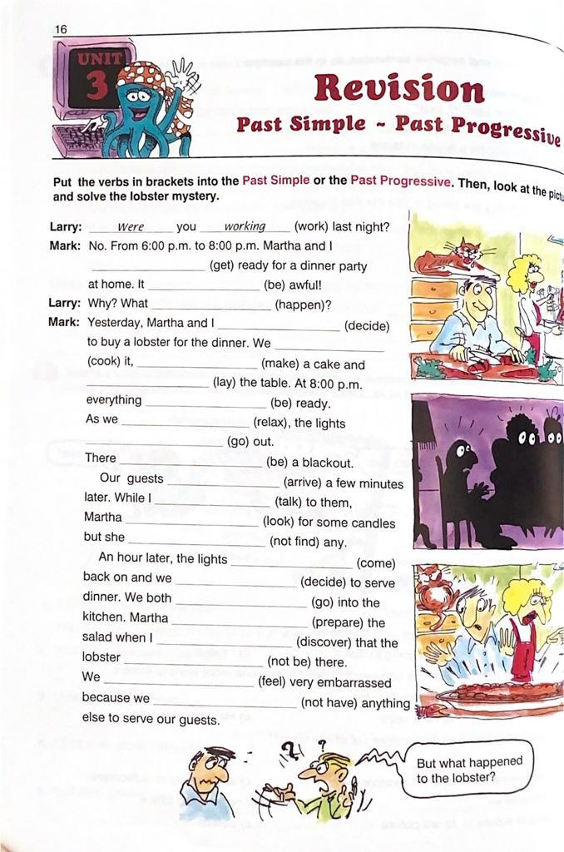

Slide 17
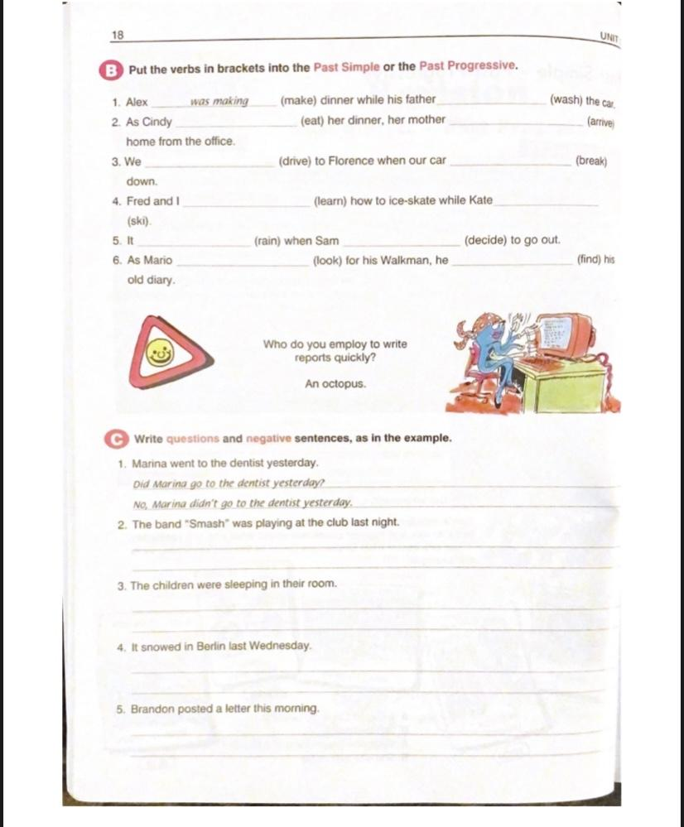

Slide 19
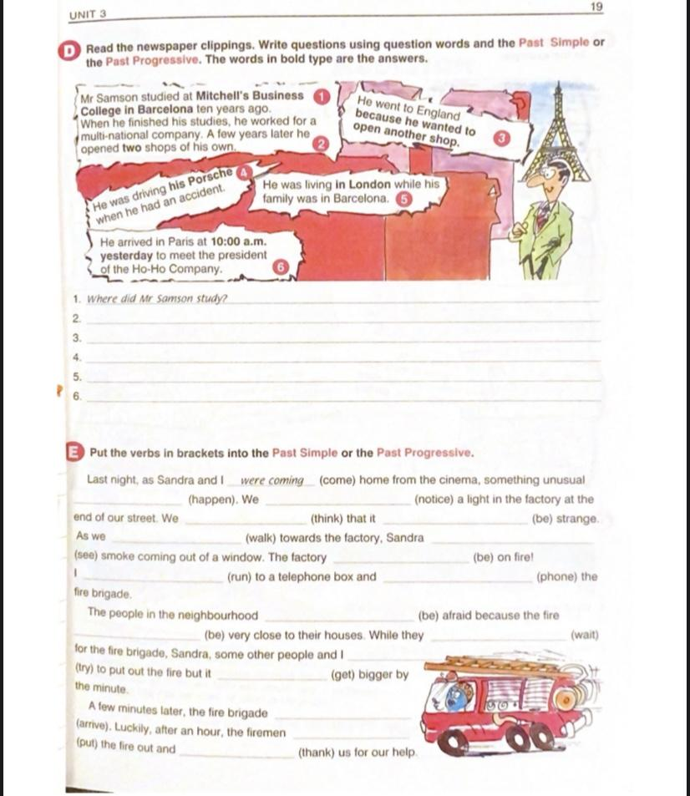

Slide 21
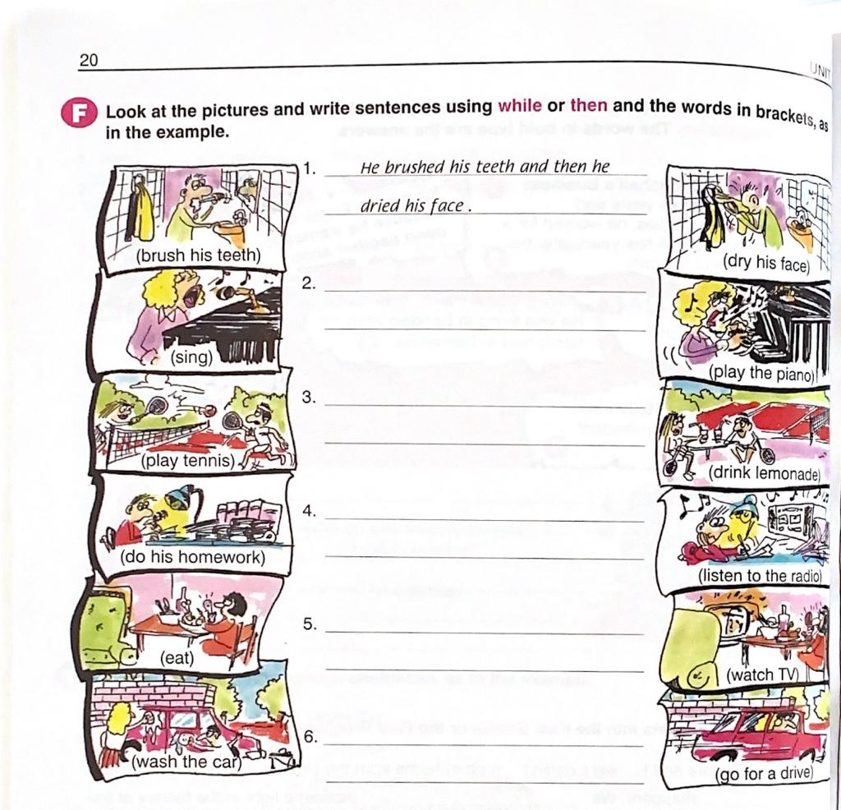

Slide 22
Fill in the blanks with past simple or past progressive.
Did you __________ (call) Debbie?
I __________ (finish) work, __________ (walk) to the beach and __________ (find) a nice place to swim.
They __________ (not stay) at the party the entire time.
As the audience __________ (applaud), he __________ (fall) off the stage.
Alan __________ (cut) the grass the other day when the snake __________ (appear).

Slide 23
6.While she __________ (sleep), someone __________ (clean) the hall.
7. __________ you __________ (do/call) me?
8. __________ she __________ (do/ski) today?
9. When we __________ (get) to the house yesterday morning, the baby __________ (drink) a bottle.
10. Mark __________ (make) pizza while Anthony __________ (watch) him.

