Slide 1
Non-fiction
1st Semester

Slide 2
Identify the features of a chronological report.
Dates
Time connectives
Past tense
Passive verb form

Slide 3
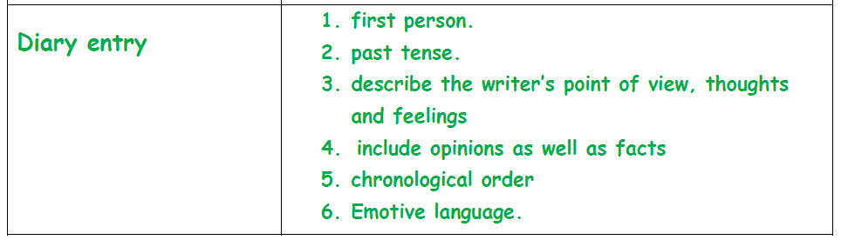
Identify the features of a diary.

Slide 4
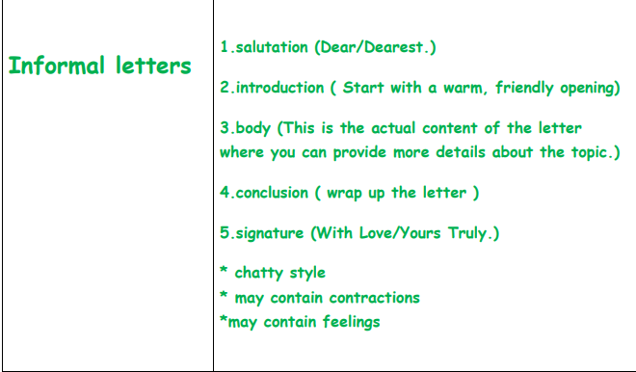
Identify the features of a letter.

Slide 5
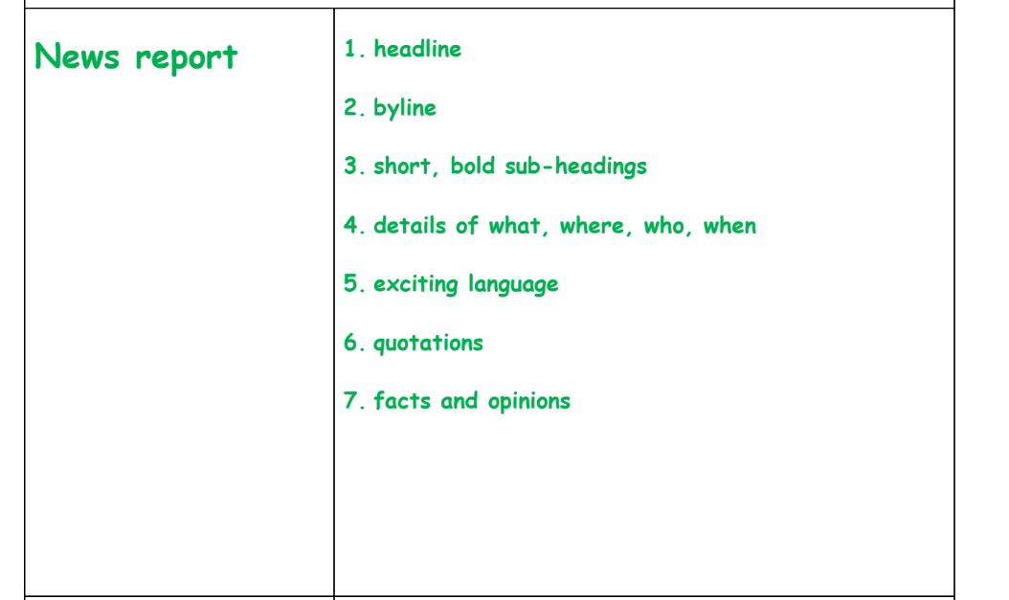
Identify the features of a newspaper report.

Slide 6
How does the writer get our attention in non-fiction?
talks directly to us
exclamation marks
short sentences/ two-word phrase
repetition
italics
powerful adjectives
informal language

Slide 7
Features of informal language
use of second person
use of questions
use of contractions
shortened clauses

Slide 8
Why has the writer chosen to write in an informal style?
to entertain the reader
to grab the reader’s attention

