Slide 1
Reading Comprehension Practice

Slide 2
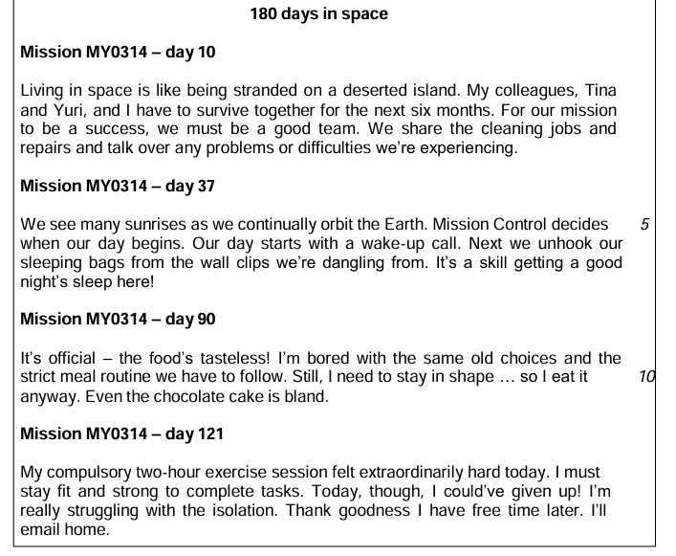

Read the text 5 min

Slide 3
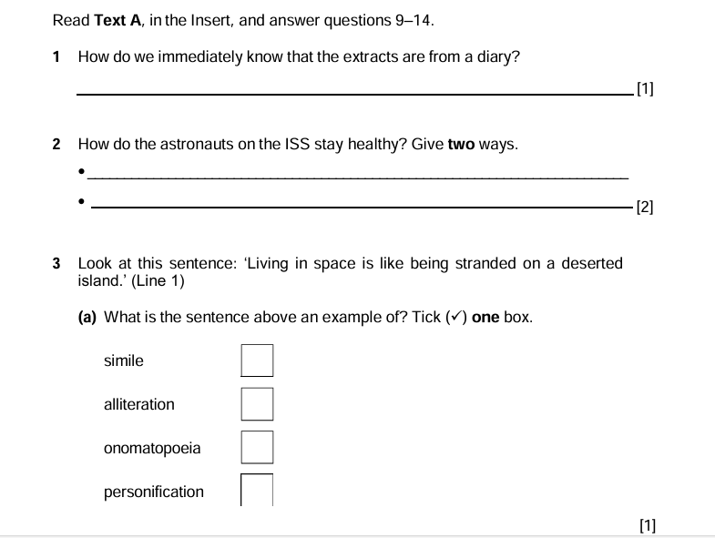
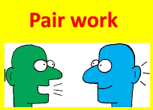

5 min

Slide 4


1-
2-

Slide 5
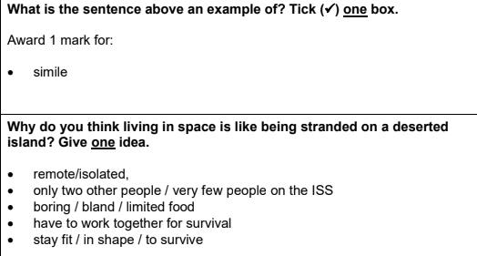
3-
4-

Slide 6
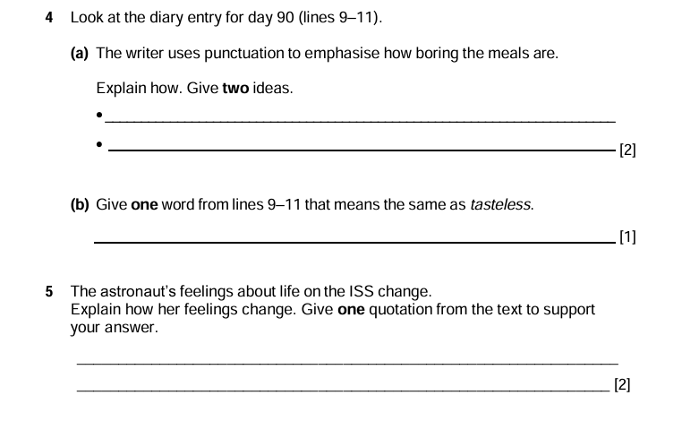
5 min

Slide 7
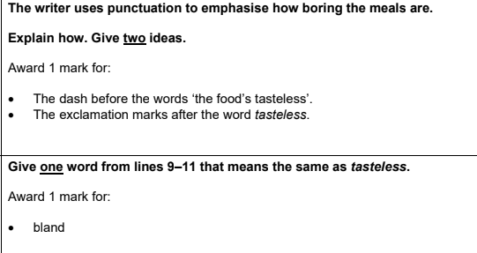
4 (a)-
(b)-

Slide 8
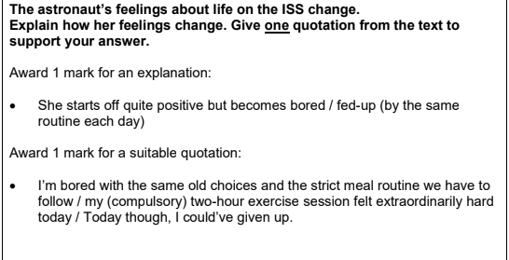
5-

Slide 9

3 min

Slide 10
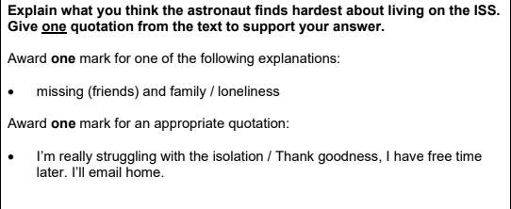
6-

