Slide 1
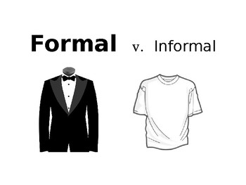
Formal and Informal
Language

Slide 2
Formal Language
Formal language is a type of language that you use in more formal or serious situations.
Some places you may use formal language in:
- Business
- Essays and academic papers
- When speaking with someone important

Slide 3

Characteristics of Formal Language
When writing a formal piece of writing, it usually consists of the following:
1- Full sentences
2- Correct grammar and advanced vocabulary
3- No contractions ( example: I would NOT I’d )
4- No figurative language
5- Passive voice (example: the application form was completed)
6- No abbreviations (example: As soon as possible).
7- No exclamation marks
8- No imperatives - do not give orders (example: Complete the form.)

Slide 4
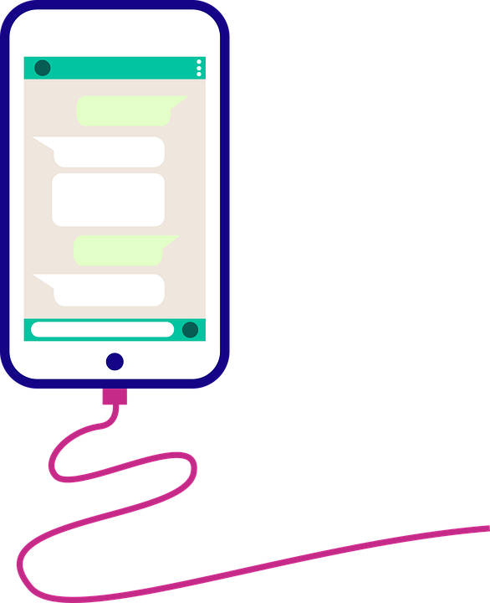
Informal Language
Informal language is a type of language you use in more laid back and casual situations.
Some places you may find informal language are:
-At home
-With friends/family
-Any place that is casual
It’s everyday language.
It’s NOT chat/text message language!

Slide 5

Characteristics of Informal Language
When writing an informal piece of writing, it usually consists of the following:
1- Short sentences
2- Lack of formal grammar and vocabulary
3- Contractions (example: I’d)
4- You may use figurative language.
5- Active voice (example: I completed the application form)
6- Abbreviations (example: ASAP)
7- Exclamation marks
8- Imperatives could be used

Slide 6
Time to look at how we can replace informal words with more formal ones.

Slide 7
Replace “slang” language with more formal terms
Informal | Formal
kids | children
bad | negative
good | positive
really big | considerable / large
right | correct
wrong | incorrect
smart | intelligent
cheap | inexpensive
loaded | rich
stuff | objects/ items / things

Slide 8
Replace“abbreviations” with the corresponding lengthened words
Informal | Formal
ASAP | as soon as possible
T.V. | television
photo | photograph
phone | cell phone
net | Internet

Slide 9
Not all emphasis words are formal...
Informal | Formal
lots of/ a lot of | much, many
tons of, heaps of | large quantities of
totally | completely, strongly
really | definitely

Slide 10
Make sure you are using formal transitions in your writing
Informal | Formal
Anyways | Nevertheless
Plus/Also | Moreover/ Furthermore/In addition/ Additionally
But | However
So | Therefore/Thus
Okay, OK | acceptable
I think | In my opinion,
Finally, | To conclude,
To sum up | In conclusion,
In a nutshell/Basically | To summarize,
All right | Acceptable
Do not use the words “Well,” or “Now,” to introduce ideas in formal writing.

Slide 11
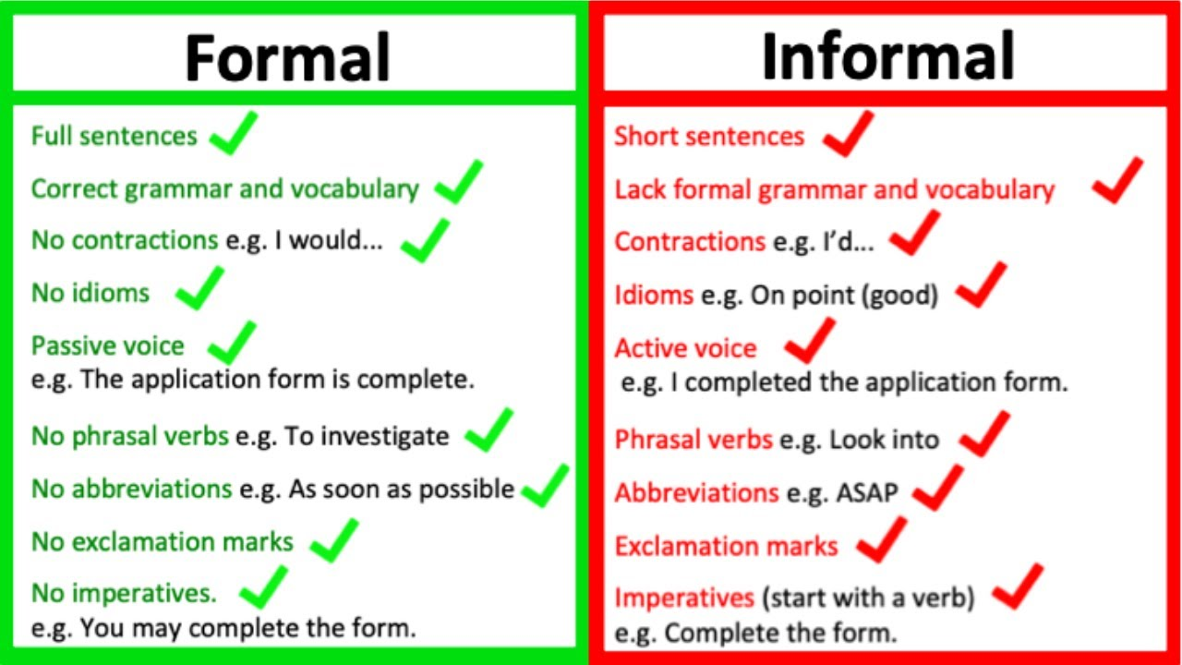
Quick Recap

