Slide 1

In the company of cheerful ladies

Slide 2
Learning Objectives:
Analyze how the setting of the café on Tlokweng Road and the surrounding environment contribute to the atmosphere of the story.
Describe how the setting influences Mma Ramotswe's reflections and interactions.
Explore Mma Ramotswe's character’s through her actions, thoughts and observation.
Identify and discuss themes such as change, nostalgia, and morality as presented in the passage.
Analyze the use of sensory details in the descriptions of the café and the eucalyptus.
Identify and discuss the narrative techniques used by Alexander McCall Smith, such as internal monologue and descriptive passages.
Compare Mma Ramotswe's idealized vision.

Slide 3
Match the term with the definition
Idealized
Morality
Nostalgia
Morality: principles concerning the distinction between right and wrong or good and bad behaviour.
Nostalgia: a longing to go back to one's home, home town, or homeland; homesickness. 2. a longing for something far away or long ago or for former happy circumstances.
Idealized: regarded or represented as perfect or better than in reality.
Play me

Slide 4

Alexander McCall Smith
(born 1948) has written more than 100 academic books, short stories and children's stories. The extract on the right is from In the Company of Cheerful Ladies which is part of a series of novels that feature the character Mma Precious Ramotswe. The stories are set in Botswana.
Alexander McCall Smith

Slide 5
TEC TAC TOE Activity
Students must select and answer three questions in a row (horizontally, vertically, or diagonally) to complete the activity.
Theme Analysis What is the main idea in the passage (like change or remembering the past), and how does Mma Ramotswe think about it? | Character Development What do Mma Ramotswe’s thoughts and actions in the café show about her personality? | Creative Writing Imagine you are sitting in a café like the one in the passage. What do you see, hear, and feel? Describe it using details.
Narrative Techniques What storytelling techniques does the author use (like showing Mma Ramotswe’s thoughts or describing the setting)? How do they make the story better? | Sensory Imagery What sights, sounds, or smells does the author describe in the café, and how do they help create the mood? | Group Discussion Talk with your group: How do Mma Ramotswe’s thoughts about selfish behavior show her views on how Botswana is changing?
Setting Analysis How does the café setting affect what Mma Ramotswe thinks about and observes? | Reflection Writing Can you think of a time in your life when you noticed change, like Mma Ramotswe does? Write about it. | Compare and Contrast How is Mma Ramotswe’s view of the past different from the modern behavior she sees in the café? What does this show about how society is changing?

Slide 6
Theme Analysis
What is the main theme in the passage (e.g., change or nostalgia),
and how is it presented through Mma Ramotswe's reflections?
The main theme of the passage is nostalgia, as Mma Ramotswe reflects on her past experiences and the changes in her society. Through her quiet moments in the café, she contrasts her idealized memories of Botswana with the contemporary behaviors she observes, indicating a sense of longing for a more community-focused past.
Community-focused: "Community-focused" refers to a perspective or approach that prioritizes the needs, values, and connections within a community. It emphasizes collaboration, support, and shared experiences among members rather than individualism.
Back

Slide 7
Narrative Techniques
What narrative techniques does Alexander McCall Smith use in the passage, such as internal monologue or descriptive passages, and how do they enhance the story?
Alexander McCall Smith employs internal monologue to provide insight into Mma Ramotswe’s thoughts, allowing readers to connect with her emotions and reflections. Descriptive passages vividly portray the café’s setting, enhancing the atmosphere and making readers feel present in the scene. This combination helps convey Mma Ramotswe's contemplative/reflective nature and her observations of societal changes.
Back

Slide 8
Setting Analysis
How does the setting of the café influence Mma Ramotswe's reflections and observations?
The café setting provides Mma Ramotswe with a peaceful space to reflect on her week and the state of the world. The open verandah allows her to observe the hustle and bustle of life around her, prompting thoughts about societal changes and her feelings of nostalgia for a more communal past. The comforting view of the eucalyptus trees adds to her contemplative/reflective mood.
Back
Hustle and bustle: A large amount of activity and work, usually in a noisy surrounding.

Slide 9
Character Development
What do Mma Ramotswe's actions and thoughts in the café reveal about her personality?
Mma Ramotswe’s actions demonstrate that she is introspective, thoughtful, and values reflection. Her choice to sit alone in the café shows her appreciation for solitude, while her reactions to the events around her reveal her sense of justice and concern for societal morals.
Introspective: "Introspective" describes a reflective or self-examining attitude, where a person looks inward to consider their thoughts, feelings, and motivations. It often involves deep thinking about one's own experiences and emotions.
Back

Slide 10
Sensory Imagery
What sensory details (e.g., sounds, sights) does the author use to describe the café and eucalyptus trees, and how do they contribute to the mood of the scene?
The author uses sensory details like the sound of the eucalyptus leaves rustling, which Mma Ramotswe imagines to sound like the sea, creating a serene and tranquil mood. The visual imagery of dark green foliage/leaves and the open verandah evokes a sense of openness and connection to nature, enhancing the café's comforting atmosphere.
Back

Slide 11
Reflection Writing
What personal connections can you make between Mma Ramotswe's reflections on change and any similar experiences in your life?
I can relate to Mma Ramotswe’s feelings of nostalgia, as I often think about how my hometown has changed over the years. Like her, I feel a longing for the sense of community that seems to have diminished/decreased, and I find myself reminiscing about simpler times when people were more connected and considerate of one another.
Back

Slide 12
Creative Writing
Imagine you're sitting in a café similar to the one described in the passage. What do you see, hear, and feel? Write a descriptive paragraph using sensory details.
Sitting in the café, I see the sunlight filtering through the green leaves of the eucalyptus trees, casting dancing shadows on the wooden tables. The air is filled with the soothing sound of leaves rustling, reminiscent of ocean waves, creating a calming atmosphere. I feel a gentle breeze against my skin and smell the rich aroma of freshly brewed coffee wafting through the air. Laughter and soft conversations from nearby tables add to the vibrant yet relaxed ambiance.
Back

Slide 13
Group Discussion
In your group, discuss how Mma Ramotswe's observations of selfish behavior reflect her thoughts on societal changes in Botswana.
In our discussion, we noted that Mma Ramotswe’s observations highlight her disappointment with the increasing selfishness she perceives in contemporary society. Her reaction to the hit-and-run incident indicates her belief that people are becoming less considerate and ethical. This reflects a broader theme of societal decline in moral values, contrasting with her idealized memories of the past.
Back

Slide 14
Compare and Contrast
How does Mma Ramotswe’s idealized vision of the past compare with the modern behaviors she witnesses in the café? What does this reveal about changes in society?
Mma Ramotswe’s idealized vision of the past is characterized by a sense of community, kindness, and responsibility. In contrast, the modern behaviors she observes, such as the hit-and-run incident, reflect a growing self-centeredness and lack of accountability. This contrast highlights a societal shift from traditional values to a more individualistic approach, suggesting a decline in moral standards and community cohesion/unity.
Back

Slide 15
In the company of cheerful ladies
What does Mma Ramotswe's choice to sit alone and think about the week tell us about her?
It shows that she values quiet time to think and reflect. She cares about the events of the week and the world around her, indicating that she is thoughtful and introspective (spends considerable time examining his own thoughts and feelings).
What is the setting in the story?
The setting of the story is a café located at the edge of a shopping center at the Gaborone 4 end of Tlokweng Road in Gaborone, Botswana.
Saturday.
Mma Ramotswe was sitting alone in her favourite café, on the edge of the shopping centre at the Gaborone 4 end of Tlokweng Road. It was a Saturday, the day she preferred HI above all others, a day on which one might do as much or as little as SUBTITLE one liked, a day to have lunch with a friend at the President Hotel, or, FAV as on that day, to sit by oneself and think about the bents of the week, and the state of the world. This café was a good place to be, for several reasons.

Slide 16
What makes the café Mma Ramotswe's favorite place to be on Saturdays?
Mma Ramotswe enjoys the café because it has a comforting view of eucalyptus trees and a relaxing atmosphere. The open verandah lets her enjoy the fresh air and observe the world around her, making it a perfect place for her to relax and reflect on the week.
Why does Mma Ramotswe imagine the sound of the wind through the eucalyptus leaves as resembling the sea?
because she has never actually heard the sound of the sea herself. Being landlocked in Botswana, far from any ocean, she draws on her imagination to associate the rustling of the eucalyptus leaves with what she believes the sea might sound like.
Firstly, there was the view, VOL- that of a stand of eucalyptus trees with foliage of comforting dark green which made a sound like the MENU sea when the wind blew through the leaves. Or that, at least, was the sound which Mma Ramotswe imagined the sea to make. She had never seen the ocean, which was far away from landlocked Botswana far away across the deserts of Namibia, across the red sands and dry mountains.

Slide 17
What thoughts crossed her mind upon hearing the sound of the eucalyptus trees, and what was the reason behind these thoughts?
She imagined standing on the shore and feeling the waves wash over her feet when she heard the sound of the eucalyptus trees. This daydream likely arose from the calming and atmospheric experience of the trees in the wind, evoking a sense of tranquility and longing for a serene seaside moment.
But she could imagine it when she listened to the eucalyptus trees in the wind and closed her eyes. Perhaps one day she would see it, and would stand on the shore and let the waves wash over her feet. Perhaps. The other advantage that this cafe had was the fact that the tables were out on an open verandah, and there was always something to watch.

Slide 18
The other advantage that this cafe had was the fact that the tables were out on an open verandah, and there was always something to watch.
That morning, for instance, she had seen a minor dispute between a teenage girl and her boyfriend- an exchange of words that she did not catch but which was clear enough in its meaning - and she had witnessed a woman scrape the side of a neighbouring car while she tried to park. The woman had stopped, quickly inspected the damage, and had then driven off.
What is the significance of the café open verandah in the story?
It allows Mma Ramotswe to observe various incidents and interactions happening around her, providing her with entertainment and a glimpse into everyday life.
It provides a sense of openness and connection to the outside world.
How does Mma react to the incidents she witnessed that morning?
She was half-risen to her feet to protest the woman's hit-and-run, showing her sense of justice and desire to intervene (involve oneself).

Slide 19
Why does Mma feel incredulous (unbelievable) about the woman’s action with the car?
because the woman does not take responsibility for the damage and drives away without leaving any contact information. This action goes against Mma Ramotswe's sense of fairness and honesty.
How does Mma Ramotswe reconcile/ harmonize her thoughts about the incident with her views on the past and present in Botswana?
She acknowledges that incidents like the hit-and-run could have occurred in the past in Botswana, but she believes they are more common in contemporary times (present-time).
What does Mma Ramotswe's decision to pour herself another cup of tea suggest about her state of mind after witnessing the incident?
she is processing her thoughts and emotions after witnessing the incident. It shows her contemplative nature and perhaps a need to calm herself after feeling unsettled by the events.
How does Mma Ramotswe's observation of selfish behavior reflect on her perception of societal changes?
She sees an increase in individuals who prioritize their own interests over consideration for others. It highlights her awareness of ethical standards and community values.
Mma Ramotswe had watched this incredulously, and had half-risen to her feet to protest, but was too late: the woman's car had by then turned the corner and disappeared and she did not even have time to see its number-plate.
She had sat down again and poured herself another cup of tea. It was not true that such a thing could not have happened in the old Botswana- it could - but it was undoubtedly true that this was much more likely to happen today. There were many selfish people about these days, people who seemed not to care if they scraped the cars of others or bumped into people while walking on the street.
Alexander McCall Smith

Slide 20
Bent
The events that happened during the week.
back

Slide 21
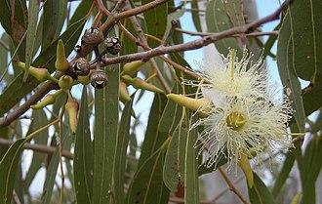
Eucalyptus tree
Eucalyptus gets its name from the Greek word 'eu' which means good, well, true, beautiful or very and the word 'kalypto' which means cover, conceal or hide, in reference to the caps that cover the plant's flowers.
back

Slide 22
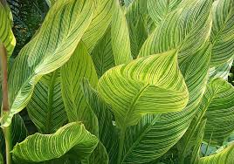
Foliage
The leaves of a plant are referred to as its foliage.
back

Slide 23
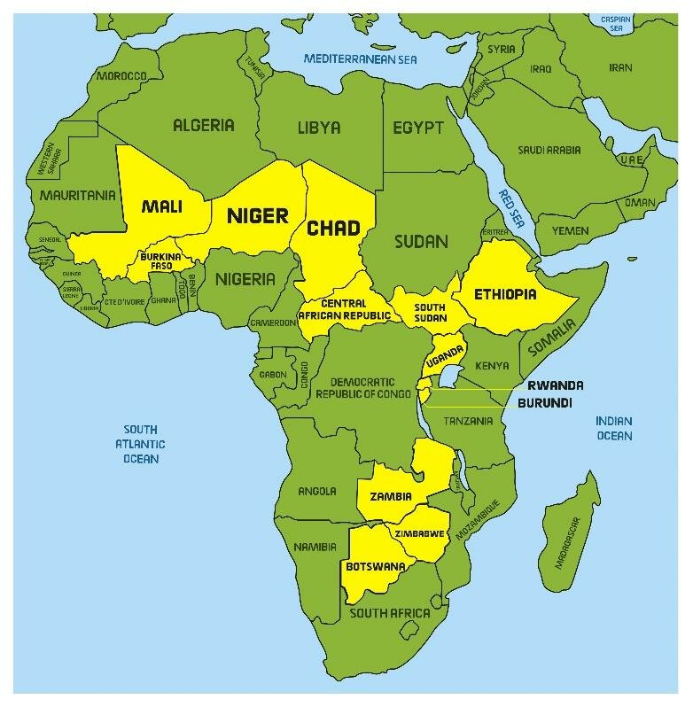
Landlocked
Refers to a geographic location or state of being surrounded entirely by land with no direct access to the ocean or any significant body of water.
back

Slide 24
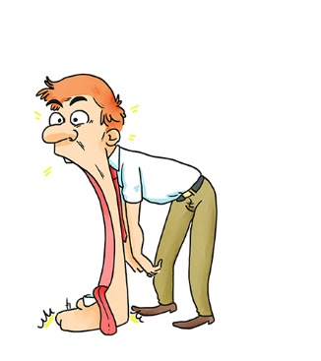
Incredulously
Unwilling to admit or accept what is offered as true.
back

Slide 25

dispute
a disagreement or argument.
back

Slide 26
witnessed
have knowledge of (a development) from observation or experience.
back

Slide 27
Let’s Talk: Student’s Book page 15
Imagine you are sitting in a café near where you live. Write a paragraph to describe what you see, hear and feel.
'a stand of eucalyptus trees with foliage of comforting dark green which made a sound like the sea, 'she listened to the eucalyptus trees in the wind and closed her eyes', 'the tables were out on an open verandah, and there was always something to watch'.

