Slide 1
Newspaper reports

Slide 2

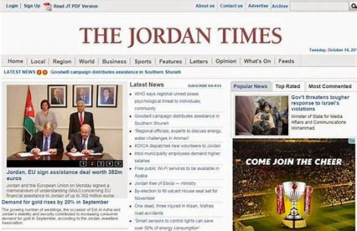
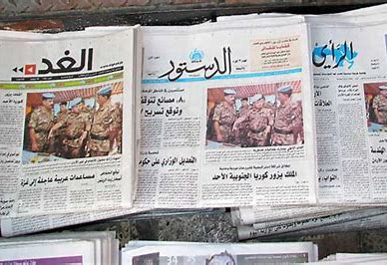
Newspaper Reports 2:30 https://youtu.be/wpZ_Q2ntCzY?si=jDelaNWKNT3G9o6c
What are newspaper reports?

Slide 3
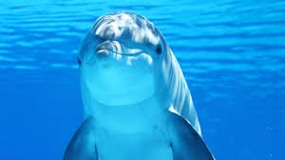
Open Booklet 1 to page 138 and read the report individually. 5 min.
Danny the Dolphin Dives Deep
Reported by: Rachel Barndt
Yesterday in Aqaba, a child named Charley escaped
a tragic accident in the Red Sea by the heroic act
of Danny the Dolphin.
The incident occurred during a boat tour when seven-year-old Charley accidentally flipped overboard while playing near the edge of the boat. Panicked and unable to swim, Charley began to drown. Fortunately, Danny the dolphin, who happened to be nearby, swiftly darted towards Charley and nudged him towards the surface near the boat. Charley's father quickly retrieved him and headed towards the shore.
“We couldn’t believe our eyes as we watched the dolphin come to Charley’s rescue. It was truly a miraculous sight,” exclaimed Charley’s dad.
“I called the ambulance as soon as it happened,” said a witness. “They arrived at the beach within 10 minutes.”
Charley has now fully recovered and he is back to enjoying his holiday with his family. The Aqaba community praised Danny the Dolphin for his bravery and intelligence. Local authorities reminded visitors to follow safety rules while on boat tours and to always keep children supervised near the water. Danny’s remarkable act of courage will long be remembered as a symbol of friendship between humans and animals.
Danny the dolphin saves a child from drowning.

Slide 4

What is the headline/title of the report?
What did the writer use to make the headline catchy and interesting?
Is it written in chronological order or non-chronological order?
What tense is used in the text?
5 min.

Slide 5
Danny the Dolphin Dives Deep
alliteration
chronological
It is written in the past tense

Slide 6

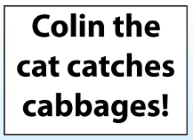

How are these headlines catchy and interesting? How did the writer grab the reader’s attention?
https://www.youtube.com/watch?v=6Q5rFp2DHbg

Slide 7
5. Give an example of a quotation.
6. Find one fact.
7. Find one opinion.
8. From which point of view the report is written?
5 min.

Slide 8
5. “We couldn’t believe our eyes as we watched the dolphin come to Charley’s rescue. It was truly a miraculous sight,” exclaimed Charley’s dad.
“I called the ambulance as soon as it happened,” said a witness. “They arrived at the beach within 10 minutes.”
6. Facts:
Charley accidentally flipped overboard while playing near the edge of the boat.
Charley was released from the hospital on the same day with no lasting injuries.
7. Opinions:
"It was truly a miraculous sight," exclaimed Charley’s dad.
8. 3rd person

Slide 9
Read the lead paragraph and answer the questions.
Yesterday in Aqaba, a child named Charley escaped a tragic accident in the Red Sea by the heroic act of Danny the Dolphin.
When did the event happen?
Where did it happen?
Who was involved in the incident?
What exactly happened?
5 min.

Slide 10
Read the first paragraph and answer the questions.
Yesterday in Aqaba, a child named Charley escaped a tragic accident in the Red Sea by the heroic act of Danny the Dolphin.
When did the event happen?Yesterday
Where did it happen? in Aqaba
Who was involved in the incident?a child named Charley
What exactly happened?Charley escaped a tragic accident in the Red Sea by the heroic act of Danny the Dolphin.

Slide 11

Write as many features of a newspaper report as you can.
3 min.

Slide 12
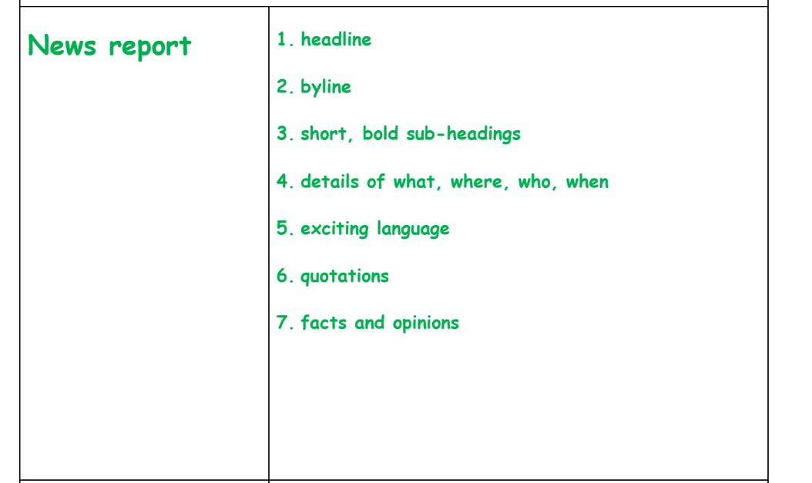

Slide 13

After you watch the video, work in pairs to annotate the parts of a newspaper report.
https://www.youtube.com/watch?v=8_NmVtnEEA8

Slide 14
Annotate the parts of a newspaper report.
Headline Byline Lead Body Conclusion
Danny the Dolphin Dives Deep
Reported by: Reem Dweik
Yesterday in Aqaba, a child named Charley escaped
a tragic accident in the Red Sea by the heroic act
of Danny the Dolphin.
The incident occurred during a boat tour when seven-year-old Charley accidentally flipped overboard while playing near the edge of the boat. Panicked and unable to swim, Charley began to drown. Fortunately, Danny the dolphin, who happened to be nearby, swiftly darted towards Charley and nudged him towards the surface near the boat. Charley's father quickly retrieved him and headed towards the shore.
“We couldn’t believe our eyes as we watched the dolphin come to Charley’s rescue. It was truly a miraculous sight,” exclaimed Charley’s dad.
“I called the ambulance as soon as it happened,” said a witness. “They arrived at the beach within 10 minutes.”
Charley was released from the hospital on the same day with no lasting injuries. Danny the Dolphin's heroic act has quickly become the talk of the community, spreading joy and gratitude among the locals.
Danny the dolphin saves a child from drowning.
5 min.

Slide 15
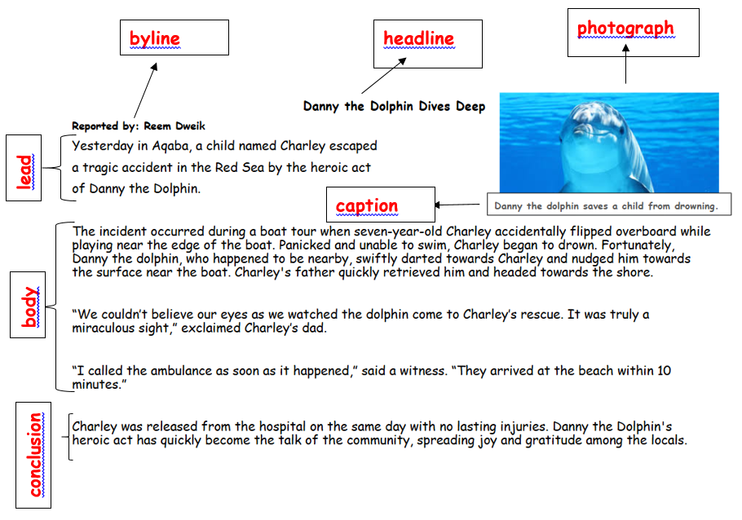

Slide 16
Structure of a Newspaper Report
Headline: A catchy title
Byline: A fictional reporter's name.
Lead: A brief introduction that answers the questions: who, what, when and where. The teacher explains that the first paragraph in a newspaper report answers these 4WH questions and is called a “lead paragraph” because it leads the reader into the rest of the story.Also, when a lead is well written, it pulls the reader into the story and prepares them for what is coming next.
Body: The main details of the event, written in a clear and organized manner. It explains how and why the incident happened. One should use at least one quote.
Conclusion: A final paragraph that wraps up the report( What the reader wants to know? What happened afterwards?)

Slide 17
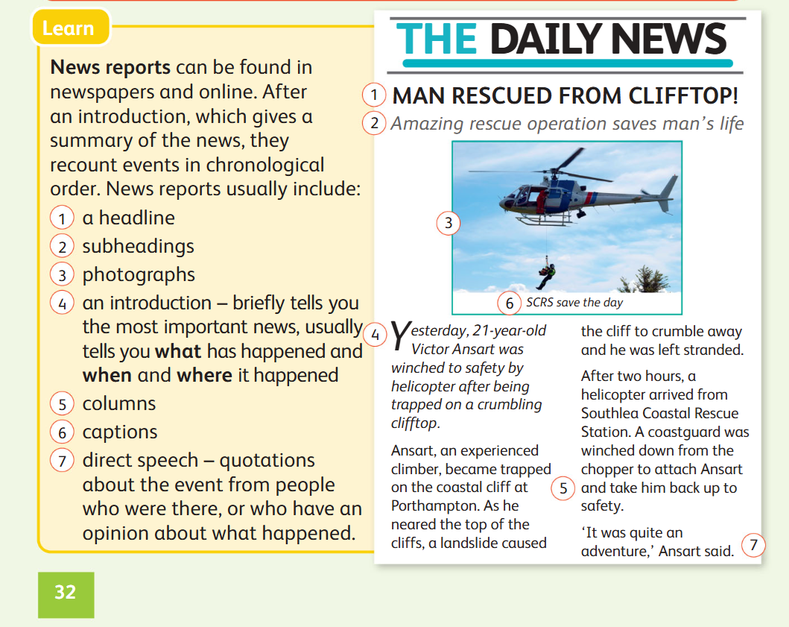

Student book page 32

Slide 18

Identify three features found in newspaper reports.
3 min

