Slide 1
Writing a Newspaper Report

Slide 2
Watch the video to answer the following questions.
https://www.youtube.com/watch?v=O-5BWEN2z5c
  “What did you learn about the headline?”
  “What is the purpose of the lead in a newspaper report?”
  “What does the body of the article include?”
  “Why is the conclusion important?”

Slide 3
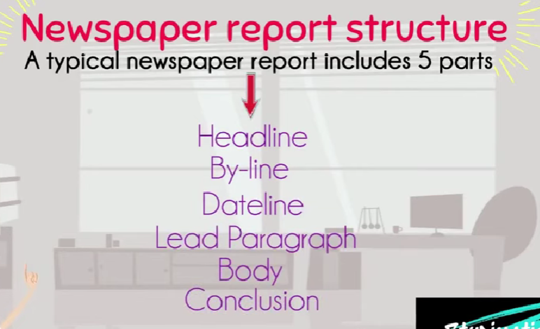

Slide 4


Slide 5


Slide 6

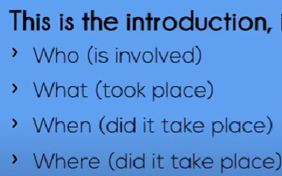

Slide 7
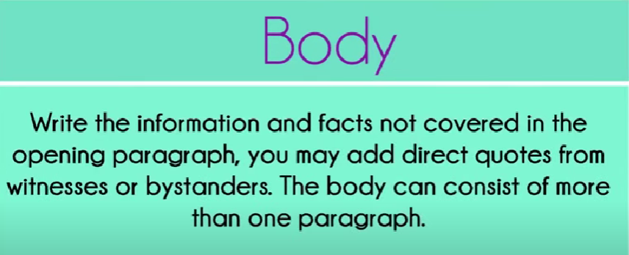

Slide 8
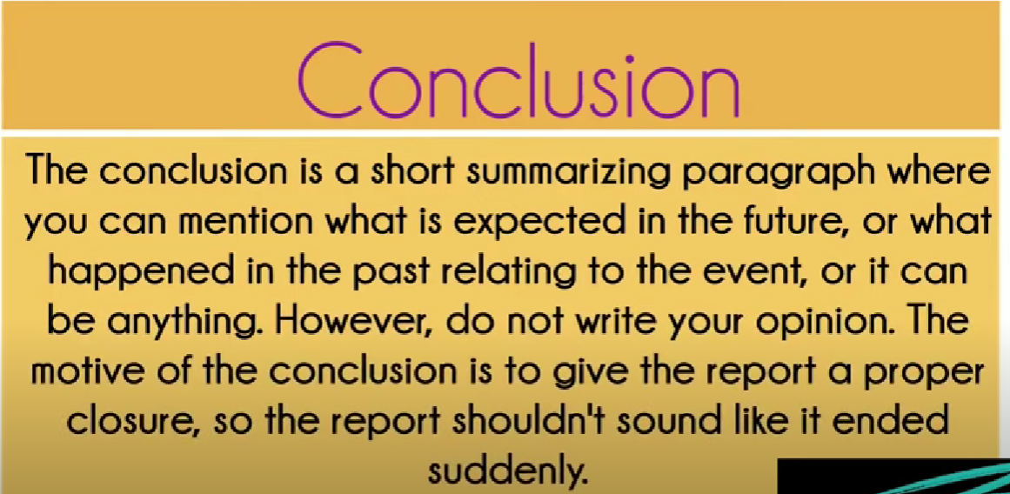

Slide 9


Slide 10
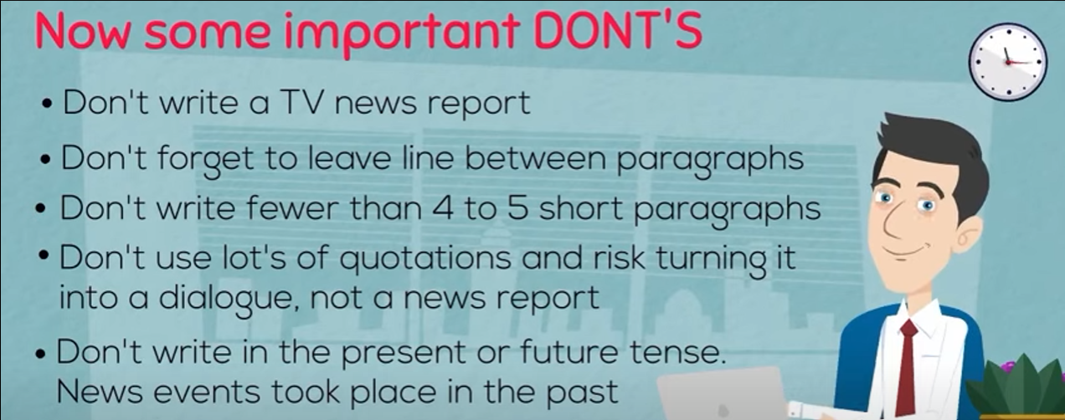

Slide 11
Write a newspaper report about a dog who saved a group of climbers from freezing to death.

Slide 12
Imagine the story of a dog rescuing climbers. Write the following questions on the board:
  Who is involved?
  What happened?
  When did this happen?
  Where did the rescue take place?
  How did the dog save them?

Slide 13
Imagine the story of a dog rescuing climbers. Write the following questions on the board:
  Who is involved? (The heroic dog and the climbers)
  What happened? (The dog rescued the climbers from freezing to death)
  When did this happen? (The time of day or year)
  Where did the rescue take place? (The location, such as a mountain or snowy area)
  How did the dog save them? (Describe the dog’s actions)

Slide 14

Newspaper report organizer

Slide 15
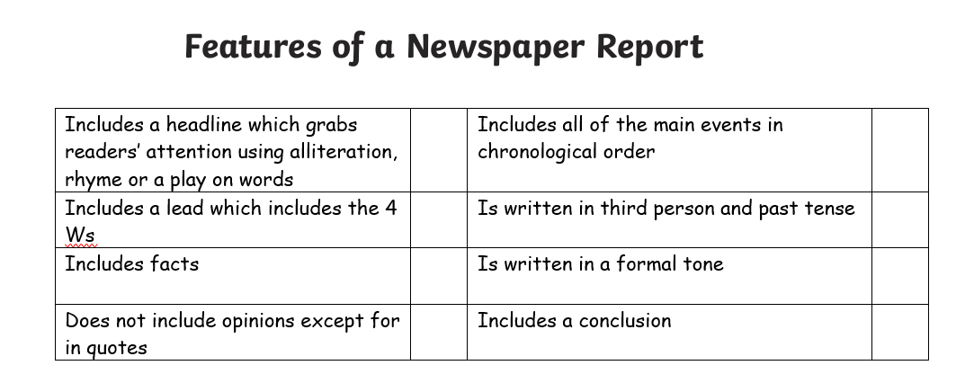
Checklist

