Slide 1
Unit 2 Vocabulary

Slide 2
Gondola

Slide 3
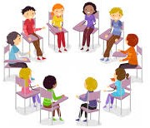
Gondola (n.):
the compartment of a cable car where people stand or sit
Example: We decided to ride the gondola because it looked fun but my little brother was scared of the height.

Slide 4
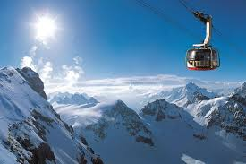
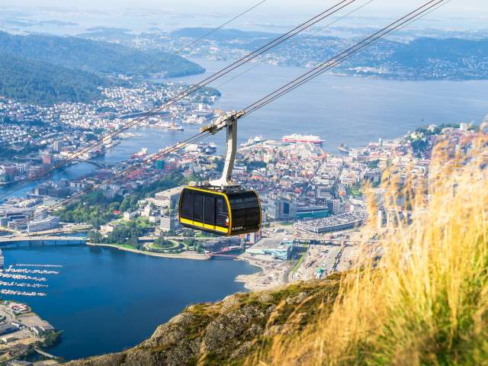
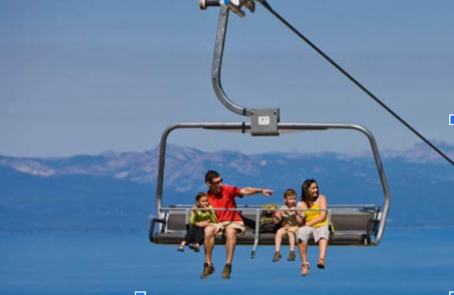

Slide 5
Sentences
The gondola slowly floated across the lake and the passengers enjoyed the beautiful view of the mountains.
Although the gondola was a bit wobbly, we felt safe as we climbed higher and higher.
As the gondola moved over the water, we saw fish swimming below and the sunlight sparkled on the surface.
My family rode the gondola to the top of the mountain where we went skiing after.
The gondola ride was quiet and smooth but I was nervous because it was my first time going up so high.

Slide 6
Glacier

Slide 7
Glacier (n.):
a huge, solid “river” of ice
Example: I loved snowboarding on the glacier because the snow was perfect and the view was amazing.

Slide 8
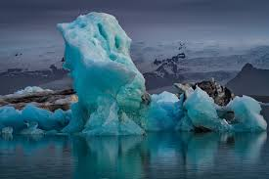
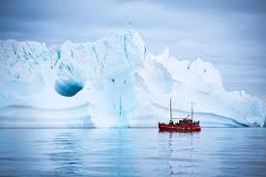
https://www.youtube.com/watch?v=nB-tbjlkqKM
https://www.youtube.com/watch?v=kE_1s6sPjQQ

Slide 9
Sentences
The snow on the glacier was thick so snowboarding felt like gliding on a soft cloud.
The glacier moved slowly down the mountain and we could hear the crackling of the ice.
Although the glacier was huge, we were able to hike around its edges and explore.
We hiked toward the glacier and the cold air made our cheeks turn red.
We went up the mountain to see the glacier and the view was amazing.
We saw the glacier from the boat but it was far away.
The glacier was big and it covered the entire mountain.

Slide 10
Record-breaking

Slide 11
Record-breaking (adj.):
better than anything else
Example:The team scored a record-breaking number of goals and they celebrated their victory with a big party.

Slide 12
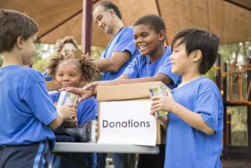
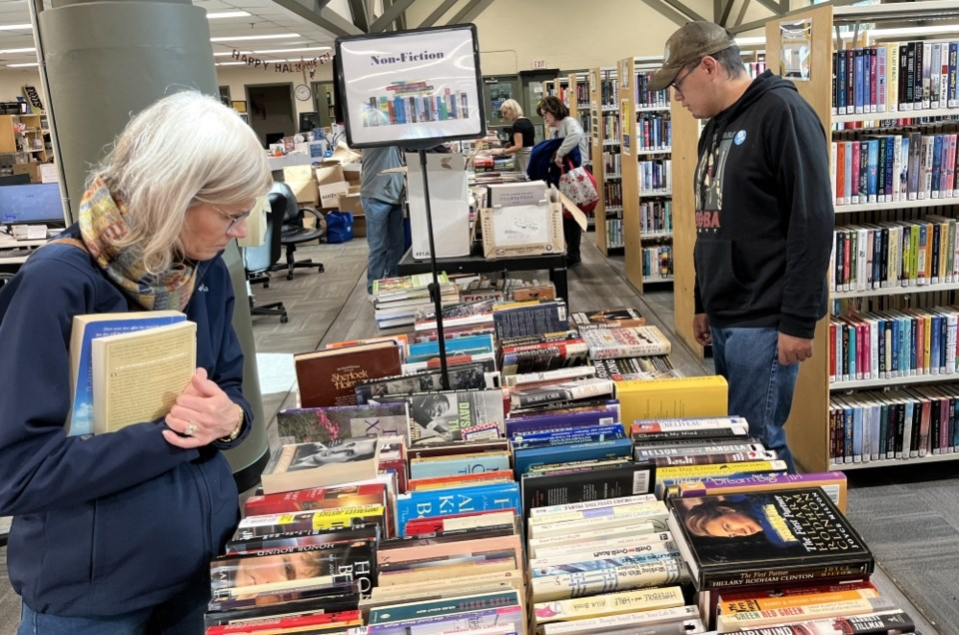

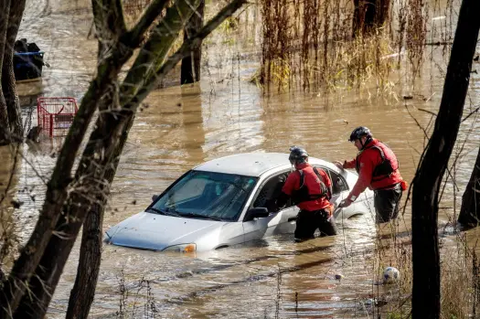

Slide 13
Sentences
The students set a record-breaking amount of donations for charity and they felt happy to help others.
There was a record-breaking number of books sold and the author felt very proud of the success.
The teacher gave a record-breaking number of stickers to the students and they were all excited.
She achieved a record-breaking score on her test even though she had studied for just a few hours.
The storm caused record-breaking flooding but the city was able to recover quickly.

Slide 14
Commander

Slide 15
Commander (n.)
the person in charge, especially in the military, who leads or directs a group of people
Example: The commander gave orders to his team because he wanted to ensure that they were ready for the mission ahead.

Slide 16
Mission controller

Slide 17
Mission controller (n.)
The person on the Earth who was in charge of the moon landing
Example: The mission controller watched the rocket launch because he wanted to ensure everything was safe and working well.

Slide 18
Cascades

Slide 19
Cascades(n.):
things that fall or move down in steps like a waterfall
Example:As we walked near the cascades, we felt the cool breeze coming from the water.

Slide 20
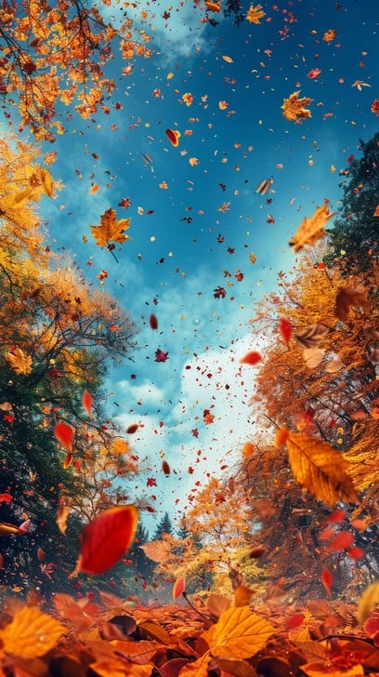
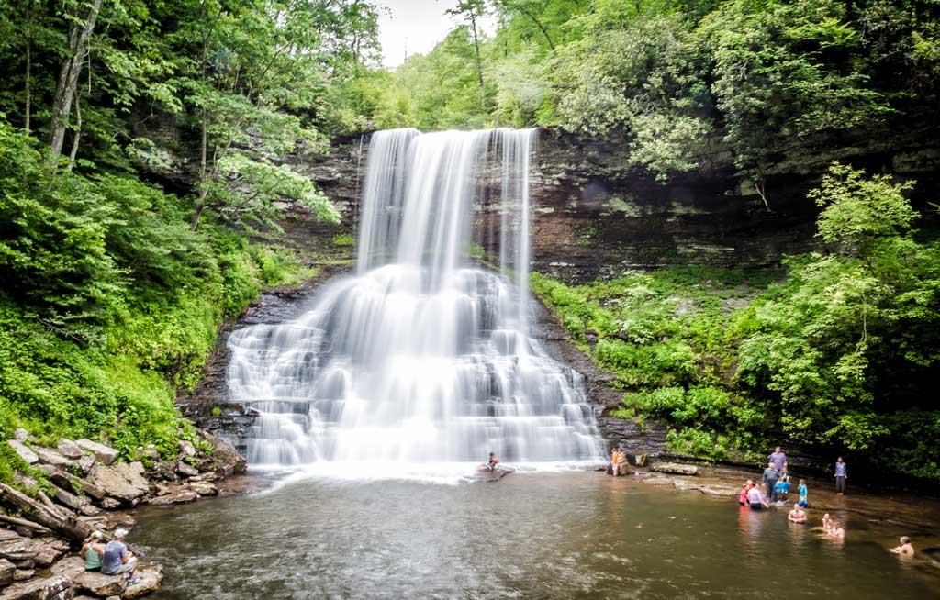
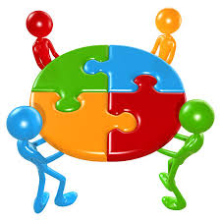
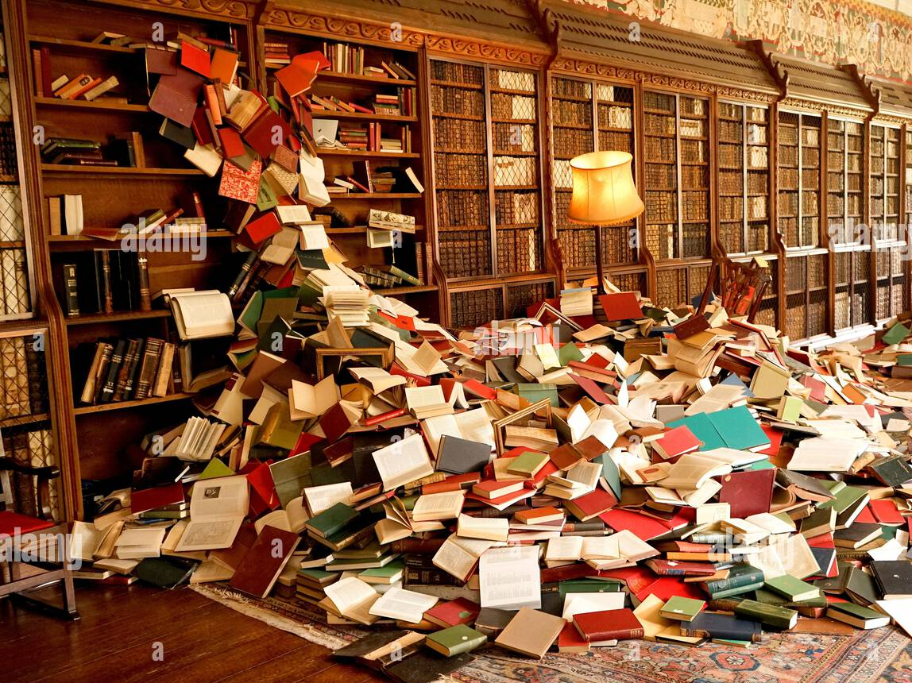

Slide 21
Sentences
The leaves fell in a cascade, covering the ground with bright colors.
The books tumbled off the shelf in a cascade, making a loud noise on the floor.
We stopped to admire the cascades but we had to keep moving because the hike was long.
Although the cascades were beautiful, we had to be careful not to slip on the wet rocks.
The cascades of water fell down the mountain and the sound was soothing to hear.
While the fireworks exploded in a brilliant cascade of colors, the crowd cheered loudly.

Slide 22
Tension

Slide 23
Tension (n.)
excitement and fear
Example:The tension between the two friends grew when they couldn’t agree on what movie to watch.

Slide 24
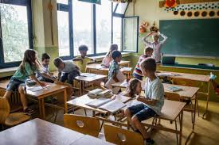

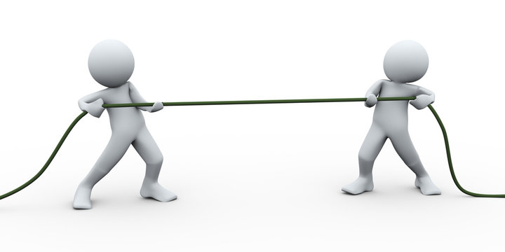
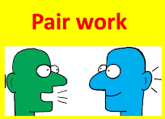

Slide 25
Sentences
The tension between the two teams grew and the coach tried to calm them down.
Everyone felt the tension so we decided to take a short break.
The argument caused tension but they made up later that day.
When the teacher entered the classroom, the tension immediately disappeared.
The tension increased because nobody agreed on the solution.
Although there was some tension at first, they eventually worked well together.
You could feel the tension in the air as the results were being announced.

Slide 26
Harsh (adj.)
rough, not gentle
Example:The teacher’s harsh rules were hard to follow yet they helped the class stay organized.

Slide 27
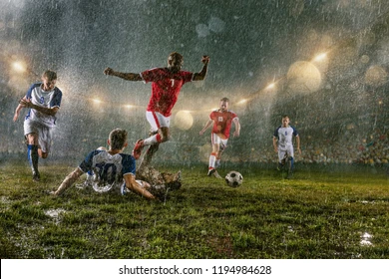
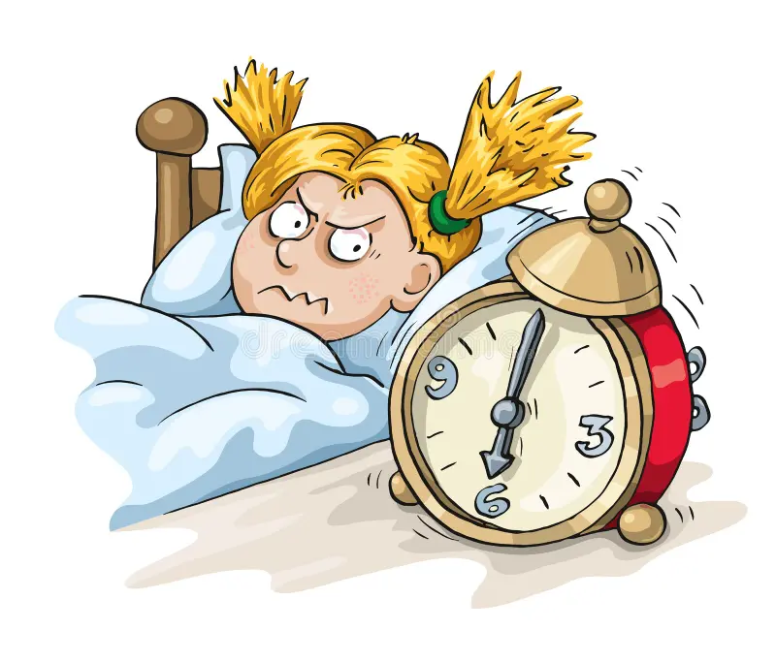
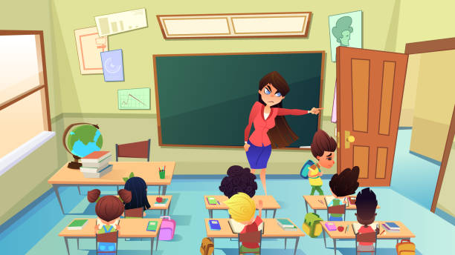
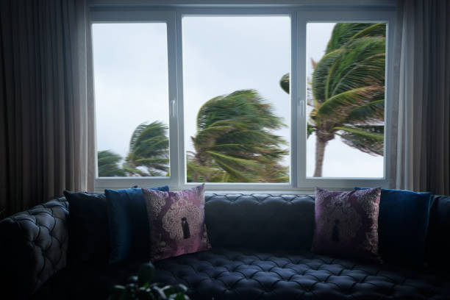

Slide 28
Sentences
The harsh rain poured down during the game but the players kept playing until the final whistle.
The harsh sound of the alarm woke us up and we rushed to get ready for school.
The teacher’s harsh rules were hard to follow yet they helped the class stay organized.
The harsh winds howled through the trees but we felt safe in the cozy cabin.
The harsh weather made the hike difficult yet we kept going because we were so close to the top.
The teacher’s words were harsh but she wanted to make sure we understood the lesson.

