Slide 1
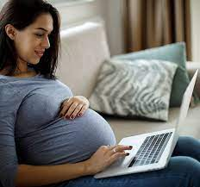
Pregnant Women

Slide 2
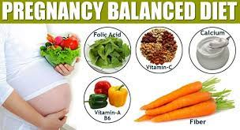
It is important that the diet of a pregnant woman is nutritionally sound, so that she produces a healthy baby, and at the same time maintains her own health.
Before pregnancy, it is vital that a woman of child- bearing age has a balanced diet so that she can cope with the demands of pregnancy.

Slide 3
A popular saying that a pregnant woman should “eat for two”.
In one sense this is true, but it does not mean that she should eat double her normal amount of food.
This is not necessary, and it could lead to obesity.
It does mean, however, that her diet should provide sufficient nutrients to cope with the demands of the growing baby (foetus) as well as the needs of her own body.

Slide 4
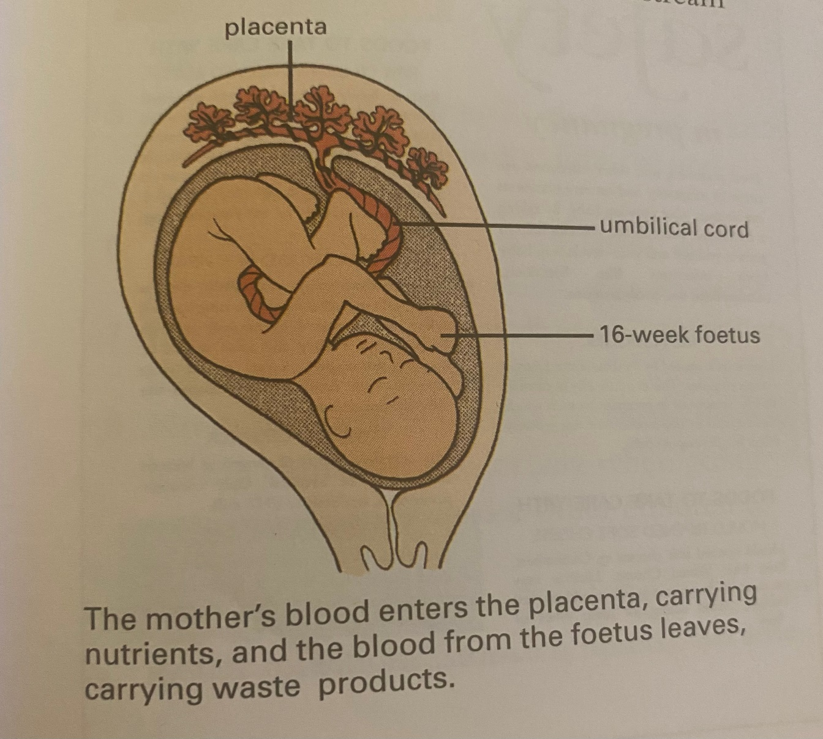
The foetus receives nutrients from the mother. The nutrients are carried from the mother’s bloodstream through the placenta and umbilical cord into the baby’s bloodstream.

Slide 5
If the woman is healthy and has a good, mixed diet, then both she and the foetus will receive all the nutrients they need.
If a particular nutrient is in short supply, the foetus may receive it and not the mother.
This may happen if food is scarce or the mother has a poor diet, and it will affect the health of both mother and baby quite drastically.

Slide 6
Pregnant women can get dietary advice from the community midwife, doctor, and health visitor, who keep careful check on the health of mother and baby.
During early pregnancy a woman may feel sick (nauseous) or be sick at any time of the day or the night.
This can make eating well very difficult.
The sickness often passes after (10-12) weeks, but can go on right through the pregnancy.

Slide 7
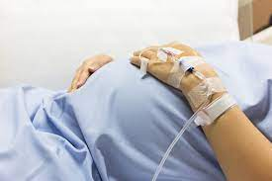
If the mother is very unwell and not gaining weight she may be admitted to hospital and fed through an intravenous drip to ensure that she gets all the nutrients and energy that she needs.

Slide 8
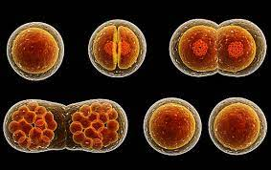
All the nutrients are important in pregnancy, but particularly the following:
Essential fatty acids
These are needed by the foetus for : 1. brain growth
2. cell division

Slide 9
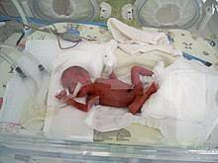
2. Vitamin D
A deficiency can lead to low birth weight and tetany in the body, and to osteomalacia in the mother.
This problem may occur in communities that live in areas where there is little sunlight, or have religious customs requiring the whole body to be covered with clothing.

Slide 10
3. Vitamin E
Most Vitamin E is transferred to the foetus in the last 10 weeks of pregnancy.
If a baby is born prematurely, it may need a Vitamin E supplement.
4. Vitamin K
Vitamin K deficiency can lead to haemorrhaging ( bleeding where the blood will not clot) in the first month after birth.

Slide 11
Most newborn babies are given Vitamin K, either by mouth or as an injection, to prevent this.
5. Folate
Folate is required very early in pregnancy for the correct development of the brain and the nervous system in the foetus.
A woman needs sufficient folate in her diet even before she becomes pregnant, or there may be problems in the pregnancy.

Slide 12
Folate deficiency can lead to miscarriage ( losing the developing foetus), slow growth, malformations in the foetus (e.g. spina bifida), or premature birth.
6. Vitamin B12
A vegetarian mother may be deficient in Vitamin B12. and may need to take a supplement during pregnancy and while breast feeding to ensure she has sufficient.
the foetus stores Vitamin B12 so that it has enough for the first 6 months after birth.

Slide 13
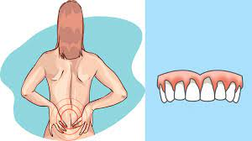
7. Calcium
The foetus needs a lot of calcium in the last few weeks in pregnancy, as the skeleton develops.
If there is not enough calcium or Vitamin D in the mother’s diet, she may lose calcium from her skeleton, which can lead to weakened bones and teeth.

Slide 14
8. Iron
the mother must have enough iron during pregnancy. It is needed to
supply her own body and to provide the growing baby with a store of iron for the first few months of birth.
Breast milk and cow’s milk are both poor sources of iron. So this store is vital.
During pregnancy, the level of haemoglobin in the blood is checked regularly.
If there is less than 10mg per dl, the mother is anaemic, and the doctor may describe iron tablets.

Slide 15
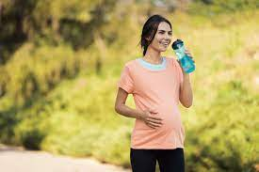
9. NSP
Constipation can be a problem in pregnancy. If it is, women should increase the amount of the fibre in their diet and take gentle exercise e.g. walking and swimming.

Slide 16
Weight gain in pregnancy
A woman normally gains weight during pregnancy.
how much she gains is influenced by her diet, age, level of activity, weight before pregnancy, and whether or not she smokes.
The weight gained is approximately 62% water (including extra blood), 30% fat, and 8% protein.
As the baby is breast-fed, the energy stored as fat is gradually used up.

Slide 17
Fasting during pregnancy
Some religious customs require people to fast for a certain part of the day.
This can cause problems in pregnancy, because the glucose and insulin in the mother’s bloodstream will be used up, which may cause brain damage in the growing baby.
Pregnant woman should not fast for more than 6-8 hours.

Slide 18
Food poisoning
Some types of food poisoning are particularly dangerous to pregnant women.
The bacterium listeria monocytogenes is common in unpasteurized soft cheese, e.g. ( Brie, goat’s cheese), pre-cooked chicken, pate, and ready-prepared salads.
It may lead to an illness called Listeriosis, which can cause stillbirth or miscarriage.
*Women should avoid these foods altogether during pregnancy.

Slide 19

Salmonella bacteria can also cause severe food poisoning.
It is common in dishes that contain raw or partially cooked eggs. Such as mayonnaise, cold soufflés, and mousses.
Notices warning women to avoid these foods during pregnancy are often displayed in shops where food are sold.

Slide 20
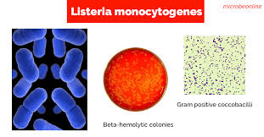
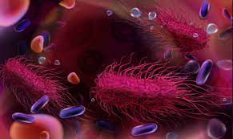

Slide 21
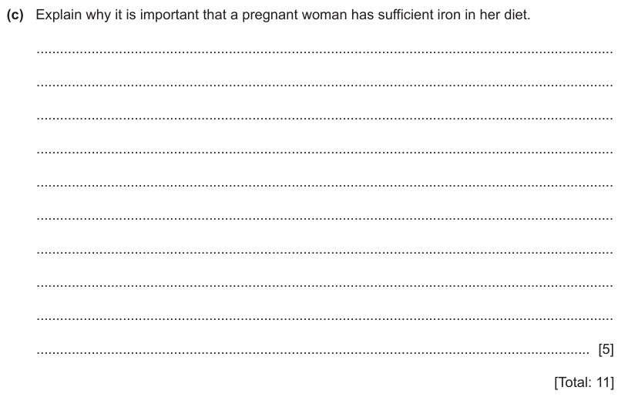

Slide 22
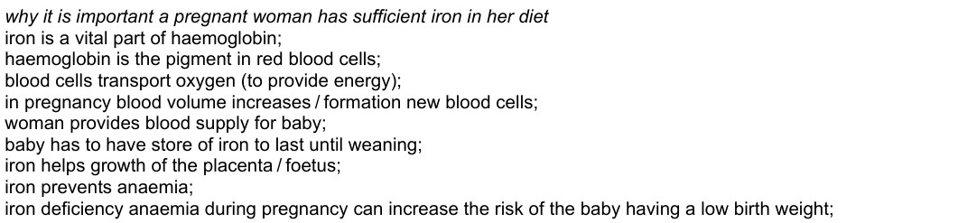

Slide 23
Post- natal (after the birth of the baby)
After the birth, the mother’s nutrient requirements increase.
Her body needs more nutrients to cope with the demands of breast-feeding and the increased activity associated with rearing a baby.
Any weight gained during pregnancy will usually take a few months to go.
Weight loss is helped considerably if the mother is breast-feeding, and breast-feeding mothers should increase their intake of liquids.

Slide 24


