Slide 1
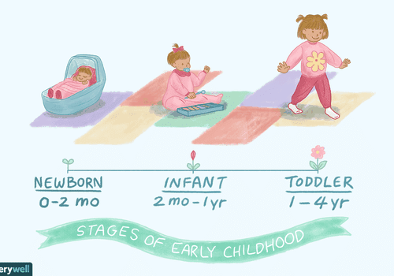
Infancy (up to one year)

Slide 2
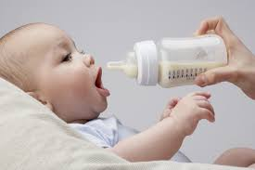
An infant’s diet for the first few months of life consists solely of milk.

Slide 3
Breast- feeding ( lactation)
Human breast milk is specially designed to feed human babies. It is the best milk to give babies because:
It provides the correct mix and quantity of nutrients for the infant to grow normally.
The milk is at the right temperature and consistency.
The baby lies close to the mother to feed, and forms a strong bond with her, and she with the baby.

Slide 4
4. The action of sucking produces hormones in the baby’s body that help the intestines to develop and to absorb nutrients more efficiently.
The body digests virtually all the milk which gives it a feeling of satiety (fullness) and drowsiness.
The baby takes what it needs, and is therefore less likely to become overweight.
Immunity from certain disease is passed to the baby from the mother.
No preparation is needed, so breast-feeding is very convenient especially when going out, and when there are other children to look after.

Slide 5

There is little chance of the baby picking up gastric infections (stomach upsets), because the milk is sterile and does not come into contact with the outside air.
Breast-fed babies are less likely to be sensitive to foods, or have eczema and asthma.

Slide 6
For the first 5 days, the mother produces a watery substance called colostrum.
This provides essential nutrients and immunity to the baby. After this, the milk “matures”, and the volume produced increases as the baby demands more of it.
Mother’s are advised to feed ‘on demand’ rather than keep to a rigid feeding timetable, as babies need different amounts at different times of the day.
Gradually, the baby establishes its own feeding timetable, and the mother can predict when to feed.

Slide 7
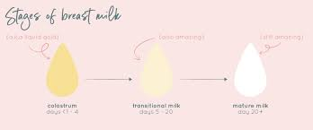

Slide 8
Breast-feeding takes time to become properly established, and the mother may have problems with sore and cracked nipples, infection of the breast (mastitis), and engorgement (over-full breasts leading to lumpiness and discomfort).
Midwives and health visitors can offer help, support and encouragement to new mothers who may want to give up breast-feeding when problems arise.
One breast-feeding is established, it can go on for many months, and give great pleasure and good health to both baby and mother.

Slide 9
Bottle feeding
Not every mother is able to or wants to breast-feed her baby, and she should not be made to feel bad about this.
Instead, she needs careful guidance on bottle-feeding. Her partner and other members of the family can also enjoy the pleasure of feeding the baby.
Powdered milk preparations for bottle-feeding babies are made from modified cow’s milk. Ordinary cow’s milk must not be given because it is too high in mineral salts and protein, and would put a great strain on the bay’s kidneys.

Slide 10
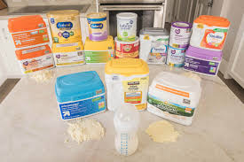
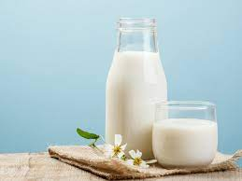

Slide 11
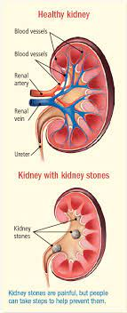
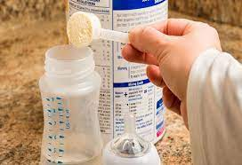
Bottle-fed babies are not at any disadvantages, as long as the milk is prepared exactly as instructed.
Using too much powdered milk to make up a feed can lead to obesity, great thirst, and strain on the kidneys.

Slide 12
The mother may interpret the baby’s distress as being hungry rather than thirsty, and give it more milk, thus causing more problems.
Bottle-fed babies should therefore be offered plain cooled, boiled water to drink as well as milk.
Powdered milk, bottles, teats, and sterilizing equipment are all expensive, and bottles and teats must be sterilized after each use.
Milk is the perfect medium for bacteria to grow, and poorly cleaned equipment can cause dangerous infections.

Slide 13
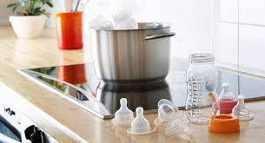
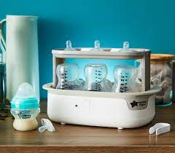


Slide 14
Babies under 4 months should not have sweetened fruit juices or other drinks, as the sugar in them can cause tooth decay, even when the teeth have not yet erupted (come through).
They should have plain cooled, boiled water as a supplementary drink if the weather is hot. This will encourage them to drink water when they are older.
Babies should not be given dummies that have been dipped in sugar or syrup. The sugar would be in prolonged contact with the gums and would cause tooth decay.

Slide 15
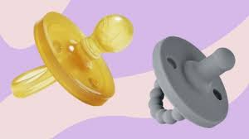


Slide 16
Weaning
Weaning is the gradual introduction of solid food into the baby’s diet, to supplement milk which still forms the main part of the diet.
Most babies should not have any solid foods before they are 4 months old. Below that age the kidneys and digestive system may not be developed sufficiently to cope with solid food.
By 6 months, all babies should have a mixed diet ( a variety of solid foods & milk).

Slide 17

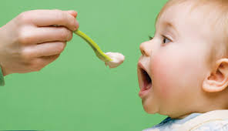

Slide 18
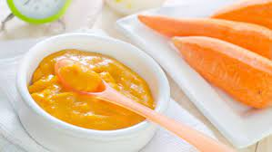
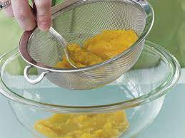
Foods should be offered from a spoon rather than a bottle. This will encourage the baby to try more solid foods, and food will be in contact with the gums and teeth for a much shorter time.
Different foods should be introduced a little at a time, and should be sieved or pureed so that the baby can swallow them without choking.

Slide 19
Suggested introductory foods include:
low-sugar rusks or unsweetened ground rice in milk. Breast milk can be expressed (squeezed out) by the mother into a sterile bottle and kept in the refrigerator for this.
Pureed cooked vegetables, e.g. carrot and potato, parsnip and peas.
Pureed cooked meat and fish with unsalted gravy.
Pureed fruit, e.g. banana and fresh orange juice, cooked apples, pear and mango.
Sieved, cooked egg yolk (hard boil the egg first).

Slide 20
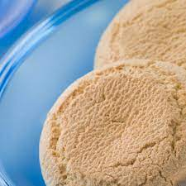
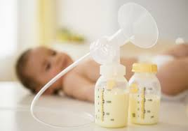
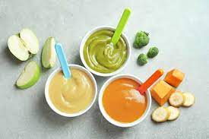

Slide 21
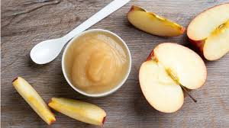
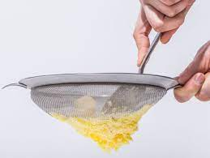

Slide 22
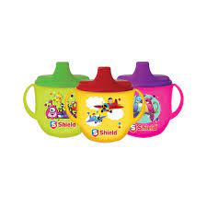
It is not necessary or advisable to add sugar or salt to these foods. This would encourage a taste for salty and sweet foods, which can be undesirable and unhealthy.
Salt also put extra strain on kidneys.
As the baby eats more solid foods it will drink less milk, and can drink water with a meal instead, from 6 months babies should be encouraged to drink from a trainer beaker.

Slide 23
As the baby’s teeth start to erupt, coarser foods can be introduced, but less finely pureed.
Foods to encourage chewing and to help teething can be given, such as:
Dry low-sugar rusks.
Toasted bread.
Commercially made bread sticks (grissini).
Pieces of fruit, e.g. apple with skin removed.

Slide 24
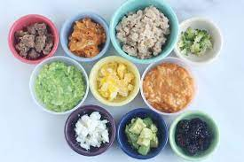

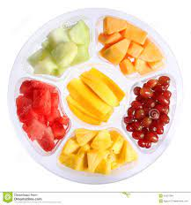

Slide 25
Babies and children should never be left alone while eating in case they choke on the food.
Foods for a baby can be prepared from family meals using a liquidizer, processor, sieve, or special baby-food grinder.
The recommendation to reduce fat intake does not apply to babies and children under 2 years of age, and full-fat milk should be given to this age of group. Dietary fat should be reduced gradually between the ages of 2 and 5 years.

Slide 26
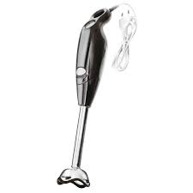
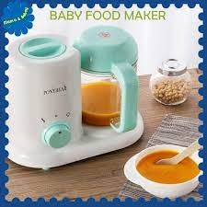
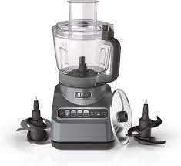

Slide 27
Apart from natural sugar found in milk (lactose), sugar should not make up more than 10% of the total energy intake. Parents need to know the names of the various sugars used in food products and to check food labels carefully.
Sweets and chocolates are often used as treats or to encourage the child to behave well. They can become habit forming as they are very palatable, often brightly coloured, interestingly shaped and packaged, and very appealing.
Small children cannot understand the effect of too much sugar on their teeth, so the parent or child minder must restrict the number of sweets they eat.

Slide 28
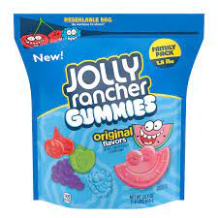
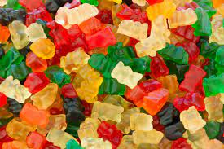

Eating sweets at the end of the meal, just before teeth are cleaned, will do little harm. The same advice applies to sweetened soft drinks.

Slide 29
A variety of protein food should be offered, including plant proteins (e.g. beans, pulses, soya products). Non- vegetarians should also have animal proteins (meat, fish, dairy products, and eggs).
Gradually, more carbohydrate foods (e.g. starchy vegetables, pasta, cereal products, bread and fruit) and less fatty foods should be offered as the child approaches 2 years of age.
Infants need adequate calcium and iron, along with vitamins D and C to help absorb them. Many commercially prepared baby foods are enriched with vitamins and minerals, and the labels should declare this.

Slide 30
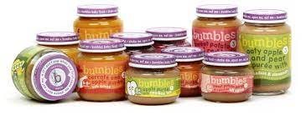
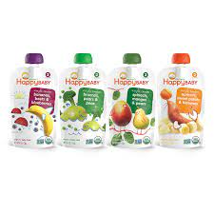

Slide 31
Breast- fed and bottle-fed infants should not need vitamin supplements before 6 months providing the mother has a good diet, and the mixed weaning diet contains plenty of fruit, vegetables, pulses, cereals, milk, and if eaten, meat and fish.

