Slide 1

Adults

Slide 2
Body growth declined in adulthood. Adults need food to maintain and repair the body and to keep it healthy.
The amount of daily activity affects energy and nutrient requirements, and meals should be planned according to these needs.
Nutrient requirements are determined to some extent by the body size. On the whole, women need less food than men, but they need more iron because of menstruation. Their requirements change during pregnancy and after birth of a baby.

Slide 3
Active lifestyle
Meals for active people must provide sufficient energy while keeping to the dietary goals of reduced saturated fats and increased carbohydrate foods.
Extra water and salt (sodium chloride) should be taken in very hot weather.
It is important to try and spread the energy intake throughout the day.

Slide 4
Diet and sports training
People who train intensively for sport have to ensure that their diet satisfies their needs before, during, and after training and competing.
For most sports, a diet of 60-70% carbohydrate, 12% protein, and the rest fat is suitable.
During sporting activities, muscle glycogen stores are used up, large volumes of sweat are excreted (with loss of body salts), and muscles, joints and ligaments are subjected to stresses and need to be required by the body.

Slide 5
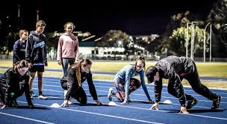
Sports people have to be careful to obtain enough iron, B vitamins, and calcium from food to ensure efficient energy release and good maintenance of the skeleton.
Increased fluid intake is essential to avoid dehydration.

Slide 6
Sedentary lifestyle
People with a sedentary lifestyle need to pay careful attention to their energy input, as it can easily exceed their energy output, leading to weight increase.
Energy-dense snack foods, such as chocolate, pastries, cakes, biscuits, and crisps should be eaten only in moderation. They are highly palatable and convenient, but can increase energy intake markedly.

Slide 7
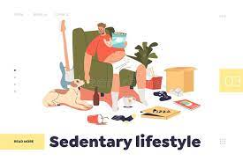
Meals should also not be too bulky as they take longer to digest in an inactive job.
Drinking alcohol increases the energy intake, as alcohol yields (7Kcal) per gram. Many people have a drink with a meal and this adds to their energy intake considerably.

Slide 8
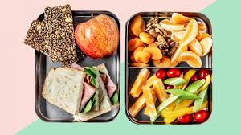
Packed meals
Many people take a packed midday meal to work or school, or as a picnic in preference to buying a meal in a canteen or restaurant.
Such meals are an important part of the daily food supply, and so should be well planned and prepared.

Slide 9
Some rules for packed meals should be considered:
The meal should be substantial and should supply one third of the daily intake of nutrients and energy.
The meal should be well balanced. Foods that supply energy and little else should be kept to a minimum.
The food should be easy to eat, using minimum cutlery and producing the minimum of waste, bearing in mind that it may have to be eaten in an awkward place such as a building site.

Slide 10
The food should be carefully packed, so that it is not crushed or damaged in transit. Delicate items should be packed above more robust foods. A sturdy package, e.g. a plastic box with a lid, is ideal for transporting the food. Items inside the box should be individually wrapped.
If the meal is to be left in a warm place, such as a car, foods such as cooked meats should not be included to avoid the possibility of bacterial growth. Special lunch boxes with insulation and spaces for ice packs can be used to keep food at a safe temperature for a time.

Slide 11
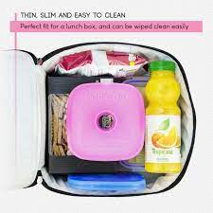
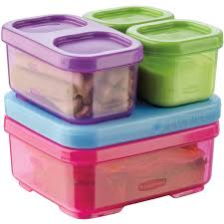

Slide 12
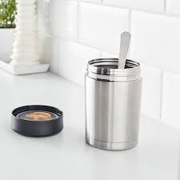
A variety of texture and flavours should be included.
The meal should also include a drink. Drinks and soups can be kept hot in vacuum flasks.

